Slide 1
Chapter 8
PROJECT QUALITY MANAGEMENT

Slide 2
Project quality management
the processes and activities of the performing organization that determine quality policies, objectives, and responsibilities so that the project will satisfy the needs for which it was undertaken
it supports continuous process improvement activities as undertaken on behalf of the performing organization
It works to ensure that the project requirements, including product requirements, are met and validated.
Project quality management process includes :- plan quality management, perform quality assurance and control quality

Slide 3
Plan quality management
the process of identifying quality requirements and/or standards for the project and its deliverables, and documenting how the project will demonstrate compliance with relevant quality requirements.
The key benefit of this process is that it provides guidance and direction on how quality will be managed and validated throughout the project.

Slide 4
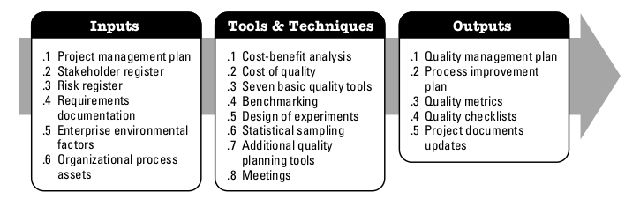
Plan quality management

Slide 5
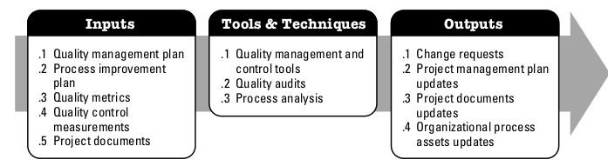
Perform quality assurance
the process of auditing the quality requirements and the results from quality control measurements to ensure that appropriate quality standards and operational definitions are used
The key benefit of this process is that it facilitates the improvement of quality processes

Slide 6
Control quality
the process of monitoring and recording results of executing the quality activities to assess performance and recommend necessary changes
The key benefits of this process include: (1) identifying the causes of poor process or product quality and recommending and/or taking action to eliminate them; and (2) validating that project deliverables and work meet the requirements specified by key stakeholders necessary for final acceptance.

Slide 7
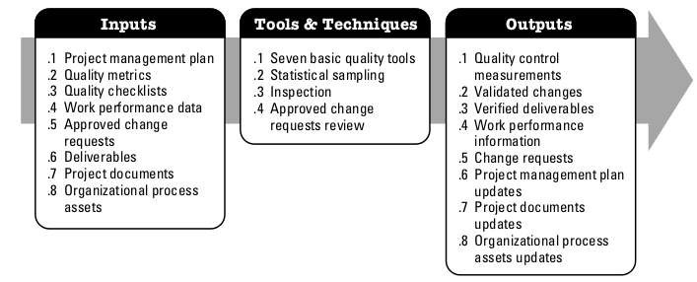
Control quality

