Slide 1
Chapter: 2
Project Organization and Project Life Cycle

Slide 2
Organizational Structure
Organizational structure is an enterprise environmental factor, which can affect the availability of resources and influence how projects are conducted
Organizational structures range from functional to projectized, with a variety of matrix structures in between.

Slide 3
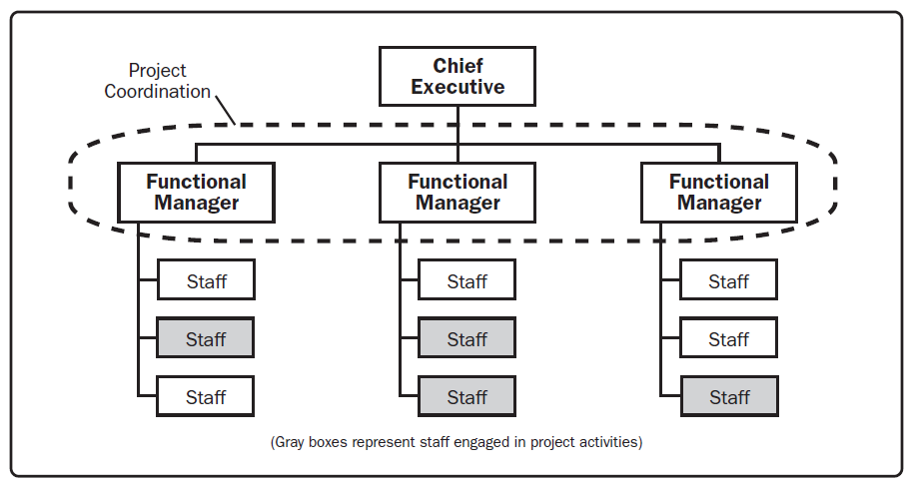
Classic functional organzation

Slide 4
Matrix Organization and its types
Matrix organizations can be classified as weak, balanced, or strong depending on the relative level of power and influence between functional and project managers.
Weak matrix organizations maintain many of the characteristics of a functional organization, and the role of the project manager is more of a coordinator or expediter.

Slide 5
Matrix Organization and its types
Strong matrix organizations have many of the characteristics of the projectized organization, and have full-time project managers with considerable authority and full-time project administrative staff.
Balanced matrix organization recognizes the need for a project manager, it does not provide the project manager with the full authority over the project and project funding.

Slide 6
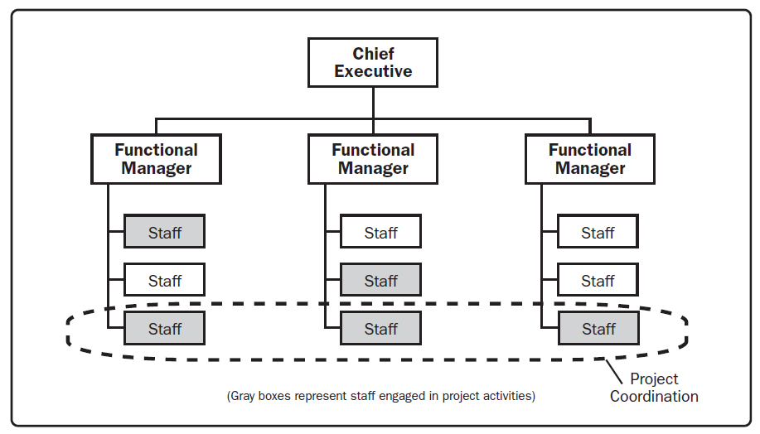
Weak matrix organization

Slide 7
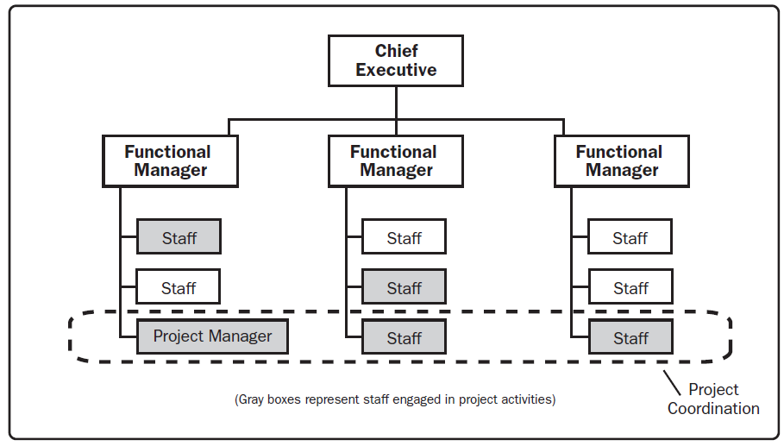
Balanced matrix organization

Slide 8
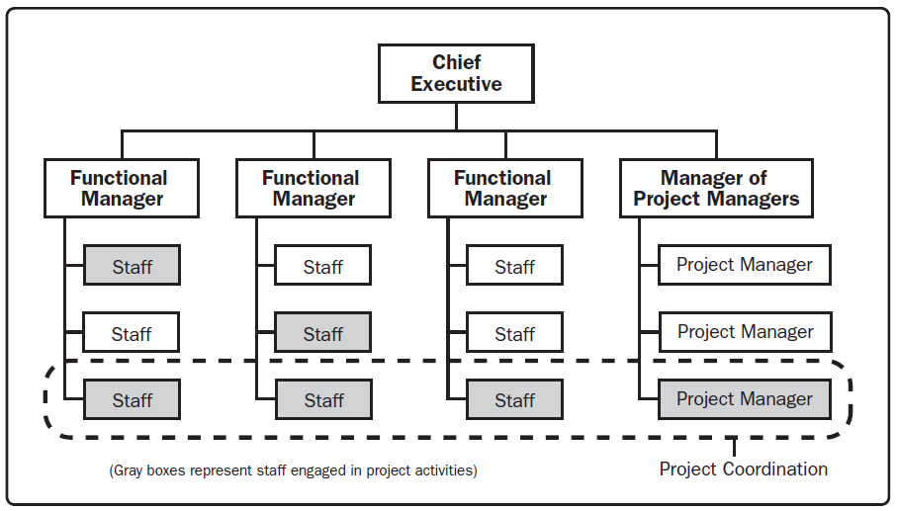
Strong matrix organization

Slide 9
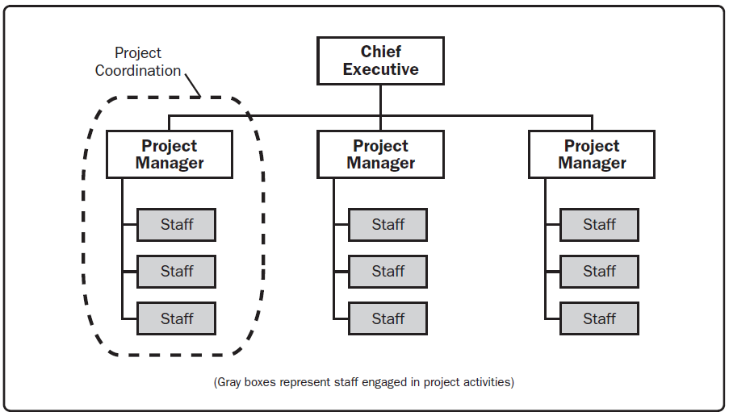
Projectized Organization

Slide 10
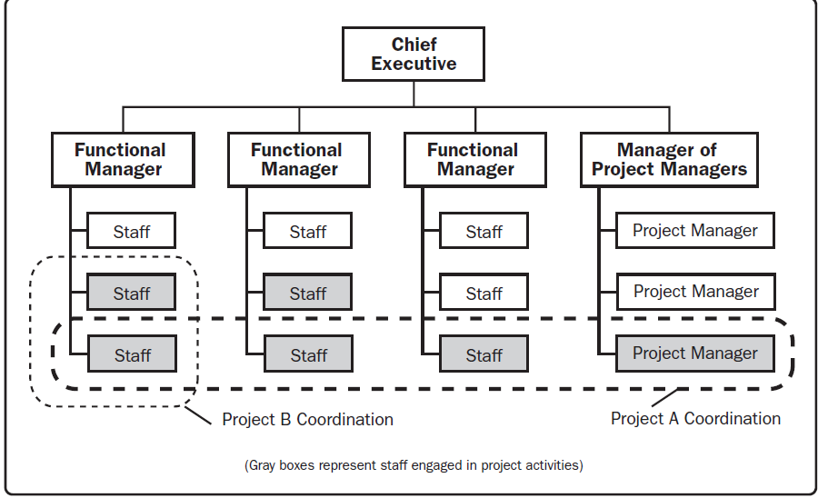
Composite Organization

Slide 11
Organizational structure influence on Project
An organization’s culture, style, and structure influence how its projects are performed.
The organization’s level of project management maturity and its project management systems can also influence the project.
When a project involves external entities such as those that are part of a joint venture or partnering agreement, the project will be influenced by more than one organization.

Slide 12
Organizational structure influence on Project
The following are organizational characteristics, factors, and assets within an enterprise that are likely to influence the project.
1. Organizational cultures and styles
2. Organizational communications
3. Organizational structures
4. Organizational process assets
5. Enterprise environmental factors

Slide 13
Project Team
The project team includes the project manager and the group of individuals who act together in performing the work of the project to achieve its objectives.
This team is comprised of individuals from different groups with specific subject matter knowledge or with a specific skill set to carry out the work of the project.
The structure and characteristics of a project team can vary widely, but one constant is the project manager’s role as the leader of the team

Slide 14
Project Team
Project Teams include roles such as:
Project management staff
Project staff
Supporting experts
User or customer representative
Sellers
Business partner members
Business partners

Slide 15
Composition of project team
The composition of project teams varies based on factors such as organizational culture, scope, and location.
The relationship between the project manager and the team varies depending on the authority of the project manage
The following are examples of basic project team compositions:
1. Dedicated
2. Part-time

Slide 16
Project life cycle and phases
A project life cycle is the series of phases that a project passes through from its initiation to its closure.
The phases are generally sequential, and their names and numbers are determined by the management.
The phases can be broken down by functional or partial objectives, intermediate results or deliverables, specific milestones within the overall scope of work, or financial availability.
Phases are generally time bounded, with a start and ending or control point.
Projects vary in size and complexity.

Slide 17
Project Life cycle and Phases
Project life cycles can range along a continuum from predictive or plan-driven approaches at one end to adaptive or change-driven approaches at the other.
In a predictive life cycle, the product and deliverables are defined at the beginning of the project and any changes to scope are carefully managed.
In an adaptive life cycle, the product is developed over multiple iterations and detailed scope is defined for each iteration only as the iteration begins.

Slide 18
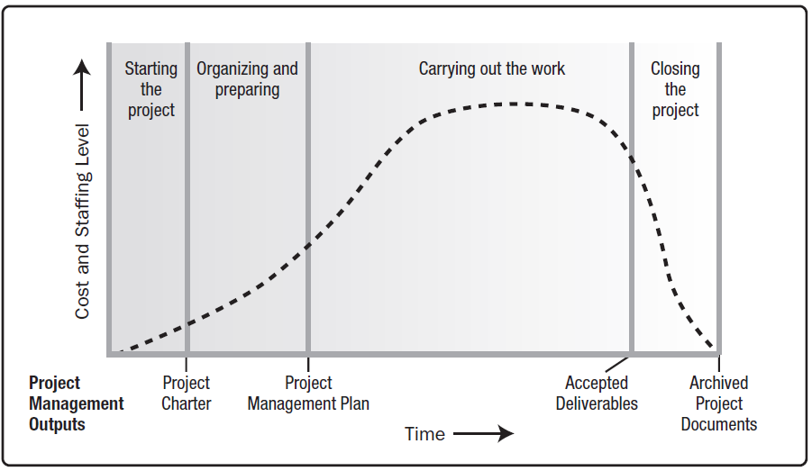
Generic life cycle structure

Slide 19
Project phases
A project may be divided into any number of phases.
A project phase is a collection of logically related project activities that culminates in the completion of one or more deliverables.
Project phases are used when the nature of the work to be performed is unique to a portion of the project, and are typically linked to the development of a specific major deliverable.
Project phases typically are completed sequentially, but can overlap in some project situations.

