Slide 1
Chapter 10
Project communication management

Slide 2
Project communication management
the processes that are required to ensure timely and appropriate planning, collection, creation, distribution, storage, retrieval, management, control, monitoring, and the ultimate disposition of project information
Effective communication creates a bridge between diverse stakeholders who may have different cultural and organizational backgrounds, different levels of expertise, and different perspectives and interests, which impact or have an influence upon the project execution or outcome.
Processes include: plan communications management, manage communications, control communications

Slide 3
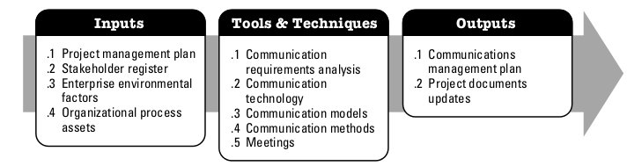
Plan communication management
the process of developing an appropriate approach and plan for project communications based on stakeholder’s information needs and requirements, and available organizational assets.
The key benefit of this process is that it identifies and documents the approach to communicate most effectively and efficiently with stakeholders.

Slide 4
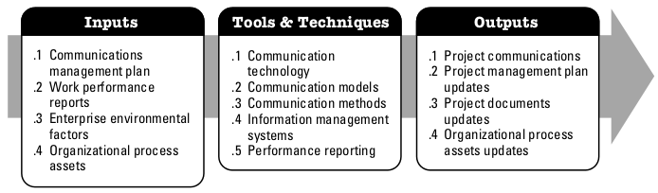
Manage communications
the process of creating, collecting, distributing, storing, retrieving, and the ultimate disposition of project information in accordance to the communications management plan
The key benefit of this process is that it enables an efficient and effective communications flow between project stakeholders

Slide 5
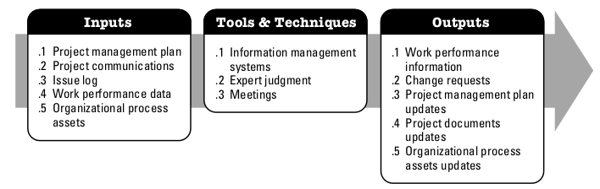
Control communications
the process of monitoring and controlling communications throughout the entire project life cycle to ensure the information needs of the project stakeholders are met
The key benefit of this process is that it ensures an optimal information flow among all communication participants, at any moment in time.

