Slide 1
Chapter 6
TIME MANAGEMENT

Slide 2
Project time management process
It includes
Plan schedule management
Define activities
Sequence activities
Estimate activity resources
Estimate activity durations
Develop schedule
Control schedule

Slide 3
Plan schedule management
process of establishing the policies, procedures, and documentation for planning, developing, managing, executing, and controlling the project schedule
The key benefit of this process is that it provides guidance and direction on how the project schedule will be managed throughout the project.

Slide 4
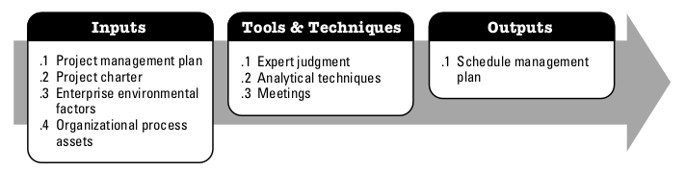
Plan schedule management

Slide 5
Define activities
the process of identifying and documenting the specific actions to be performed to produce the project deliverables
The key benefit of this process is to break down work packages into activities that provide a basis for estimating, scheduling, executing, monitoring, and controlling the project work

Slide 6
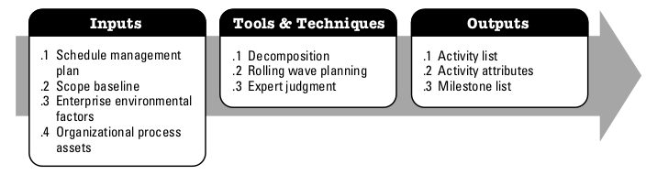
Define activities

Slide 7
Sequence activities
the process of identifying and documenting relationships among the project activities
The key benefit of this process is that it defines the logical sequence of work to obtain the greatest efficiency given all project constraints.

Slide 8
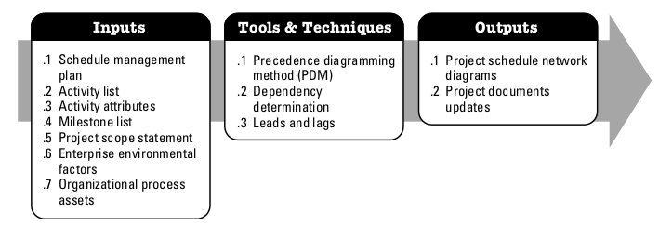
Sequence activities

Slide 9
Estimate activity resources
the process of estimating the type and quantities of material, human resources, equipment, or supplies required to perform each activity
The key benefit of this process is that it identifies the type, quantity, and characteristics of resources required to complete the activity which allows more accurate cost and duration estimates.

Slide 10
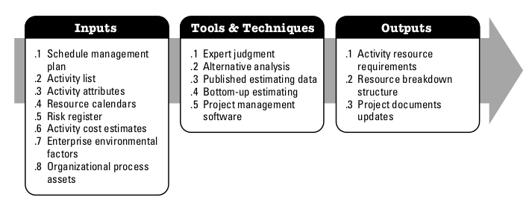
Estimate activity resources

Slide 11
Estimate activity durations
the process of estimating the number of work periods needed to complete individual activities with estimated resources
The key benefit of this process is that it provides the amount of time each activity will take to complete, which is a major input into the Develop Schedule process.

Slide 12
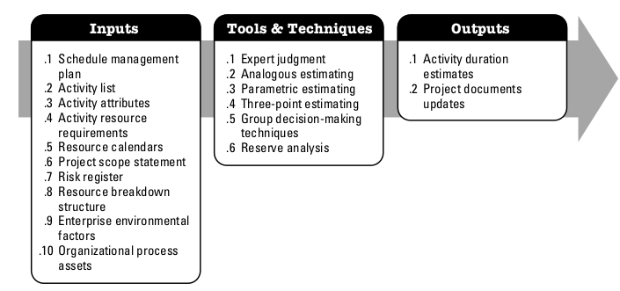
Estimate activity durations

Slide 13
Develop schedule
the process of analyzing activity sequences, durations, resource requirements, and schedule constraints to create the project schedule model
The key benefit of this process is that by entering schedule activities, durations, resources, resource availabilities, and logical relationships into the scheduling tool, it generates a schedule model with planned dates for completing project activities.

Slide 14
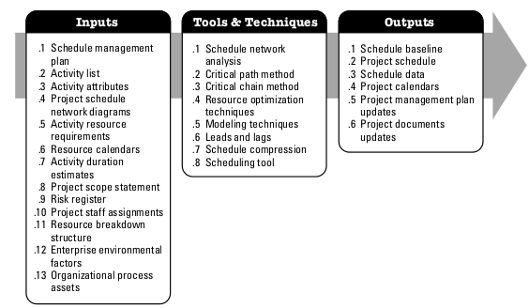
Develop schedule

Slide 15
Control schedule
the process of monitoring the status of project activities to update project progress and manage changes to the schedule baseline to achieve the plan
The key benefit of this process is that it provides the means to recognize deviation from the plan and take corrective and preventive actions and thus minimize risk.

Slide 16
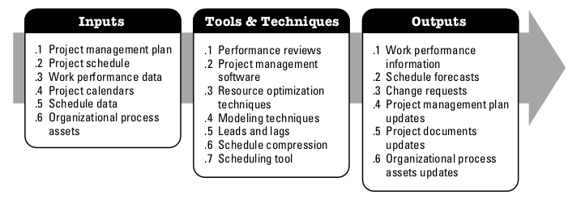
Control schedule

