Slide 1
Chapter 9
Project Human Resource Management

Slide 2
Human Resource Management
includes the processes that organize, manage, and lead the project team. The project team is comprised of the people with assigned roles and responsibilities for completing the project
Project team members may have varied skill sets, may be assigned full or part-time, and may be added or removed from the team as the project progresses
Participation of team members during planning adds their expertise to the process and strengthens their commitment to the project
Processes involved: plan human resource management, acquire project team, develop project team, manage project team

Slide 3
Plan human resource management
the process of identifying and documenting project roles, responsibilities, required skills, reporting relationships, and creating a staffing management plan
The key benefit of this process is that it establishes project roles and responsibilities, project organization charts, and the staffing management plan including the timetable for staff acquisition and release

Slide 4
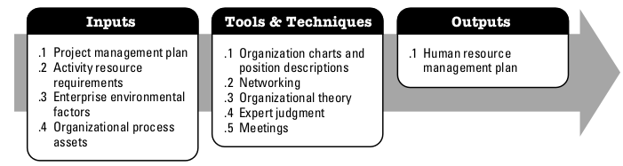
Plan human resource management

Slide 5
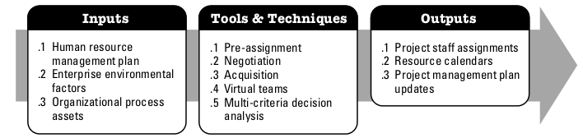
Acquire project team
the process of confirming human resource availability and obtaining the team necessary to complete project activities
The key benefit of this process consists of outlining and guiding the team selection and responsibility assignment to obtain a successful team

Slide 6
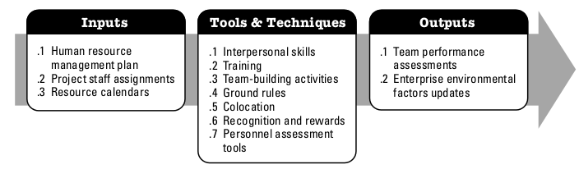
Develop project team
the process of improving competencies, team member interaction, and overall team environment to enhance project performance
The key benefit of this process is that it results in improved teamwork, enhanced people skills and competencies, motivated employees, reduced staff turnover rates, and improved overall project performance.

Slide 7
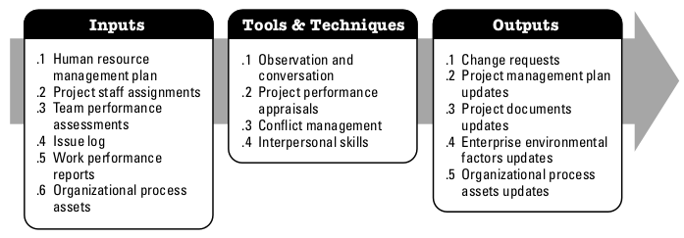
Manage project team
the process of tracking team member performance, providing feedback, resolving issues, and managing team changes to optimize project performance
The key benefit of this process is that it influences team behavior, manages conflict, resolves issues, and appraises team member performance.

