Slide 1
Chapter 11
PROJECT RISK MANAGEMENT

Slide 2
Project risk management
It includes the processes of conducting risk management planning, identification, analysis, response planning, and controlling risk on a project
The objectives of project risk management are to increase the likelihood and impact of positive events, and decrease the likelihood and impact of negative events in the project.
Processes includes: plan risk management, identify risk, perform qualitative risk analysis, perform quantitative risk analysis, plan risk response, control risk

Slide 3
Plan risk management
the process of defining how to conduct risk management activities for a project
The key benefit of this process is it ensures that the degree, type, and visibility of risk management are commensurate with both the risks and the importance of the project to the organization.
The risk management plan is vital to communicate with and obtain agreement and support from all stakeholders to ensure the risk management process is supported and performed effectively over the project life cycle.

Slide 4
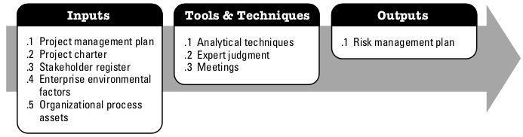
Analytical techniques: Analytical techniques are used to understand and define the overall risk management context of the project. Risk management context is a combination of stakeholder risk attitudes and the strategic risk exposure of a given project based on the overall project context.

Slide 5
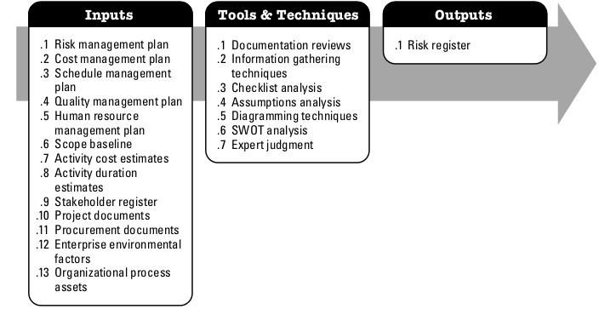
Identify risks
the process of determining which risks may affect the project and documenting their characteristics
The key benefit of this process is the documentation of existing risks and the knowledge and ability it provides to the project team to anticipate events.

Slide 6
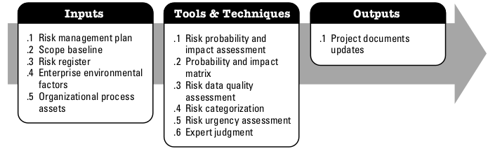
Perform qualitative risk analysis
the process of prioritizing risks for further analysis or action by assessing and combining their probability of occurrence and impact
The key benefit of this process is that it enables project managers to reduce the level of uncertainty and to focus on high-priority risks.

Slide 7
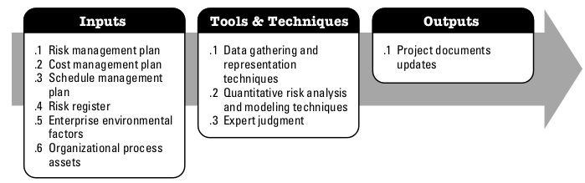
Perform quantitative risk analysis
the process of numerically analyzing the effect of identified risks on overall project objectives.
The key benefit of this process is that it produces quantitative risk information to support decision making in order to reduce project uncertainty.

Slide 8
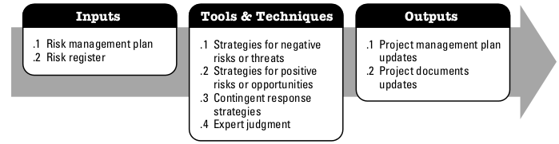
Plan risk response
the process of developing options and actions to enhance opportunities and to reduce threats to project objectives
The key benefit of this process is that it addresses the risks by their priority, inserting resources and activities into the budget, schedule and project management plan as needed.

Slide 9
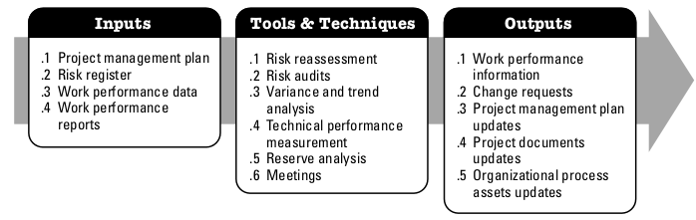
Control risk
process of implementing risk response plans, tracking identified risks, monitoring residual risks, identifying new risks, and evaluating risk process effectiveness throughout the project
The key benefit of this process is that it improves efficiency of the risk approach throughout the project life cycle to continuously optimize risk responses.

