Slide 1
Chapter 12
PROJECT PROCUREMENT MANAGEMENT

Slide 2
Project procurement management
It includes the processes necessary to purchase or acquire products, services, or results needed from outside the project team.
The organization can be either the buyer or seller of the products, services, or results of a project.
It includes the contract management and change control processes required to develop and administer contracts or purchase orders issued by authorized project team members.
It also includes controlling any contract issued by an outside organization (the buyer) that is acquiring deliverables from the project from the performing organization (the seller), and administering contractual obligations placed on the project team by the contract.

Slide 3
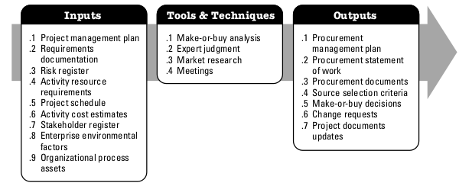
Plan procurement management
the process of documenting project procurement decisions, specifying the approach, and identifying potential sellers
The key benefit of this process is that it determines whether to acquire outside support, and if so, what to acquire, how to acquire it, how much is needed, and when to acquire it.

Slide 4
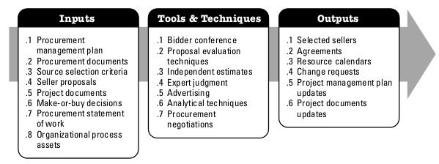
Conduct procurement
the process of obtaining seller responses, selecting a seller, and awarding a contract.
The key benefit of this process is that it provides alignment of internal and external stakeholder expectations through established agreements.

Slide 5
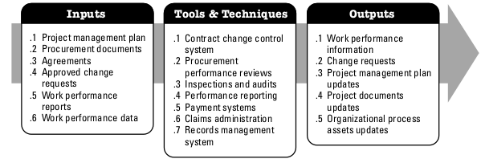
Control procurements
the process of managing procurement relationships, monitoring contract performance, and making changes and corrections to contracts as appropriate
The key benefit of this process is that it ensures that both the seller’s and buyer’s performance meets procurement requirements according to the terms of the legal agreement.

Slide 6
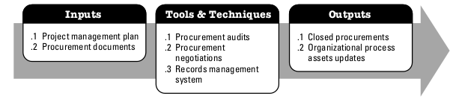
Close procurement
the process of completing each procurement
The key benefit of this process is that it documents agreements and related documentation for future reference.

