Slide 1
Chapter 4
Project Integration Management

Slide 2
Project Integration Management Process
includes the processes and activities to identify, define, combine, unify, and coordinate the various processes and project management activities within the Project Management Process Groups
includes making choices about resource allocation, making trade-offs among competing objectives and alternatives, and managing the interdependencies among the project management Knowledge Areas
necessary in situations where individual processes interact
Eg: a cost estimate needed for a contingency plan involves integrating the processes in the Project Cost, Time, and Risk Management Knowledge Areas

Slide 3
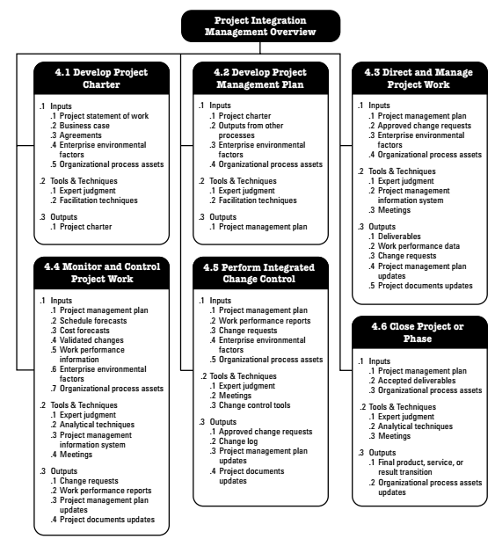
Project Integration Management overview

Slide 4
Develop Project Charter—The process of developing a document that formally authorizes the existence of a project and provides the project manager with the authority to apply organizational resources to project activities.
Develop Project Management Plan—The process of defining, preparing, and coordinating all subsidiary plans and integrating them into a comprehensive project management plan. The project’s integrated baselines and subsidiary plans may be included within the project management plan.
Direct and Manage Project Work—The process of leading and performing the work defined in the project management plan and implementing approved changes to achieve the project’s objectives.

Slide 5
Monitor and Control Project Work—The process of tracking, reviewing, and reporting project progress against the performance objectives defined in the project management plan.
Perform Integrated Change Control—The process of reviewing all change requests; approving changes and managing changes to deliverables, organizational process assets, project documents, and the project management plan; and communicating their disposition.
Close Project or Phase—The process of finalizing all activities across all of the Project Management Process Groups to formally complete the phase or project.

Slide 6
Developing Project Charter
process of developing a document that formally authorizes the existence of a project and provides the project manager with the authority to apply organizational resources to project activities
key benefit of this process is a well-defined project start and project boundaries, creation of a formal record of the project, and a direct way for senior management to formally accept and commit to the project

Slide 7
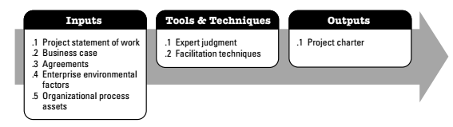
Develop project charter: inputs, tools and techniques, and outputs

Slide 8
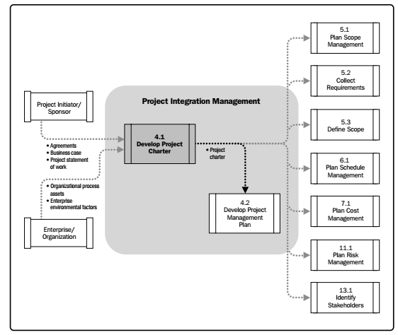
Develop project charter data flow diagram

Slide 9
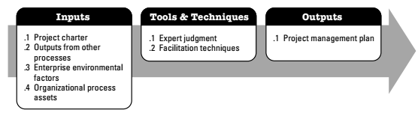
Developing Project Management Plan
process of defining, preparing, and coordinating all subsidiary plans and integrating them into a comprehensive project management plan
key benefit of this process is a central document that defines the basis of all project work

Slide 10
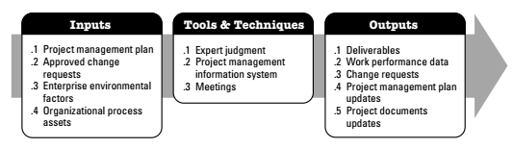
Direct and Manage Project Execution
process of leading and performing the work defined in the project management plan and implementing approved changes to achieve the project’s objectives
key benefit of this process is that it provides overall management of the project work

Slide 11
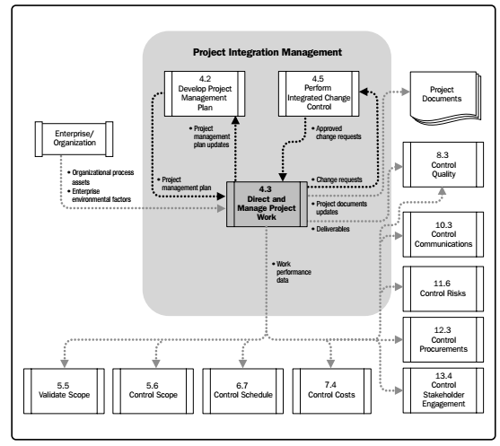
Direct and manage project work: data flow diagram

Slide 12
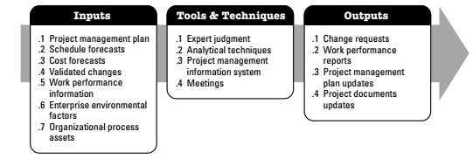
Monitoring and Controlling project work
process of tracking, reviewing, and reporting the progress to meet the performance objectives defined in the project management plan
key benefit of this process is that it allows stakeholders to understand the current state of the project, the steps taken, and budget, schedule, and scope forecasts

Slide 13
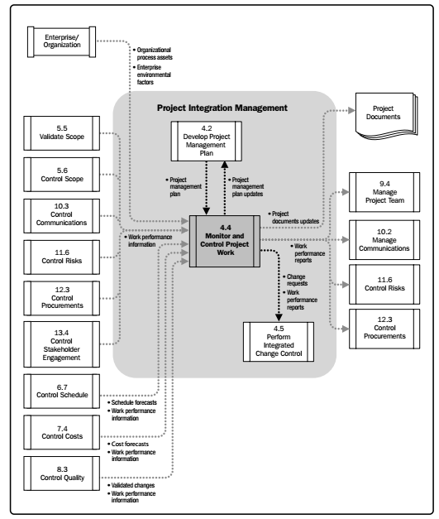
Monitoring and controlling project work

Slide 14
Perform integrated change control
process of reviewing all change requests; approving changes and managing changes to deliverables, organizational process assets, project documents, and the project management plan; and communicating their disposition
It reviews all requests for changes or modifications to project documents, deliverables, baselines, or the project management plan and approves or rejects the changes.
key benefit of his process is that it allows for documented changes within the project to be considered in an integrated fashion while reducing project risk, which often arises from changes made without consideration to the overall project objectives or plans

Slide 15
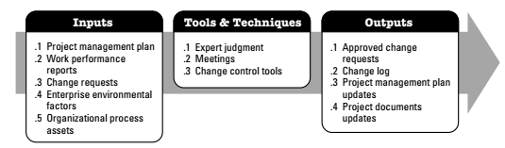
Perform Integrated Change Control: Inputs, Tools & Techniques, and Outputs

Slide 16
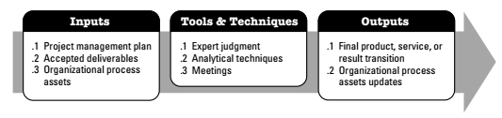
Closing project or phase
the process of finalizing all activities across all of the Project Management Process Groups to formally complete the project or phase
The key benefit of this process is that it provides lessons learned, the formal ending of project work, and the release of organization resources to pursue new endeavors

Slide 17
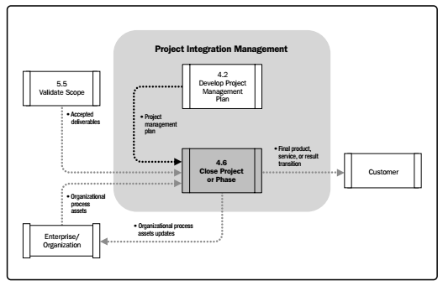
Close project or phase

