Slide 1
Chapter 13
PROJECT STAKEHOLDER MANAGEMENT

Slide 2
Project stakeholder management
includes the processes required to identify the people, groups, or organizations that could impact or be impacted by the project, to analyze stakeholder expectations and their impact on the project, and to develop appropriate management strategies for effectively engaging stakeholders in project decisions and execution
Stakeholder management also focuses on continuous communication with stakeholders to understand their needs and expectations, addressing issues as they occur, managing conflicting interests and fostering appropriate stakeholder engagement in project decisions and activities
It includes: stakeholder identification, plan stakeholder management, manage stakeholder engagement, control stakeholder engagement

Slide 3
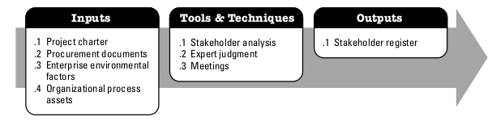
Identify stakeholder
the process of identifying the people, groups, or organizations that could impact or be impacted by a decision, activity, or outcome of the project, analyzing and documenting relevant information regarding their interests, involvement, interdependencies, influence, and potential impact on project success.
The key benefit of this process is that it allows the project manager to identify the appropriate focus for each stakeholder or group of stakeholders.

Slide 4
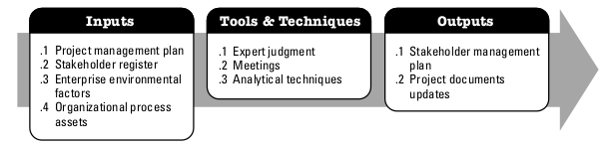
Plan stakeholder management
the process of developing appropriate management strategies to effectively engage stakeholders throughout the project life cycle, based on the analysis of their needs, interests, and potential impact on project success
The key benefit of this process is that it provides a clear, actionable plan to interact with project stakeholders to support the project’s interests.

Slide 5
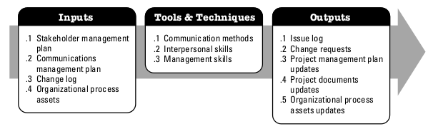
Manage stakeholder management
the process of communicating and working with stakeholders to meet their needs/expectations, address issues as they occur, and foster appropriate stakeholder engagement in project activities throughout the project life cycle
The key benefit of this process is that it allows the project manager to increase support and minimize resistance from stakeholders, significantly increasing the chances to achieve project success.

Slide 6
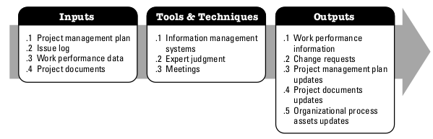
Control stakeholder engagement
the process of monitoring overall project stakeholder relationships and adjusting strategies and plans for engaging stakeholders
The key benefit of this process is that it will maintain or increase the efficiency and effectiveness of stakeholder engagement activities as the project evolves and its environment changes.

