Slide 1
EPMS
4
Enterprise Procurement
Management System
Role-based portals
8
Admin module pages
Full-stack web application for procurement requests, approvals, suppliers, deliveries, payments and reporting.
6
Core business areas
Java / Spring Boot
REST APIs
JWT Security
HTML / CSS / JS
Project Presentation

Slide 2
1. Problem Statement
2
Why a centralized procurement platform is needed
!
Common procurement challenges
✓
EPMS response
• Requests can be difficult to track across employees and managers.
• Approval status, supplier information and delivery progress can become fragmented.
• Payment records need a clear status trail for pending and completed transactions.
• Management needs consolidated reports instead of checking multiple screens or records.
• Centralized purchase-request lifecycle from creation to approval.
• Separate role-specific portals for Employee, Manager, Admin and Supplier.
• Dedicated modules for products, suppliers, deliveries, payments and reports.
• JWT-based authentication and role restrictions for protected APIs.
Enterprise Procurement Management System (EPMS)

Slide 3
2. Project Objectives
3
What the system is designed to achieve
✓
Digitize procurement
✓
Role separation
• Replace manual request handling with an online workflow.
• Give each user role only the screens and operations it needs.
✓
Approval control
✓
Supplier visibility
• Allow managers to review, approve or reject purchase requests.
• Maintain supplier profiles and procurement relationships.
✓
Operational tracking
✓
Reporting
• Track deliveries and payment status in dedicated modules.
• Provide summary views and downloadable CSV data for analysis.
Enterprise Procurement Management System (EPMS)

Slide 4
3. System Architecture
4
Frontend pages communicate with Spring Boot REST APIs
Role-based Frontend
Employee • Manager • Admin • Supplier
↓
REST API Layer
Authentication • Users • Products • Purchase Requests • Suppliers • Deliveries • Payments
↓
Business Logic
Validation • Approval rules • Status handling • Email notification
↓
Data & Security
Persistent records • JWT token • Role-based authorization
Enterprise Procurement Management System (EPMS)

Slide 5
4. Role-Based Modules
5
Separate HTML pages keep each workflow clear and independent
EMPLOYEE
MANAGER
Create requests • Browse products • Cart • Deliveries • Payments • Ratings
Review requests • Approve/Reject • Products • Deliveries • Payments • Reports
ADMIN
SUPPLIER
Users • Products • Requests • Suppliers • Deliveries • Payments • Reports
Supplier dashboard • Orders • Deliveries • Payments • Reports
Enterprise Procurement Management System (EPMS)

Slide 6
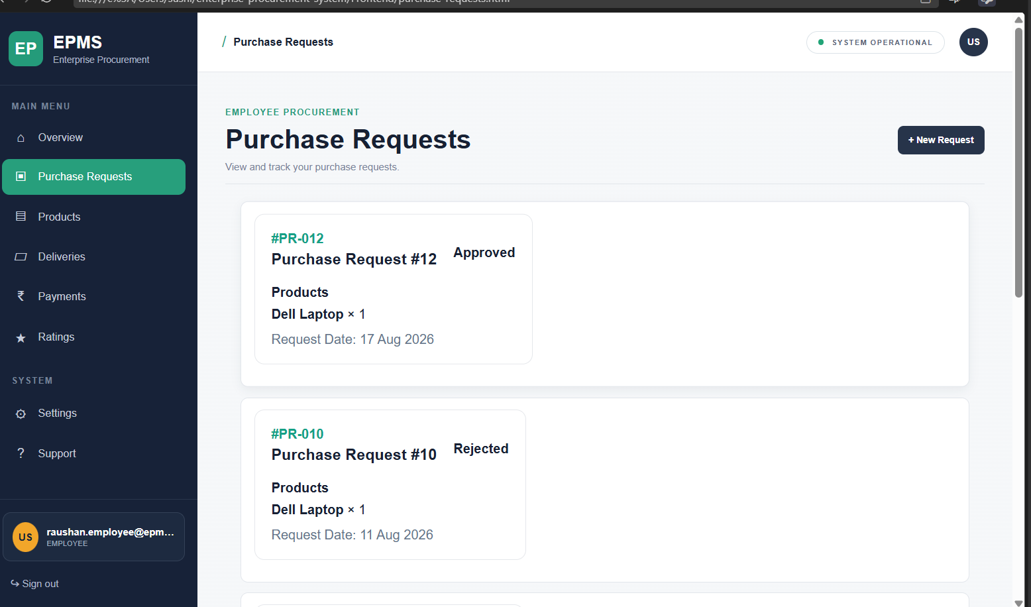
5. Employee Procurement Workflow
6
From product selection to an approved purchase request
1
→
2
→
3
→
4
→
5
→
6
→
7
Login
Browse products
Add to cart
Create request
Manager review
Approved / Rejected
Delivery & payment
→
Workflow highlights
• Employees see their request history and status.
• New Request starts the procurement flow.
• Cart data is maintained on the frontend.
• Approval outcome is visible after manager action.
Employee Purchase Requests screen
Enterprise Procurement Management System (EPMS)

Slide 7
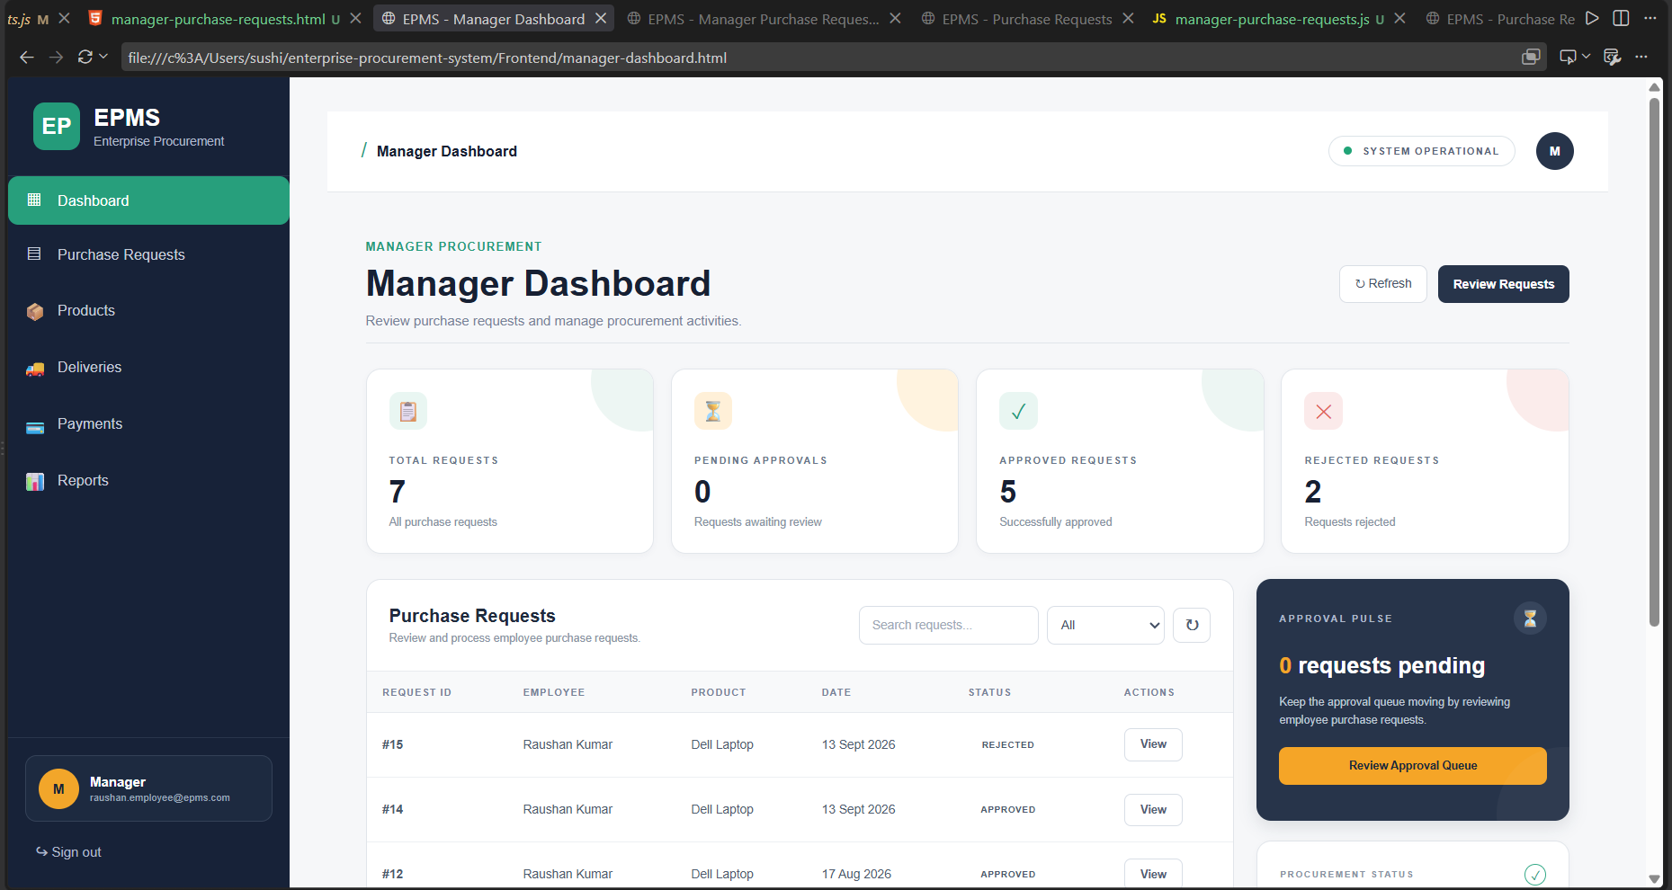
6. Manager Approval & Operations
7
Managers control the approval decision and monitor procurement activity
✓
Manager responsibilities
• View employee purchase requests.
• Approve or reject requests.
• Monitor pending, approved and rejected counts.
• Access products, deliveries, payments and reports.
• Approval actions trigger employee notification by email.
Manager Dashboard — request review and approval queue
Enterprise Procurement Management System (EPMS)

Slide 8
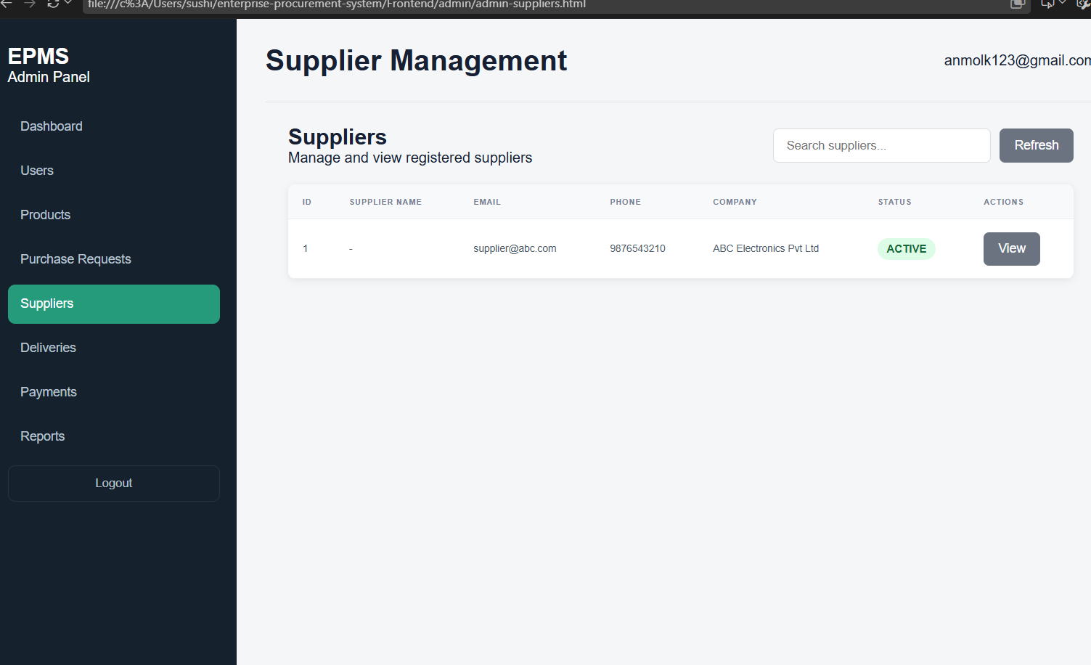
7. Supplier Management
8
Supplier information and operational status are managed separately
🏢
Supplier capabilities
• Dedicated supplier portal.
• Supplier profile and contact information.
• Order and delivery visibility.
• Payment and report modules.
• Admin can view registered suppliers.
Supplier Management screen
Enterprise Procurement Management System (EPMS)

Slide 9
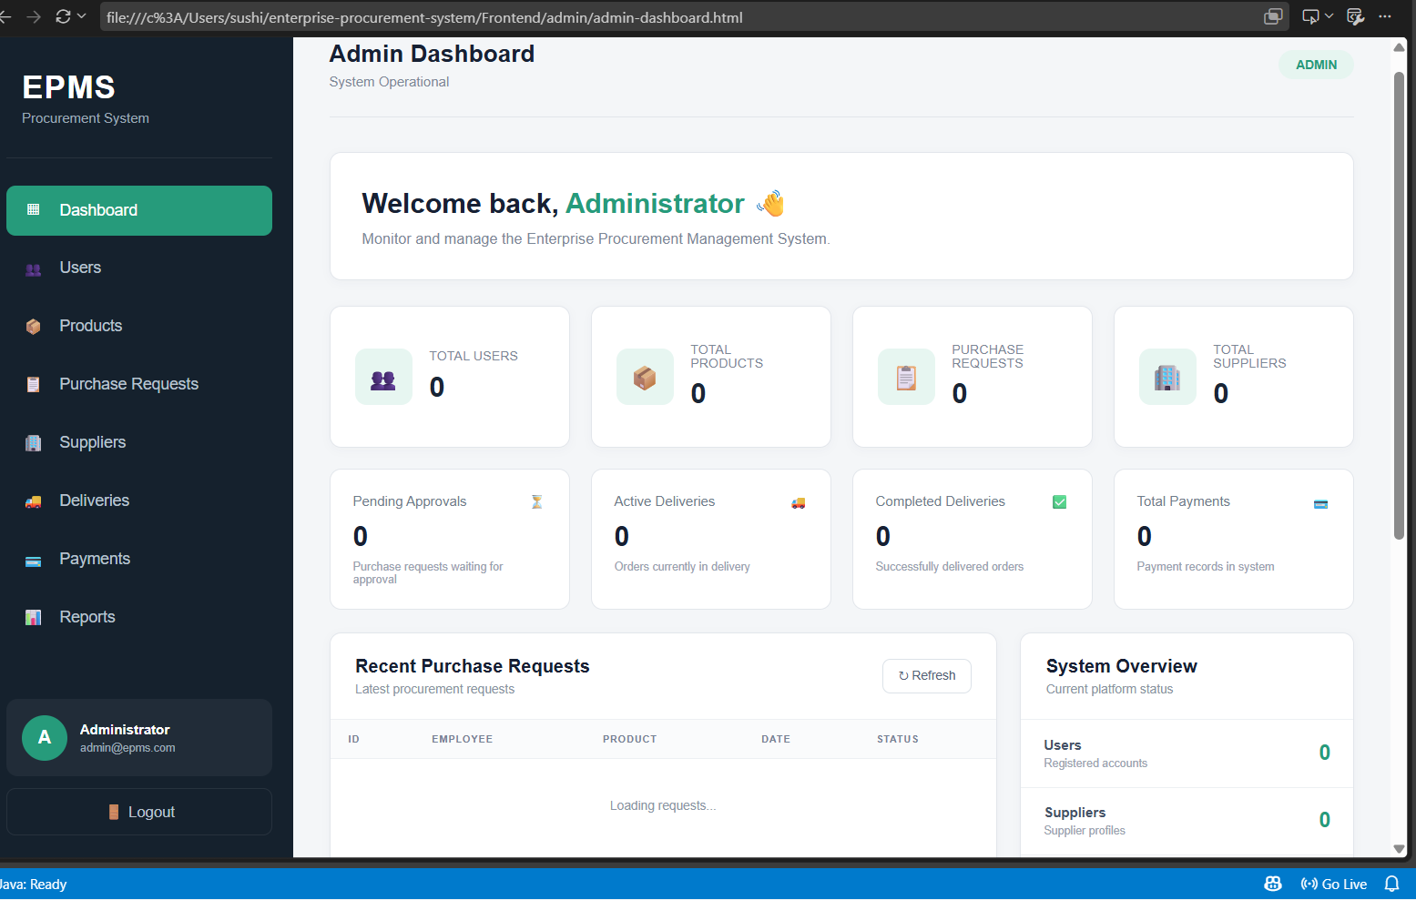
8. Admin Control Center
9
Central administration across users, products and procurement operations
⚙
Admin modules
• Users management.
• Products management.
• Purchase requests.
• Supplier management.
• Deliveries and payments.
• Reports and CSV export.
Admin Dashboard
Enterprise Procurement Management System (EPMS)

Slide 10
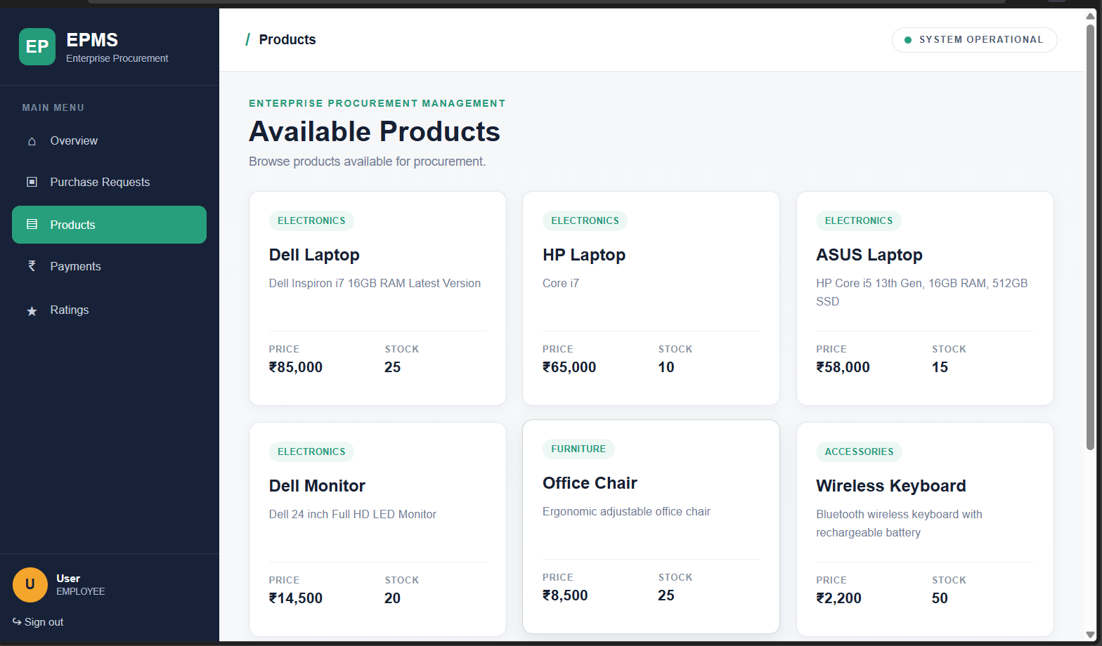
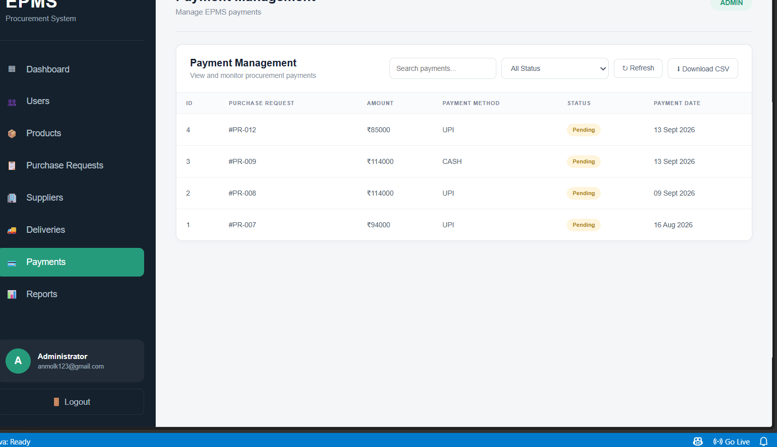
9. Products & Payments
10
Product inventory supports procurement; payment records track transaction status
Employee product catalog
Admin Payment Management — pending payment verification
4 PENDING PAYMENTS
₹4,07,000 total
Enterprise Procurement Management System (EPMS)

Slide 11
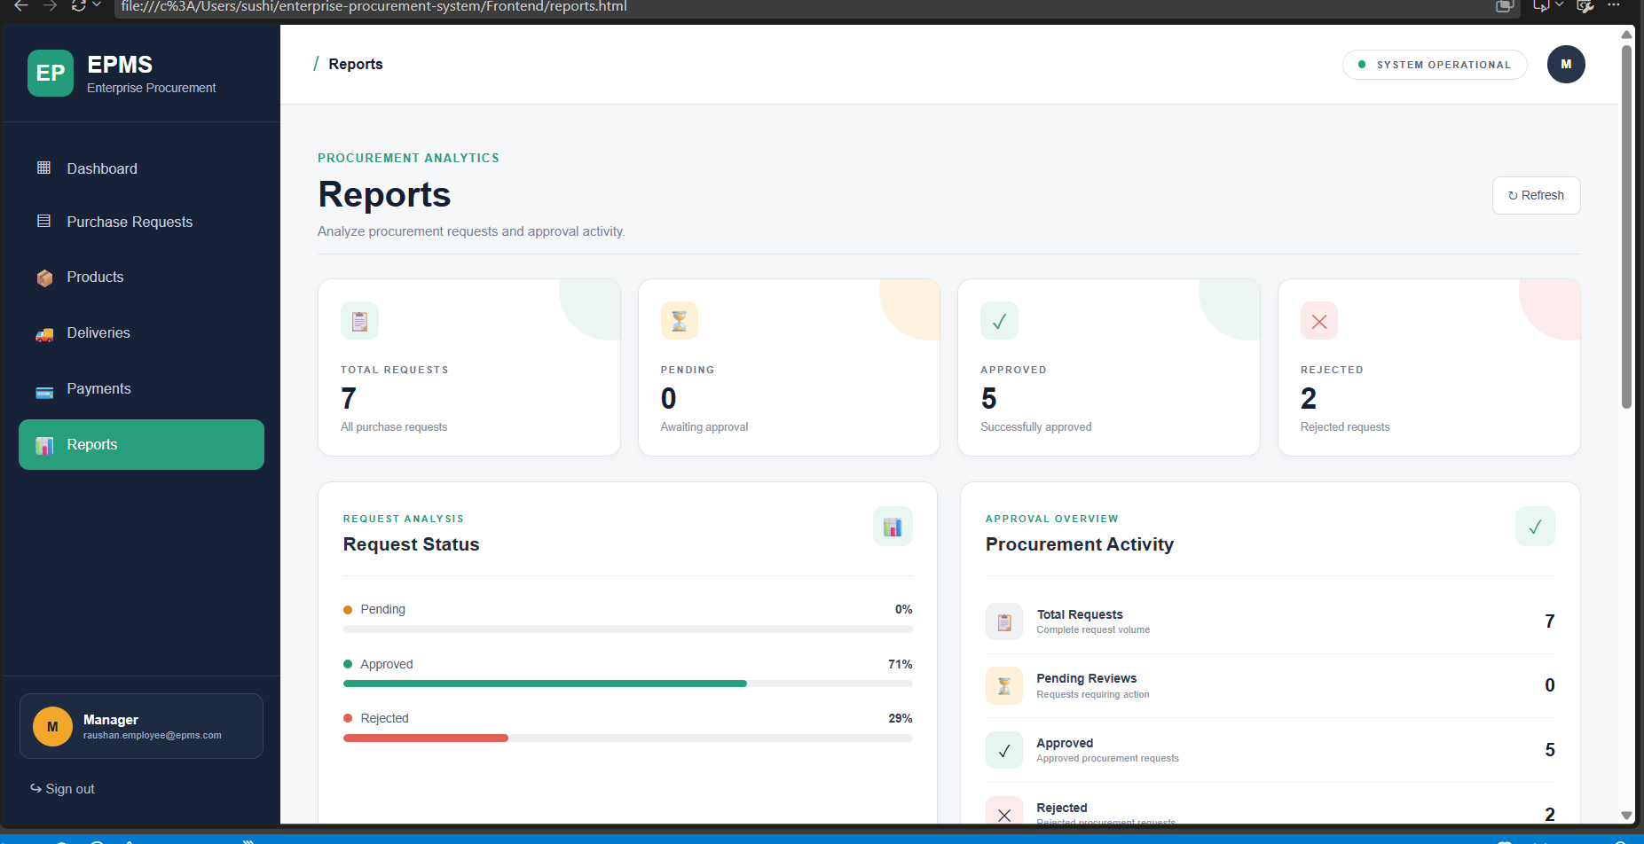
10. Reporting & Data Export
11
Reports summarize request activity and support operational analysis
📊
Reporting features
• Total request count.
• Pending / approved / rejected breakdown.
• Approval activity overview.
• Admin reports combine users, products, requests, suppliers, deliveries and payments.
• CSV export can be used for offline analysis.
Reports dashboard
Enterprise Procurement Management System (EPMS)

Slide 12
11. Security & Access Control
12
Authentication and authorization protect role-specific operations
🔐
JWT Authentication
🛡
Role Authorization
✓
Workflow Rules
• Login returns a JWT token.
• Token is stored on the frontend.
• Protected API requests send the token in the Authorization header.
• Roles include ADMIN, MANAGER, EMPLOYEE and SUPPLIER.
• Backend security restricts protected endpoints.
• Example: supplier APIs are limited to authorized roles.
• Only managers can approve/reject purchase requests.
• Employees access their own request workflow.
• Admin pages are separated from employee workflows.
Enterprise Procurement Management System (EPMS)

Slide 13
12. Testing & Verification
13
Key workflows verified during implementation
Authentication
Role-based login routing tested for all four roles.
PASS
Purchase Requests
Create → review → approve/reject workflow tested.
PASS
Email Notification
Approval/rejection notification to employee tested.
PASS
Payments
Pending filter and payment table verified.
PASS
CSV Export
Filtered pending payments downloaded and checked.
PASS
Navigation
Separate role/module pages tested with Live Server.
PASS
Enterprise Procurement Management System (EPMS)

Slide 14
13. Conclusion & Future Scope
13. Conclusion & Future Scope
14
Current achievement and logical next improvements
Current achievement and logical next improvements
What is complete
Future scope
✓ Role-based portals with separate HTML/JS pages
✓ Purchase request approval workflow
✓ Supplier, delivery and payment modules
✓ Admin management and reporting
✓ JWT authentication and role authorization
✓ Pending payment verification and CSV export
→ Advanced analytics and visual charts
→ Automated supplier notifications
→ More detailed delivery tracking
→ Payment processing/status automation
→ PDF report generation and scheduled reporting
→ Cloud deployment and production monitoring
Thank you

