Slide 1
RENTAL PROPERTY MANAGEMENT SYSTEM
-By sushil suhang

Slide 2
Table of contents
01
02
03
04
Modules
Functionalities
Existing system
ENHANCING FEATURES

Slide 3
01
Modules

Slide 4
Module
Property
Tenant

Slide 5
Module
Rent Collection
Documents
Finance & Accounting Management

Slide 6
Module
Maintenance
Reports
Communication
Marketing

Slide 7
Module
Compliance
User Management

Slide 8

Features

Slide 9
Property Management
-Adding Property
-Categorize Property
-Search/Filter Property
-Edit Property
-Delete Property

Slide 10
Tenant Management
-Adding Tenant
-Removing Tenant
-Request maintenance request
-Paying rent online

Slide 11
Rent Management
-sending rent reminders
-tracking late payments
-managing any penalties for late payment

Slide 12
Maintaince
- receive maintenance requests from tenants
- Schedules maintenance for properties

Slide 13
Accounting and reporting
- income and expenses
- tracking payments
- managing budgets

Slide 14
Communication
- communication platform for landlords, tenants, and property managers
- Tenants can address issues or concerns.

Slide 15
Managing Documents
- legal documents related to the rental properties - Including rental agreements, ease renewals, and maintenance contracts

Slide 16
Marketing
- online listings
- social media marketing
- other promotional materials.

Slide 17
Security and User Management
- security features, such as encryption, firewalls, and access controls, to protect sensitive data from unauthorized access and breaches.
- levels of access for landlords, tenants, and property managers.

Slide 18
03
EXISTING SYSTEMS

Slide 19

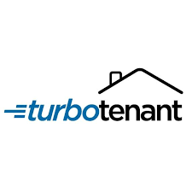


EXISTING SYSTEMS
Step 1
Buildium
TurboTenent
Property Care Online
Nepal Property Bazaar

Slide 20
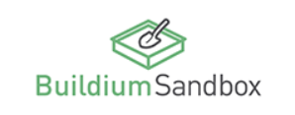
Buildium
Brief Description
cloud-based property management software that enables managers of residential and association properties to take control of every aspect of their business

Slide 21
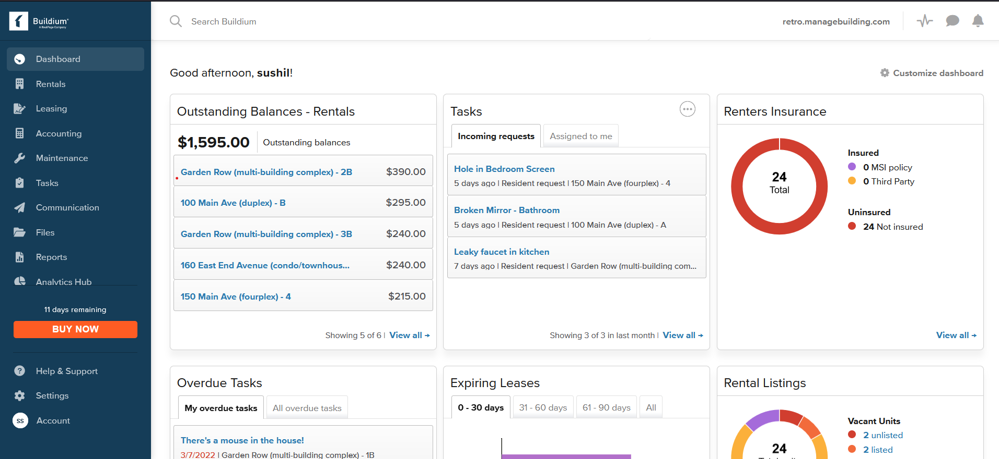
Dashboard

Slide 22
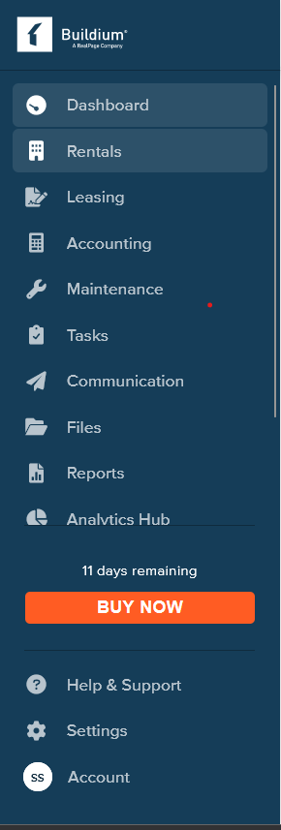
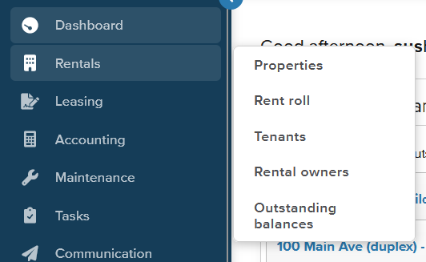
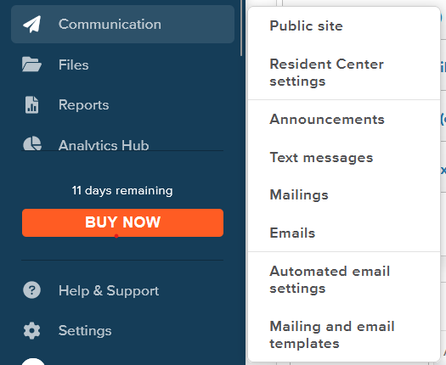
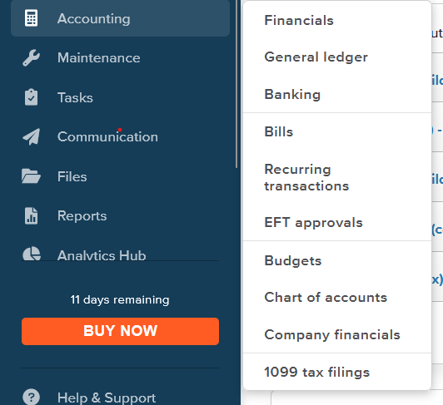
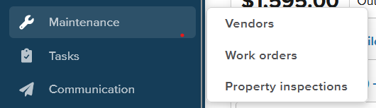
Other features

Slide 23
TurboTenent
Brief Description
TurboTenant’s pricing model puts all of its costs on the tenants, making it the best free option for landlords.

Slide 24
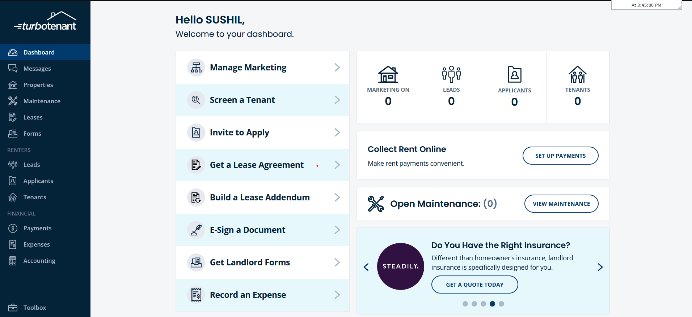
Dashboard

Slide 25
Property Care Online
Brief Description
Property Care Online is a powerful cloud-based property management solution that allows residential and commercial property owners or managers to effectively market, manage and grow their business.

Slide 26
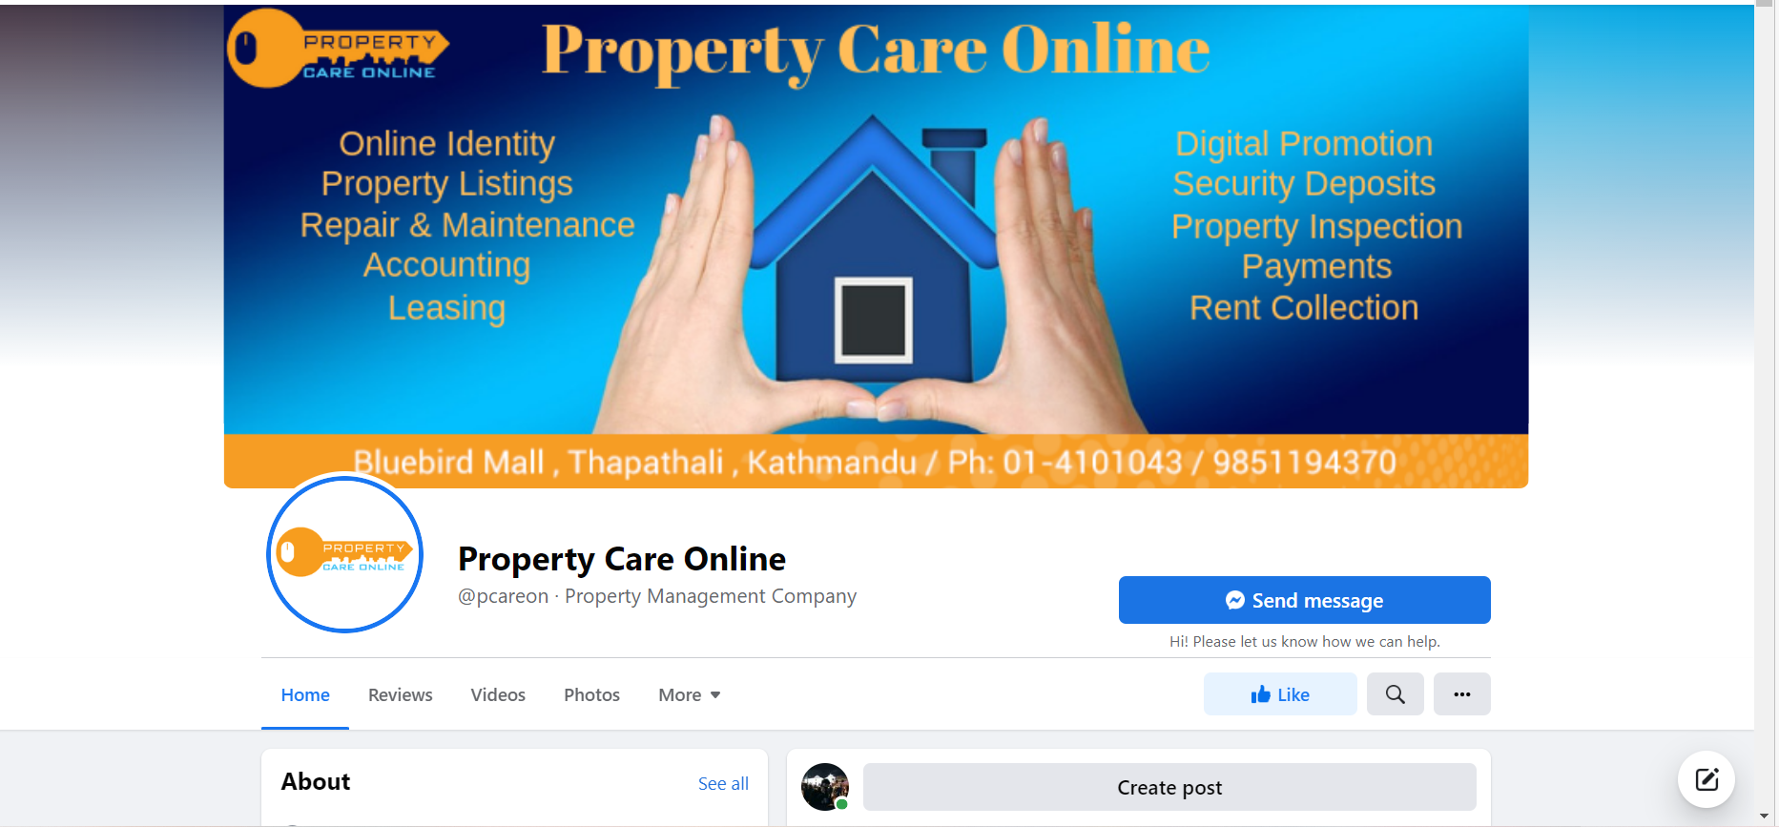
Facebook page

Slide 27
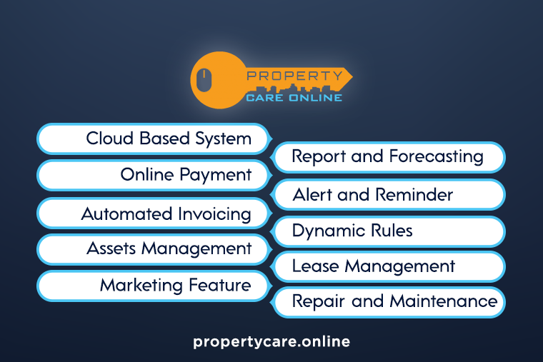
Functions

Slide 28
Nepal Property Bazaar (NPB)
Brief Description
- Provides a range of flexible rental management services.
- They provide you with Rental Management portal login detail after agreement is signed and you can mange your property from any part of the world.

Slide 29
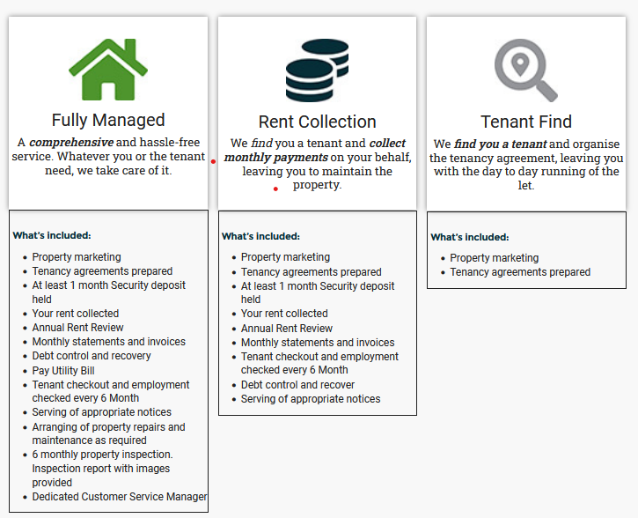
Functions

Slide 30
Common functionalities
Venus
1
er
Mars
Property Listing
Tenant Management
Rent collection
Repair and Maintenance
Alert and reminder
Marketing features

Slide 31
Comparing the systems
 | MEDIOCRE | AVERAGE | GOOD
UI | Property Care Online, Nepal Property Bazaar | Buildium | TurboTenent
Functionalities | Property Care Online, Nepal Property Bazaar | TurboTenent | Buildium

Slide 32
ENHANCING FEATURES

Slide 33
ENHANCING FEATURES
Automated financing : When tenants pays rent, it will automatically goes to the landlord account after cutting fees for manger and maintaince cost.

Slide 34
Thanks!
Do you have any questions?
youremail@freepik.com
+34 654 321 432
yourwebsite.com
Please keep this slide for attribution

