Slide 1
Understanding Customer Sentiment Toward American Airlines
Sentiment Analysis of Customer Reviews Using NLP
Notes:
"Today, I’ll walk you through an analysis of how customers feel about American Airlines, using natural language processing to extract sentiment from their online reviews."

Slide 2
Why Customer Sentiment Matters?
Impacts brand loyalty and revenue
Revels pain points in service
Helps prioritize improvements
Notes:
"Airlines compete not just on price or routes but on customer satisfaction. Understanding sentiment helps American Airlines make better decisions."

Slide 3
How We Analyzed the Reviews
Collected reviews from online source
Used TextBlob for polarity and subjectivity scoring
Categorized sentiments into Positive, Neutral, Negative
Notes:
"We used TextBlob to analyze thousands of reviews. Polarity measures emotion—from negative to positive—and subjectivity measures how opinionated the review is."

Slide 4
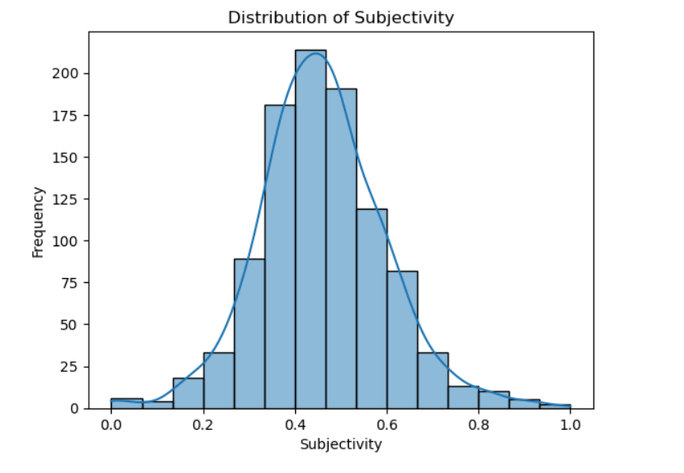
Subjectivity Distribution
Review are moderately subjective, indicating customers are sharing personal opinions.
Fig 1: Bar chart of Subjectivity
Notes:
"Most people are writing reviews based on their personal experiences rather than just stating facts."

Slide 5
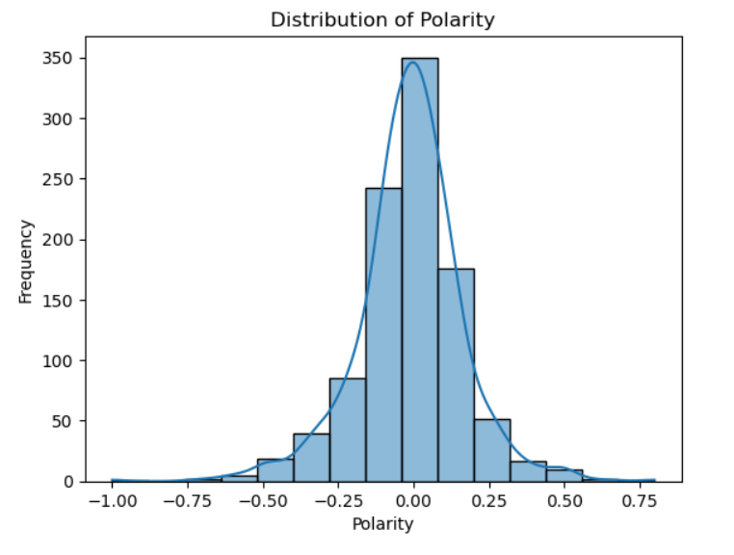
Polarity Distribution
Slight skew towards negative sentiment. More customers had poor experiences than excellent once.
Having this much negative review is an issue.
Fig 1: Bar chart of Polarity
Notes:
"The reviews aren't overwhelmingly negative, but there’s a clear tilt in that direction."

Slide 6
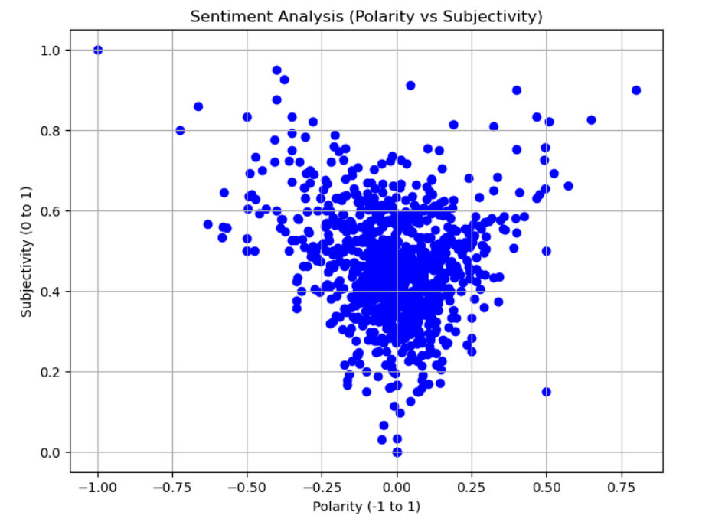
Polarity vs. Subjectivity
Most reviews are moderately emotional and not extreme in sentiment.
Fig 1: Scatter chart of Subjectivity and Polarity
Notes:
"This shows that most people are sharing their opinions, but they aren’t super angry or extremely happy—just somewhere in the middle."

Slide 7
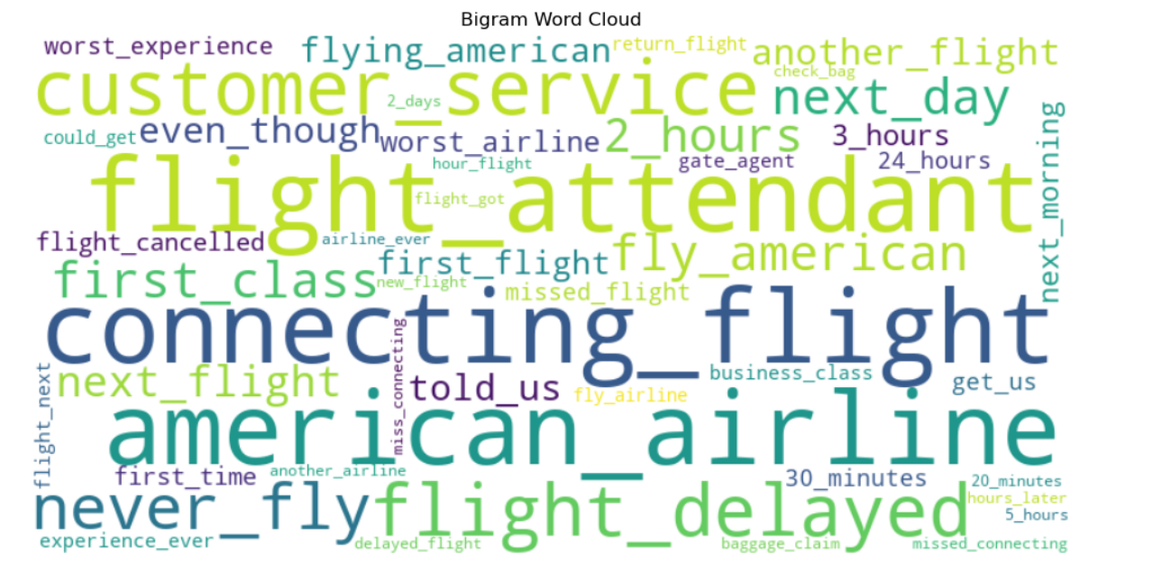
Common Themes in Customer Feedback
“Connecting flight”, “flight delayed” and “customer service ” are most commonly mentioned.
Many phrases related to frustration with timing(e.g. ‘2 hours’, ‘next day’) and flight disruption.
Terms like "never fly", "worst experience", and "first class" suggest strong emotional reactions—mostly negative.
Fig 2: Word Cloud of Customer review bigram
Notes:
Customer feedback often focuses on delays, service quality, and missed connections, highlighting clear areas for improvement.

Slide 8
Key Takeaways for the Business
Slightly negative skew shows service gaps
Most feedback is emotional but not extreme—customers care enough to share, even if not ranting or raving
Polarized sentiment clusters show people are frustrated, not indifferent
There's a clear opportunity to turn pain points into loyalty drivers
Notes:
"What we’re seeing is that customers aren’t just throwing out angry rants or glowing praise—they’re expressing real, specific concerns. This tells us they still want to be heard. That emotional engagement is powerful. American Airlines has a chance to not only fix operational issues but also rebuild trust by responding directly to what customers are saying the most."

Slide 9
How to Act on This Data
Investigate top issues in negative reviews (e.g., connecting flight delays, customer service, cancellations)
Use feedback to improve training for customer-facing staff
Monitor recurring bigrams like “never_fly” or “told_us” to detect early warning signals
Track sentiment clusters over time to evaluate customer experience improvements
Notes:
"The next step is to go deeper — mine the negative reviews for recurring themes like delays, miscommunication, and missed connections. These issues are not just operational—they're emotional. Action plans should focus on solving what matters most to customers. And by monitoring trends in both word usage and sentiment over time, American Airlines can measure whether interventions are actually working."

Slide 10
Thank You

