Slide 1
Coffee Sales Dashboard Report
Power BI Report
Prepared by: Sushil Admane

Slide 2
Project Overview
Objective:
Analyze coffee sales performance using Power BI.
Dataset includes date, payment type, coffee type, and sales amount.

Slide 3
Key KPIs
Total Sales
Total Orders
Card Sales
Cash Sales
Best Selling Coffee

Slide 4
Sales Trend Analysis
Monthly sales trend shows peak performance in May.
Sales slightly declined after May.

Slide 5
Product Performance
Latte is the best-selling coffee.
Americano with Milk and Cappuccino follow closely.

Slide 6
Payment Analysis
Card payments dominate sales.
Cash payments contribute a smaller portion.

Slide 7
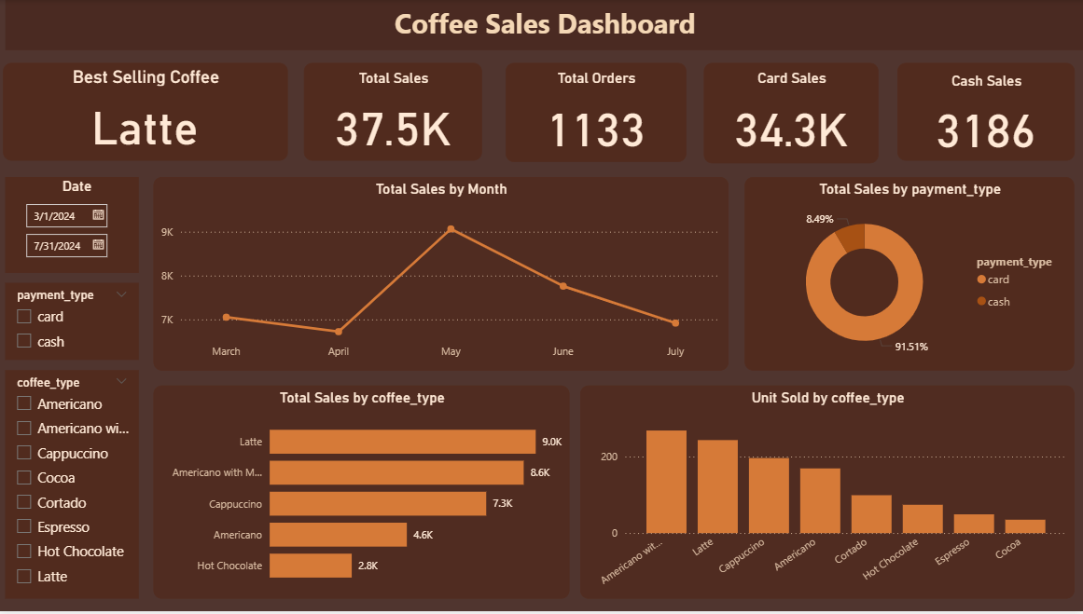
Dashboard

Slide 8
Insights & Conclusion
Focus on top-performing coffee types
Encourage card payments
Use insights for inventory planning

