Slide 1
Google Play Store App Analysis
Python + Power BI Project Report
By: Data Analyst

Slide 2
Project Overview
Objective:
Analyze Google Play Store app data to uncover insights on installs, ratings, and revenue.
Dataset Size: 9,000+ apps
Tools Used: Python, Power BI

Slide 3
Dataset Description
Columns:
• App
• Category
• Rating
• Reviews
• Installs
• Type (Free/Paid)
• Price
• Content Rating
• Genres
• Last Updated
• Android Version

Slide 4
Data Cleaning & Preparation
• Removed null ratings
• Converted price and installs to numeric
• Filtered invalid ratings (>5)
• Created revenue metric
Libraries: Pandas, NumPy

Slide 5
Power BI Dashboard Pages
1. Overview Page – KPIs, installs trend, free vs paid
2. Category Insights – Revenue, installs, ratings
3. App Details – App-level performance & rating distribution

Slide 6
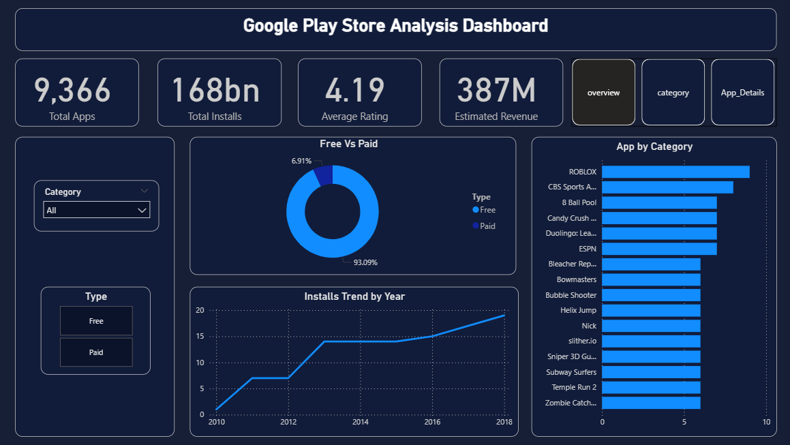

Slide 7
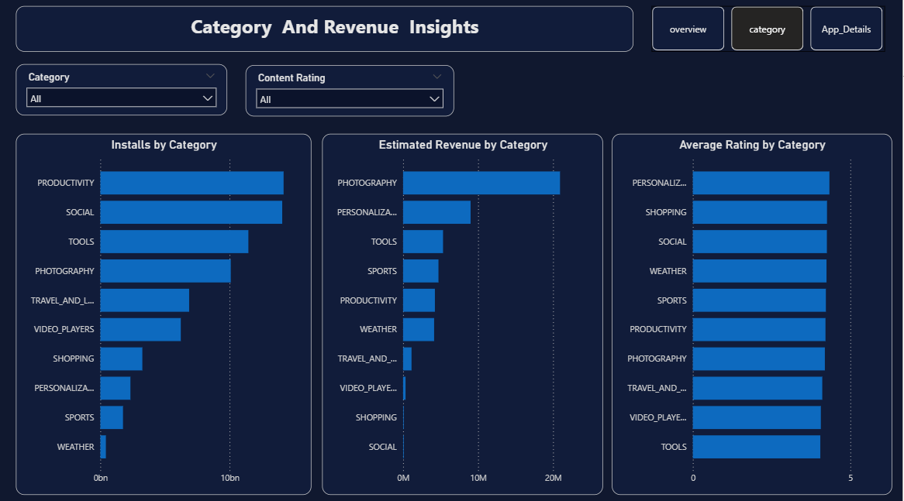
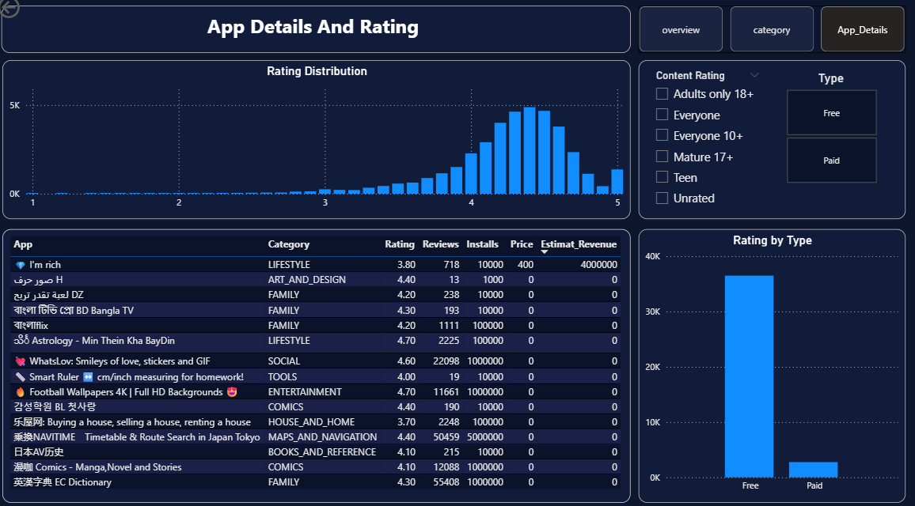

Slide 8
Key Insights
• Free apps dominate total installs
• Paid apps have higher average ratings
• Communication & Social categories lead installs
• Business & Productivity apps generate higher revenue

Slide 9
Conclusion
This project demonstrates end-to-end data analysis skills including:
• Data cleaning
• Business insights
• Dashboard storytelling
Future Scope: Predict app success using ML

