Slide 1
Uber Trip Demand & Fleet Performance Analysis
Python | Machine Learning | Power BI
Portfolio Project

Slide 2
Project Objective
• Analyze Uber trip demand and fleet utilization
• Understand relationship between active vehicles and trips
• Predict trip demand using machine learning
• Build insights-driven Power BI dashboard

Slide 3
Dataset Overview
Columns Used:
• Dispatching Base Number
• Date
• Active Vehicles
• Trips
Data covers Jan–Feb operational activity

Slide 4
Data Preparation (Python)
• Converted date to datetime format
• Removed missing and zero values
• Created time features (month, weekday)
• Calculated Trips per Vehicle KPI

Slide 5
Machine Learning Models
• Linear Regression (baseline model)
• Decision Tree Regressor
Target Variable: Trips
Features: Active Vehicles, Month, Weekday

Slide 6
Model Evaluation
• Compared models using MAE and R² Score
• Decision Tree captured non-linear patterns better
• Predictions exported for Power BI integration

Slide 7
Power BI Dashboard
Key Visuals:
• Total Trips & Active Vehicles KPIs
• Trips trend over time
• Top dispatching bases by trips
• Trips per vehicle (utilization)
• Actual vs Predicted trips

Slide 8
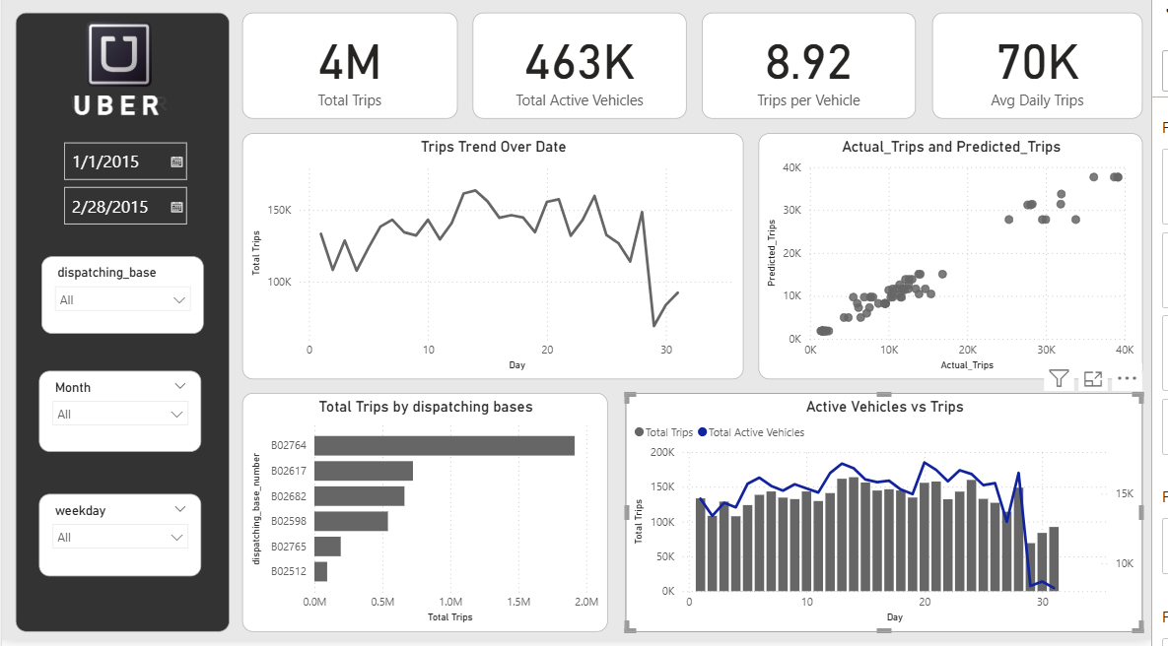

Slide 9
Key Business Insights
• Some bases show high trips with fewer vehicles
• Demand fluctuates by time and base
• Fleet optimization opportunities identified
• ML predictions support demand planning

Slide 10
Tools & Skills
• Python (Pandas, Scikit-learn)
• Machine Learning
• Power BI & DAX
• Data Visualization
• Business Analysis

Slide 11
Conclusion
• End-to-end analytics project completed
• Combined data analysis, ML, and BI
• Dashboard enables data-driven decisions
• Strong portfolio project for Data Analyst roles

