Slide 1
Retail Sales and Customer Behavior Analytics
MSDS-632-M51: Big Data
University of the Cumberlands
June 15, 2025
Sushila Sipai
Satyanarayana Reddy Muttana
Yanjie Liu

Slide 2
Introduction
Analyzed 500,000+ retail transactions (UCI Online Retail dataset)
Objective: Understand customer behavior, sales trends, seasonal patterns
Tools: Apache Spark, PySpark, Pandas, Matplotlib, SQLite

Slide 3
Big Data Characteristics – 5Vs
Volume: 500k records – simulates mid-size retail platform
Velocity: Mimics real-time transaction flow
Variety: Structured fields (e.g., InvoiceNo, Date, Price)
Veracity: Data cleaning needed (nulls, returns)
Value: Insight into customer segments and sales drivers

Slide 4
Business Goals & Drivers
Personalized marketing using customer segments
Seasonal sales optimization
Inventory management & demand forecasting
Country-wise revenue analysis

Slide 5
Technical Architecture
Foundation: Java 11, Spark 3.5.6, Winutils
Processing: Apache Spark (local mode), PySpark
Extension: Pandas, Matplotlib, Google Colab, SQLite
Seamless Spark–Python interoperability

Slide 6
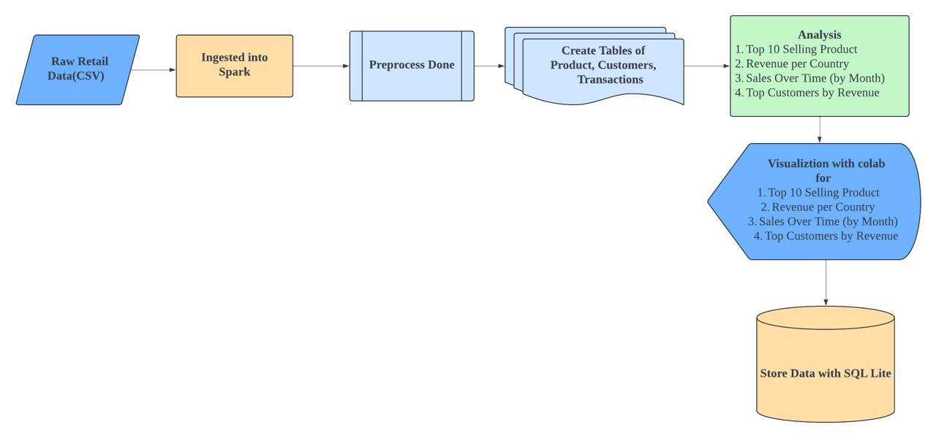
Architecture Diagram

Slide 7
Big Data Lifecycle
1. Business Case Evaluation
2. Data Identification (UCI Retail CSV)
3. Acquisition & Filtering (cleaning nulls, malformed entries)
4. Data Transformation (revenue metrics)
5. Analysis (top products/customers, time series)
6. Visualization (line, bar, histograms)
7. Interpretation & Deployment (SQLite storage)

Slide 8
Key Analysis & Results
Top 10 Selling Products
Monthly Sales Trends
Top Revenue-Generating Countries
Customer Lifetime Value Segments

Slide 9
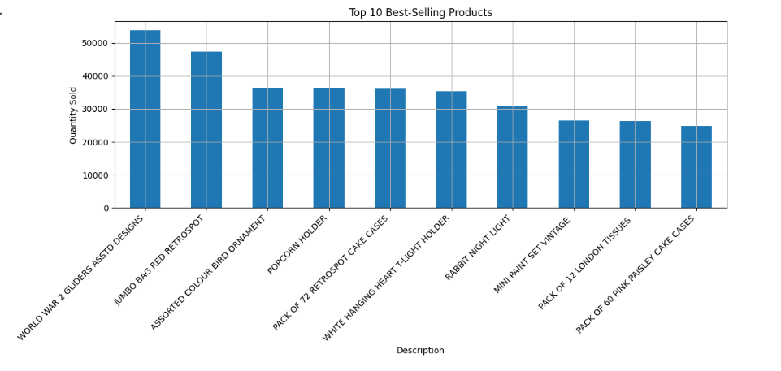
Top 10 Best-Selling Products

Slide 10
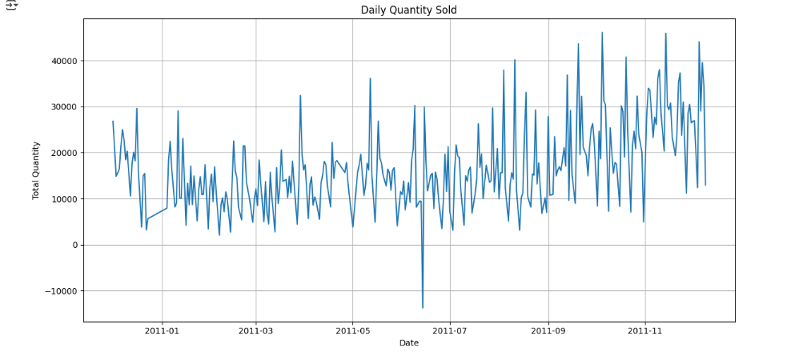
Daily Quality Sold

Slide 11
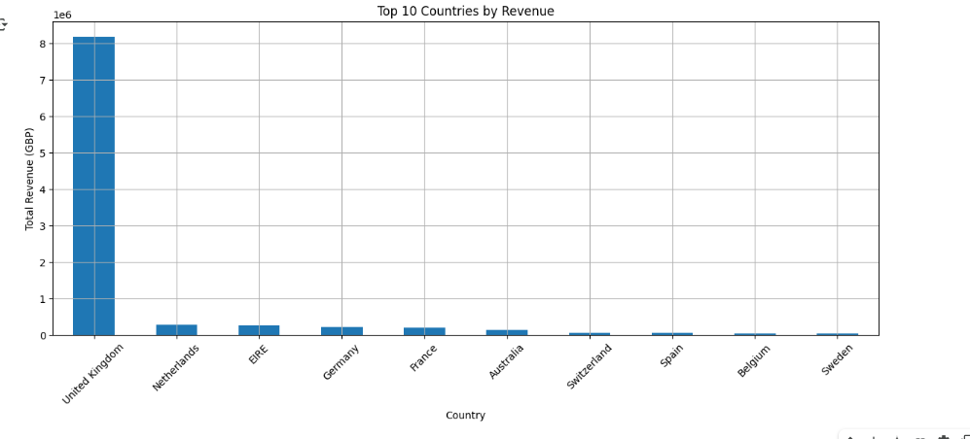
Top 10 Countries by Revenue

Slide 12
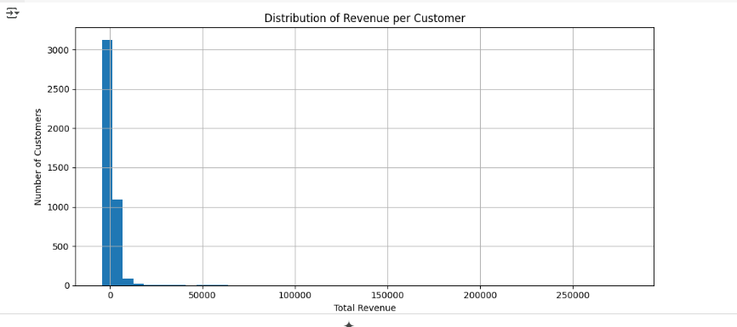
Distribution of Revenue per Customer

Slide 13

Challenges Faced in the Project
Data Volume: Retail dataset with 500k+ rows.
Data Quality: Missing values and product returns required cleaning.
Infrastructure Setup: Spark installation and JVM/winutils configuration were time-consuming.
Tool Interoperability: Data needed to be transferred between Spark and Pandas.
Visualization Accuracy: Ensuring proper time intervals and avoiding clutter in Matplotlib.
Performance: Pandas DataFrames had performance issues with large volumes.
Learning Curve: Required skills in Scala, SQL, and Python.

Slide 14
Technologies Used
Apache Spark – Distributed data processing
PySpark – Python API for Spark
Pandas – Exploratory data analysis
SQLite – Lightweight relational storage
Matplotlib – Data visualization
Google Colab – Cloud collaboration

Slide 15
Conclusion
Effective hybrid workflow (Spark + Python)
Real-time business use cases simulated
Big Data tools helped uncover actionable insights
Skills gained: Spark setup, lifecycle management, visualization

Slide 16

References
Chen, D. (2012). UCI Machine Learning Repository.
EMC Education Services. (2015). Data Science & Big Data Analytics.
Hashem et al. (2015). Information Systems, 47, 98–115.
Russom, P. (2011). TDWI Big Data Analytics Report.

