Slide 1
Retail Sales and Customer Behavior Analytics
MSDS-632-M51: Big Data
University of the Cumberlands
June 15, 2025
Sushila Sipai
Satyanarayana Reddy Muttana
Yanjie Liu

Slide 2
Introduction
Retailers today collect vast amounts of data from POS systems, online platforms, and customer interactions. This project focuses on using Apache Spark, Pandas, and Matplotlib to analyze a real-world retail dataset for insights into product performance and customer behavior.

Slide 3
Preview
Analyzed 500,000+ retail transactions (UCI Online Retail dataset)
Objectives and Goals: : Clean, transform, and analyze retail transaction data, understand customer behavior, sales trends, seasonal patterns
Technologies and Tools: Apache Spark, PySpark, Pandas, Matplotlib, SQLite, Google Colab

Slide 4
Big Data Characteristics – 5Vs
Volume: 500k records – simulates mid-size retail platform
Velocity: Mimics real-time transaction flow
Variety: Structured fields (e.g., InvoiceNo, Date, Price)
Veracity: Data cleaning needed (nulls, returns)
Value: Insight into customer segments and sales drivers

Slide 5
Business Goals & Drivers
Personalized marketing using customer segments
Seasonal sales optimization
Inventory management & demand forecasting
Country-wise revenue analysis

Slide 6
Technical Architecture
Foundation: Java 11, Spark 3.5.6, Winutils
Processing: Apache Spark (local mode), PySpark
Extension: Pandas, Matplotlib, Google Colab, SQLite
Seamless Spark–Python interoperability

Slide 7
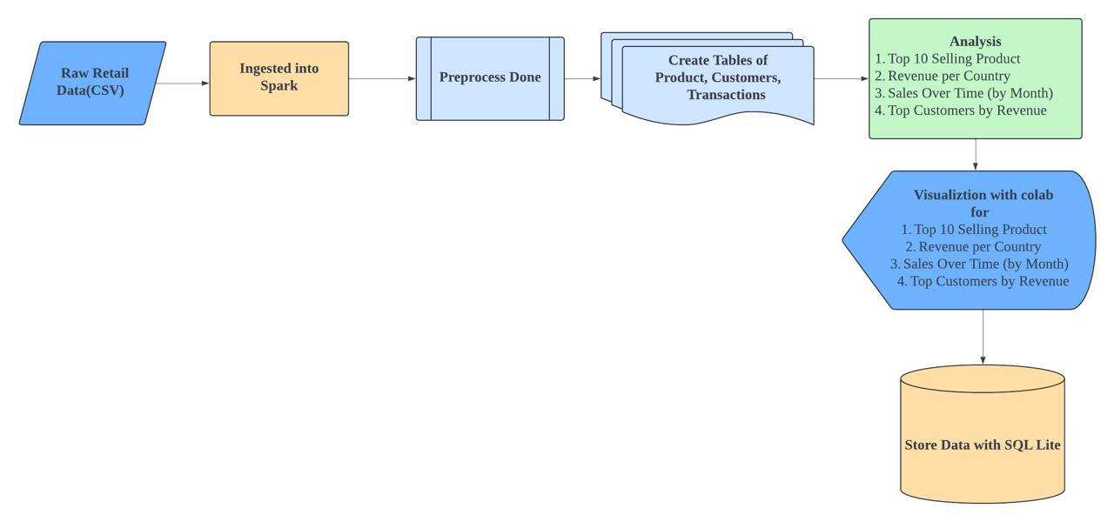
Architecture Diagram

Slide 8
Big Data Lifecycle
1. Business Case Evaluation
2. Data Identification (UCI Retail CSV)
3. Acquisition & Filtering (cleaning nulls, malformed entries)
4. Data Transformation (revenue metrics)
5. Analysis (top products/customers, time series)
6. Visualization (line, bar, histograms)
7. Interpretation & Deployment (SQLite storage)

Slide 9
Key Analysis & Results
Top 10 Best-Selling Products
Top 10 Countries by Total Revenue
Sales Trend over Time
Customer Distribution by Revenue

Slide 10
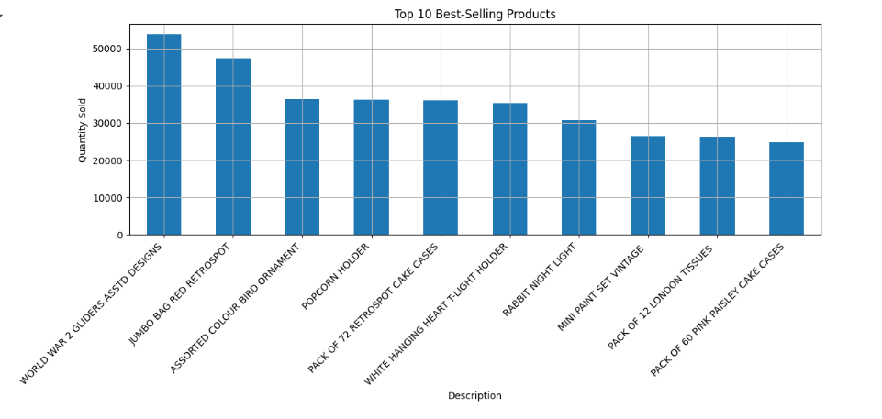
Top 10 Best-Selling Products

Slide 11
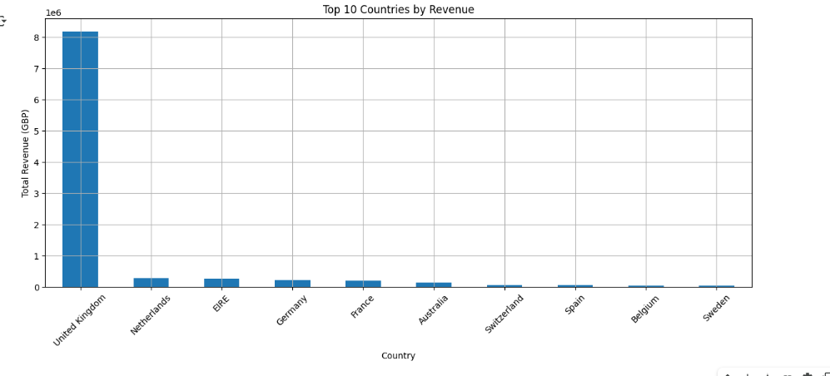
Top 10 Countries by Revenue

Slide 12
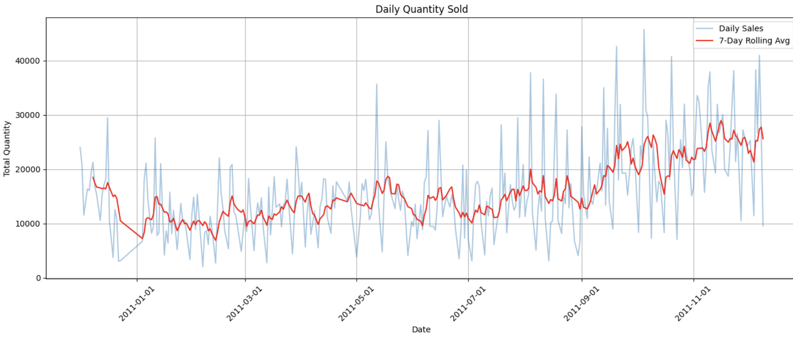
Daily Quantity Sold

Slide 13
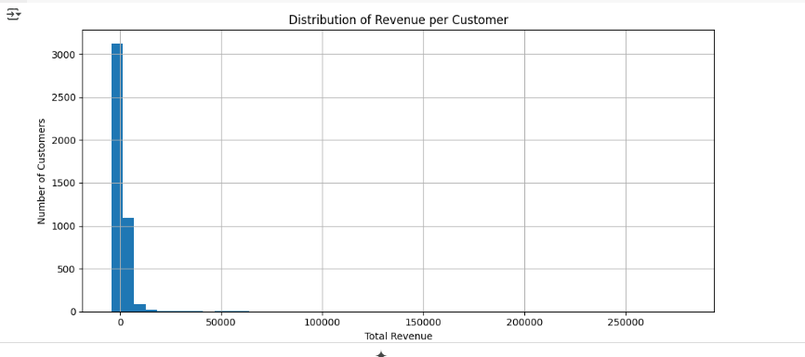
Distribution of Revenue per Customer

Slide 14

Challenges Faced in the Project
Data Quality: Missing values and product returns required cleaning.
Infrastructure Setup: Spark installation and JVM/winutils configuration were time-consuming.
Visualization Accuracy: Ensuring proper time intervals and scale of the graphs to avoid clutter in Matplotlib.
Learning Curve: Required skills in Spark, SQL, and Python.

Slide 15
Technologies Used
Apache Spark – Distributed data processing
PySpark – Python API for Spark
Pandas – Exploratory data analysis
SQLite – Lightweight relational storage
Matplotlib – Data visualization
Google Colab – Cloud collaboration

Slide 16
Key Takeaways
Spark enables scalable data processing
Revenue and sales insights easily derived
Visualizations help communicate data trends
Retail analytics is effective for customer behavior insights

Slide 17

References
Chen, D. (2012). UCI Machine Learning Repository.
EMC Education Services. (2015). Data Science & Big Data Analytics.
Hashem et al. (2015). Information Systems, 47, 98–115.
Russom, P. (2011). TDWI Big Data Analytics Report.
ChatGPT

