Slide 1

B.TECH CSE — JOB SIMULATION REPORT
GenAI Powered Data Analytics Job Simulation
Tata Group, via Forage: Exploratory Risk Profiling, AI-Driven Delinquency Prediction, and Collections Strategy
School of Computer Science and Engineering
IILM University, Greater Noida, U.P.
Sushil Kumar
Roll No.: 25SCS1003004474 | Batch: 2025–29 | Section: 2CSE37
Program: B.Tech CSE, 3rd Year | Organization: Tata Group (via Forage)

Slide 2
Introduction
A B.Tech CSE report documenting the GenAI Powered Data Analytics Job Simulation, designed and provided by Tata Group and delivered through the Forage virtual experience platform. The simulation was completed in August 2026, with the Certificate of Completion issued on 25 August 2026.
PROVIDED BY
Tata Group
DELIVERED VIA
Forage Platform
It centred on four task-based modules replicating real data-analyst work in credit risk and collections — combining exploratory data analysis, AI-assisted prediction, and business-facing data storytelling.
COMPLETED
August 25th, 2026
FOCUS AREA
Data Analytics & GenAI
IILM University | B.Tech CSE | Sushil Kumar
2

Slide 3
Organization / Platform Profile
Tata Group
Forage
A global Indian multinational conglomerate with business interests spanning financial services, technology, and consulting. As part of its outreach to early-career talent, Tata Group partnered with Forage to offer this simulation.
A platform hosting free, self-paced virtual job simulations designed by real companies — giving students structured, practical exposure to industry-relevant tasks and realistic business scenarios, without a formal internship placement.
IILM University | B.Tech CSE | Sushil Kumar
3

Slide 4
Problem Statement
Identifying borrowers at risk of delinquency
Manually profiling large customer bases is time-consuming
Analysis must convert into actionable recommendations
Generative AI can accelerate analysis and reporting
AI-assisted outputs must be validated and used responsibly
IILM University | B.Tech CSE | Sushil Kumar
4

Slide 5
Project Objectives
Risk Profiling
AI Prediction
Data Storytelling
Exploratory data analysis and borrower risk profiling
AI-assisted delinquency prediction
Business reporting and data storytelling
Strategy
Responsible AI
AI-driven collections strategy
Responsible use of Generative AI
IILM University | B.Tech CSE | Sushil Kumar
5

Slide 6
Project Scope — Four Modules
01
02
03
04
→
→
→
Exploratory Data Analysis & Risk Profiling
Predicting Delinquency with AI
Business Report & Data Storytelling for Collections
Implementing an AI-Driven Collections Strategy
A sequential four-module workflow — each stage builds on the outputs of the one before it.
IILM University | B.Tech CSE | Sushil Kumar
6

Slide 7
Technologies and Tools
Forage Platform
Generative AI Tools
Data Analysis
Access to task briefs, datasets, and submission workflows
Accelerating exploratory analysis, prediction, and report drafting
Spreadsheet/data-analysis tools for exploratory analysis and risk profiling
AI-Assisted Prediction
Business Reporting
Data Storytelling
Applying AI-assisted methods to delinquency prediction
Structured business report formats
Communicating findings through narrative-driven presentation
IILM University | B.Tech CSE | Sushil Kumar
7

Slide 8
System Architecture / Work Process
Simulated Dataset
▼
Exploratory Data Analysis
▼
Risk Profiling
▼
AI-Assisted Delinquency Prediction
▼
Business Report & Data Storytelling
▼
AI-Driven Collections Strategy
IILM University | B.Tech CSE | Sushil Kumar
8

Slide 9
Methodology
Explore the provided dataset and identify borrower-risk variables.
1
Apply AI-assisted techniques to estimate delinquency likelihood.
2
Convert analytical findings into a business report using data storytelling.
3
Translate predictive findings into a proposed AI-driven collections strategy.
4
Generative AI was used as an aid to analysis, prediction, interpretation, and communication — within the guided structure provided by Forage and Tata Group.
IILM University | B.Tech CSE | Sushil Kumar
9

Slide 10
Expected Outcomes & Key Learnings
OUTCOMES
SKILLS DEVELOPED
✓
Completion of exploratory data analysis and borrower risk profiling
★
Practical exposure to data analytics and Generative AI
✓
Application of AI-assisted delinquency prediction
★
Improved analytical thinking and interpretation
✓
Development of business reporting and data storytelling
★
Stronger problem-solving skills
✓
Proposed AI-driven collections strategy
★
Better business communication
IILM University | B.Tech CSE | Sushil Kumar
10

Slide 11
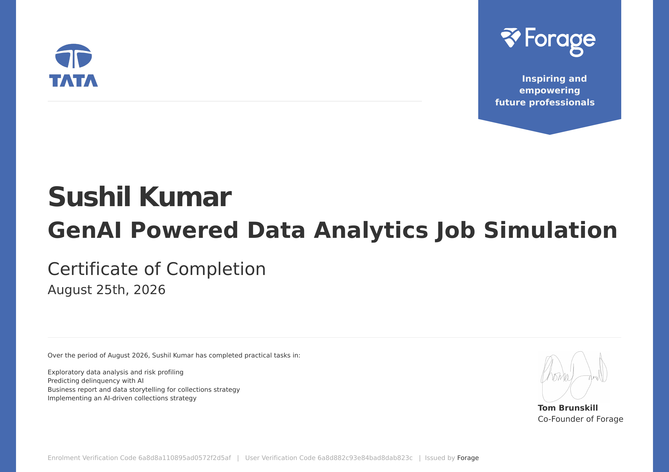
Certificate of Completion
IILM University | B.Tech CSE | Sushil Kumar
11

Slide 12
Conclusion
•
Practical exposure to data analytics and AI-assisted business problem-solving
•
Understanding of credit risk and collections
•
Experience with exploratory analysis and delinquency prediction
•
Experience in business data storytelling
•
Understanding of AI-driven collections strategy
THANK YOU

