Slide 1
Welcome to Math’s Tutorial Graphics in R (PLOTS)

Slide 2
Computer Graphics
Graphics are important for conveying important features of the data
They can be used to examine
Marginal distributions
Relationships between variables
Summary of very large data
Important complement to many statistical and computational techniques

Slide 3
Histograms
R creates histogram using hist() function.
Syntax for creating histogram
hist(v,main,xlab,xlim,ylim,breaks,col,border)
v is a vector containing numeric values used in histogram.
main indicates title of the chart.
col is used to set color of the bars.
border is used to set border color of each bar.
xlab is used to give description of x-axis.
xlim is used to specify the range of values on the x-axis.
ylim is used to specify the range of values on the y-axis.
breaks is used to mention the width of each bar.

Slide 4
Load datasets and put airquality data in your workspace
Let us use the built-in dataset “airquality” which has “Daily air quality measurement in New York, May to September 1973”.
data()
airquality
str(airquality) #Observing airquality
We will use the temperature parameter which has 154 observations in degree Fahrenheit.

Slide 5
histograms
#Simple histogram
Temperature <- airquality$Temp
hist(Temperature)
#Histogram with added parameters
hist(Temperature,
main="Maximum daily temperature at La Guardia Airport",
xlab="Temperature in degrees Fahrenheit",
xlim=c(50,100),
col="darkmagenta",
freq=FALSE # freq=FALSE we can get the probability distribution instead of the frequency.
)
Notes:
We can see above that there are 9 cells with equally spaced breaks. In this case, the height of a cell is equal to the number of observation falling in that cell.
We can pass in additional parameters to control the way our plot looks. You can read about them in the help section ?hist.
Some of the frequently used ones are, main to give the title, xlab and ylab to provide labels for the axes, xlim and ylim to provide range of the axes, col to define color etc.
Additionally, with the argument freq=FALSE we can get the probability distribution instead of the frequency.
Note that the y axis is labelled density instead of frequency. In this case, the total area of the histogram is equal to 1.

Slide 6
Return Value of hist()
The hist() function returns a list with 6 components.
output <- hist(Temperature)
output
We see that an object of class histogram is returned which has:
Breaks- places where the breaks occur,
Counts- the number of observations falling in that cell,
Density- the density of cells,mids- the midpoints of cells,
Xname- the x argument name and
Equidist- a logical value indicating if the breaks are equally spaced or not.

Slide 7
Use Histogram return values for labels using text()
h <- hist(Temperature,ylim=c(0,40))
text(h$mids,h$counts,labels=h$counts,
adj=c(0.5, -0.5))
#Defining the Number of Breaks
hist(Temperature, breaks=4, main="With breaks=4")
hist(Temperature, breaks=20, main="With breaks=20")
Notes:
Defining the Number of Breaks
With the breaks argument we can specify the number of cells we want in the histogram. However, this number is just a suggestion.
R calculates the best number of cells, keeping this suggestion in mind. Following are two histograms on the same data with different number of cells.

Slide 8
Contd..
#Histogram with manual breaks
hist(Temperature,
main="Maximum daily temperature at La Guardia Airport",
xlab="Temperature in degrees Fahrenheit",
xlim=c(50,100),
col="chocolate",
border="brown",
breaks=c(55,60,70,75,80,100))
)
Notes:
In the above figure we see that the actual number of cells plotted is greater than we had specified.
We can also define breakpoints between the cells as a vector. This makes it possible to plot a histogram with unequal intervals. In such case, the area of the cell is proportional to the number of observations falling inside that cell.

Slide 9
Boxplots
A box plot provides a graphical view of the median, quartiles, maximum, and minimum of a data set.
Command:
boxplot(object)

Slide 10

Boxplots
You can enter your own data manually and then create a boxplot.
Example:
The data for these examples are the ages of female and male Oscar winners for twelve consecutive years from Mario F.
Notes:
tree <- read.csv(file="trees91.csv",sep=",",head=TRUE)

Slide 11
Creating a boxplot using vector
# This boxplot will be constructed using the female ages from the table above.
F <- c(26, 25, 33, 35, 35, 28, 30, 29, 61, 32, 33, 45)
boxplot(F, horizontal = TRUE)

Slide 12
Boxplots
You can compare two sets of data, enter each set separately and include them in boxplot command.
Example:
F <- c(26, 25, 33, 35, 35, 28, 30, 29, 61, 32, 33, 45)
M <- c(46, 40, 36, 47, 29, 43, 37, 38, 45, 50, 48, 60)
genders <- c("Female", "Males")
boxplot(F, M, names=genders,
horizontal = TRUE,col=c("blue","pink"))

Slide 13
Boxplots
Now you compare three sets of data.
Add title and labels
How to plot it horizontally?
set horizontal to TRUE
You can add names to each boxplot.
boxplot(x,y,z, horizontal=TRUE, names=c("Level 1","Level 2","Level 3"))
Try to add different colors
Notes:
boxplot(x,y,z, horizontal=TRUE, names=c("Level 1","Level 2","Level 3"), col=c("red","yellow","blue"))

Slide 14
Boxplots
How to display a box plot on the same image as a histogram?
add option
Example:
hist(airquality$Temp,col="pink")
boxplot(airquality$Temp,horizontal=TRUE,
at=15.5,add=TRUE,axes=FALSE,col="blue")
Try to import data from file.

Slide 15
Normal Q-Q Plots
Still, histograms leave much to the interpretation of the viewer.
A better graphical way to tell whether your data is distributed normally is to look at a so called quantile-quantile (QQ) plot.
Command to generate a normal quantile plot :
qqnorm(obj$vals)
You can also add the theoretical line
qqline(obj$vals)
Notes:
This plot is used to determine if your data is close to being normally distributed. You cannot be sure that the data is normally distributed, but you can rule out if it is not normally distributed.

Slide 16
Comparing two samples
Use the in-built dataset “beaver2”.
To check whether the temperatures during activity and during rest are distributed equally.
#load the beaver2 dataset to your workspace
data()
beaver2
# Plotting a QQ plot of two different samples.
qqplot(beaver2$temp[beaver2$activ==1], beaver2$temp[beaver2$activ==0])

Slide 17
Using a QQ plot to check for normality
In most cases, you don’t want to compare two samples with each other, but compare a sample with a theoretical sample that comes from a certain distribution (for example, the normal distribution).
R has the special “qqnorm()” function. As the name implies, this function plots your sample against a normal distribution.
R also has a “qqline()” function, which adds a line to your normal QQ plot. This line makes it a lot easier to evaluate whether you see a clear deviation from normality.

Slide 18
Example
#Multiple plots in the same window, attach/detach
par(mfrow=c(1,2))
qqnorm( beaver2$temp[beaver2$activ==0], main="Inactive")
qqline( beaver2$temp[beaver2$activ==0] )
qqnorm(beaver2$temp[beaver2$activ==1], main="Active")
qqline( beaver2$temp[beaver2$activ==1] )

Slide 19
Fun with R Functions
Run the commands and answer :
Number of elements or components
length(object)
class or type of an object
class(object)
Names
names(object)
Lists all of the objects
ls()
Lists all of the objects that matches pattern
ls(pattern=“xx”)

Slide 20
Fun with R Functions
Run the commands and answer :
combine objects into a vector
c(object,object,...)
combine objects as columns
cbind(object, object, ...)
combine objects as rows
rbind(object, object, ...)
prints the object
object
Delete an object
rm(object)

Slide 21
Fun with R Functions
Find the list of objects whose name starts with “t”.
Find the list of objects whose name ends with “sh”.
Notes:
ls(pattern = “^t")
ls(pattern = "sh$")

Slide 22
Fun with R Functions
mean(object)
weighted.mean(vect,wt_vect)
median(object)
min(object)
max(object)
var(object)
sd(object)
quantile(object)
quantile(object, level)
Notes:
You can determine any quantile using this function. Set the level to any value e.g. 0.25, 0.75 to return the appropriate quantile
quantile(variable, level)

Slide 23
summary command
It prints out the min, max, mean, median, and quantiles.
Command:
summary(object)

Slide 24
Curve Fitting
Curve fitting is the process of constructing a curve, or mathematical function, that has the best fit to a series of data points, possibly subject to constraints.
Example:
x <- c(32,64,96,118,126,144,152.5,158) # predictor
y<-c(99.5,104.8,108.5,100,86,64,35.3,15) #response variable usually on the y-axis
plot(x,y,pch=19)

Slide 25
WHAT PCH IS?
symbols used in R plot
When the PCH is 21-25, the parameter "col=" and "bg=" should be specified.
PCH can also be in characters, such as "#", "%", "A", "a", and the character will be plotted.

Slide 26
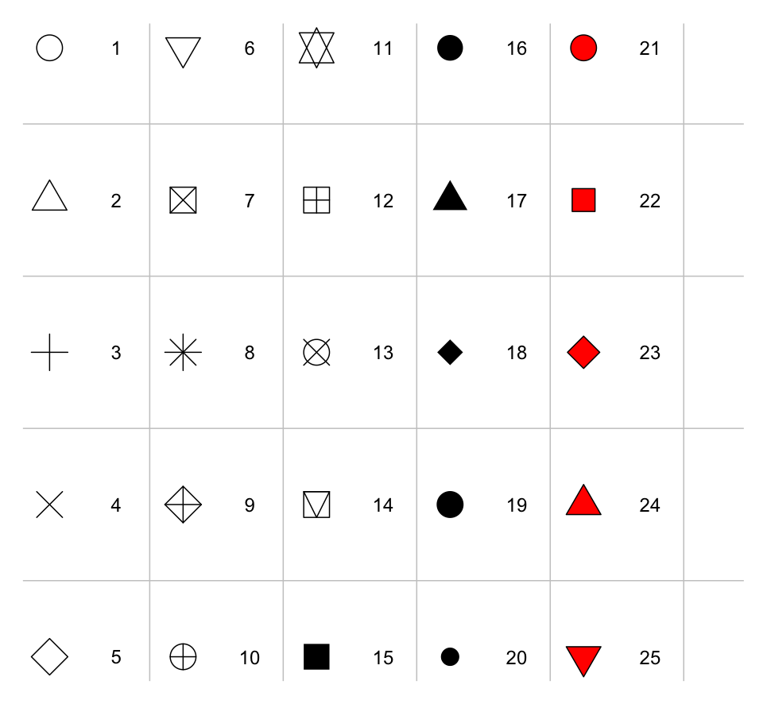
PCH SYMBOLS CHART

Slide 27
R Colors
Thus far, we have frequently used numbers in plot to refer to a simple set of colors.
There are 8 colors where 0:8 are white, black, red, green, blue, cyan, magenta, yellow and grey.
If you provide a number greater than 8, the colors are recycled.
Therefore for plots where other or greater numbers of colors are required, we need to access a larger palette of colors.

Slide 28
Contd..
plot(1:12, col=1:12, main="Default 9 Colors", ylab="",xlab="", pch=19, cex=3)
text(1:12, c(1:12)+.75, c(1:8, 1:4))
R has a large list of over 650 colors that R knows about. This list is held in the vector colors(). Have a look at this list, and maybe search for a set you are interested in.
colors()[1:10]
length(colors())

