Slide 1
Smart Elderly Home Monitoring: An Integrated Analysis of Gas, Temperature, and Position Sensors for Anomaly Detection and Safety Enhancement
Sushil JANGID

Slide 2
Introduction
Integration of advanced sensor technologies in contemporary healthcare landscape
Focus on Smart Elderly Home Monitoring for enhanced safety and well-being of elderly residents
Comprehensive system combining gas, temperature, and position sensors
Objective: Secure and conducive living environment for seniors
Four anomaly prediction models employed: Autoencoder, Isolation Forest, Local Outliers Factor (LOF), One-Class Support Vector Machine (SVM)
Autoencoder demonstrates unparalleled accuracy with a perfect score of 1.00
Promising solution for detecting subtle irregularities within the monitoring system
Contribution to the evolving field of smart home monitoring
Nuanced exploration of anomaly detection methodologies with significant potential for elderly well-being

Slide 3
Motivation
Research motivated by the urgent need to confront evolving challenges faced by the aging population, with a focus on Smart Elderly Home Monitoring.
Demographic shifts reveal a significant increase in the elderly population, accompanied by a rise in age-related health issues, including cognitive impairments.
The imperative for innovative solutions to ensure the well-being and safety of elderly individuals, particularly those opting to age in place.
Integration of gas, temperature, and position sensors, combined with advanced anomaly detection models: Autoencoder, Local Outliers Factor, Isolation Forest, (LOF), One-Class Support Vector Machine (SVM).
Potential to revolutionize the monitoring and care of elderly residents, offering a proactive approach to their safety and health.

Slide 4
Research Question
"How does the integration of gas, temperature, and position sensors, utilizing Autoencoder, Isolation Forest, Local Outliers Factor (LOF), and One-Class Support Vector Machine (SVM) models, contribute to effective anomaly detection and safety enhancement in the context of Smart Elderly Home Monitoring?"

Slide 5
Objectives
Evaluate Model Performance:
Assess the individual effectiveness of Autoencoder, Isolation Forest, LOF, and One-Class SVM models in anomaly detection within smart elderly home environments.
Employ quantitative metrics including precision, recall, and F1 score for comprehensive evaluation.
Explore Sensor Integration Impact:
Investigate the collective influence of integrating gas, temperature, and position sensors on the overall anomaly detection system.
Gain insights into the system's performance enhancement potential.
Enhance Safety Measures:
Examine how timely anomaly detection contributes to safety enhancement measures within Smart Elderly Home Monitoring systems.
Explore preventive measures and intervention strategies for improved safety outcomes.
Assess Practical Feasibility:
Evaluate the practical feasibility of implementing the proposed anomaly detection models in real-world smart elderly home environments.
Consider adaptability and scalability to varying conditions for robust implementation.
Offer Practical Recommendations:
Conclude the research by providing practical recommendations for the implementation of anomaly detection systems.
Contribute valuable insights to the field of Smart Elderly Home Monitoring, advancing the well-being and safety of the aging population.

Slide 6
Literature Review
Study | Focus | Methodology | Key Findings
Erhan et al. (2021) | Sensor-based Anomaly Detection | Multi-perspective evaluation | Integration of information enhances anomaly detection.
Mansour et al. (2021) | Video Surveillance | IVADC-FDRL model | IVADC-FDRL achieves high accuracy in video anomaly detection.
Mokhtari et al. (2021) | Industrial Control Systems | Measurement Intrusion Detection System (MIDS) | MIDS effectively detects abnormal activity in ICS.
Ni et al. (2020) | Structural Health Monitoring | Deep Learning | Deep learning enables data compression and reconstruction for SHM.
Nassif et al. (2021) | Machine Learning Models | Systematic Literature Review | Unsupervised anomaly detection shows promise in ML models.
Al-amri et al. (2021) | Internet of Things (IoT) | Contemporary Approaches | Comprehensive overview of IoT anomaly detection methods.

Slide 7
Literature Review
Study Title and Year | Focus | Methodology | Key Findings
Haghi et al. (2022) | Healthcare Systems | Bus-based Scalable Intelligent System | Smart homes enable health monitoring and disease prevention.
Wang et al. (2021) | In-home Health Monitoring | Literature Analysis | Analysis of sensor technology applications for in-home health monitoring.
Fahim and Sillitti (2019) | Anomaly Detection in Industries | Literature Review | Review of anomaly detection methods in various industries.
Morita et al. (2023) | IoT for Behavioral Monitoring | Scoping Review | IoT-based smart homes offer opportunities for continuous monitoring.
DeFranco and Kassab (2021) | Smart Home Research | Literature Review | Review of smart home research and creation of a taxonomy.
Taiwo et al. (2022) | Home Automation | Machine Learning | Deep learning improves motion detection in home automation.

Slide 8
Literature Review
Study Title and Year | Focus | Methodology | Key Findings
Tukur et al. (2021) | Internet of Things (IoT) | Edge-based Blockchain | Edge computing with blockchain enhances IoT data processing.
Del-Valle-Soto et al. (2023) | Wireless Sensor Networks | Continuous Monitoring | Low-cost WSN improves sleep parameters in geriatric patients.
Taiwo and Ezugwu (2021) | Cloud-based Home Automation | Android Mobile App | Machine learning distinguishes between residents and intruders.
Maswadi et al. (2020) | Smart Home Monitoring | Systematic Literature Review | Review of adoption of smart home monitoring technologies.
Ali et al. (2019) | Continuous Patient Monitoring | Wearable and Contextual Sensors | Effective monitoring of physiological parameters in smart homes.
Sokullu et al. (2020) | Smart Home IoT System | Continuous Data Gathering | IoT system ensures safety and early warnings for seniors.

Slide 9
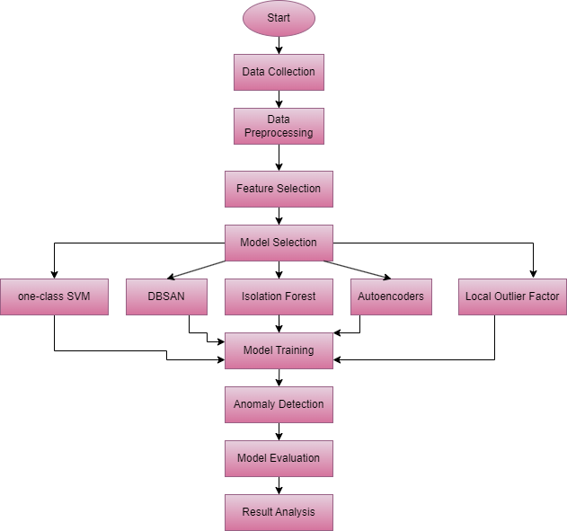
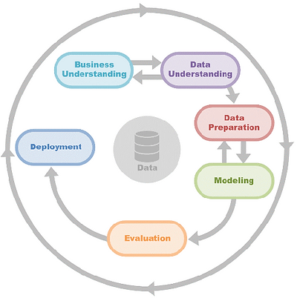
Methodology

Slide 10
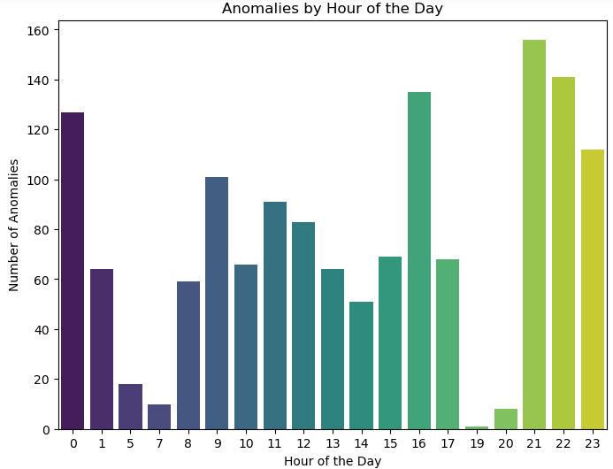
Methodology
Data Collection
Home monitoring dataset
UCI Repository
2019-11-06 to 2020-02-13
Database_gas.csv – 10 columns
Database_pos.csv - 28478 rows and 16 columns
Data Preparation
Merging
Fill nulls
Standardisation

Slide 11
Methodology
Modelling
80:20 split
DBScan
Autoencoder
Isolation Forest
Local Outlier Factor
One-class SVM

Slide 12
Results - Accuracy
Model | Accuracy
Autoencoder | 1.00
Isolation Forest | 1.00
Local Outliers Factor | 0.90
One –class SVM | 0.03

Slide 13
Results – Precision, Recall, F1-score
Algorithms | Precision | Recall | F1 score
Autoencoder | 1 | 1 | 1
Isolation Forest | 1 | 1 | 1
Local Outlier Factor | 0.95 | 0.95 | 0.95
One-class SVM | 0.17 | 0.17 | 0.18

Slide 14
Results
DBScan
Silhouette Score: Measures the clarity of clusters, ranging from -1 to 1.
A high score (e.g., 0.445) indicates well-defined and separated clusters.
Calinski-Harabasz Index: Assesses clustering quality by comparing variance within and across clusters.
A higher value (e.g., 163.09) signifies distinct and efficient clustering.

Slide 15
Discussion
Autoencoder:
Achieved flawless scores (1.00) across accuracy, precision, recall, and F1 score.
Exceptional in identifying anomalies with a balanced trade-off between false positives and false negatives.
Local Outlier Factor (LOF):
Demonstrated high accuracy (0.90) and strong precision, recall, and F1 score (0.95).
Effective in outlier detection while maintaining a balanced prediction profile.
One-Class SVM:
Lower accuracy (0.03) with moderate precision, recall, and F1 score (0.17 and 0.18).
Challenges in accurate positive predictions, leading to increased erroneous negative and false positive rates.
DBSCAN Clustering:
Silhouette Score of 0.445 and Calinski-Harabasz Index of 163.09.
Signifies meaningful cluster creation and ability to identify well-defined clusters within the data.
Isolation Forest:
Attained perfect scores (1.00) in accuracy, precision, recall, and F1 score metrics.
Demonstrated outstanding proficiency in identifying anomalies while maintaining a well-balanced trade-off between false positives and false negatives.

Slide 16
Conclusion
Model Selection Considerations:
Choose models based on specific use cases and desired balance between recall and precision.
Autoencoder , Isolation Forest and LOF for precise anomaly identification.
DBSCAN for meaningful cluster creation and data exploration.
Informed Decision-Making:
Understand individual model strengths and limitations.
Empower practitioners to make informed decisions for anomaly detection tasks.
Expect ongoing research and model enhancements in the evolving field of anomaly detection.

Slide 17
Limitations
One-Class SVM Limitation:
Notably low accuracy (0.03) observed in the smart elderly home monitoring system analysis.
Attributed to the absence of model tuning during experimentation.
Future Improvement Focus:
Emphasis on model tuning techniques to enhance One-Class SVM performance.
Potential steps include hyperparameter optimization, algorithm-specific parameter fine-tuning, and exploring advanced optimization methods.
Importance of Addressing Limitations:
Acknowledgment of limitations is crucial for research transparency and improvement.
Proactive approach towards enhancement underscores commitment to refining the model.
Expected Outcomes:
Future iterations may yield significant accuracy improvements for One-Class SVM.
Strengthening its contribution to gas, temperature, and position sensors' integrated analysis for anomaly detection in smart elderly home monitoring.

Slide 18
Future Scope
Model Interpretability and Transparency:
Integration with explainable AI approaches to enhance model transparency.
Improved understanding of the decisions made by anomaly detection models.
Scalability and Adaptation to Changing Data Patterns:
The future of anomaly detection hinges on scalability and adaptability.
Models must evolve to accommodate shifting data patterns and environments.
Real-Time Data Handling:
Emphasis on creating streaming and dynamic anomaly detection algorithms.
Ability to process data in real-time for timely insights and responses.
Utilization of Deep Learning and Unsupervised Techniques:
Application of deep learning architectures and innovative unsupervised learning methods.
Capable of handling complex, high-dimensional datasets for improved accuracy.

