Slide 1
Uber Case Study

Slide 2
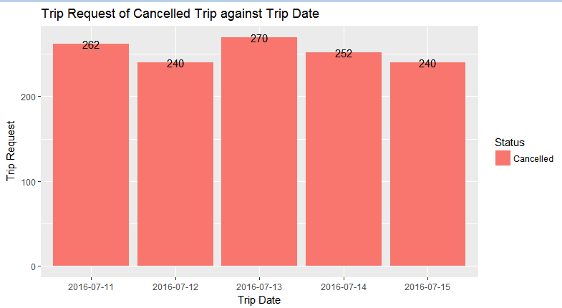
Visually Identify most Pressing Problems for Uber Trip Cancellation
Frequency of requests that get cancelled against different date. This slide contains trip cancellations data. Trip cancellation data has segmented in different date. It is high level segmented on cancellation trip. Looking into Date wise segmented, it observed that, we had most cancellations on date “13/07/2017”. So now we need to perform more granular level segmented analysis on “13/07/2017” data.
Notes:
This slide contains trip cancellations data. Trip cancellation data has segmented in different date. It is high level segmented on cancellation trip. Looking into Date wise segmented, it observed that, we had most cancellations on date “13/07/2017”. So now we need to perform more granular level segmented analysis on “13/07/2017” data.

Slide 3
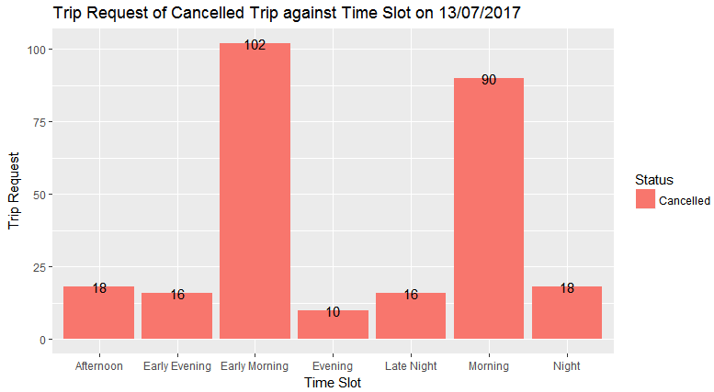
Visually Identify most Pressing Problems for Uber Trip Cancellation
Frequency of requests that get cancelled against different time slots on particular date(13/07/2017). Now collected cancelled trip data of date 13/07/2017{where it has more cancellations) and performed more granular level of analysis at different time slots like evening, morning, night etc . Looking into data, Early morning and morning time slots had more cancellations so this data will be filtered out and available for next analysis.
Notes:
Now collected trip cancellation data of date 13/07/2017{where it has more cancellations) and performed more granular level of analysis at different time slots like evening, morning, night etc on particular date. Looking into data, Early morning and morning time slots had more cancellations so this data will be filtered out and available for next analysis.

Slide 4
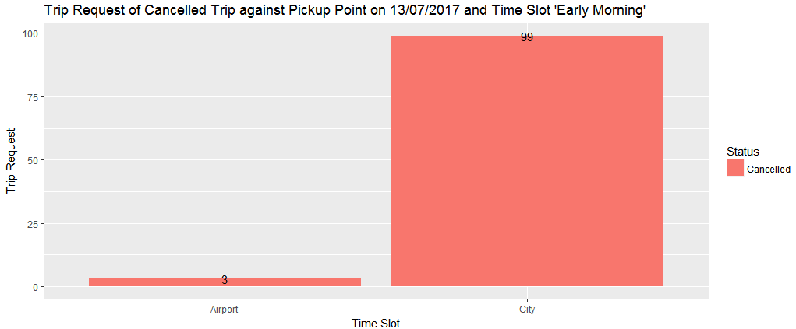
Visually Identify most Pressing Problems for Uber Trip Cancellation
Frequency of requests that get cancelled against different Pick Points on particular date(13/07/2017) and on particular time slot(‘Early Morning’). Now applied one more level of filter on data(Early morning) and performed more detail level of analysis. There are 2 way of rides on provided data, Airport to City and City and Airport. For defining problem in more detail level, it requires to add one more dimension attribute(Pickup point) in this analysis. After adding this attribute, it appears that, Major Trip cancellation problem on trips which starts from City to Airport at timeslot “Early Morning”(5 to 8 am).
This Analysis take away is.. Trip Cancellation problem is on trip which starts from City to Airport at Early morning and Morning.
Notes:
Now applied one more level of filter on data(Early morning) and performed more detail level of analysis. There are 2 way of rides on provided data, Airport to City and City and Airport. For defining problem in more detail level, it requires to add one more dimension attribute(Pickup point) in this analysis. After adding this attribute, it appears that, Major Trip cancellation problem on all trips which starts from City to Airport at timeslot “Early Morning”(5 to 8 am).
This Analysis take away is.. Trip Cancellation problem is on all trip which starts from City to Airport at Early morning and Morning.

Slide 5
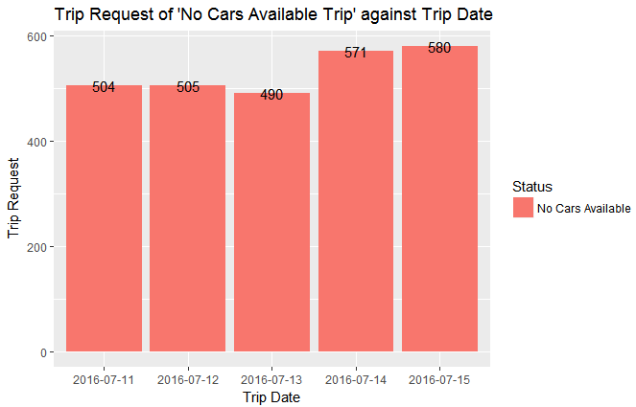
Visually Identify most Pressing Problems for Uber No Cars Available
Frequency of request where “No Cars Available” against different date. This slide contains trip “No Cars Available” data. This data has segmented in different date. It is high level segmented on “No Cars Available” trip. Looking into Date wise segmentation, it observed that, It had most “No Cars Available” on dated “15/07/2017”. So now we need to perform more granular level segmented analysis on “15/07/2017”.
Notes:
This slide contains trip “No Cars Available” data. This data has segmented in different date. It is high level segmented on “No Cars Available” trip. Looking into Date wise segmented, it observed that, It had most “No Cars Available” on dated “15/07/2017”. So now we need to perform more granular level segmented analysis on “15/07/2017”.

Slide 6
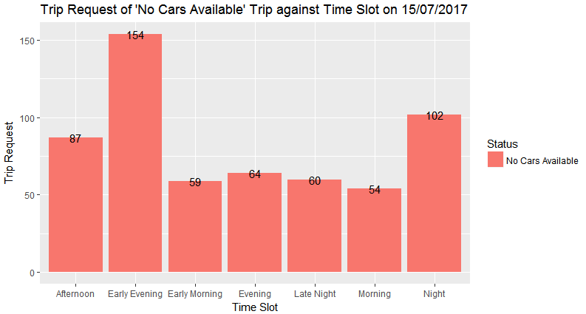
Visually Identify most Pressing Problems for Uber No Cars Available
Frequency of request where ‘No Cars Available’ against different time slots on particular date(15/07/2017). Now collected ‘No Cars Available’ data of dated 15/07/2017{where it has more ‘No Cars Available’ trips) and performed more granular level of analysis at different time slots like evening, morning, night etc on particular date. Looking into data, Early Evening and Night time slots had more ‘No Cars Available’ trip so this data will be filtered out and available for next analysis.
Notes:
Now collected ‘No Cars Available’ data of dated 15/07/2017{where it has more ‘No Cars Available’ trips) and performed more granular level of analysis at different time slots like evening, morning, night etc on particular date. Looking into data, Early Evening and Night time slots had more ‘No Cars Available’ trip so this data will be filtered out and available for next analysis.

Slide 7
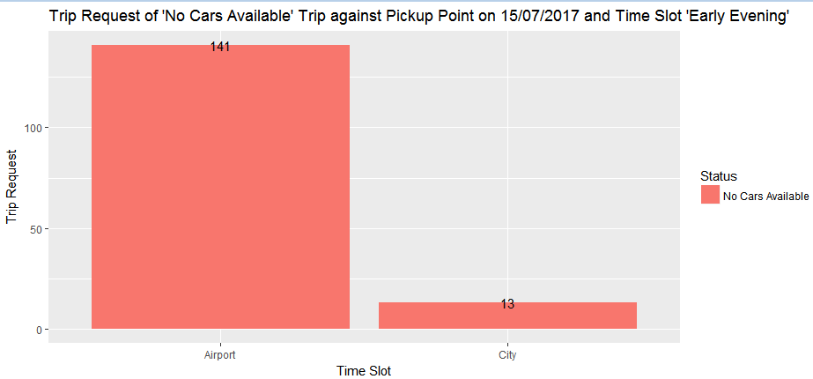
Visually Identify most Pressing Problems for Uber No Cars Available
Frequency of request where ‘No Cars Available’ trip against different Pick Points on particular date(15/07/2017) and on particular time slot(‘Early Evening’). Now applied one more level of filter on data(Early Evening) and performed more detail level of analysis. There are 2 way of rides on provided data, Airport to City and City and Airport. For defining problem in more detail level, it requires to add one more dimension attribute(Pickup point) in this analysis. After adding this attribute, it appears that, Major ‘No Cars Available’ trip problem on all trips which starts from Airport to City at timeslot “Early Evening”(17 to 20 pm).
This Analysis take away is.. Trip ‘No Cars Available’ problem is on trip which starts from City to Airport at Early Evening and Evening.
Notes:
Now applied one more level of filter on data(Early Evening) and performed more detail level of analysis. There are 2 way of rides on provided data, Airport to City and City and Airport. For defining problem in more detail level, it requires to add one more dimension attribute(Pickup point) in this analysis. After adding this attribute, it appears that, Major ‘No Cars Available’ trip problem on all trips which starts from Airport to City at timeslot “Early Evening”(17 to 20 pm). This Analysis take away is.. Trip ‘No Cars Available’ problem is on all trip which starts from City to Airport at Early Evening and Evening.

Slide 8
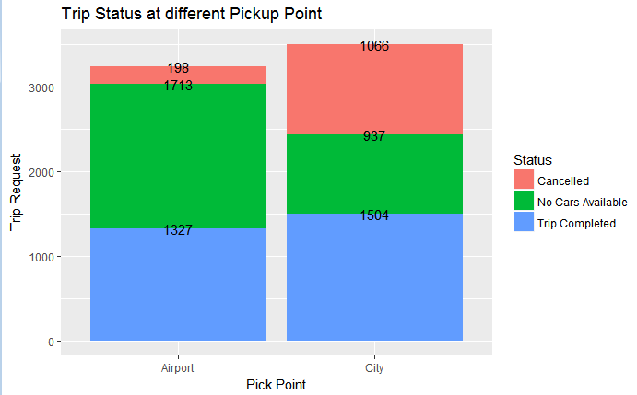
Visually Identify most Pressing Problems for Uber
This is another cross verification check analysis on “No Cars Available” and Cancelled trips against PickUp points. This slide shows that, Most of the trip Cancelled from City to Airport and Most of the Trip ‘No Cars Available’ found on Airport to City.
Notes:
This slide shows that, Most of the trip Cancelled from City to Airport and Most of the Trip ‘No Cars Available’ found on Airport to City

Slide 9
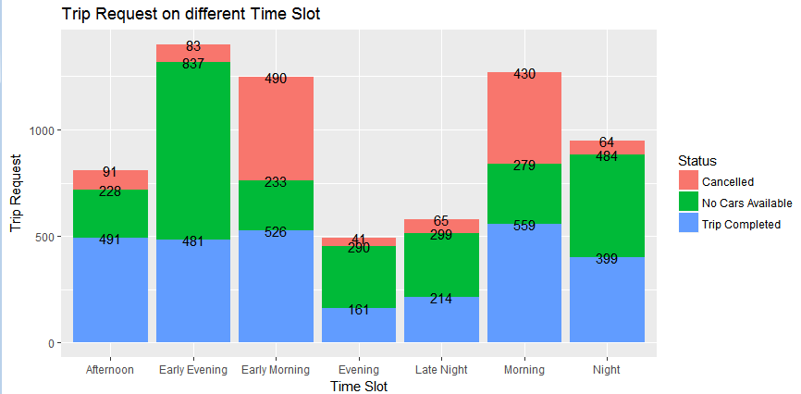
Visually Identify most Pressing Problems for Uber
This is another cross verification check analysis on “No Cars Available” and Cancelled trips against different time slots. This slide shows that, Most of the trip Cancelled at Early Morning and Morning time and Most of the Trip ‘No Cars Available’ found at Early Evening and Night.
Notes:
This slide shows that, Most of the trip Cancelled at Early Morning and Morning time and Most of the Trip ‘No Cars Available’ found at Early Evening and Night.

Slide 10
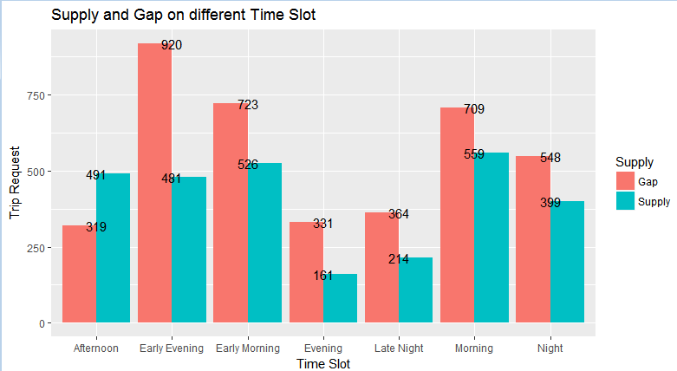
Demand Gap and Supply Analysis for Uber
Problem :- Find the time slots when the highest gap exists.
Solution :- This plot shows Comparison on Gap and Supply on different time slot. Gap is the trip request which was demanded but could not supplied like Trips which were cancelled or ‘no cars available’). Here is the definition of Demand, Gap and Supply.
Demand=Total Trip Requests(Trip Completed + Cancelled + ‘No Cars Available’)
Supply=Trip Completed(All demands which supplied means trip requests which were completed)
Gap=Demand-Supply(Total Trip Request-Trip Completed). Looking into plot, It confirms that, There were many gaps at Early Evening, Early morning and Morning slot so Uber Administration have to look these slots.
Notes:
Here is the definition of Demand, Gap and Supply.
Demand=Total Trip Requests(Trip Completed + Cancelled + ‘No Cars Available’)
Supply=Trip Completed(All demands which supplied means trip requests which were completed)
Gap=Demand-Supply(Total Trip Request-Trip Completed). Looking into plot, It confirms that, There were many gaps at Early Evening, Early morning and Morning slot so Uber Administration have to look these slots.

Slide 11
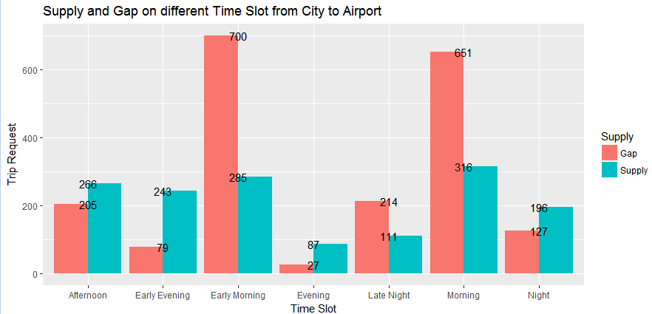
Demand Gap and Supply Analysis for Uber
Problem :- Find the types of requests (City-Airport) for which the gap is the most severe in the identified time slots
Solution :- This plot shows Comparison on Gap and Supply on different time slot at Pickup Point City. Gap is the trip requests which were demanded but could not supplied like Trips which were cancelled or ‘no cars available’).
It appears that data at Pickup point “City”, Most Demand Gap is at Early Morning and Morning. Demand Gap is the trip which was requested but could not supply because it was cancelled or ‘no cars available’.
Notes:
It appears that data at Pickup point “City”, Most Demand Gap is at Early Morning and Morning. Demand Gap is the trip request which was requested but could not supply because it was cancelled or ‘no cars available’.

Slide 12
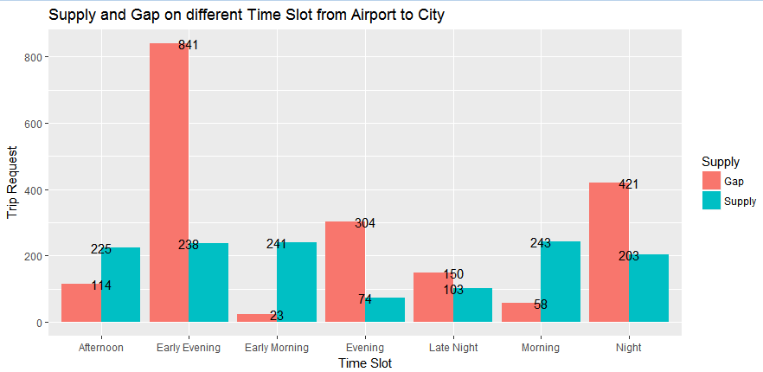
Demand Gap and Supply Analysis for Uber
Problem :- Find the types of requests (Airport-City) for which the gap is the most severe in the identified time slots
Solution :- This plot shows Comparison on Gap and Supply on different time slot at Pickup Point Airport. Gap is the trip requests which were demanded but could not supplied like Trips which were cancelled or ‘no cars available’). It appears that data at Pickup point “Airport”, Most Demand Gap is at Early Evening and Night. Demand Gap is the trip which was requested but could not supply because it was cancelled or ‘no cars available’.
Notes:
It appears that data at Pickup point “Airport”, Most Demand Gap is at Early Evening and Night. Demand Gap is the trip request which was requested but could not supply because it was cancelled or ‘no cars available’.

Slide 13
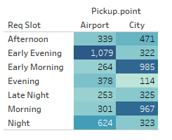
Gap and Supply Conclusion
What do you think is the reason for this issue for the supply-demand gap?
Lets identify different possible reasons by pickup point
City to Airport:-
1. High Demand :- From City to Airport, there is high demand of cabs because most of the flights fly at morning time and people would be interested to reach destination at time and get whole day at destination for their work.
2. Less Supply :- There would be limited cabs availability at morning because Cabs would be busy on other office morning pickup. .(General office time is 8-5 where most cab would be allocated on office’s pick up).
3. No return trip from Airport at morning :- Driver would be thinking, if he goes on Airport drop, he will not get return trip from Airport{looking into data, it doesn’t have much traffic from Airport to City at morning time.}

Slide 14
Gap and Supply Conclusion
What do you think is the reason for this issue for the supply-demand gap?
Lets identify different possible reasons by pick point
Airport to City:-
1. High Demand :- From Airport to City, there is high demand of cabs because most of the flights land at Early evening and Night .Most of the people would be returning at their home after completing their work.
2. Less Supply :- There would be limited cabs availability at Evening because Cab would be busy on other office evening drop.(General office time is 8-5 where more can would be allocated on office’s drop.)
3. Return trip from City:- If driver gets drop from Airport, he would not be getting return trip from city to airport so once he is in city, he would not be interested to go Airport for another drop.{looking into data, it doesn’t have much traffic from City to Airport at evening time.}

Slide 15
Recommendation for Uber Cab
Recommend some ways to resolve the supply-demand gap?
1. Uber should create a pool of cabs which should be allocated on particular route on particular time, so maximum cabs should be available on that route like
A) One pool at Airport area between 17 to 22 and these should be dedicated only
from Airport to City.
B) One pool at City area between 5 to 9 and these should be dedicated only for
City to Airport.
It can not be failed because demand is totally linked with flights which fly from city and land on City.
2. Pool should be created dynamically on daily basis and select only cabs which are available near to that area so it should take time to pick/drop to the customer.
3.Since it is very crucial trip(City to Airport) because flight will not wait for cab so cab should be reached on time at Airport so put the cabs on pool which have good customer ‘s feedback , driver is punctual etc.
4.Uber can put extra charges on customer to take this facility. Customer who are travelling on flight would be ok to give these extra charges for this type of trips.
5. There should be bonus, gift or extra pay to driver who work on pool concept so it will be motivation factor for Uber cab drivers.

