Slide 1
Topics Covered
ALZ From Networks and Security Perspective
Deployment of subset of ALZ
  Terraform code explanation.
  Network connectivity with on-prem data centers.
Security policy demo-
Benefits with Terraform Deployment

Slide 2



E2E Landing Zone Provisioning
E2E Provisioning
DCC Architecture
Network
Provisioning
Security Provisioning
VM
Provisioning
Landing Zone connectivity
Terraform
Auto Policy push
Azure DevOps
Landing Zone Compute
Prov at scale
Cloud NW
Policy
Compute

Slide 3
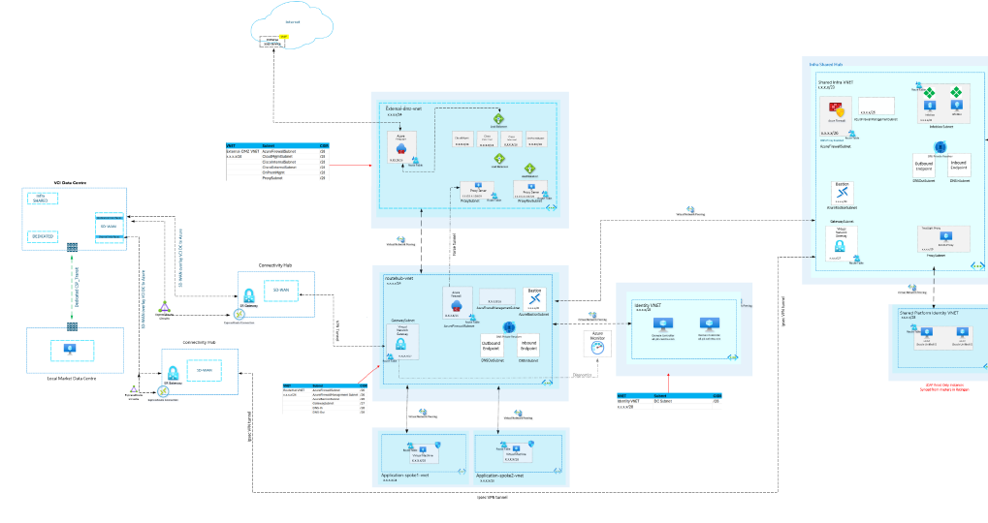
Existing DCC ALZ- Network Prospective

Slide 4



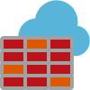
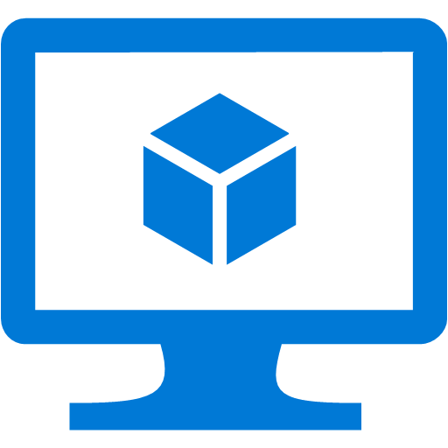
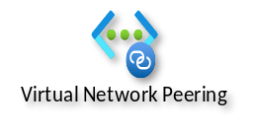
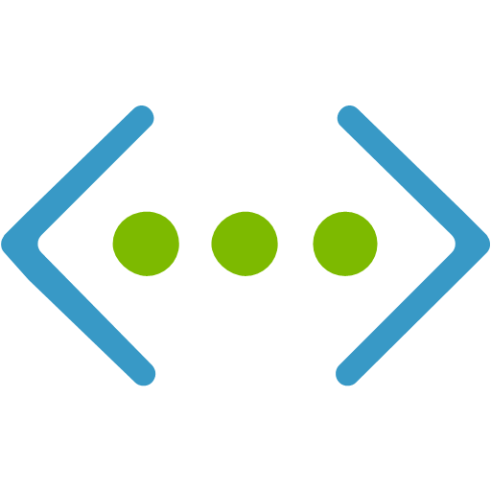
Azure  Terraform Demo | North-South & East-West Connectivity | As-is
UK South Azure Region
Dublin Azure Region
Routable Hub
INTERNET
VCI SWINDON
Connectivity Hub
Virtual Network Gateway
IPSEC + BGP
Azure FW Subnet
i
SDWAN EDGES
AS VPN GW
Gateway Subnet
Virtual Network Gateway
Virtual Machine
Azure Firewall
10.7.0.0/24
IPSEC + BGP
Route Table
10.5.0.0/16
ON-PREM DC SITE
VNET 2
10.7.0.0/16
VNET 1 (Azure uk south )
10.9.0.0/24
10.10.0.0/24
Route Table
Route Table
Virtual Machine
Virtual Machine
Local Market- Spoke-1
Local Market- Spoke-2
VNET 3
VNET 4
4

Slide 5
Azure  Terraform Demo | North-South & East-West Connectivity | Spoke-3 Addition
UK South Azure Region
Dublin Azure Region
Routable Hub
INTERNET
VCI SWINDON
Connectivity Hub
Virtual Network Gateway
IPSEC + BGP
Azure FW Subnet
i
SDWAN EDGES
AS VPN GW
Gateway Subnet
Virtual Network Gateway
Virtual Machine
Azure Firewall
10.7.0.0/24
IPSEC + BGP
Route Table
10.5.0.0/16
ON-PREM DC SITE
VNET 2
10.7.0.0/16
VNET 1
10.9.0.0/24
10.10.0.0/24
10.11.0.0/24
Route Table
Route Table
Route Table
Virtual Machine
Virtual Machine
Virtual Machine
Local Market- Spoke-1
Local Market- Spoke-2
Local Market Spoke-3
VNET 3
VNET 4
VNET 5
5

Slide 6
Test Connectivity from DC VM
ping 10.11.0.4 - spoke3 VM
telnet 10.11.0.4 22
Ping 10.10.0.4 - spoke2 vm
telnet 10.10.0.4 22

