Slide 1
Problem Statement
.Currently incremental changes like Azure Firewall Rules, VNET Peerings and Spokes UDRs are being implemented outside of Terraform.
No centralized management of these networking attributes
In case of disaster- no databases of these attributes to be replicated in DR region.
.
Solution
. Henceforth Need to start automate UDRs and firewall rules via IaC Terraform.
Need to do Terraform Import of existing firewall rules/policies and UDRs
Need Develop DR pipelines

Slide 2
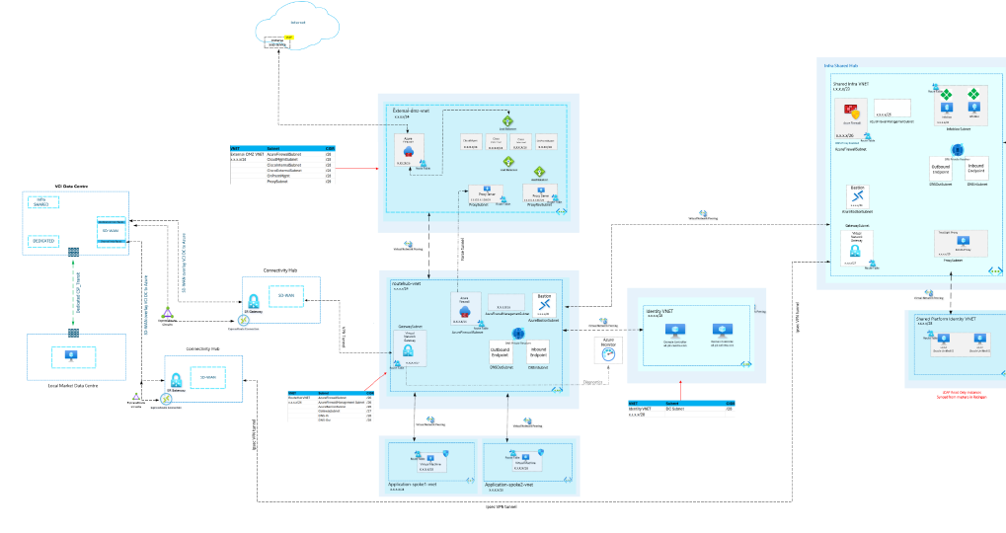
Existing DCC ALZ- Network Prospective

Slide 3

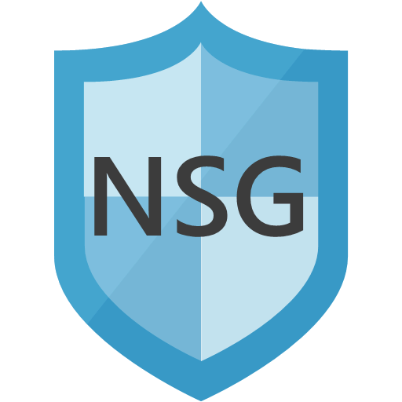

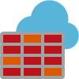
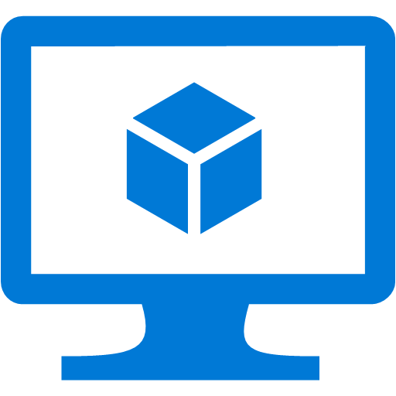
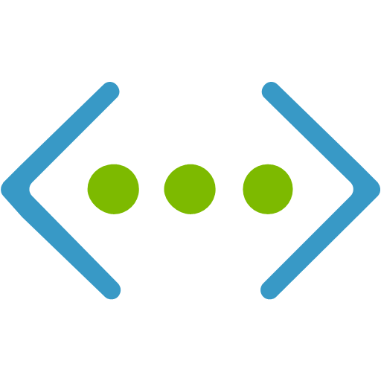
Azure  Terraform Demo | North-South & East-West Connectivity | As-is Day 0 Infra prepared using Terraform
Routable Hub
INTERNET
VCI SWINDON
Connectivity Hub
Virtual Network Gateway
Azure FW Subnet
i
SDWAN EDGES
AS VPN GW
Gateway Subnet
Virtual Network Gateway
Virtual Machine
Azure Firewall
10.7.0.0/24
Route Table
10.5.0.0/16
ON-PREM SITE
10.7.0.0/16
10.9.0.0/24
10.10.0.0/24
Route Table
Route Table
Virtual Machine
Virtual Machine
Local Market- Spoke-1
Local Market- Spoke-2
Dublin Azure Region
3

Slide 4
Azure  Terraform Demo | North-South & East-West Connectivity | Adding 3rd spoke
Connectivity Hub
Routable Hub
Virtual Network Gateway
SDWAN connectivity has been mimicked by using VNG & creating BGP-IPSec tunnel
Azure FW Subnet
i
Gateway Subnet
Virtual Network Gateway
10.5.0.0/16 – cidr subnet
10.5.1.0/24 -- gateway subnet
Virtual Machine
Azure Firewall
SDWAN connectivity has been mimicked by using VNG & creating BGP-IPSec tunnel
Route Table
10.7.0.0/16 – cidr subnet
10.7.1.0/24 -- gateway subnet
10.7.0.0/24 – vm subnet
10.9.0.0/24
10.10.0.0/24
10.11.0.0/24
Route Table
Route Table
Route Table
Virtual Machine
Virtual Machine
Virtual Machine
Test-env-spoke1-vnet
Test-env-spoke2-vnet
Test-env-spoke3-vnet

Slide 5
Test Connectivity from DC VM
ping 10.11.0.4 - spoke3 VM
telnet 10.11.0.4 22
Ping 10.10.0.4 - spoke2 vm
telnet 10.10.0.4 22

