Slide 1


Airglide
Try it
Present hands-free
Show thumb + pinky to go to the next slide
Control your slides, a laser pointer and your mouse with simple hand gestures, using only your webcam.
Notes:
Welcome. This is Airglide, a desktop app that lets you present hands-free. Everything you'll see in this demo is controlled by hand gestures in front of a normal webcam. Watch: thumb and pinky out moves to the next slide.

Slide 2



Presenting ties you down
Stuck behind the laptop
Clickers let you down
Pointing is awkward
Every slide change pulls you back to the keyboard and away from your audience.
They get forgotten, run out of battery or won't pair with the room's computer.
A laser dot doesn't show on video calls, and drawing on a slide means reaching for the mouse.
Notes:
Most presenters are tied to a laptop or a clicker. You walk back to change slides, clickers get lost or die, and a laser dot is invisible to anyone watching remotely.

Slide 3
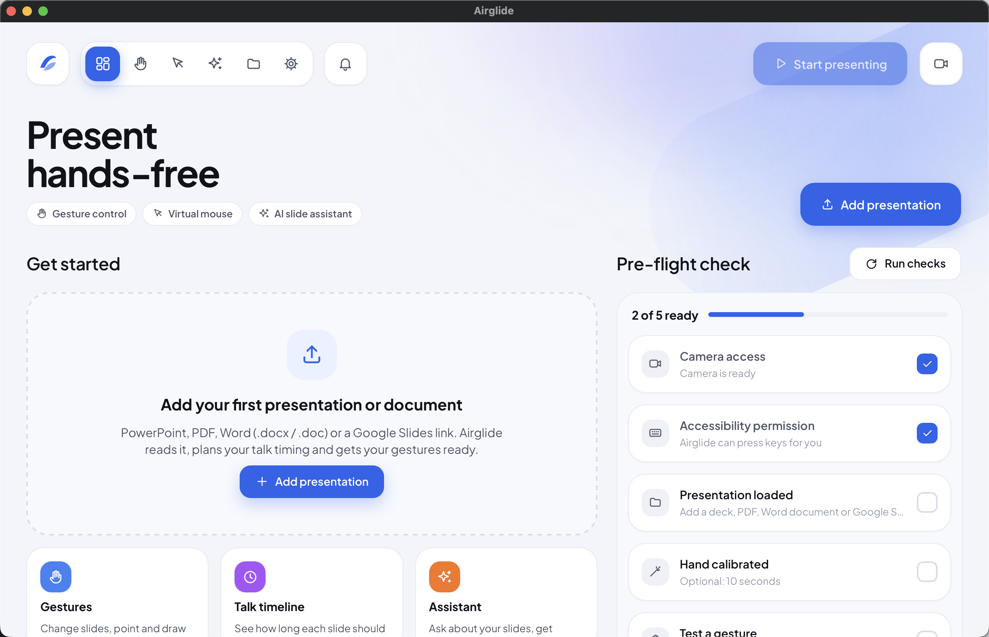


Your webcam is the remote
Airglide watches your hand through the webcam and turns simple gestures into slide changes, a laser pointer, a pen and a mouse.
Gesture control
Change slides, point and draw
Virtual mouse
Your hand moves the cursor
AI slide assistant
Answers questions about your deck
Notes:
Airglide is a small desktop app for Windows and macOS. It uses your webcam to follow your hand and turns gestures into the keys your presentation app understands. Here's the main window: add a deck, run the pre-flight check, and start presenting.

Slide 4





How it works
1 Your webcam sees your hand
2 Airglide reads the gesture
3 Your slides respond
Any built-in or USB webcam works. No gloves, sensors or extra hardware.
On-device hand tracking follows 21 points on your hand, many times a second.
Airglide presses the right key in PowerPoint, Keynote, Google Slides and more.
Hold a gesture briefly to fire it. Hold an L-shape to pause, so talking with your hands never changes slides.
Notes:
Three steps. The webcam sees your hand. Airglide's on-device hand tracking finds 21 points on it and recognises the gesture. Then it presses the right key in your presentation app. Gestures must be held for a moment, and an L-shape pauses everything, so natural hand movement while talking doesn't trigger anything.

Slide 5

Ten gestures, no clicker
Thumb + pinky
Fist
Four fingers
Pinky only
Open palm
Next slide
Previous slide
First slide
Last slide
Laser / pen / off
Three fingers
Index + pinky
L-shape, held
Index only
Index + middle
Black screen
Exit slideshow
Pause gestures
Volume up
Volume down
These are the defaults. Remap any gesture in Settings and calibrate Airglide to your hand in about 10 seconds.
Notes:
These are the default gestures. Thumb and pinky for next, a fist for previous, an open palm cycles the laser pointer and pen, three fingers blanks the screen, and an L-shape pauses. Every mapping can be changed, and a 10-second calibration tunes Airglide to your hand.

Slide 6






More than next and back
Laser and pen
Two-hand zoom
Open your palm to switch, point to aim, pinch to draw.
Point with both index fingers and move them apart or together.
Talk timeline
Jump to any slide
See how long each slide should take and whether you're on track.
Click a slide number to go straight there.
Corner quick panel
Global shortcuts
A small button over your slideshow opens the camera, controls and gesture list.
Start, pause or stop from the keyboard, even in the background.
Notes:
Beyond changing slides: a laser pointer and a pen you control with your finger, two-hand zoom, a talk timeline that tells you if you're running behind, jumping straight to any slide, and a small corner button that stays on top of a full-screen slideshow with the live camera and controls.

Slide 7




Your hand is the mouse
Index finger up
Move the cursor
Pinch index + middle
Click
Switch to the virtual mouse to click links, play videos or demo software without touching anything.
Three fingers up
Scroll by moving your hand up or down
Notes:
The virtual mouse turns your hand into a pointer. Raise your index finger to move the cursor, pinch index and middle together to click, and raise three fingers to scroll. It's handy for clicking a link or demoing software mid-talk.

Slide 8




An AI that knows your deck
Give me talking points for this slide
Runs on your computer
A small language model, added in one click (about 400 MB)
What might the audience ask?
No account, key or internet
Ask anything about your slides, even offline
Summarise the section on pricing
Optional Google Gemini
Switch engines in Settings if you prefer
Notes:
Airglide also has an AI assistant that has read your deck. Ask for talking points for the current slide, likely audience questions, or a summary. The model runs on your own computer, so there's no account, no API key and no internet needed. Google Gemini is optional.

Slide 9


Private and works anywhere
Private by design
Works with your tools
Video never leaves your computer
The AI assistant runs on-device
Offline mode blocks anything that uses the internet
PowerPoint, Keynote, Google Slides and LibreOffice Impress
PDF viewers and Word documents
Windows 10/11 and macOS
Notes:
Your camera feed never leaves your machine, and neither does the assistant. Offline mode switches off everything that uses the internet. Airglide works with PowerPoint, Keynote, Google Slides, LibreOffice Impress, PDFs and Word documents, on Windows and macOS.

Slide 10

Get Airglide
Download, allow the camera, add a deck and start presenting
For Windows and macOS
github.com/sushilydv-dev/Airglide/releases
Notes:
That's Airglide. Download it for Windows or macOS from the GitHub releases page, allow the camera, add your deck and start presenting hands-free. Thanks for watching.

