Slide 1
SSSP
Suyash Shekhar

Slide 2
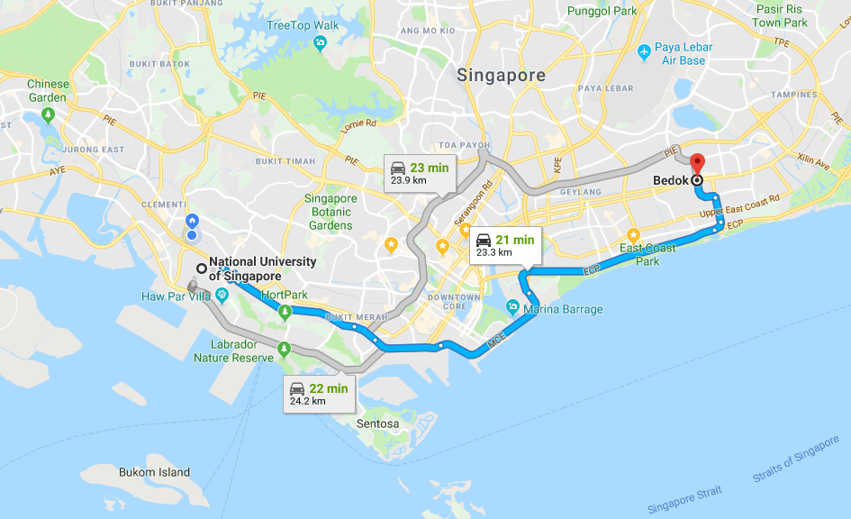
what is the shortest path from ☹ to ☺?

Slide 3
definitions

Slide 4
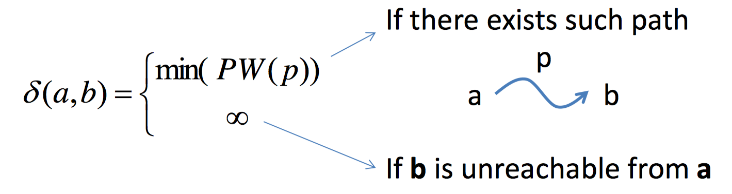
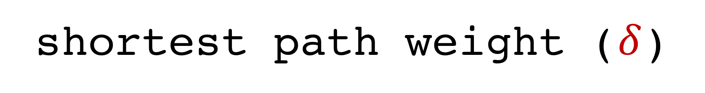
shortest path weight ($δ$)

Slide 5
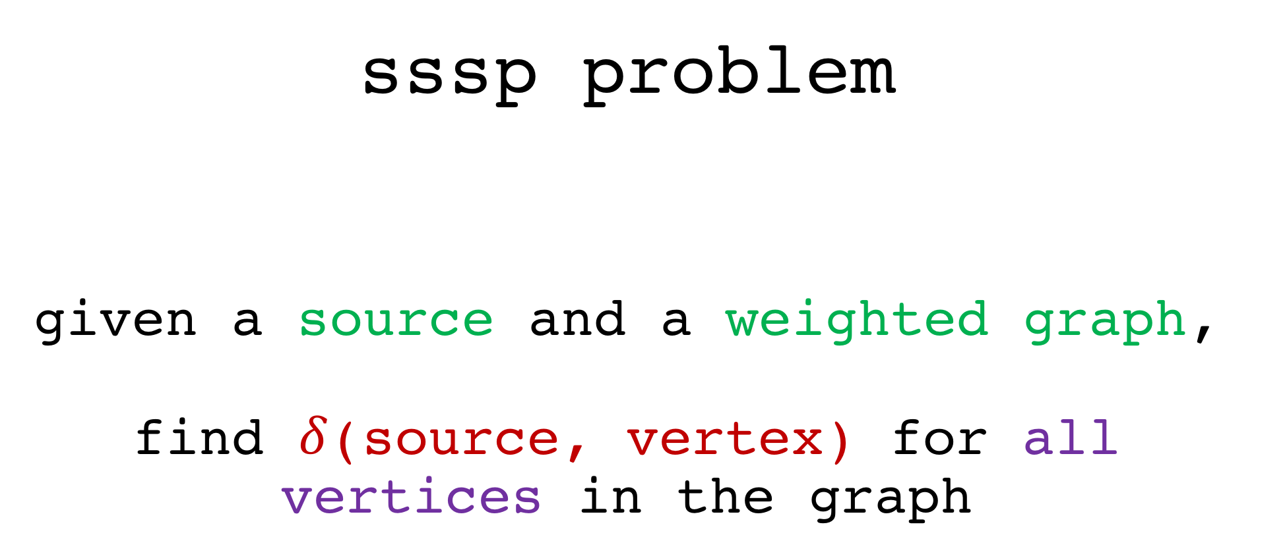
sssp problem given a source and a weighted graph, find $δ$(source, vertex) for all vertices in the graph

Slide 6
bfs O(V+E) bellman-ford’s O(VE) dijkstra’s O(ElogV)
possible solutions

Slide 7
if the graph is unweighted or every edge has the same weight
bfs

Slide 8
remember bfs computes the number of hops away from the source node
bfs

Slide 9
for all v in V visited[v] ← 0 p[v] ← -1 Q ← {s} visited[s] ← 1 while Q is not empty u ← Q.dequeue() for all v adjacent to u if visited[v] = 0 visited[v] ← true p[v] ← u Q.enqueue(v)
BFS

Slide 10
for all v in V D[v] ← INF p[v] ← -1 Q ← {s} D[s] ← 0 while Q is not empty u ← Q.dequeue() for all v adjacent to u if D[v] = INF D[v] ← D[u] + 1 p[v] ← u Q.enqueue(v)
BFS
(MODIFIED)

Slide 11
why does this work?

Slide 12
bellman-ford

Slide 13
relax

Slide 14


Slide 15
relax(u, v, w(u,v))
if D[v] > D[u] + w(u,v)
D[v] ← D[u] + w(u,v)

Slide 16
Bellman-Ford
for i = 1 to |V|-1
for each edge(u, v) in E
relax(u, v, w(u,v))

Slide 17
how many iterations does bellman-ford actually need? |V|-1?

Slide 18
bellman-ford helps to check for negative-weight cycles

Slide 19
on to the tutorial

Slide 20
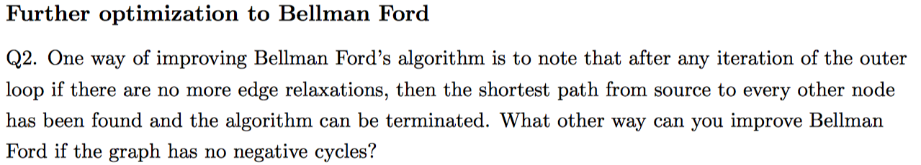

Slide 21
if a vertex v has not changed it’s shortest distance value since the last time its outgoing edges were relaxed,
then we do not have to relax it’s outgoing edges

Slide 22
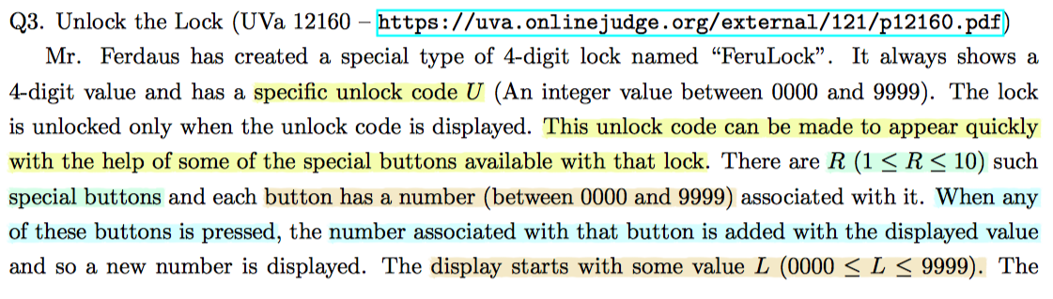
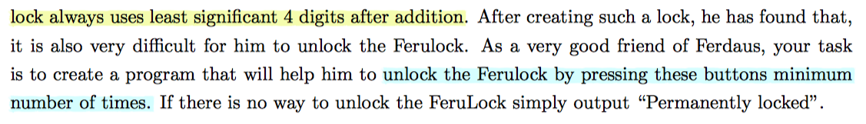

Slide 23
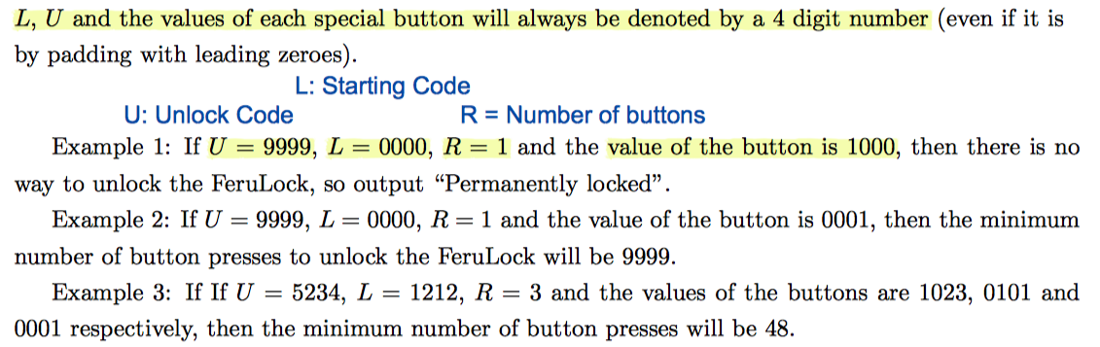

Slide 24
bfs on state space

Slide 25
state space

Slide 26
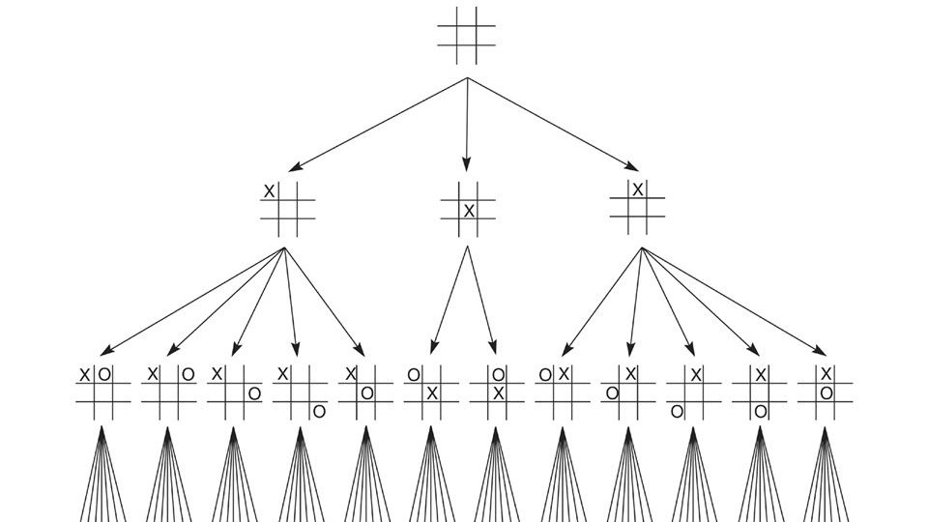

Slide 27
what a nice
short question :)

Slide 28
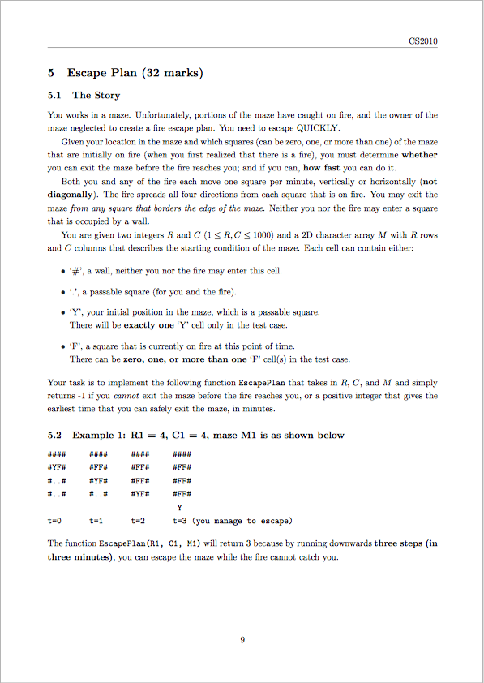
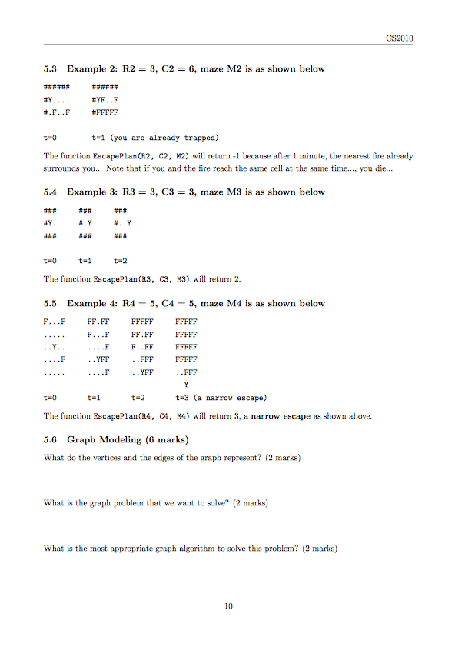
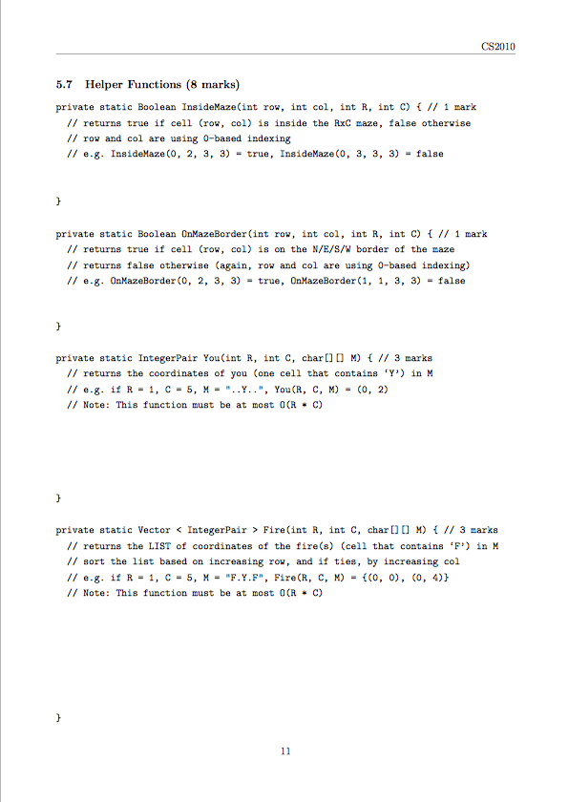

Slide 29
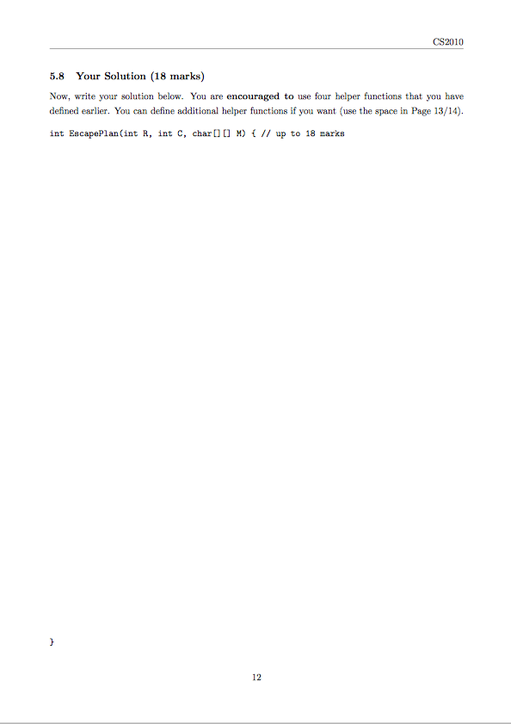
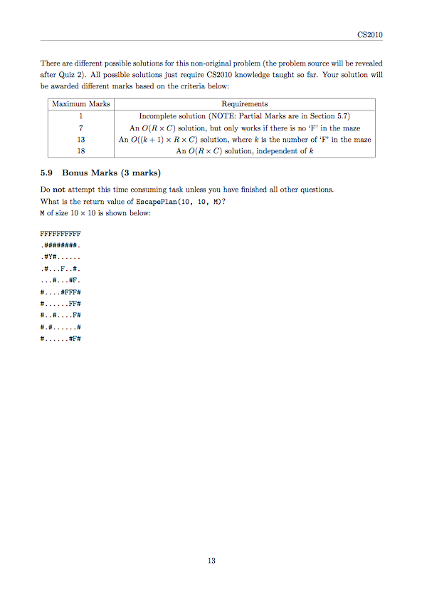

Slide 30
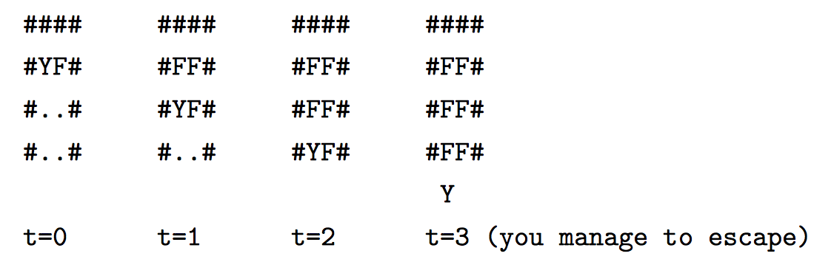

Slide 31
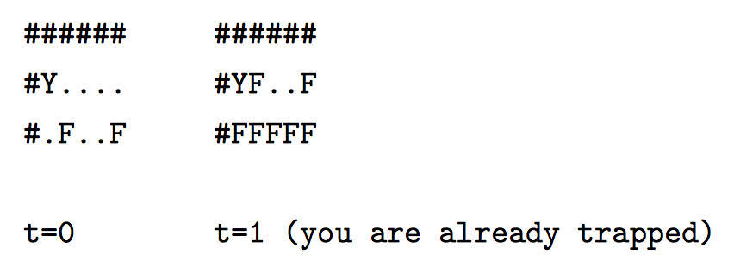

Slide 32
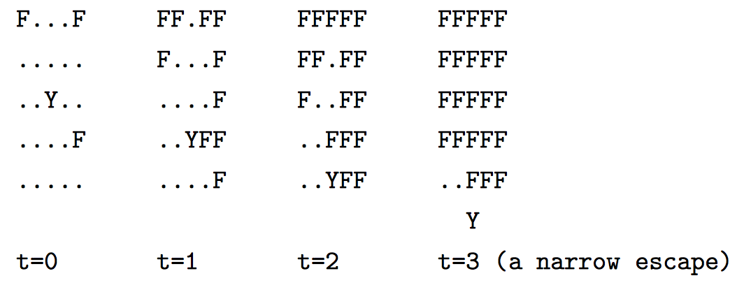

Slide 33
for all v in V visited[v] ← 0 p[v] ← -1 Q ← {s} visited[s] ← 1 while Q is not empty u ← Q.dequeue() for all v adjacent to u if visited[v] = 0 visited[v] ← true p[v] ← u Q.enqueue(v)
BFS

Slide 34
static Boolean InsideMaze(int row, int col)
static Boolean OnMazeBorder(int row, int col)
static IntegerPair You(int R, int C)
static Vector < IntegerPair > Fire(int R, int C)

Slide 35
another short question yay!

Slide 36
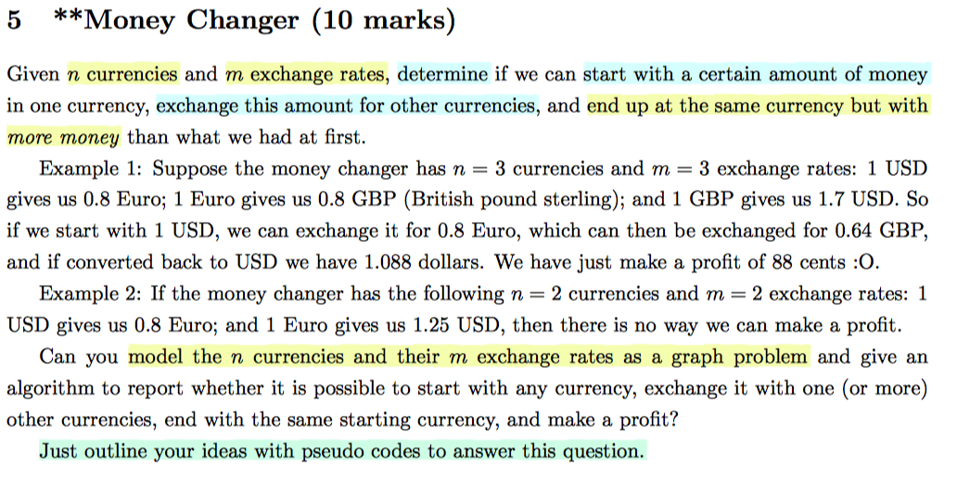

Slide 37
so we need to find a cycle whose edge weight product is > 1

Slide 38
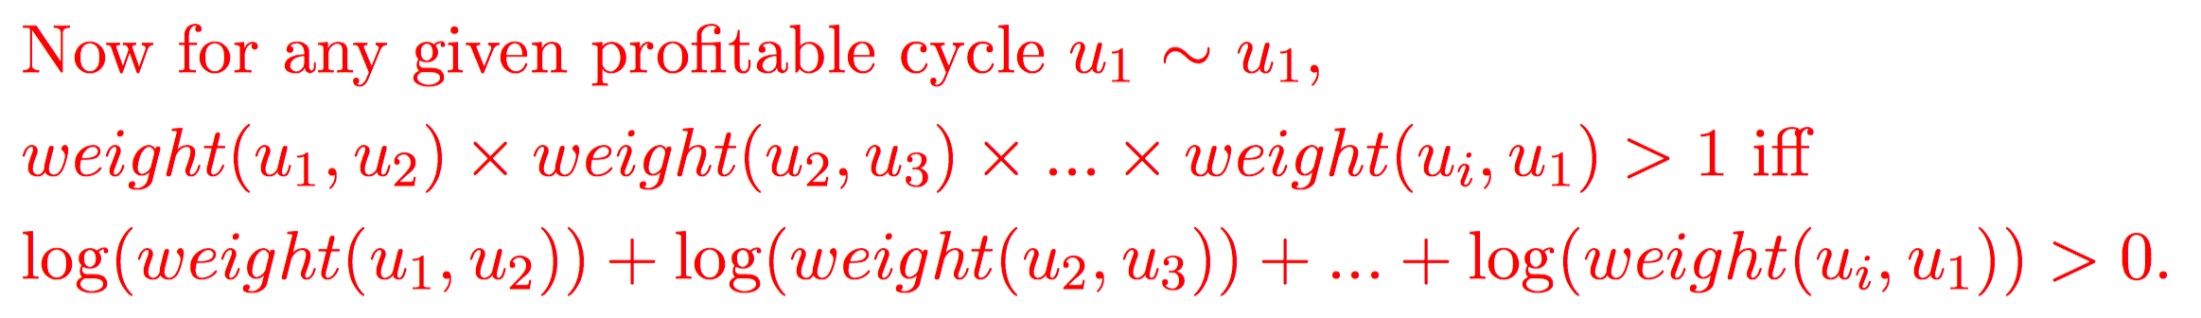
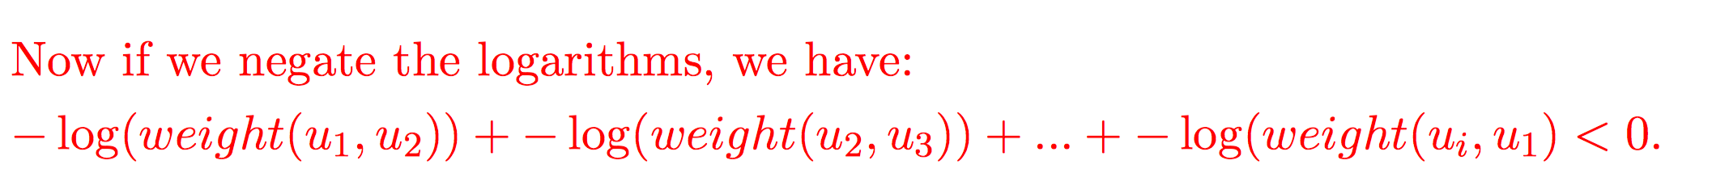

Slide 39
bellman-ford to detect negative cycle

Slide 40
BYE

