Slide 1
Trees
Suyash Shekhar

Slide 3
undirected acyclic connected
hence exactly one path between any two nodes

Slide 4
QUESTION 1 BST RECAP

Slide 5
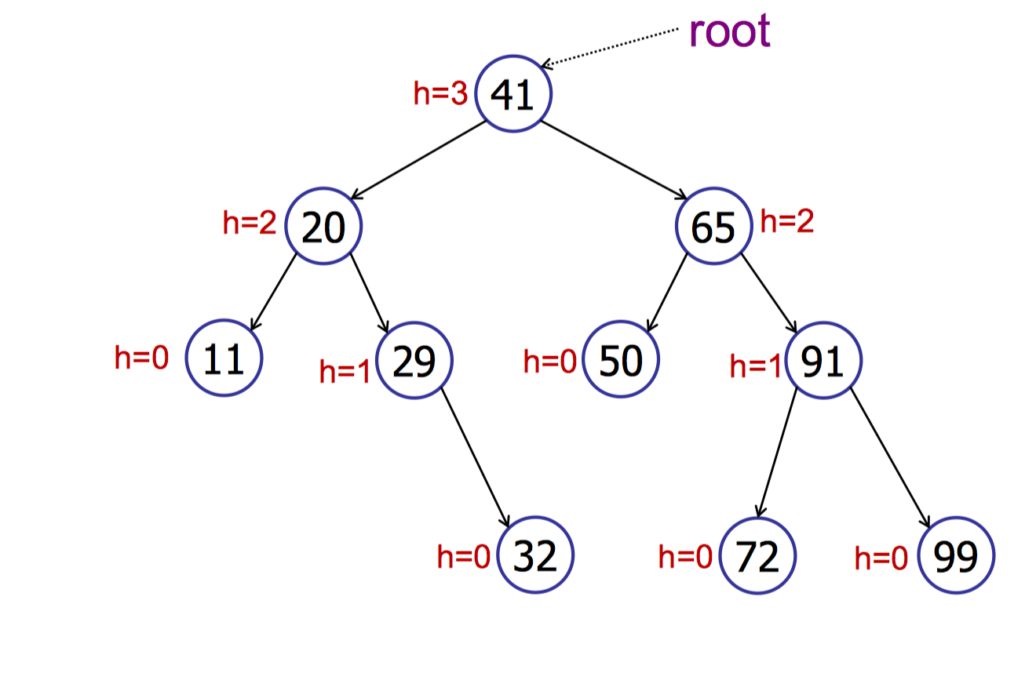
a bst

Slide 6
search predecessor insert delete in-order

Slide 7
https://visualgo.net/bst?mode=AVL

Slide 8
Modifying Operations insert: O(h) delete: O(h) Query Operations search: O(h) predecessor, successor: O(h) findMax, findMin: O(h) in-order-traversal: O(n)

Slide 9
Adelson-Velskii Landis (AVL) Trees

Slide 10
Tree Rotation

Slide 11
QUESTION 2
Q2. Draw a valid AVL Tree and nominate
a vertex to be deleted such that
if that vertex is deleted:
a). No rotation happens
b). Exactly one of the four rotation
cases happens
c). Exactly two of the four rotation
cases happens

Slide 12
insert – 1 rotation delete – log(n) rotations

Slide 13
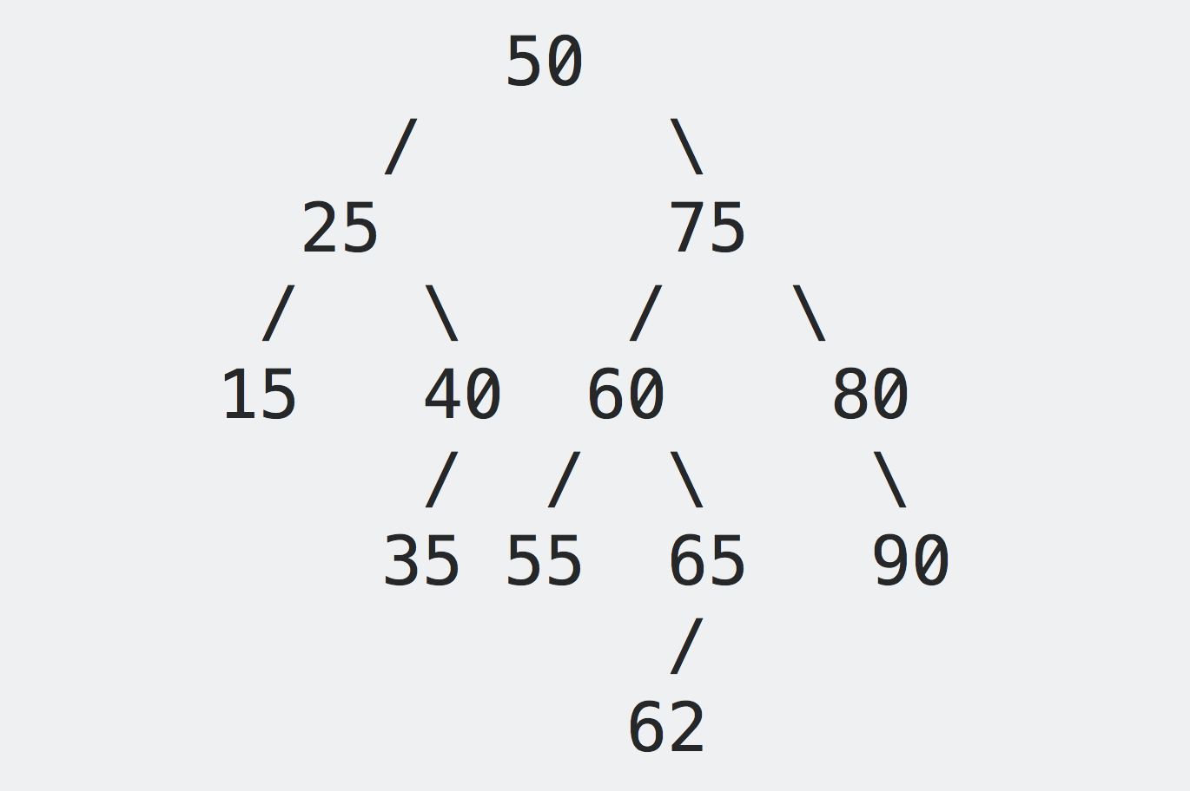
DELETE(15)

Slide 14
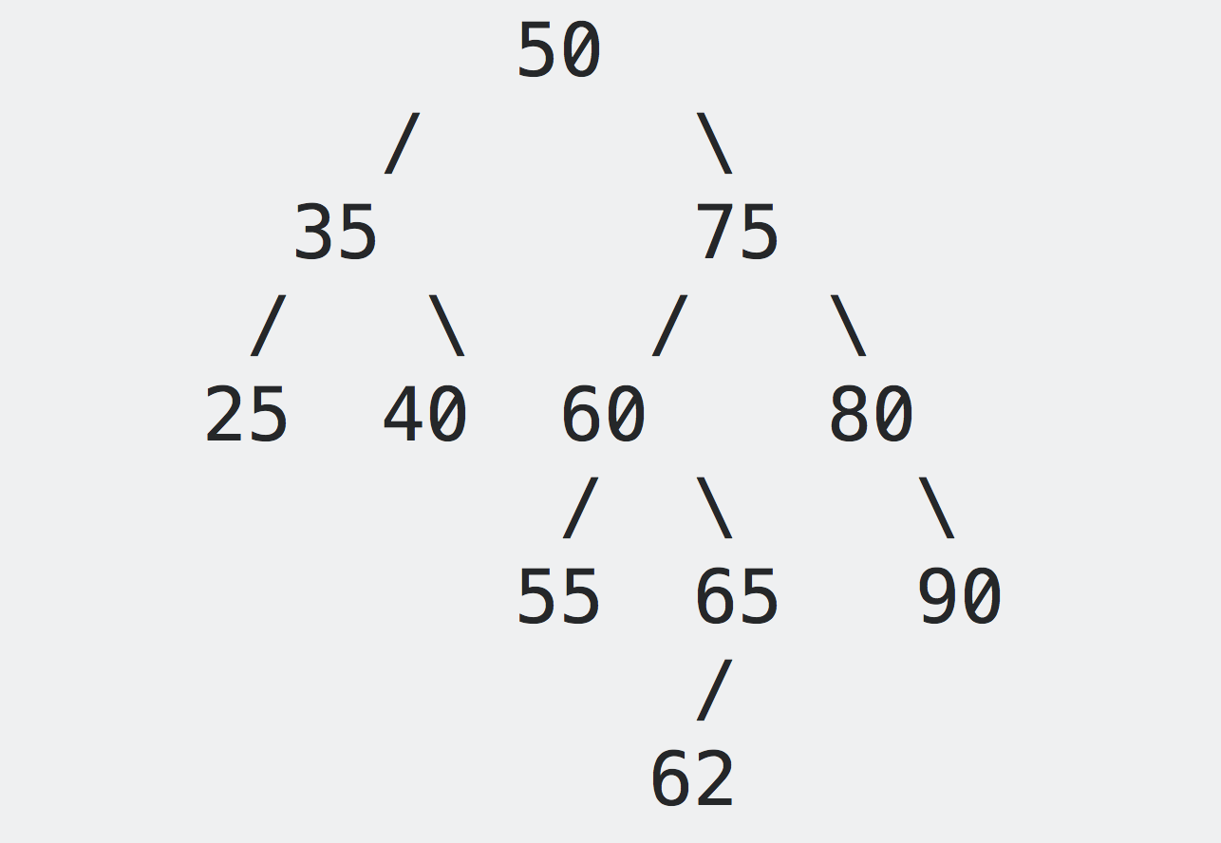

Slide 15
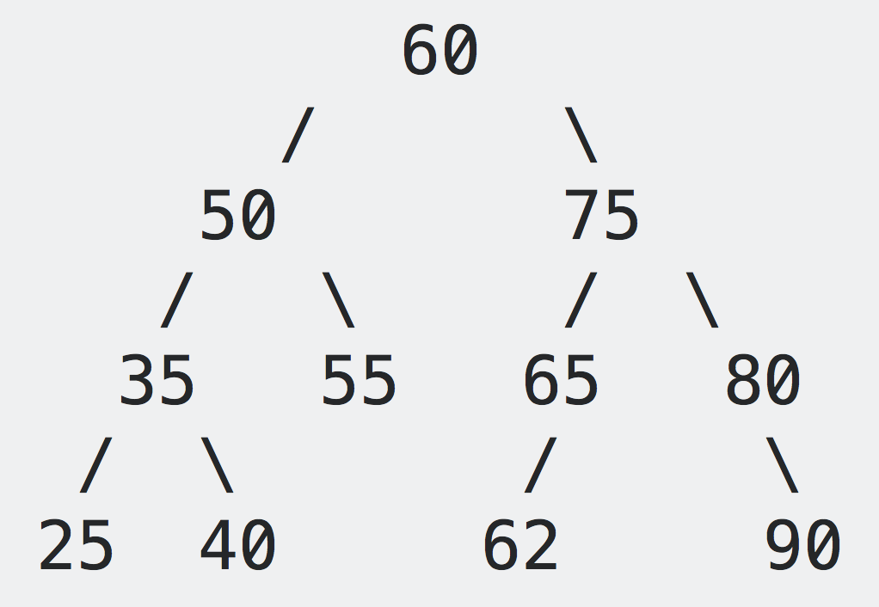

Slide 16
Remember! Zig-Zag == Double Rotation

Slide 17
int rank(node, v) { if (node.key == v) return node.left.size + 1; else if (node.key > v) return rank(node.left, v); else return node.left.size + 1 + rank(node.right, v); }
Rank

Slide 18
int select(node, k) { int q = node.left.size; if (q + 1 == k) return node.key; else if (q + 1 > k) return select(node.left, k); else return select(node.right, k-q-1); }
Select

Slide 19
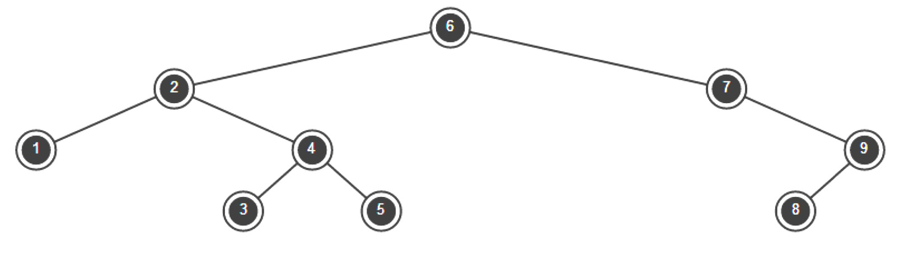
Pre-order and Post-order

Slide 20
What is the minimum number of vertices in an AVL Tree of arbitrary height h?

Slide 21
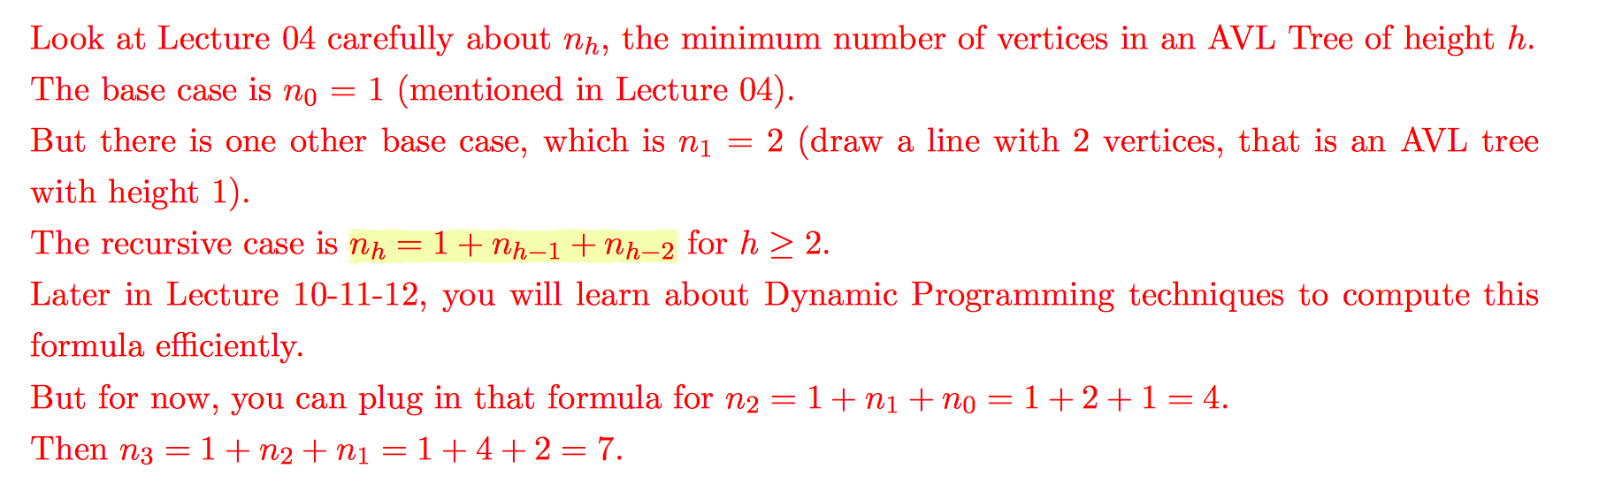

Slide 22
Range Queries on BST

Slide 23
int size(Key low, Key high) { if (low > high) return 0; if (contains(high)) return rank(high) - rank(low) + 1; else return rank(high) - rank(low); }
This is a very general pseudocode. Remember cases [) (] etc and when low and high are not in the tree.

Slide 24
BYE

