Slide 1
UFDS
Suyash Shekhar

Slide 2
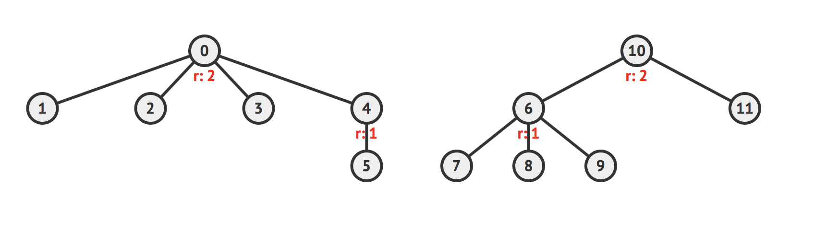
representative item

Slide 3
parent array, p rank array, r
p[i] = value of parent of i
r[i] = rank of i

Slide 4
findSet(i) isSameSet(i, j) union(i, j)

Slide 5
path compression
union-by-rank

Slide 6
public int findSet(int i) { if (p.get(i) == i) //reached root return i; else { int ret = findSet(p.get(i)); p.set(i, ret); //path return ret; compression } }
findSet(int i)

Slide 7
public Boolean isSameSet(int i, int j) { return findSet(i) == findSet(j); }
isSameSet(int i, int j)

Slide 8
public void unionSet(int i, int j) { if (!isSameSet(i, j)) { int x = findSet(i), y = findSet(j); if (rank.get(x) > rank.get(y)) { p.set(y, x); } else { p.set(x, y); if (rank.get(x) == rank.get(y)) rank.set(y, rank.get(y)+1); } } } }
unionSet(int i, int j)

Slide 9
Q3. Given n disjoint sets initially in a UFDS, is it possible to call unionSet(i, j) and/or findSet(i) operations to get a single tree with actual height h that represents a certain set? Both ‘path-compression’ and ‘union-by-rank’ heuristics are used.

Slide 10
Q3. Given n disjoint sets initially in a UFDS,
what is the max height of the any tree you can build
using unionSet(i, j) and/or findSet(i) operations

Slide 11
h ≤ log₂n.

Slide 12
GRAPH REPRESENTATIONS

Slide 13
adjacency list adjacency matrix edge list

Slide 14
E = O(V²)

Slide 15
adjacency list O(V+E) adjacency matrix O(V²) edge list O(E)
So which one should we use?

Slide 16
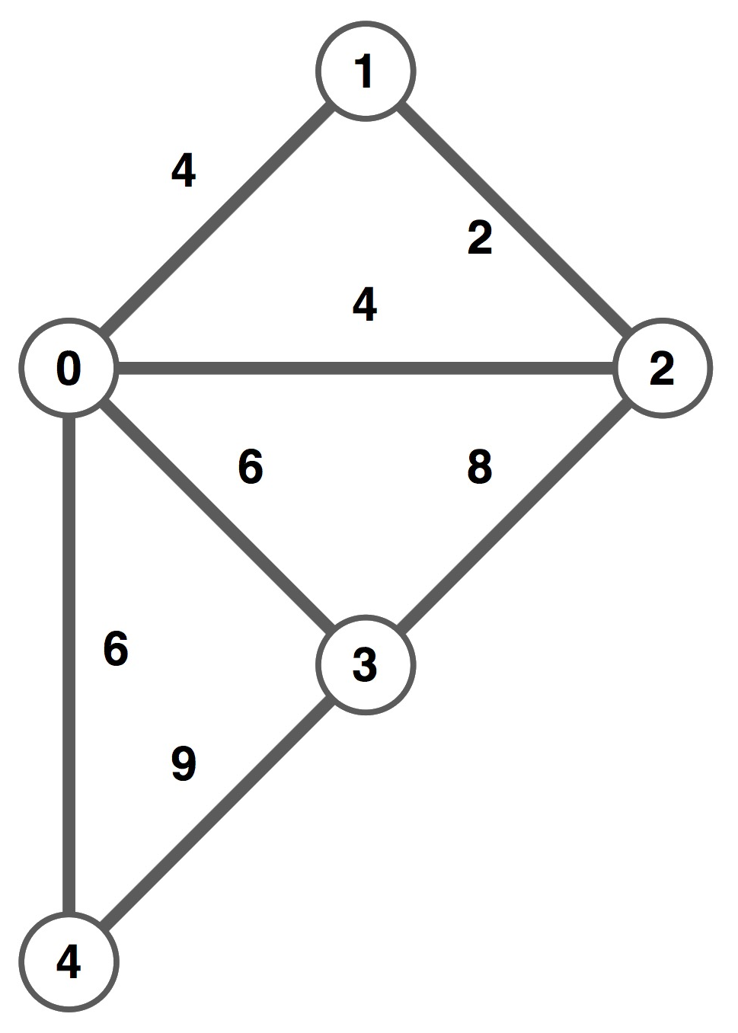
draw the adjacency list, matrix and edge list for this graph
I have free class part points

Slide 18
0: | 0 | 1 | 4
1: | 0 | 2 | 4
2: | 0 | 3 | 6
3: | 0 | 4 | 6
4: | 1 | 2 | 2
5: | 2 | 3 | 8
6: | 3 | 4 | 9
 | 0 | 1 | 2 | 3 | 4
0 | 0 | 4 | 4 | 6 | 6
1 | 4 | 0 | 2 | 0 | 0
2 | 4 | 2 | 0 | 8 | 0
3 | 6 | 0 | 8 | 0 | 9
4 | 6 | 0 | 0 | 9 | 0
0: | (1, 4) | (2, 4) | (3, 6) | (4, 6)
1: | (0, 4) | (2, 2)
2: | (0, 4) | (1, 2) | (3, 8)
3: | (0, 6) | (2, 8) | (4, 9)
4: | (0, 6) | (3, 9)

Slide 19
Matrix Multiplication of Adjacency Matrices

Slide 20
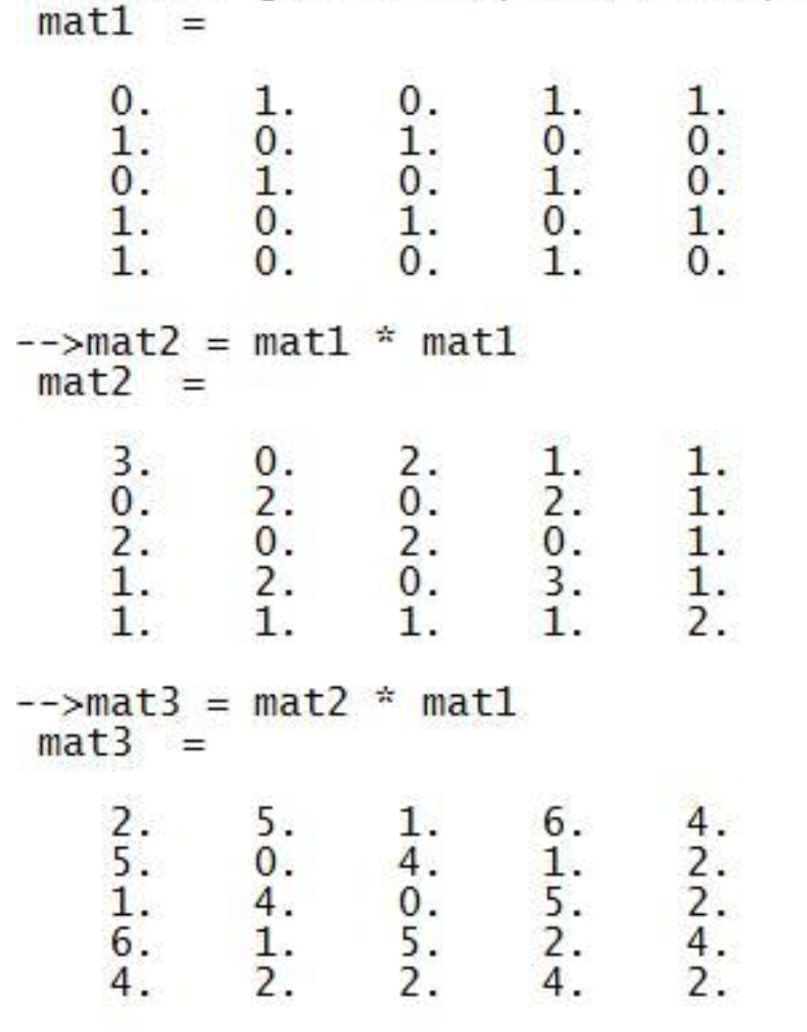
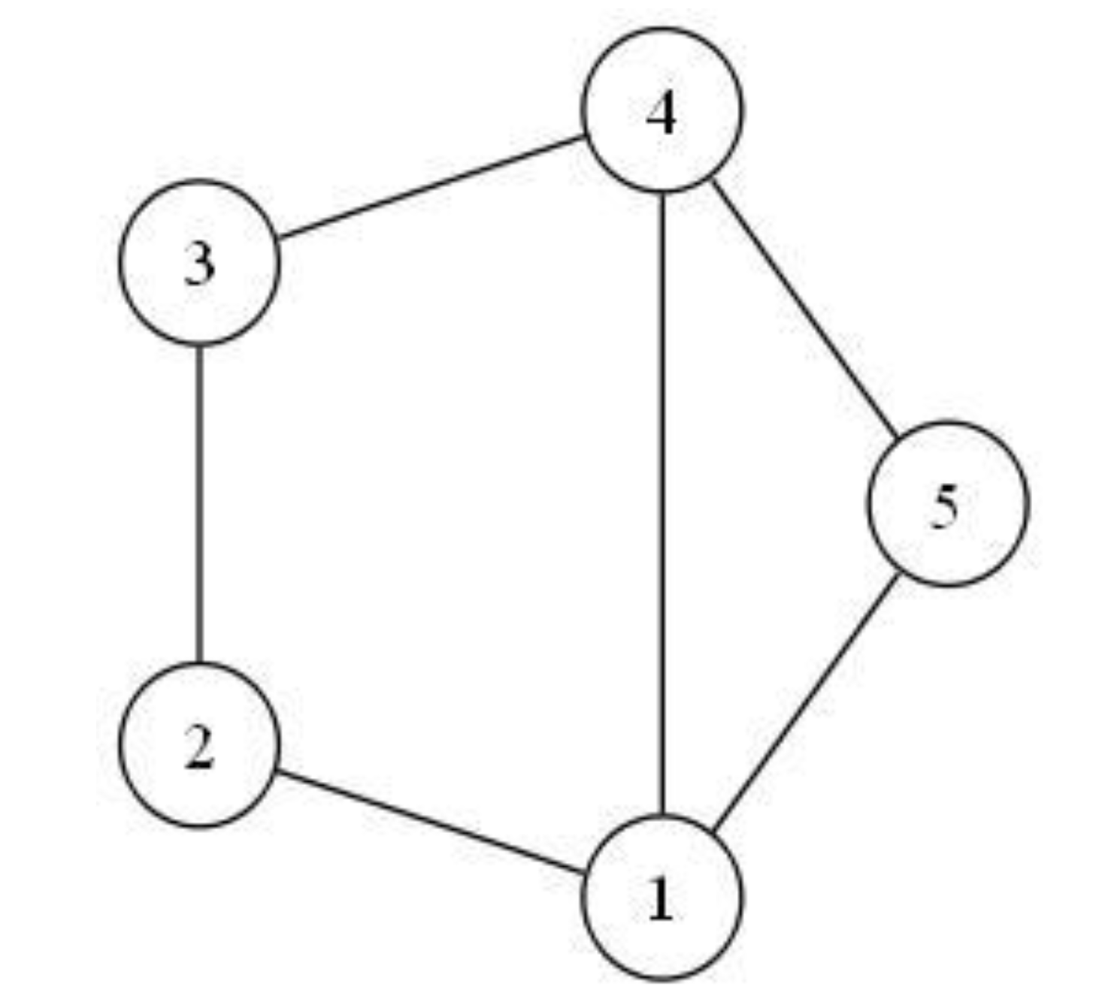

Slide 21
Draw a Directed Acyclic Graph with V vertices and V∗(V − 1)/2 edges.
Topological Sort

Slide 22
BYE

