Slide 1
Performance Optimization for Isolated Driver Domains.
Sushrut Shirole

Slide 2





Typical OS components
User
Process
User
Process
User
Process
Operating System
Hardware

Slide 3
Device Driver
A device driver is a computer program which acts as a translator between the hardware device and the application or the operating system.
User
Process
User
Process
User
Process
Operating System
Network
SATA
Hardware

Slide 4
Why Device Driver isolation ?
An analysis of the Linux kernel code using Coverity
1000 bugs in the Linux kernel 2.4.1
950 bugs in the Linux kernel 2.6.9
53% of the bugs are present in the device driver portion of the kernel
Any portion of the kernel can overwrite data structure in the kernel space
This causes a bug in a device driver to corrupt the memory of other kernel components

Slide 5
Why Device Driver isolation ?
Underlying cause of unreliability in operating systems is the lack of isolation between device drivers and a Linux kernel

Slide 6
Xen’s Isolated Driver Domain
Domain U Guest
Domain 0
The Xen hypervisor isolates the device driver by running it in a separate domain called Driver Domain
Application
TCP/IP stack
Split Device Driver
Front end
Split Device Driver
Back end
Real Device driver
Xen
Shared Memory Segment
Hardware
Physical Device

Slide 7
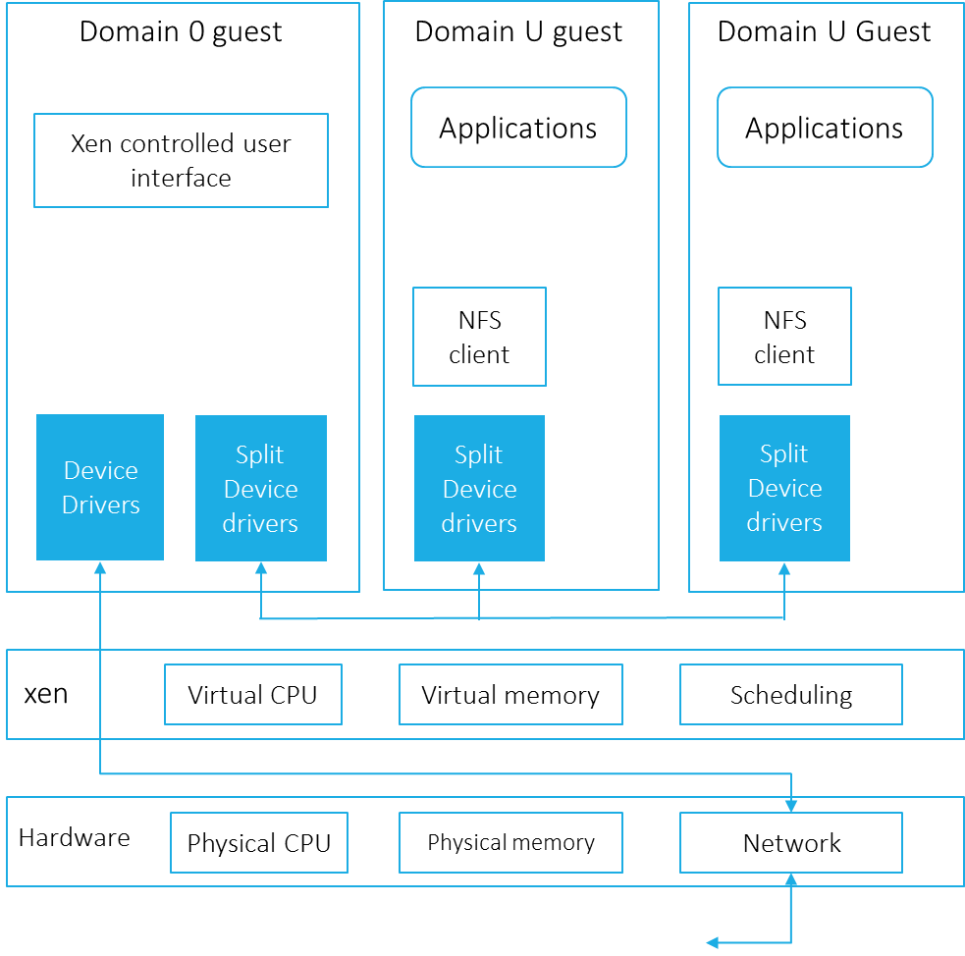
Xen Split Device Driver
Isolated Driver Domain code is not available.
The Isolated Driver Domain follows split device driver.

Slide 8
Isolated Device Driver (IDDR)
Re-implementation of the Isolated Driver Domain
Also follows the Xen split device driver model
We refer the re-implementation of Isolated Driver Domain as base IDDR system
One with the performance improvement is referred as the new IDDR system

Slide 9
Properties of the Base IDDR
Strong isolation: A bug within a device driver does not affect the other kernel component.
Transparency: User need not be aware of the system architecture to run the application.
Compatibility: Existing drivers and applications are compatible with the new architecture. Changes to the device driver and applications are not required to run the system.

Slide 10
Components of the IDDR system
User process
File system
SATA
Driver domain
Application domain

Slide 11
Components of the IDDR system
User process
Read Write Request
How to receive request from the application domain ?
How to forward to the Driver domain?
File system
/dev/sdd
Communication Channel
Backend
Frontend
SATA
Driver domain
Application domain

Slide 12
Components of the IDDR system
Frontend Driver
Provides an interface for applications
Backend Driver
Accepts the requests and sends back responses
Communication Module

Slide 13
Communication module
User process
File system
Backend
Event notification
Frontend
Share read write data
Send/receive request/response
SATA
Communication component
Driver domain
Application domain

Slide 14
Implementation of the IDDR system
User process
Event channel
Shared
pages
File system
Backend
Frontend
Ring buffer
SATA
Driver domain
Communication module
Application domain

Slide 15
Implementation of the IDDR system
User process
Event channel
Shared
pages
File system
Backend
Frontend
Ring buffer
SATA
Device queue
Driver domain
Communication module
Application domain

Slide 16
Design Goals of the New IDDR System
Performance improvement: The design goal of the New IDDR system is to improve the performance of the base IDDR system without compromising any properties of it.
The reason for the performance deterioration of the IDDR system is :
The hypervisor layer.
Extra data copy between the domains.
Overhead due to the communication between the domains.

Slide 17
The hypervisor layer
Hypervisor runs at most privileged level
Guest os runs at less privileged level
Operations such as page table updates (memory management) takes more time in guest operating system due to hypervisor layer.
Ring 3
User app
Ring 3
Ring 2
Ring 2
Privileged
instruction
/syscall
Ring 1
Guest OS
Ring 1
Ring 0
Hypercall
Ring 0
dom0
Xen
Host computer system hardware

Slide 18
Data Copy Overhead
In a usual system :
Data is copied from
User space -> kernel space
Kernel space -> Socket buffer (physical nework)
Domain U Guest
Application
TCP/IP stack
Device Driver
Physical Device
Hardware

Slide 19
Data Copy Overhead
Domain U Guest
Domain 0
In split device driver
Guest user space -> Guest kernel space
Guest kernel space -> shared memory
Shared memory -> physical device
Application
TCP/IP stack
Split Device Driver
Front end
Split Device Driver
Back end
Real Device driver
Xen
Shared Memory Segment
Hardware
Physical Device

Slide 20
Communication Overhead
Communication between the domains to share requests and responses
Requests and responses are notified by software interrupt
Software interrupt causes rescheduling of the domain – Context switch
Context switch deteriorates the performance

Slide 21
Cost of Context Switch
Direct cost : Cost required to
save and restore processor registers
execute scheduler code
reload the TLB entries
flush pipeline
Indirect cost
Processor pollution: cached entries are removed/ updated from i, d, L2, L3 cache, TLB, etc.

Slide 22
Solution
Spinning
Read request thread - Frontend
Thread runs in the backend driver
Spins for some time waiting for requests
Read response thread - Backend
Thread runs in the frontend driver
Spins for some time waiting for responses

Slide 23
New IDDR system
Read request
User process
Buffer
Buffer
Event channel
Spin some time. If response is available then return it to user process. Is response available ? NO
Yes. Response is available. Copy data to user buffer.
Spin for some time and check for requests in buffer. Is request available ? NO
Is frontend thread running ?
Yes: Copy/get request.
NO. Wakeup.
Shared
pages
File system
Read response
thread
Read request
thread
Status :
SLEEPING
Frontend
Backend
Status :
RUNNING
Status :
SLEEPING
Status :
RUNNING
Ring buffer
NO. Wake up.
Yes. PUT REQUEST in the Ring buffer.
Is backend thread running ?
SATA
Driver domain
Application domain

Slide 24
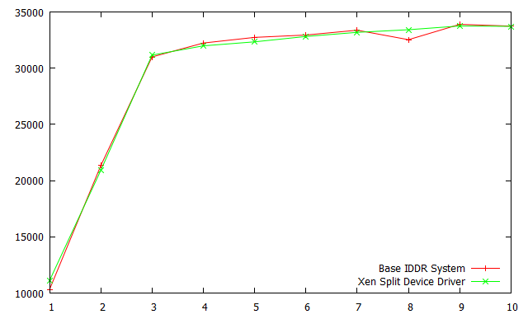
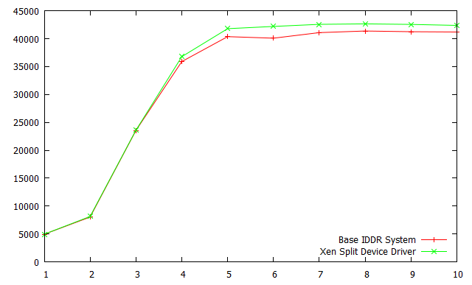
Split device driver vs base IDDR system
Ramdisk random writes
Loop device random reads

Slide 25
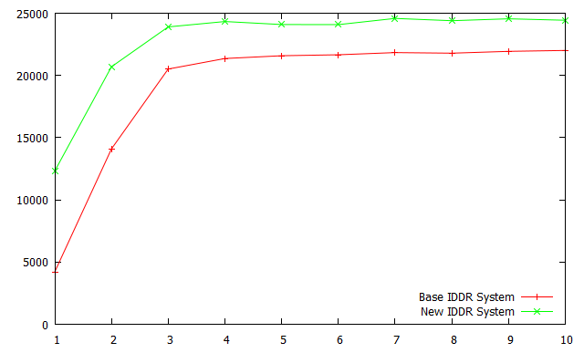
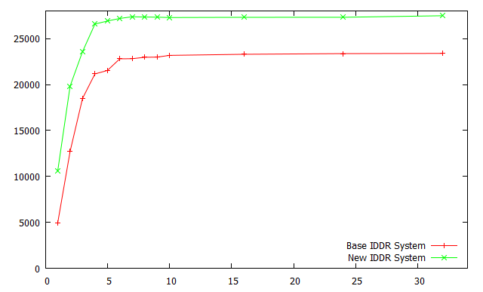
Base IDDR vs New IDDR
Random read writes - Ramdisk
Random reads - Ramdisk

Slide 26
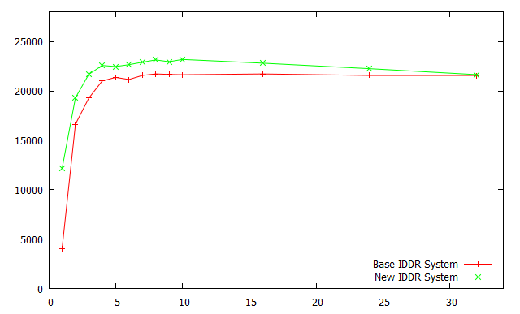
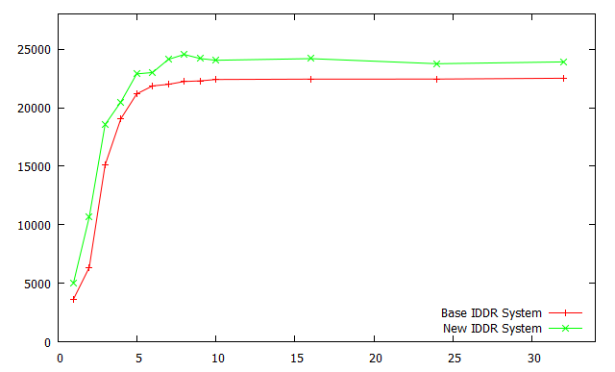
Base IDDR vs New IDDR
Random writes - Ramdisk
Random reads - Loop device

Slide 27
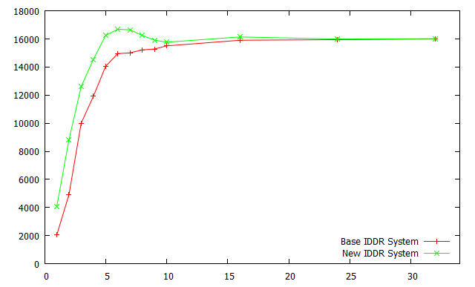
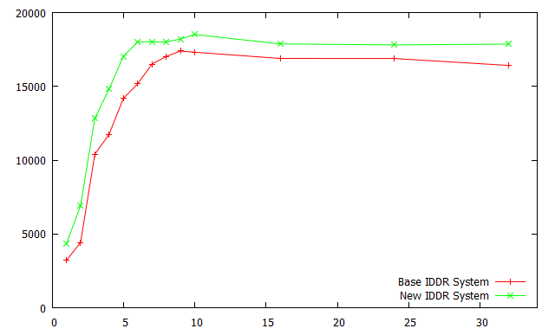
Base IDDR vs New IDDR
Random writes – Loop device
Random reads+writes loop device

Slide 28
Conclusion
Spinning implementation improve peak system throughput
But suffer from poor performance under load

Slide 29
Questions ?

Slide 30
Domain U Guest
Domain 0
Application
TCP/IP stack
Split Device Driver
Front end
Split Device Driver
Back end
Real Device driver
Xen
Shared Memory Segment
Hardware
Physical Device

Slide 31
Domain U Guest
Domain 0
Application
TCP/IP stack
Split Device Driver
Front end
Split Device Driver
Back end
Real Device driver
Xen
Shared Memory Segment
Hardware
Physical Device

Slide 32
Domain 0 guest
Domain U guest
Domain U Guest
Applications
Applications
Xen controlled user interface
NFS client
NFS client
Device Drivers
Split Device drivers
Split Device drivers
Split Device drivers
xen
Virtual CPU
Virtual memory
Scheduling
Hardware
Physical CPU
Physical memory
Network

Slide 33
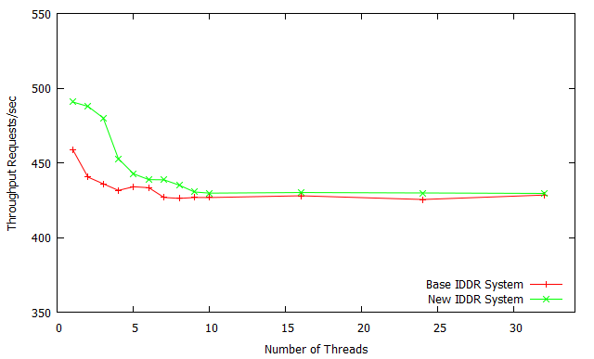
Harddisk rw

Slide 34
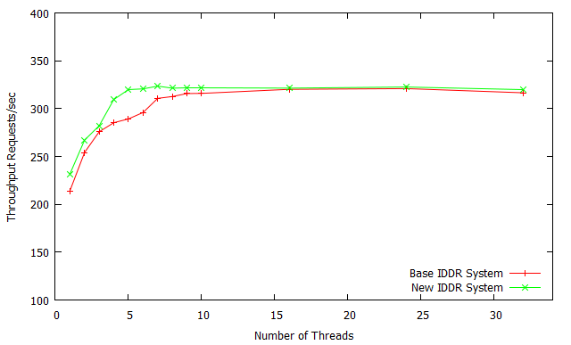
Rndrw harddisk

Slide 35
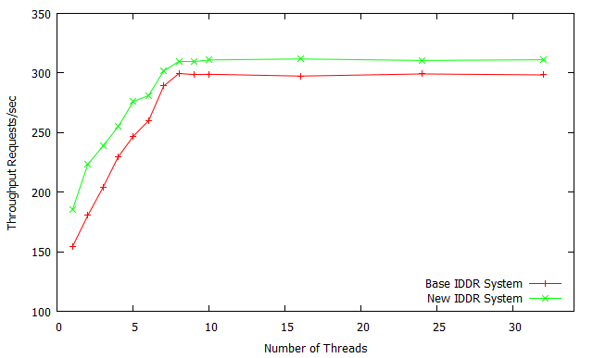
Rndrd harddisk

