Slide 1
Performance Optimizations for Isolated Driver Domains.
Sushrut Shirole
Notes:
Performance Optimization techniques for Isolated Driver Domains

Slide 2
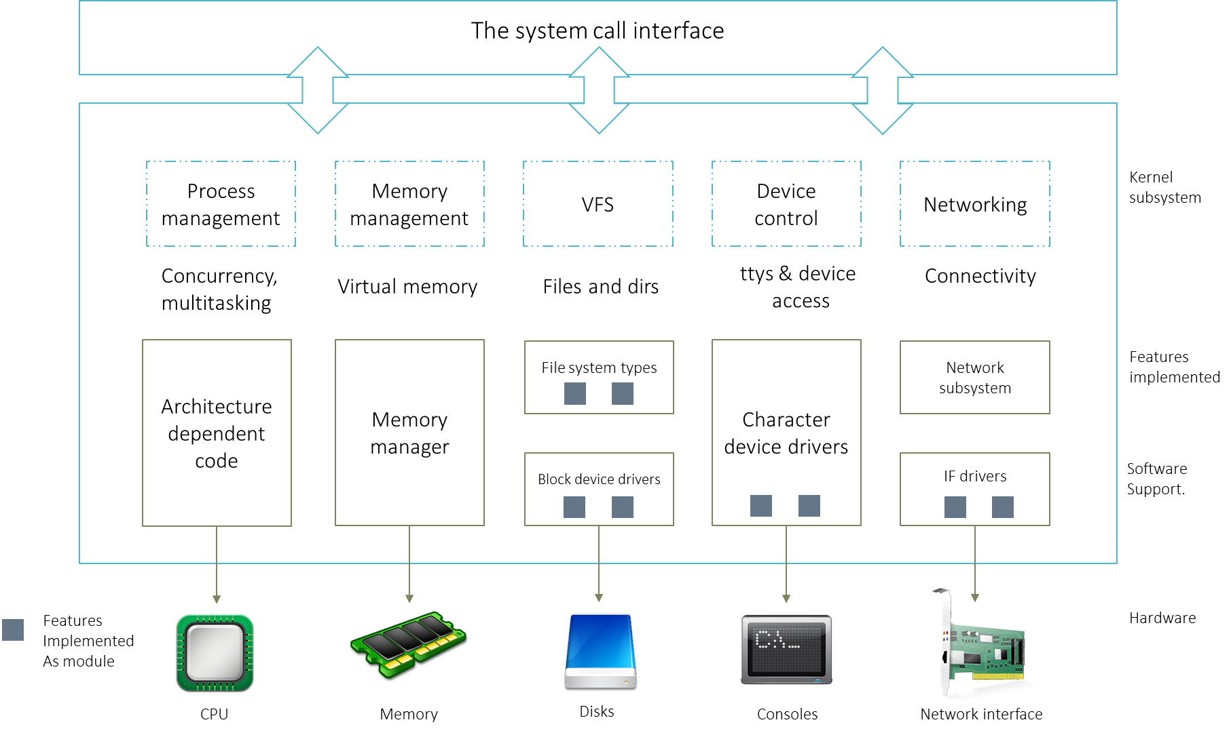
Device Drivers
A device driver is a computer program which acts as a translator between the hardware device and applications or an operating system.
Notes:
For example Ethernet driver, display Driver, Bluetooth driver, SATA driver

Slide 3




Motivation for Device Driver Isolation
An analysis of the Linux kernel code by Coverity found
1000 bugs in the Linux kernel 2.4.1
950 bugs in the Linux kernel 2.6.9
53% of the bugs are present in the device driver portion of the kernel
Any portion of the kernel can overwrite any data structures in kernel space
This causes a bug in a device driver to corrupt the memory of other kernel components
User
Process
User
Process
User
Process
User
Process
User
Process
User
Process
TCP/IP
File system
Memory Manager
TCP/IP
File system
Memory Manager
Monolithic OS kernel
Monolithic OS kernel
Ethernet
SATA
PCI
Ethernet
SATA
PCI
Hardware
Hardware
Notes:
Before moving to performance optimization techniques for iso dri do, I will explain the motivation behind device driver isolation.
Coverity is a Source code analysis tool.
In 2009 Developers of Coverity tool conducted an analysis … . The analysis found ….
In a Linux system, kernel components does not have same level of isolation that user processes has. Any ….
Consider an example … Hits a bug and accesses Invalid memory location … Without affecting the system or other independent processes.
Corrupts a data structure which is being used by other kernel compoents, it can lead to system crash

Slide 4
Motivation for Device Driver Isolation
The underlying cause of unreliability in operating systems is the lack of isolation between device drivers and the kernel
Notes:
It can be concluded that the underlying …

Slide 5
Existing approaches for driver isolation
Device driver isolation is not a new concept.
Existing solutions includes:
User level drivers [Leslie 2005]
Micro-drivers [Ganapathy 2008]
Virtual machine based approaches
DD/OS [LeVasseur 2004]
Xen Isolated Driver Domains [Fraser 2004]
Notes:
Suffer from poor performance
Requires existing device drivers to be changed

Slide 6
Xen’s Isolated Driver Domains
Application domain
Driver domain
A domain running user applications is called an application domain.
A device driver is isolated by running it in a domain separate from the application domain.
A domain running a device driver is called a driver domain.
Uses split device driver model.
Split device driver: Originally, Xen implemented the split device driver model to reuse the device driver supported by the guest OS running in the domain 0.
Application
File System
Split Device Driver
Split Device Driver
Real Device driver
Xen
Shared Memory Segment
Hardware
Physical Device
Notes:
One of the existing virtualization based sol.
In this system, a device driver is isolated from the monolithic kernel components by …
This system uses xen’s split device driver module to isolated a device driver.
It would be difficult for Xen to support the variety of hardware. Hence Originally, …
In this model, a split dd runs in an application domain and its counterpart runs in a driver domain. Requests from an application are forwarded to real dd by split dd through ..

Slide 7
Properties of Isolated Driver Domains
Strong isolation: A bug within a device driver does not affect other kernel components.
Transparency & Compatibility: Existing drivers and applications are compatible with the new architecture.
Notes:
Main properties of the isolated …
The isolated driver domain provides strong isolated between device driver and monolithic kernel, because of which a bug …
The isolated driver domain doe not require any change to existing applications and device drivers.

Slide 8
Isolated Device Driver (IDDR)
In order to optimize performance of Isolated Driver Domains, we wanted to try it out
Source code of Isolated Driver Domains is not available
We re-implemented Isolated Driver Domains
We refer our implementation as Isolated Device Driver (IDDR) system
Our work is divided into two parts :
Reimplementation of Isolated Driver Domains – IDDR System
Performance optimizations
Notes:
Our work is divided into two parts
First, I will explain the reimplementation details
After that, I will talk about the performance optimizations of isolated driver domains.

Slide 9
Components of the IDDR system
Frontend Driver
Provides a block device interface (/dev)
Accepts requests from applications
Forwards them to the communication module
Accepts responses from the communication module and notifies completion of requests
Communication Module
Shares requests and responses between frontend and backend driver
Sends virtual interrupts/notifications
Shares data between frontend and backend driver
Backend Driver
Accepts requests from the communication module
Forwards them to the real device driver
Receives responses from the real device driver
Sends back responses to communication module
Notes:
IDDR system consists of 3 components.
Frontend runs in application domain.
And backend runs in the driver domain.

Slide 10
Components of the IDDR system
How to receive request from the application domain ?
How to forward requests to the driver domain?
User process
File system
/dev/sdd
Event notification
Backend
Frontend
Share read write data
Send/receive request/response
/dev/sdd
SATA
Communication component
Driver domain
Application domain
Notes:
For the Prototype implementation, we isolated SATA device driver from the monolithic kernel.
In this example SATA device driver runs in driver domain.
… in order to follow transparency goal …
… to achieve compatibility goal …

Slide 11
Implementation of the IDDR system
User process
User buffer
Event channel
Shared
pages
File system
Backend
Frontend
Ring buffer
SATA
Request queue
Driver domain
Communication module
Application domain
Notes:
Explains and visualizes the implementation details of the IDDR.
Starting with the frontend driver; front end driver is implemented as a pseudo block device driver. It has a request queue. … request functions removes requests from the queue.
…
Communication module sends the virtual interrupt when requests and responses are shared.
Backend driver is implemented as a kernel module.

Slide 12
Optimizing IDDR’s performance
Performance improvement: The goal of the IDDR is to improve the performance of Isolated Driver Domains without compromising their design properties.
Sources of overhead include:
Data copy overhead
Inter-domain communication overhead
Notes:
The goal of IDDR …

Slide 13
Data Copy Overhead
In a Linux system :
Data is copied from
User space -> kernel space
Kernel space -> Physical device
In isolated driver domain system :
Guest OS user space -> Guest OS kernel space
Guest OS kernel space -> shared memory
Shared memory -> physical device
Notes:
In linux system, in order to execute write request, …
In case of read …

Slide 14
Inter-domain Communication Overhead
Domains share requests, responses
Requests and responses are notified by virtual interrupt
Virtual interrupt causes rescheduling of a domain – Context switch at hypervisor level
Cost of a context switch is high.
Notes:
It includes the overhead to share requests and responses
Also includes cost of virtual interrupts.
Virtual interrupts are sent to notify the domains when requests & responses are shared.

Slide 15
Cost of Context Switch
Direct cost : Cost required to
Save and restore processor registers
Execute scheduler code
Flush the TLB entries
Flush pipeline
Indirect cost
Processor pollution: cached entries are removed/ updated from I, D, TLB cache etc.
Notes:
Cost required for context switch is includes direct and indirect cost
Indirect cost is the added cost because of cache misses as a result of processor pollution.

Slide 16
Solution
Spinning
Read request thread - Backend
Thread runs in the backend driver
Spins for some time waiting for requests
Read response thread - Frontend
Thread runs in the frontend driver
Spins for some time waiting for responses
Notes:
In this thesis we propose a spinning based inter-domain communication.
We create ….
Removes the need of virtual interrupts to notify when requests and responses are shared.

Slide 17
Implementation
Read request
User process
Buffer
Buffer
Yes:
Copy/get request.
Spin and check for requests. Is request available ?
NO
Yes.
Copy data to user buffer.
Spin and check for responses.
Is response available ?
NO
File system
Shared
pages
Backend
Frontend
Read request thread
Read response
thread
Ring buffer
Status :
RUNNING
Status :
RUNNING
SATA
Driver domain
Application domain
Notes:
Similar to baseline implementation, we implement frontend driver as a pseudo block device driver.

Slide 18
More implementation details
Read request
User process
Buffer
Buffer
Event channel
Yes. Put response in Ring buffer
Is frontend thread running ?
No. Send virtual interrupt.
Shared
pages
File system
Backend
Frontend
Read request thread
Read response
thread
Ring buffer
Status :
SLEEPING
Status :
SLEEPING
Status :
RUNNING
Status :
RUNNING
No. Send virtual interrupt
Yes. Put response in the Ring buffer.
Is backend thread running ?
SATA
Driver domain
Application domain
Notes:
Even though we don’t use virtual interrupts to send notifications when requests and responses are shared, the system can not afford to spin both threads when system is not performing any IO operations
For the same reason, both threads sleep after spinning for a threshold time. We use virtual interrupts to wake the threads ..
Consider an example….

Slide 19
Evaluation Goals
Comparison of isolated driver domains with IDDR system
Comparison of Xen split device driver with IDDR system
Prove that our implementation provides a suitable baseline
An evaluation of performance improvement of spinning
Prove that spinning based inter-domain communication improves the performance of the system
Notes:
We evaluate the system in two parts.
In first part ….
Source code of the isolated driver domain is not available, and since it uses split device driver model, we compare performance of ….
In second part …

Slide 20
Methodology
We used SATA disk, RAM disk as block devices for performance testing
As RAM disk is a fast block device and SATA disk is a slow block device
Represents a range of devices

Slide 21
Methodology
Xen's split device driver vs IDDR system
Application domain/ Domain U / HVM guest
Driver domain/
Domain 0 / PV guest
SATA disk and RAM disk were attached as a physical device in the driver domain.
Both the devices were mounted as ext2 file system in the application domain through an interface provided by the frontend driver.
We ran SysBench benchmark in FileIO mode to generate 128 files with 1Gb of total data.
We executed random reads and writes through SysBench benchmark.
SysBench
FileIO mode
Frontend
Backend
Backend
SATA disk/ram disk

Slide 22
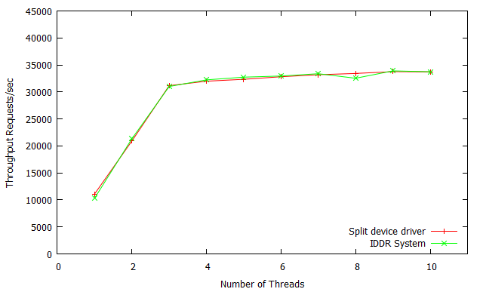
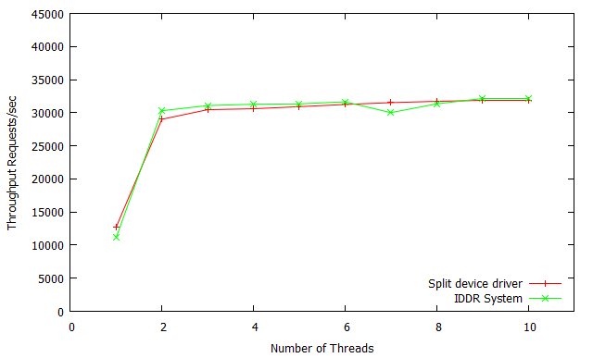
Split device driver vs IDDR system (RAM disk)
Ramdisk - Random reads
Ramdisk - Random reads + writes
Notes:
Both the graphs compares performance of split device driver and IDDR system when random reads are executed on a RAM disk.
X axis represents Number of threads
Y axis represents – Throughput

Slide 23
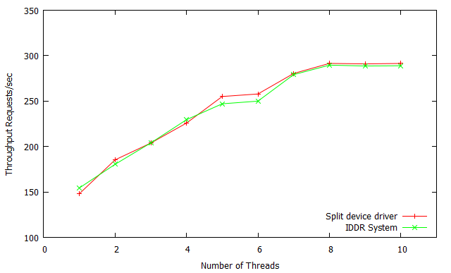
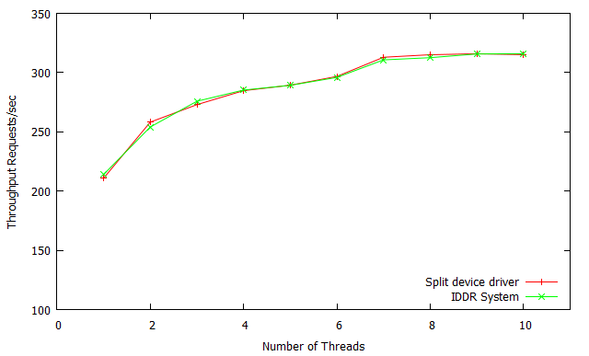
Split device driver vs IDDR system (SATA disk)
SATA disk - Random reads
SATA disk - Random reads + writes
Notes:
All four graphs shows that our implementation provides suitable baseline code for performance optimization.

Slide 24
Methodology
Interrupt based vs spinning based inter-domain communication (RAM disk)
Application domain/ Domain 0 / PV guest
Driver domain/
Domain U / HVM guest
Domain 0 – Application domain
Domain U – Driver domain
Sysbench
Frontend
Backend
RAM disk
Notes:
Similar to previous evaluation, we run sysbench benchmark in FileIO mode.

Slide 25
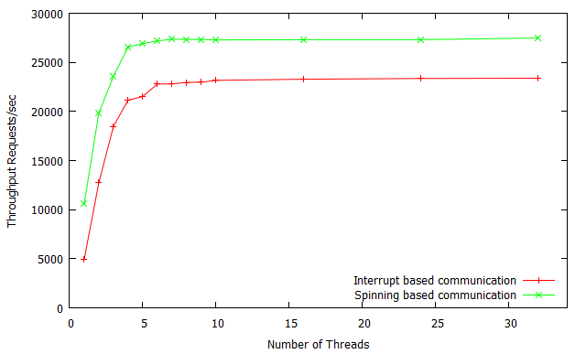
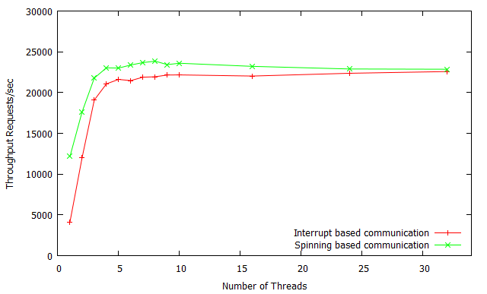
Interrupt vs Spinning (RAM disk)
Random reads
Random reads + writes

Slide 26
Methodology
Interrupt based vs spinning based inter-domain communication (SATA disk)
Application domain/ Domain U / HVM guest
Driver domain/
Domain 0 / PV guest
Domain U – Application domain
Domain 0 – Driver domain
Sysbench
Frontend
Backend
SATA disk
Notes:
Similar to previous evaluation, we run sysbench benchmark in FileIO mode.

Slide 27
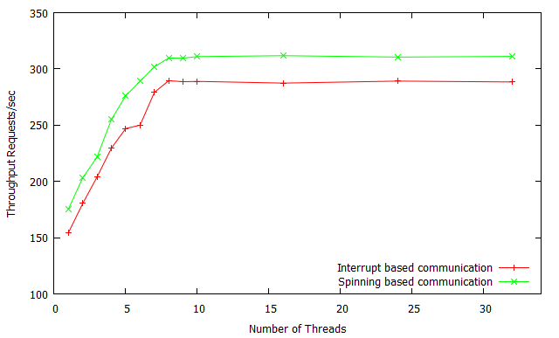
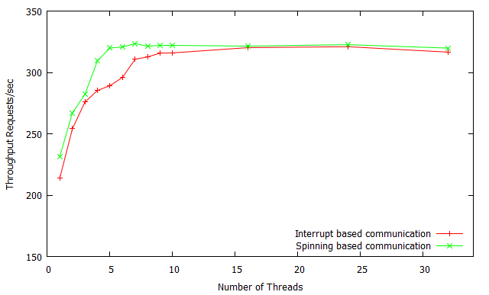
Interrupt vs Spinning (SATA disk)
Random reads
Random reads + writes

Slide 28
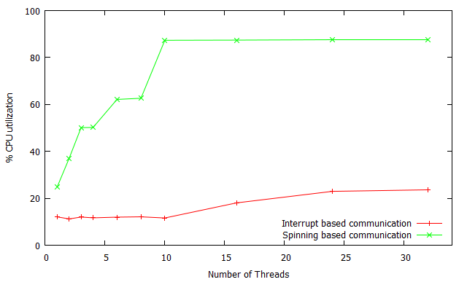
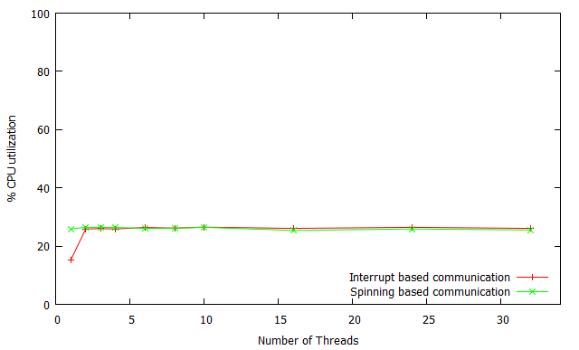
Maximum CPU utilization (RAM disk)
Both the systems shared 8 VCPUs.
Application domain
Driver domain

Slide 29
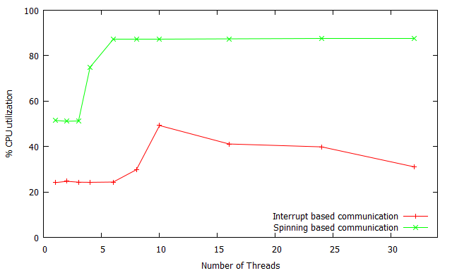
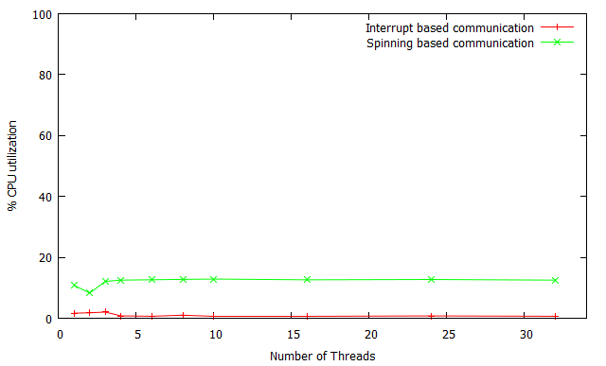
Maximum CPU utilization (SATA disk)
Application domain
Driver domain

Slide 30
Related Work
Inter domain communication
Xen split device driver [Barham 2003]
Data copy overhead and page flipping overhead
Xen socket [Zhang 2007]
A UNIX socket like interface in order to overcome page flipping overhead
Needs an existing socket interface APIs to be changed
Fido [Burtsev 2009]
Shared memory based inter domain communication mechanism
Avoid page flipping and copy overheads
Enables end-to-end zero-copy communication across multiple domains.
Leverages relaxed trust model.
Notes:
Most closely related work in this are is xen split … Xen split device driver faced data copy ….
In order to remove page flipping overhead, xen presented a unix socket like ….
Fido is a shared memory based inter-domain communication mechanism. It avoid page flipping and data copy overhead by implementing end-to-end zero copy. Fido sacrifices security in order to achieve it.

Slide 31
Future work
Adaptive spinning
In current implementation the read request thread and read response thread spins for a constant amount of time.
It will be interesting to see the impact on performance if adaptive spinning is used.

Slide 32
Conclusion
Isolated driver domain implementation
IDDR provides suitable baseline to optimize performance.
IDDR robustness
We tested the robustness of IDDR system with bonnie++, dd and xdd.
Performance
IDDR system trades off CPU cycles to achieve fast inter-domain communication.
Compatibility and transparency
IDDR system doesn’t require any changes to device drivers and applications.
Require few changes to the kernel.
Notes:
Concluding, I would like to say that, our implementation provides a suitable baseline…..
We Successfully tested the robustness of IDDR system …

Slide 33
Thank you.

