Slide 1
Performance Optimization for Isolated Driver Domains.
Sushrut Shirole

Slide 2
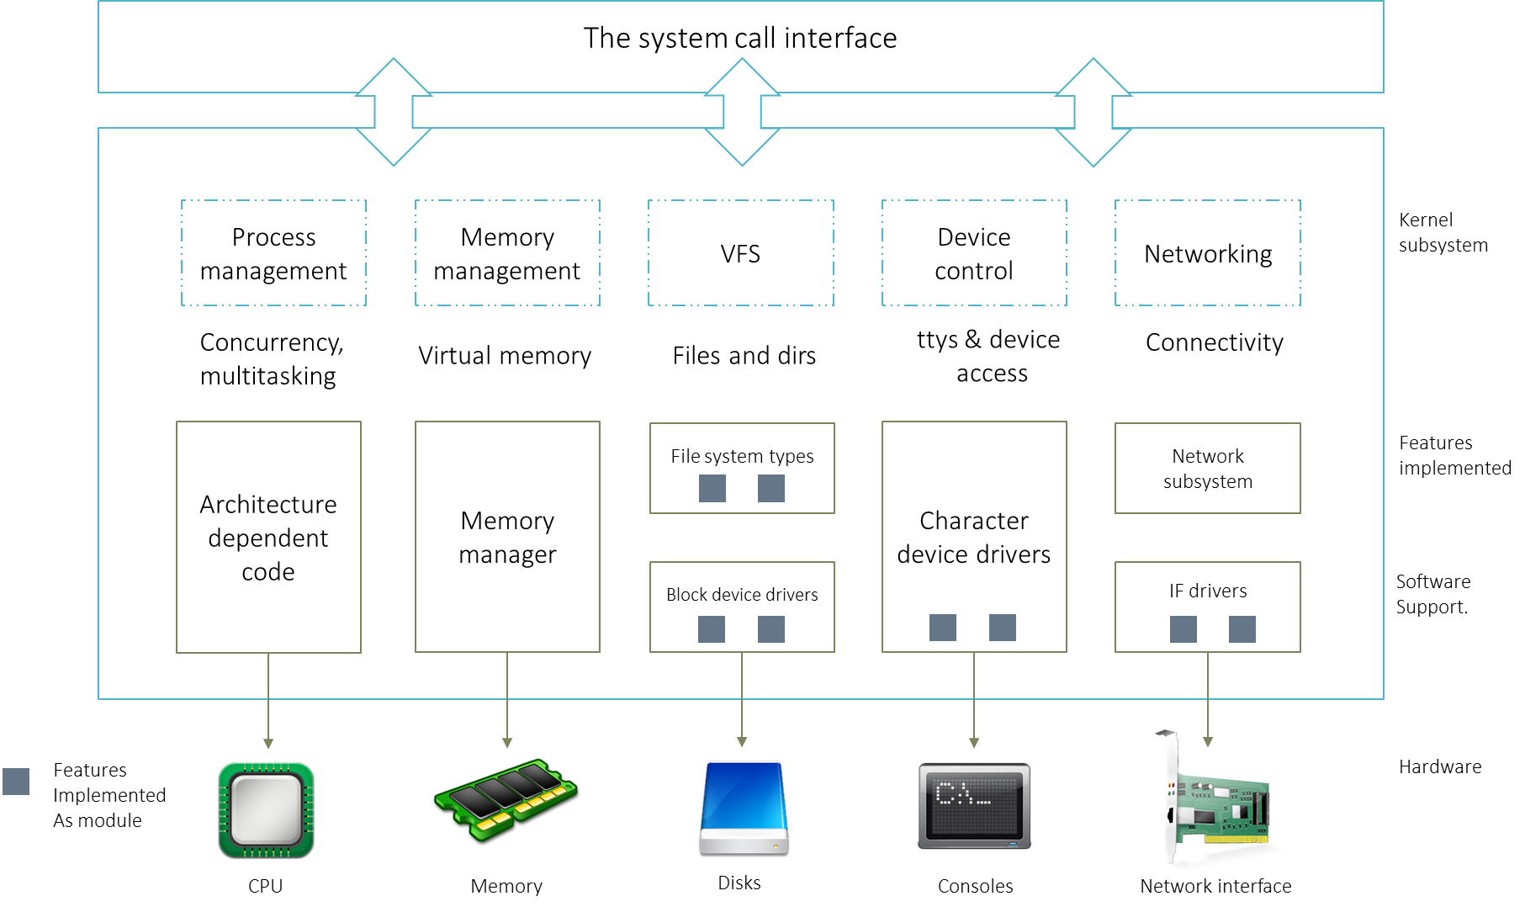
Device Driver
A device driver is a computer program which acts as a translator between the hardware device and applications or an operating system.
Notes:
A Device driver is a program which acts as a translator between the hardware device and the application.

Slide 3




Device Driver Isolation Motivation
An analysis of the Linux kernel code using Coverity
1000 bugs in the Linux kernel 2.4.1
950 bugs in the Linux kernel 2.6.9
53% of the bugs are present in the device driver portion of the kernel
Any portion of the kernel can overwrite data structure in the kernel space
This causes a bug in a device driver to corrupt the memory of other kernel components
User
Process
User
Process
User
Process
User
Process
User
Process
User
Process
TCP/IP
File system
Memory Manager
TCP/IP
File system
Memory Manager
Monolithic OS kernel
Monolithic OS kernel
Ethernet
SATA
PCI
Ethernet
SATA
PCI
Hardware
Hardware
Notes:
So basic question would be what is the motivation behind isolating a device driver ?
- Unlike user space, system components lack isolation between them.
- In a monolithic Linux kernel, any portion of the kernel can overwrite data structure in the kernel space.
- causes a bug in a device driver to corrupt the memory of other kernel components.
An analysis of the Linux kernel code conducted by coverity shows that version 2.4.1 had 1000 bus and 2.6.8 had 950 bugs in 2009.
The analysis also shows that the 53% of the bugs are present in the device driver portion od the linux kernel.

Slide 4
Device Driver Isolation Motivation
Underlying cause of unreliability in operating systems is the lack of isolation between device drivers and a Linux kernel
Notes:
- Concluding the analysis, it can be said that, the underlying cause of unreliability in operating systems is the lack of isolation between device drivers and Linux kernel.

Slide 5
Existing approaches for system reliability
Device driver isolation is not a new concept.
Existing solutions such as:
User level drivers
Micro-drivers
Virtual machine based approaches
DD/OS
Xen Isolated Driver Domains
Notes:
Device driver protection by system decomposition is not a new concept.
Existing solutions can be considered as microkernel based solutions L3 L4, user level device drivers and virtualization based solutions such as DD/OS and Xen isolated driver domains.

Slide 6
Xen’s Isolated Driver Domain
Application domain
Driver domain
A domain running user applications is called an application domain.
A device driver is isolated by running it in a domain separate from the application domain.
A domain running a device driver is called a driver domain.
Split device driver: Originally, Xen implemented the split device driver model to reuse the device driver supported by the guest OS running in the domain 0.
Application
File System
Split Device Driver
Split Device Driver
Real Device driver
Xen
Shared Memory Segment
Hardware
Physical Device
Notes:
Isolated driver domain is one of the virtualization based approaches which isolates a device driver from the Linux kernel. Isolated driver domain uses Xen hypervisor and split device driver model of the Xen hypervisor to run a device driver in a separate domain.
The role of the split device driver in a guest domain is to act as a pseudo block device driver and forward the requests to the driver domain through shared memory segment. The role of the part of split device driver in the driver domain is to read the request and data from the shared memory segment and forward those to real device driver.
Originally, Xen implemented split device driver to avoid rewriting all the device drivers in a guest OS and reuse the device drivers of the privileged domain.

Slide 7
Properties of the Isolated Driver Domain
Strong isolation: A bug within a device driver does not affect the other kernel component.
Transparency: User need not be aware of the system architecture to run the application.
Compatibility: Existing drivers and applications are compatible with the new architecture. Changes to the device driver and applications are not required to run the system.
Notes:
The main properties of the Isolated Driver Domain are :
1. Strong isolation – Because of a strong isolation between a device driver and Linux kernel, a bug within a device driver does not affect the other kernel components.
2. Transparency and compatibility – Any changes to the device driver are not needed to isolated the device driver. Isolated driver domain does not require any changes to user applications in order to run on this system.
User also need not be aware of the structure of the system to run an application.

Slide 8
Isolated Device Driver (IDDR)
Re-implementation of the Isolated Driver Domain
Our implementation also follows the Xen split device driver model
We refer it as base Isolated Device Driver (IDDR) system
Notes:
In order to work on the driver domain, we wanted to try out it first. But the source code of driver domain is not available.
Hence we re-implemented the device domain.
We refer the reimplementation as Isolated Device Driver or IDDR system
Similar to the driver domain, the IDDR system also follows the Xen split device driver model.

Slide 9
Components of the IDDR system
Frontend Driver
Provides an interface (/dev)
Accepts requests from applications
Forwards them to the communication module
Accepts responses from the communication module and ends requests
Communication Module
Shares requests and responses between frontend and backend driver
Sends virtual interrupts/notifications
Share data between frontend and backend driver
Backend Driver
Accepts requests from the communication module
Forwards them to the real device driver
Sends back responses to communication module
Notes:
The IDDR system is divided into 3 logical components : Frontend driver, Backend driver and communication module.
The role of the frontend driver is to
provide an interface in /dev for a block device. User applications or file systems access a block device through this interface.
The frontend driver accepts requests from applications through interface. And forwards them to the communication module.
Frontend driver then accepts the responses from the communication module and then ends corresponding requests
Role of Communication module is to provide a channel to
share requests and responses between frontend driver and backend driver
send virtual interrupts between frontend and backend driver
share read write data between both drivers
Backend driver is responsible for
accepting requests from communication module
forwarding the request to the real block device driver for execution,
accept response from the real device driver and
share the response with frontend driver through communication module.

Slide 10
Components of the IDDR system
Read Write
Request
User process
How to receive request from the application domain ?
How to forward requests to the driver domain?
File system
/dev/sdd
Event notification
Backend
Frontend
Share read write data
Send/receive request/response
/dev/sdd
SATA
Communication component
Driver domain
Application domain
Notes:
The diagram here visualizes the roles of frontend driver, backend driver and communication module.
We refer the domain running real device driver as a Driver domain and domain running user applications as a Application domain.
Like explained before, the frontend driver provides an interface for block devices. And forwards the request to backend through communication modules.
The response is sent back via reverse path.

Slide 11
Implementation of the IDDR system
User process
User buffer
Event channel
Shared
pages
File system
Backend
Frontend
Ring buffer
SATA
Device queue
Driver domain
Communication module
Application domain
Notes:
The diagram here visualizes the implementation details of the IDDR system.
A ring buffer is used for sharing requests and responses between application domain and driver domain. Size of a ring buffer is limited to 4K page, hence we do not use it for sharing read write data.
We use shared pages for that purpose. Shared page is a page allocated in memory shared between Driver domain and application domain.
Event channel is a event notification system which sends the virtual interrupts between domains. It is used for notifying an event.
Lets consider an example where user application wants to write data to the block device.
In order to write the data, a higher level code sends 3 different write requests to an interface provided by the frontend driver.
This requests are then queued in the request queue of the frontend driver.
The frontend driver removes requests from the head of the queue and copies into the ring buffer.
It then copies corresponding data into shared pages.
And then sends a virtual interrupt to the backend driver.
The backend driver reads the requests and data in shared pages.
The backend driver forward the requests to the real device driver.
The backend driver then reads responses from the device, and sends response back to frontend driver via ring buffer.

Slide 12
Design Goals of the New IDDR System
Performance improvement: The design goal of the New IDDR system is to improve the performance of the Isolated Driver Domain system without compromising any properties of it.
The performance of the Isolated Driver Domain system can be improved by removing :
Extra data copy between the domains.
Overhead of the communication between the domains.
Notes:
Even though the IDDR system provides an isolation between device driver and the linux kernel, it faces performance overhead.
The goal of this thesis is to improve the performance of the IDDR system.
The performance of the IDDR system is impacted by
the extra data copy between the domains
And due to the overhead of the communication between the application domain and driver domain.

Slide 13
Data Copy Overhead
In a Linux system :
Data is copied from
User space -> kernel space
Kernel space -> Physical device
In isolated driver domain system :
Guest OS user space -> Guest OS kernel space
Guest OS kernel space -> shared memory
Shared memory -> physical device
Notes:
In a Linux system, user application copies data
from the user space to the kernel space, and
from the kernel space to the physical device
However, in isolated driver domain system data is copied
from user space of the guest OS to the kernel space of the guest OS,
from kernel space of the guest OS to shared memory and
then from shared memory to the physical device

Slide 14
Communication Overhead
Domains share requests, responses and data
Requests and responses are notified by software interrupt
Virtual interrupt causes rescheduling of a domain – Context switch at hypervisor level
Cost of a context switch is high.
Notes:
Communication overhead includes
- the time spend on sharing requests and responses between the domains
Virtual interrupts causes rescheduling of the domain, which in turn causes a context switch at the hypervisor level.
Since the cost for the context switch is high, which can impact the performance badly.

Slide 15
Cost of Context Switch
Direct cost : Cost required to
save and restore processor registers
execute scheduler code
Flush the TLB entries
flush pipeline
Indirect cost
Processor pollution: cached entries are removed/ updated from i, d, L2, L3 cache, TLB, etc.
Notes:
Cost of the context switch includes direct cost and indirect cost.
Direct cost is the cost required to save the processor registers in order to restore the context at later time.
It also includes the cost required to execute the scheduler code,
flush the entries in the TLB and
flush pipeline
Indirect cost involves the cost due to processor pollution. In a context switch, data, instruction, L2, L3 and TLB caches are flushed, which causes more number of cache misses and hence impacts the performance.

Slide 16
Solution
Spinning
Read request thread - Backend
Thread runs in the backend driver
Spins for some time waiting for requests
Read response thread - Frontend
Thread runs in the frontend driver
Spins for some time waiting for responses
Notes:
So in thesis we propose a spinning based solution to avoid a context switch.
We create a read request thread in the backend driver, which spins for some time, waiting for the requests to be available in ring buffer.
We also create a read response thread in the frontend driver, which spins for some time waiting for the responses.

Slide 17
New IDDR system
Read request
User process
Buffer
Buffer
Spin some time. If response is available then return it to user process. Is response available ? NO
Yes. Response is available. Copy data to user buffer.
Spin for some time and check for requests in buffer. Is request available ? NO
Yes. PUT RESPONSE in the Ring buffer
Yes: Copy/get request.
Is frontend thread running ?
Shared
pages
File system
Read request
thread
Read response
thread
Backend
Status :
RUNNING
Status :
RUNNING
Frontend
Ring buffer
Yes. PUT REQUEST in the Ring buffer.
Is backend thread running ?
SATA
Driver domain
Application domain
Notes:
The diagram here visualizes the implementation details of the new IDDR system.

Slide 18
New IDDR system
Write request
User process
Buffer
Buffer
Event channel
Spin some time. If response is available then return it to user process. Is response available ? NO
Yes. Response is available. Copy data to user buffer.
Spin for some time and check for requests in buffer. Is request available ? NO
Is frontend thread running ?
Yes: Copy/get request.
NO. Wakeup.
Shared
pages
File system
Read request
thread
Read response
thread
Status :
SLEEPING
Frontend
Backend
Status :
RUNNING
Status :
SLEEPING
Status :
RUNNING
Ring buffer
NO. Wake up.
Yes. PUT REQUEST in the Ring buffer.
Is backend thread running ?
SATA
Driver domain
Application domain
Notes:
However, we can not afford to spin when the system is not performing any IO operations, hence both the read response and read request threads go to sleep state after spinning for a constant time. We use an virtual interrupt to wake up the sleeping threads.

Slide 19
Evaluation Goals
Comparison of Xen's isolated driver domain with the base IDDR system
prove that our implementation provides a suitable baseline for the performance improvement
An evaluation of performance improvement
Prove that spinning based communication channel improves the performance of the system

Slide 20
Hardware specifications of the system
System parameter | Configuration
Processor | Quad-core AMD Opteron(tm) Processor 2380, 2.49 Ghz
Number of cores | 2 X 4
Hyper threading | Off
L1/L2 cache | 64K/512K per core
L3 cache | 6144K
Main Memory | 16 GB
Storage SATA, HDD | 7200RPM

Slide 21
Methodology
We used SATA disk, RAM disk and loop device as block devices for the performance testing.
A loop device is a device that makes a file accessible as a block device.
RAM disk being faster block device and SATA disk being slower block device, we cover range of devices for the performance testing.

Slide 22
Methodology
Xen's split device driver Vs the base IDDR system
Driver domain/
Domain 0 / PV guest
Application domain/ Domain U / HVM guest
SATA disk/RAM disk/Loop device is attached as a physical device in the driver domain.
It is mounted as ext2 file system in the application domain through interface provided by the frontend driver.
We ran SysBench benchmark in FileIO mode to generate 128 files with 1Gb of total data.
We execute random reads and writes through SysBench benchmark.
SysBench
FileIO mode
Backend
Backend
Frontend
SATA disk/ram disk/loop device

Slide 23
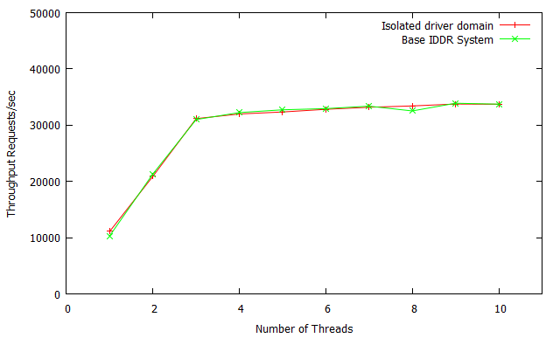
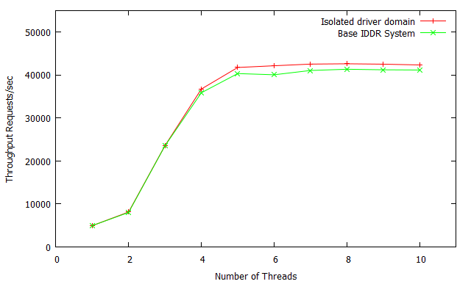
Split device driver vs base IDDR system
Ramdisk - Random writes
Loop device - Random reads

Slide 24
Methodology
Base IDDR system Vs new IDDR system ( RAM disk and loop device)
Application domain/ Domain 0 / PV guest
Driver domain/
Domain U / HVM guest
Domain 0 – Application domain
Domain U – Driver domain
Sysbench
Frontend
Backend
RAM disk/loop device

Slide 25
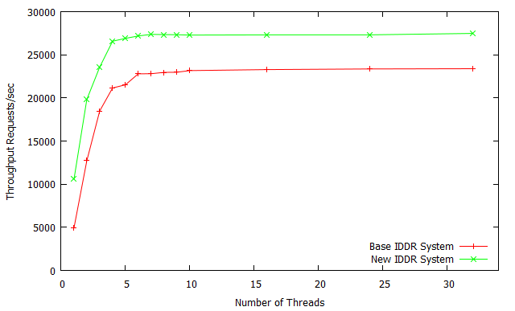
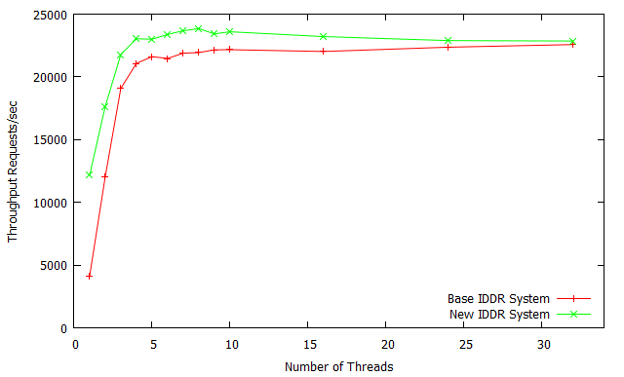
Base IDDR vs New IDDR (Ramdisk)
Random reads
Random reads writes

Slide 26
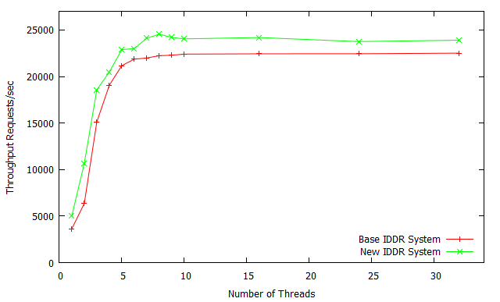
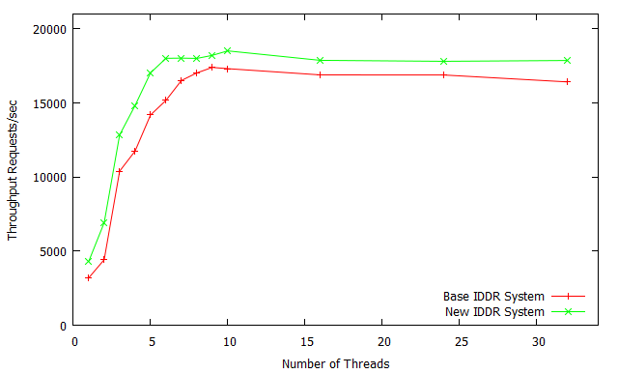
Base IDDR vs New IDDR (Loop device)
Random reads
Random reads writes

Slide 27
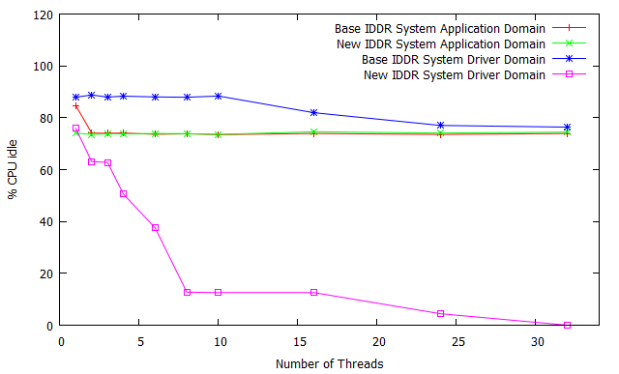
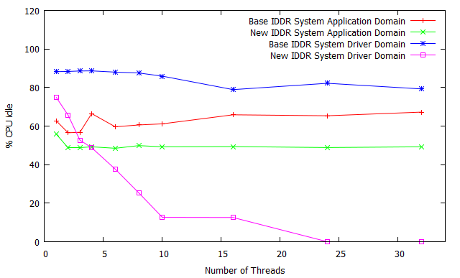
CPU utilization
Random reads on a RAM disk
Random reads on a loop disk

Slide 28
Methodology
Base IDDR system Vs new IDDR system ( SATA Disk)
Driver domain/
Domain 0 / PV guest
Application domain/ Domain U / HVM guest
Domain U – Application domain
Domain 0 – Driver domain
Sysbench
Backend
Frontend
SATA disk

Slide 29
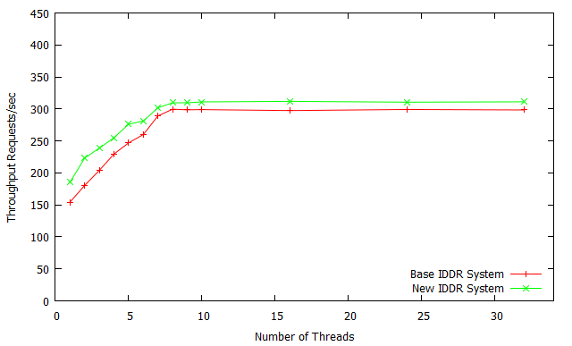
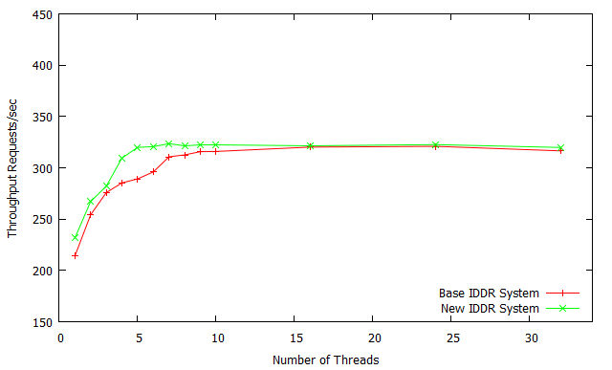
Base IDDR vs New IDDR (SATA disk)
Random reads
Random reads writes

Slide 30
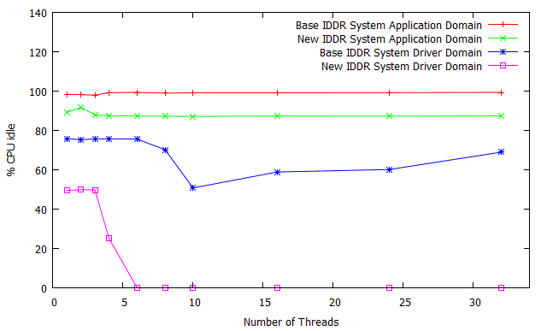
CPU utilization
Random reads on a SATA disk

Slide 31
Related Work
Inter domain communication
Xen split device driver :
Faces the performance issues because of data copy overhead and page flipping overhead
Xen socket :
A UNIX domain socket like interface in order to overcome the page flipping performance overhead
Needs an existing socket interface APIs to be changed

Slide 32
Related Work
Inter domain communication
Fido :
Shared memory based inter domain communication mechanism
Avoid page flipping and copy overheads
Enables end-to-end zero-copy communication across multiple domains.
Leverages relaxed trust model.

Slide 33
Future work
Adaptive spinning
In current implementation the read request thread and read response thread spins for a constant amount of time.
It will be interesting to see the impact of adaptive spinning of these threads.

Slide 34
Questions ?

