Slide 1
Isolated Device Driver
Sushrut Shirole

Slide 2




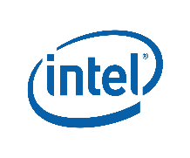
Typical OS components
User
Process
User
Process
User
Process
Operating System
Hardware

Slide 3
Device Driver
A device driver is a computer program which acts as a translator between the hardware device and the application or the operating system.
User
Process
User
Process
User
Process
Operating System
Network
SATA
Hardware

Slide 4
Why Device Driver isolation ?
Coverity's analysis of the Linux kernel code
1000 bugs in the Linux kernel 2.4.1
950 bugs in the Linux kernel 2.6.9
53% of the bugs are present in the device driver portion of the kernel
Any portion of the kernel can overwrite data structure in the kernel space
This causes a bug in a device driver to corrupt the memory of other kernel components

Slide 5
Why Device Driver isolation ?
Underlying cause of unreliability in operating systems is the lack of isolation between device drivers and a Linux kernel

Slide 6
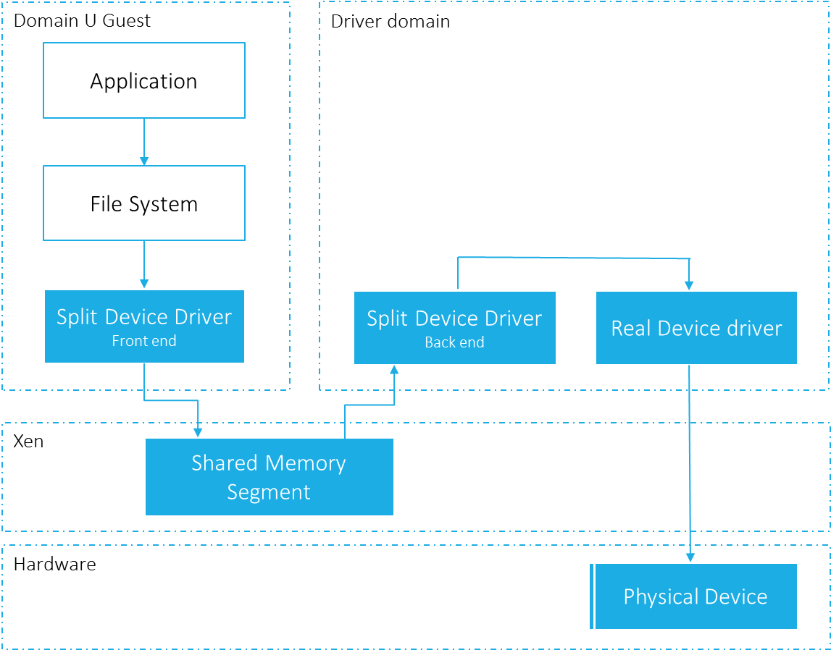
Xen’s Isolated Driver Domain
The Xen hypervisor isolates the device driver by running it in a separate domain called Driver Domain

Slide 7
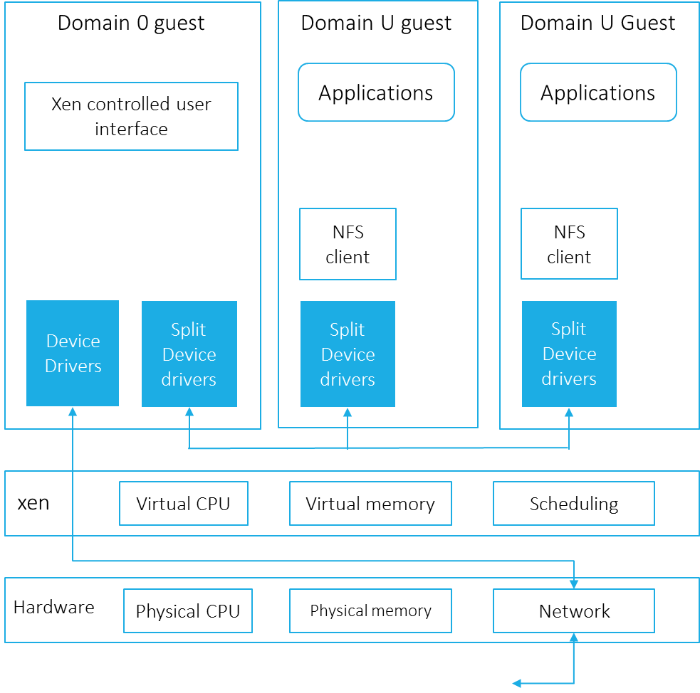
Xen Split Device Driver
Source code for the Isolated Driver Domain is not available.
But the Isolated Driver Domain follows split device driver.

Slide 8
Isolated Device Driver (IDDR)
Our implementation of the Isolated Driver Domain
Follows the same Xen split device driver model
We refer the baseline code or the re-implementation of Isolated Driver Domain as Base IDDR system
One with the performance improvement is referred New IDDR system.

Slide 9
Properties of the Base IDDR
Strong isolation: A bug within a device driver does not affect the other kernel component.
Transparency: User need not be aware of the system architecture to run the application.
Compatibility: Existing drivers and applications are compatible with the new architecture. Changes to the device driver and applications are not required to run the system.

Slide 10
Design Goals of the New IDDR System
Performance improvement: The only design goal of the New IDDR system is to improve the performance of the base IDDR system without compromising any properties of it.

Slide 11
Domain 0 guest
Domain U guest
Domain U Guest
Applications
Applications
Xen controlled user interface
NFS client
NFS client
Device Drivers
Split Device drivers
Split Device drivers
Split Device drivers
xen
Virtual CPU
Virtual memory
Scheduling
Hardware
Physical CPU
Physical memory
Network

