Slide 1
Predicting optimal location for a Fast Food Restaurant in Chicago
Made by sushma

Slide 2
Location Elements considering for potential restaurant location 1 since there are lots of restaurants in Berlin we will try to detect locations that are not already crowded with restaurants. 2 we are particularly interested in areas with no Fast Food Restaurants in vicinity.
Acessibility
3 Located near to center makes accessible for customers
4 Drive through should be there

Slide 3
Advantages of Fast Food Restaurant
One of the advantage of choosing Fast Food over regular restaurant are
Fast serving time
convenient
Nutritious items like peanut butter, pasta, brown rice are relatively inexpensive
Low cost food can help stay with budget

Slide 4
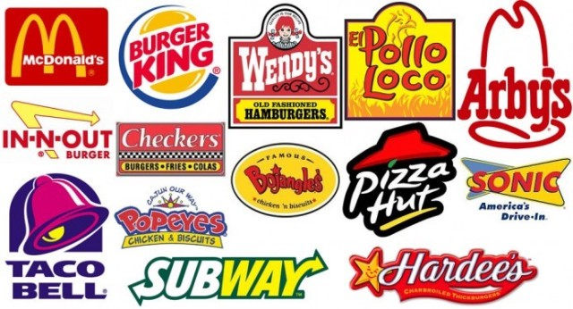

Slide 5
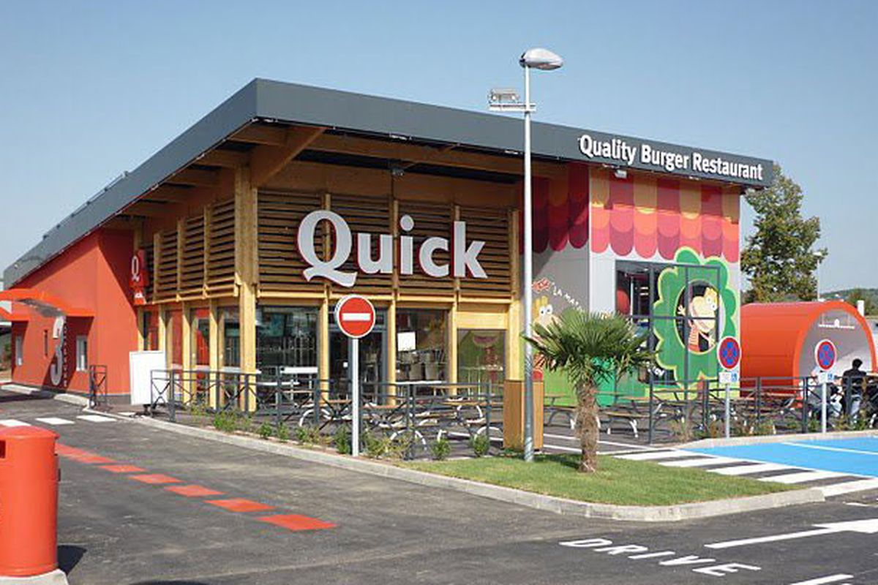

Slide 6
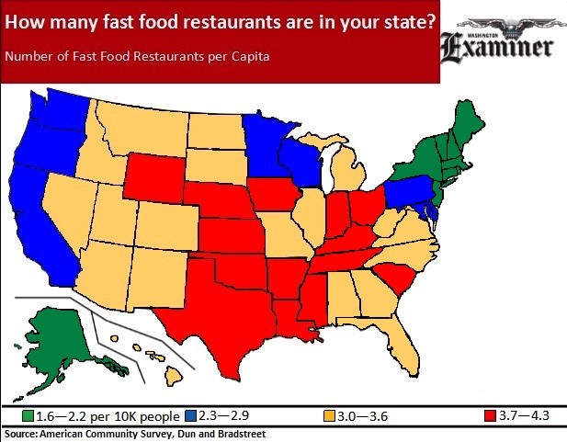

Slide 7
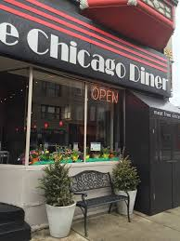

Slide 8
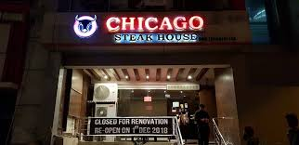

Slide 9
DATA
In this project we will try to find an optimal location for a restaurant.
Specifically, this report will be targeted to stakeholders interested in opening
an Fast Food Restaurant in Chicago.
We would also prefer locations as close to city , Advantages of each area will
then be clearly expressed so that best possible final location can be chosen by
stakeholders.

Slide 10
conclusion
After doing analysis and discussion , the conclusion is
Purpose of this project was to identify Chicago areas close to center with low number of restaurants (particularly Fast food restaurants) in order to aid stakeholders in narrowing down the search for optimal location for a new Fast food restaurant. By calculating restaurant density distribution from Foursquare data we have first identified general boroughs that justify further analysis , and then generated extensive collection of locations which satisfy some basic requirements regarding existing nearby restaurants. Clustering of those locations was then performed in order to create major zones of interest (containing greatest number of potential locations) and addresses of those zone centers were created to be used as starting points for final exploration by stakeholders.
Final decision on optimal restaurant location will be made by stakeholders based on specific characteristics of neighborhoods and locations in every recommended zone, taking into consideration additional factors like attractiveness of each location (proximity to park or water), levels of noise / proximity to major roads, real estate availability, prices, social and economic dynamics of every neighborhood etc.

Slide 11
