Slide 1
Student Management System
Image source: icon-icons.com

Slide 2
Framework for 3 Weeks
Every Day Discussion about previous topics and Technologies and doubt clarifications.
Every day interaction with SME/Trainer discussions of Project progress & transformation based on UML & Technologies.

Slide 3
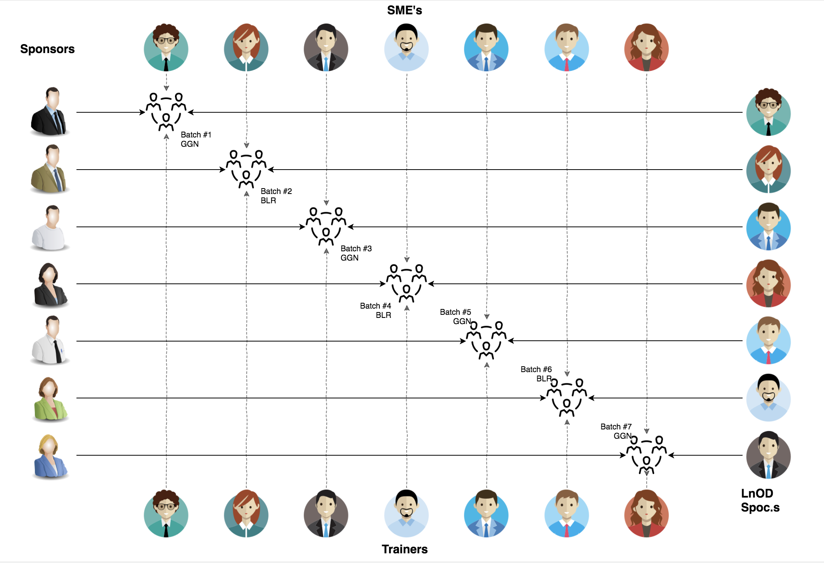
Stakeholders
Sponsors
1. Flipkart
SME’s
SMES
Other HR & Experts
Trainers
Trainers
Image source: googleImages

Slide 4
PLANNING
Notes:
Time – 1 min
Swati

Slide 5
3 Weeks of Training + Project demo
15 DAYS
150 HOUR
9000 MINUTES
5,40,000 SECONDS
Limitless knowledge

Slide 6
Agenda
01
Our Journey
02
Our Team
03
Project Goals
04
Engineering Practices
05
Tech Stack
06
Development
07
Challenges & Learnings
08
Demo
09
Questions
Image source: dokmart.com
Notes:
Time – 1 min

Slide 7
Our Journey
Image source: clipart.com
Notes:
Time - 2 mins

Slide 8
Demo
Mindset
Process
5
Project Demo
Tools
4
Adapting to a Developer
mindset
Comprehend
3
Design Thinking (UML)
2
Decide the Technologies JAVA/REST
1
Understanding Project Goals

Slide 9

Our Team
Sushma Manthena
Amit Balyan Sir (Mentor)
Image source: googleImages
Notes:
Time – 2 mins

Slide 10

Project Goals
Image source: googleImages
Notes:
Time – 3 mins

Slide 11




Our Vision
To create an Student Management System, using Java and MySQL, where a student can register for courses, make payment for the semester and view grades when uploaded by professor.
1
2
Quality
Security
3
4
Interactivity
Speed
Image source: googleImages
Notes:
User satisfaction and brand value

Slide 12

Engineering Practices
Image source: googleImages
Notes:
Time – 5 mins

Slide 13
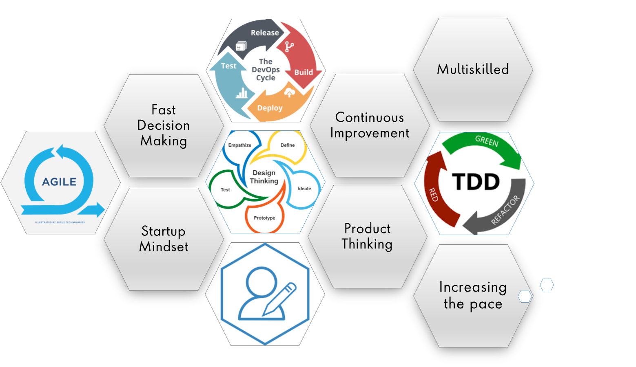
Image source: googleImages
Notes:
Product Thinking (Design Thinking, Requirement Analysis, )
Multi Skilled (Frontend, Backend, DevOps)
Fast Decision Making (Agile)
Increasing the Pace (Automation CI/CD)
Startup Mindset (Agile)
Continuous Improvement (Retros)

Slide 14
SDLC:
1. Requirement gathering
2. Design
3. Implementation and coding
4. Testing
5. Deployment
6. Maintenance
Image source cdn.softwaretestinghelp.com

Slide 15

Technology Stack
Image source: googleImages
Notes:
Time – 2 mins

Slide 16


The technologies used in the project are:
1. Core Java
2. MySQL
3. GIT
4. Apache - Jersey
5. Dropwizard
eclipse
dropwizard
Image source: icons8.com
Notes:
Time – 1 min

Slide 17

Development
Image source: googleImages
Notes:
Time – 1 min

Slide 18
Planning
Understanding problem statement
Requirement understanding
Research and analysis
Estimation
Sprint Planning
Spring Grooming
Sprint Implementation
Delivery
Integrate
Deploy
Test
LLD
Development
Code Review
Commit
Notes:
Time – 1 min

Slide 19

Challenges & Learnings
Image source: googleImages
Notes:
Time – 2 mins

Slide 20
Got familiarized with Unix commands and Git commands
Learnt UML Diagrams
Understood new Java8 features and used them
Using dropwizard
Java version Conflicts

Slide 21

Demo
Image source: googleImages
Notes:
Time –
Architecture – 5 mins
NFR Dashboard – 3 mins
Demo – 10 mins
1. Show the Responsiveness and Wave tool first

Slide 22

Questions
Image source: googleImages
Notes:
Time - ?

Slide 23
Thank you
Notes:
Time – After this show the testimonial video. 1 min

