Slide 1
DATA-DIGGERS
Implementing a live dashboard on event data using Tableau

Slide 2

Meet the Team
Sushma Yedugani

Slide 3
Agenda
Introduction
Software and hardware requirements
Configurations.
Demo

Slide 4
Project Introduction
The prime objective of this project is to implement a live dashboard on event data using Tableau.
The events we will track will be recent changes to various Wikimedia projects, including Wikipedia.

Slide 5
Software requirements
For this project, we will need:
Tableau Desktop, with an active account
An active Rockset account
Rockset Java client library and JDBC driver

Slide 6
Hardware requirements
Operating system: Windows 10, macOS X
Intel Core i5 processor
Ram: 2 GB
Hard disk: 20 GB hard disk space
A stable internet connection

Slide 7
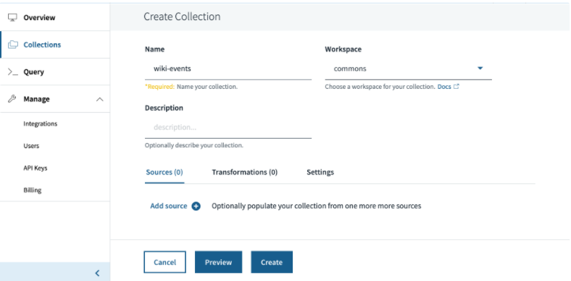
Ingesting Data from Wikimedia Event Stream
First create a collection, to which we will write the events originating from the Wikimedia stream.

Slide 8
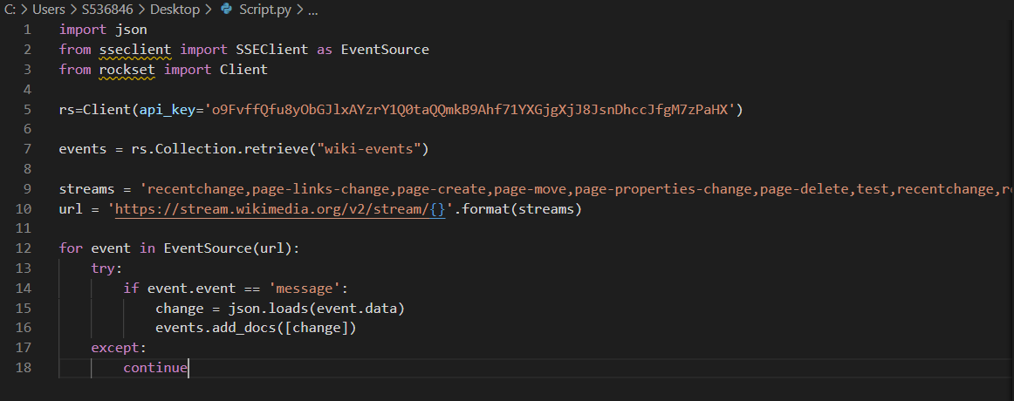
Script that subscribes to events from the wikimedia stream and writes them to wiki-events collection in Rockset.

Slide 9
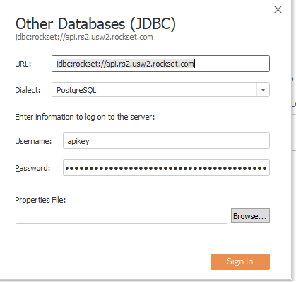
Connecting a Tableau Dashboard to Real-Time Event Data
Place the Rockset Java SDK jar in the following folder depending on the operating system:
Windows: C:\Program Files\Tableau\Drivers
Mac: ~/Library/Tableau/Drivers
In Tableau, navigate to a server and select other databases (JDBC)
Next configure the connection as follows:
Use jdbc:rockset://api.rs2.usw2.rockset.com for URL
Select PostgreSQL as dialect.
Enter apikey as Username and Rockset API Key as the password.
Click on Sign In

Slide 10
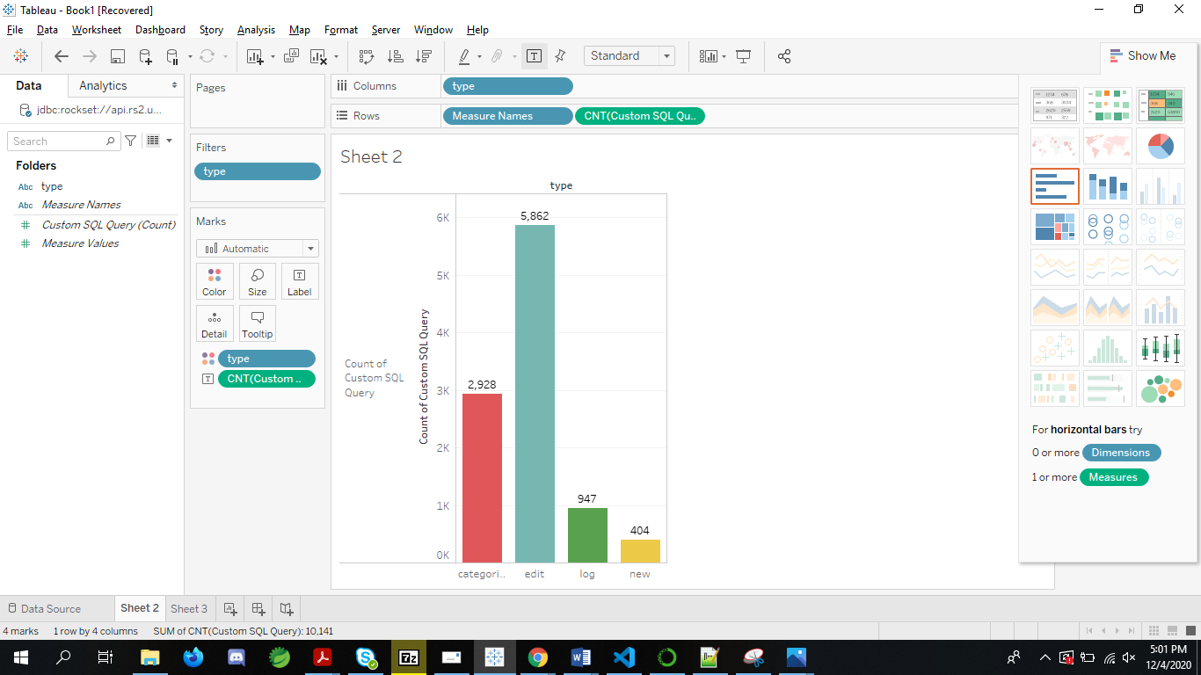
Wikimedia also tracks several types of change events: edit, new, log, and categorize. We can get an up-to-date view of the count of various types of changes made every minute.

Slide 11
Project Demo

Slide 12
Thank You

