Slide 1
Clustering of Countries
Sushma Vemuri

Slide 2
INTRODUCTION :
HELP International is an international humanitarian NGO that is committed to fighting poverty and providing the people of backward countries with basic amenities and relief during the time of disasters and natural calamities. It runs a lot of operational projects from time to time along with advocacy drives to raise awareness as well as for funding purposes.
BUSINESS UNDERSTANDING:
After the recent funding programs, they have been able to raise around $ 10 million. Now the NGO needs to decide
how to use this money strategically and effectively by choosing the countries that are in the direst need of aid.
PROBLEM STATEMENT:
The company wants to understand from the data analyst which are the top countries that need the aid.
ANALYSIS STEPS:
Read Data
EDA
Visualiza & Analysis
Clustering
Final Output based on the above methods

Slide 3
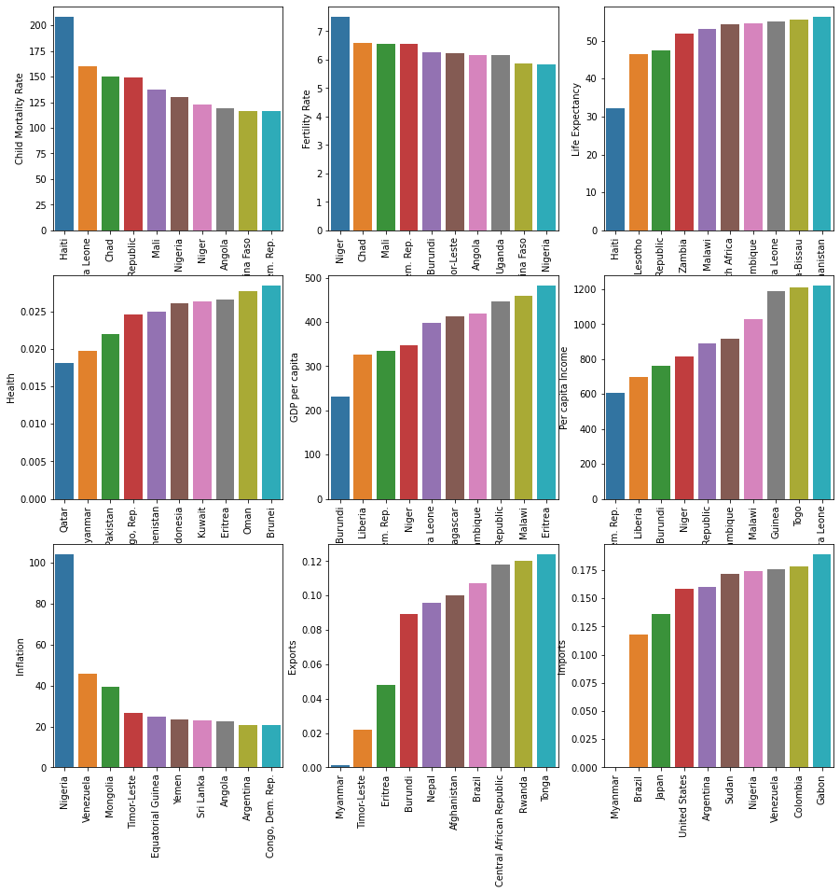
EXPLORATORY DATA ANALYSIS (EDA) :
The approach used to solve the case study is EDA i.e. Exploratory data analysis.
Exploratory data analysis uses data visualization techniques to draw inferences and obtain insights from them.
EDA also involves the preparation of data sets for analysis by removing irregularities in the data, so that these irregularities do not affect the further steps in the process of data analysis.
The following steps are used in EDA process to get to achieve the business objective.
Data Sourcing
Data cleaning
Data analyzing
Performing Univariant and Bivariant analysis on the data

Slide 4
Analysis methodology
EDA :Data Sourcing ,Data Cleaning & Analyzing
Outliers Analysis & Capping
Visualizing data to look for pattern.
Hopkins method, to know whether the data points for clustering is good enough
Scaling the data for all continuous variables
Performing clustering
1)Performing K means Clustering:
Choose the value of K
Silhouette score
Elbow curve-ssd
Clustering profiling
Clustering of countries
Clustering of countries
2)Hierarchical Clustering

Slide 5
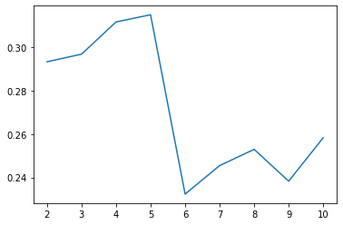
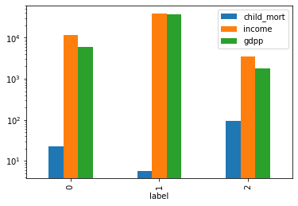
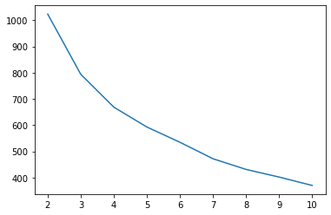
Silhoutte score , K=3
K MEANS Clustering:
For K means clustering k to be choosen based on
# Silhouette score
# Elbow curve-ssd
Clustering profile has been after the above steps to check the countries that has
Low income, Low GDP and High Child_mort
SSD :K =3

Slide 6
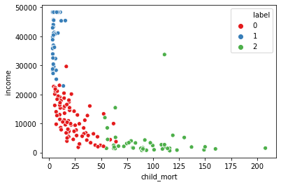
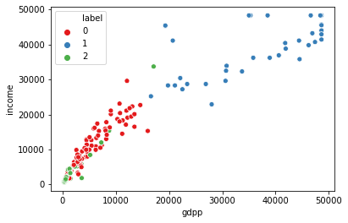
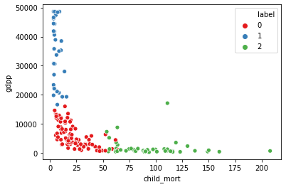
K MEANS Clustering
Plot Between Child Mortality vs Income
Plot Between Income vs GDPP
Plot Between Child Mortality vs GDPP

Slide 7
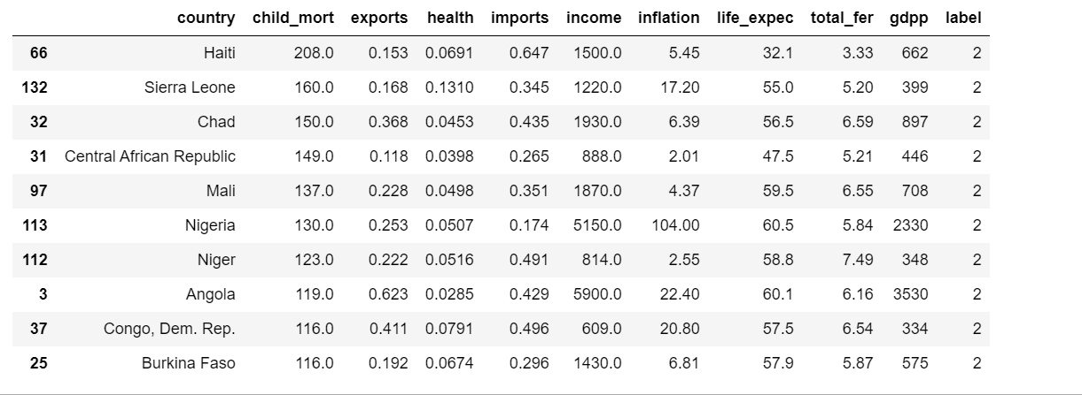
Top countries that need help based on K Means Clustering :

Slide 8
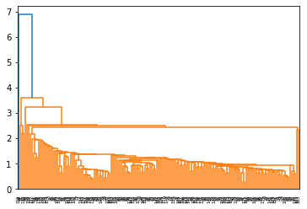
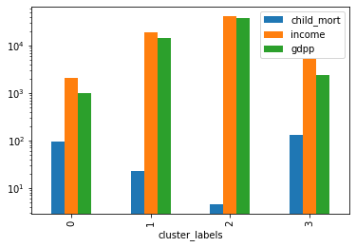
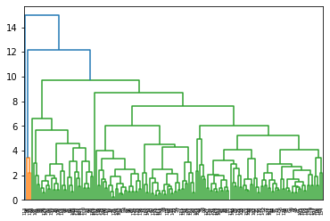
Single Linkage
Hierarchical Clustering
Hierarchical clustering is the second method of clustering.
It has two linkages simplage and complete linkages.
Based on this we can choose K value
Clustering Profile is done to get the result of top countries
Complete Linkage

Slide 9
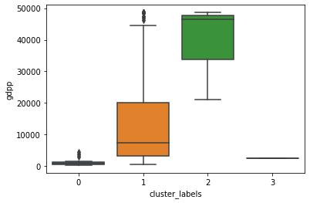
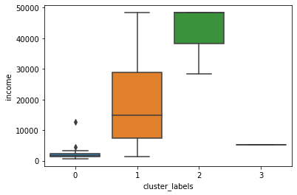
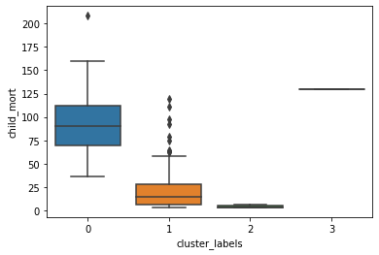
Hierarchical Clustering
Plot Between cluster_labels vs GDPP
Plot Between cluster_labels vs Income
Plot Between cluster_labels vs Child Mort

Slide 10
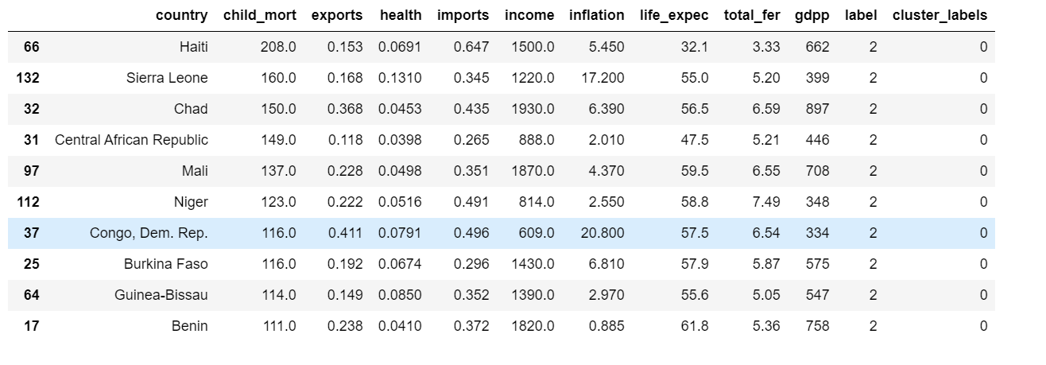
Top countries that need help based on Hierarchical Clustering :

Slide 11
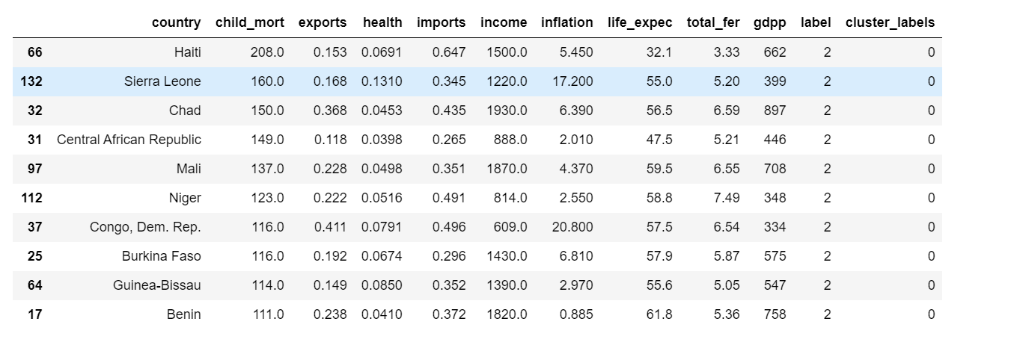
SUMMARY
As by both K means and Hierarchical clustering method - we have got same countries which requires aid. The following are the countries which are in direst need of aid by considering socio – economic factor into consideration:

