Slide 1
Data Science Week 1
17 March 2023

Slide 2
EXCEL
EXCEL
PIVOT TABLES
PIVOT CHARTS
DATA VALIDATION
SOLVER
SLICER

Slide 3
MySQL
Data Manipulation
SELECT
INSERT
UPDATE
DELETE
JOIN
GROUP BY
ORDER BY
Data Definition
Create Table
Alter Table
Delete Table or
Drop Table
Data Analysis
Sum
Avg
Max
Min

Slide 4
Sales Contribution By Region And Product Category

Slide 5
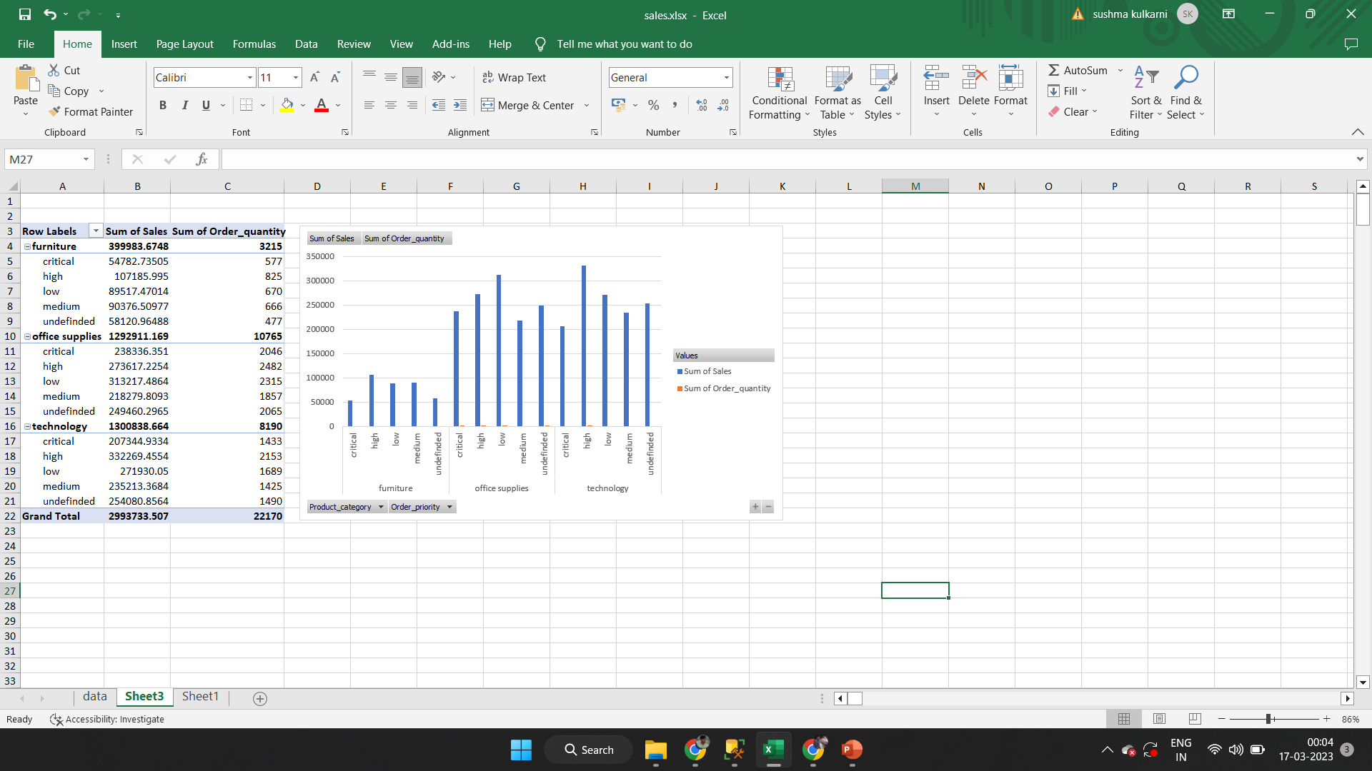
SELECT Product_category, Order_quantity, Sales, Order_priority
FROM dbo.Sales
WHERE Unit_price BETWEEN (SELECT MIN(Unit_price) FROM dbo.Sales) AND (SELECT AVG(Unit_price) FROM dbo.Sales)
AND Profit BETWEEN (SELECT AVG(Profit) FROM dbo.Sales) AND (SELECT MAX(Profit) FROM dbo.Sales)

Slide 6
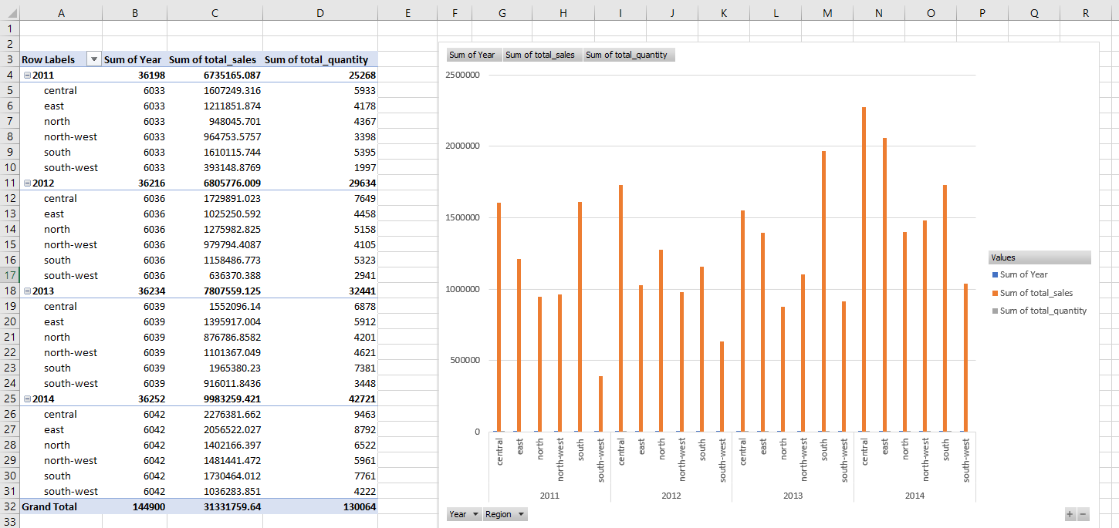
SELECT YEAR(Order_date) AS Year, Region, Product_category, SUM(Sales) AS total_sales, SUM(Order_quantity) AS total_quantity
FROM dbo.Sales
WHERE YEAR(Order_date) BETWEEN 2011 AND 2014
GROUP BY YEAR(Order_date), Region, Product_category
ORDER BY YEAR(Order_date) ASC, total_sales DESC

Slide 7
SELECT Profit, Discount, Product_category FROM dbo.Sales WHERE Discount BETWEEN (SELECT AVG(Discount) FROM dbo.Sales) AND (SELECT MAX(Discount) FROM dbo.Sales) AND Profit <0

