Slide 1
Data Science Week 2
24 March 2023

Slide 2
INTRODUCTION TO GIT
Git is a popular version control system: VCS is a system that records changes to a file or set of files.
It is used for:
Tracking code changes
Tracking who made changes
Coding collaboration
What does it do?
Manage project repositories
Branch and merge to allow for work on different parts and versions of a project
Pull the latest version of the project
Push local updates to the main project

Slide 3

THREE-TREE ARCHITECTURE
REPOSITORY
3. Commit changes with
a message
COMMIT
STAGING INDEX
2. Add Changes
ADD
WORKING
1. Make Changes

Slide 4
Main Commands
git init - Initialize the file or folder
git status – To check the status of the files
git add --a – to add
git commit –m “ message to commit” - To commit to repo
git diff – To see the difference between two or more branches
git rm f1.txt – Deletes the file from repo
git mv f1.txt f2.txt - Moving (renaming) files.
git log – To see what was done in the file or code

Slide 5
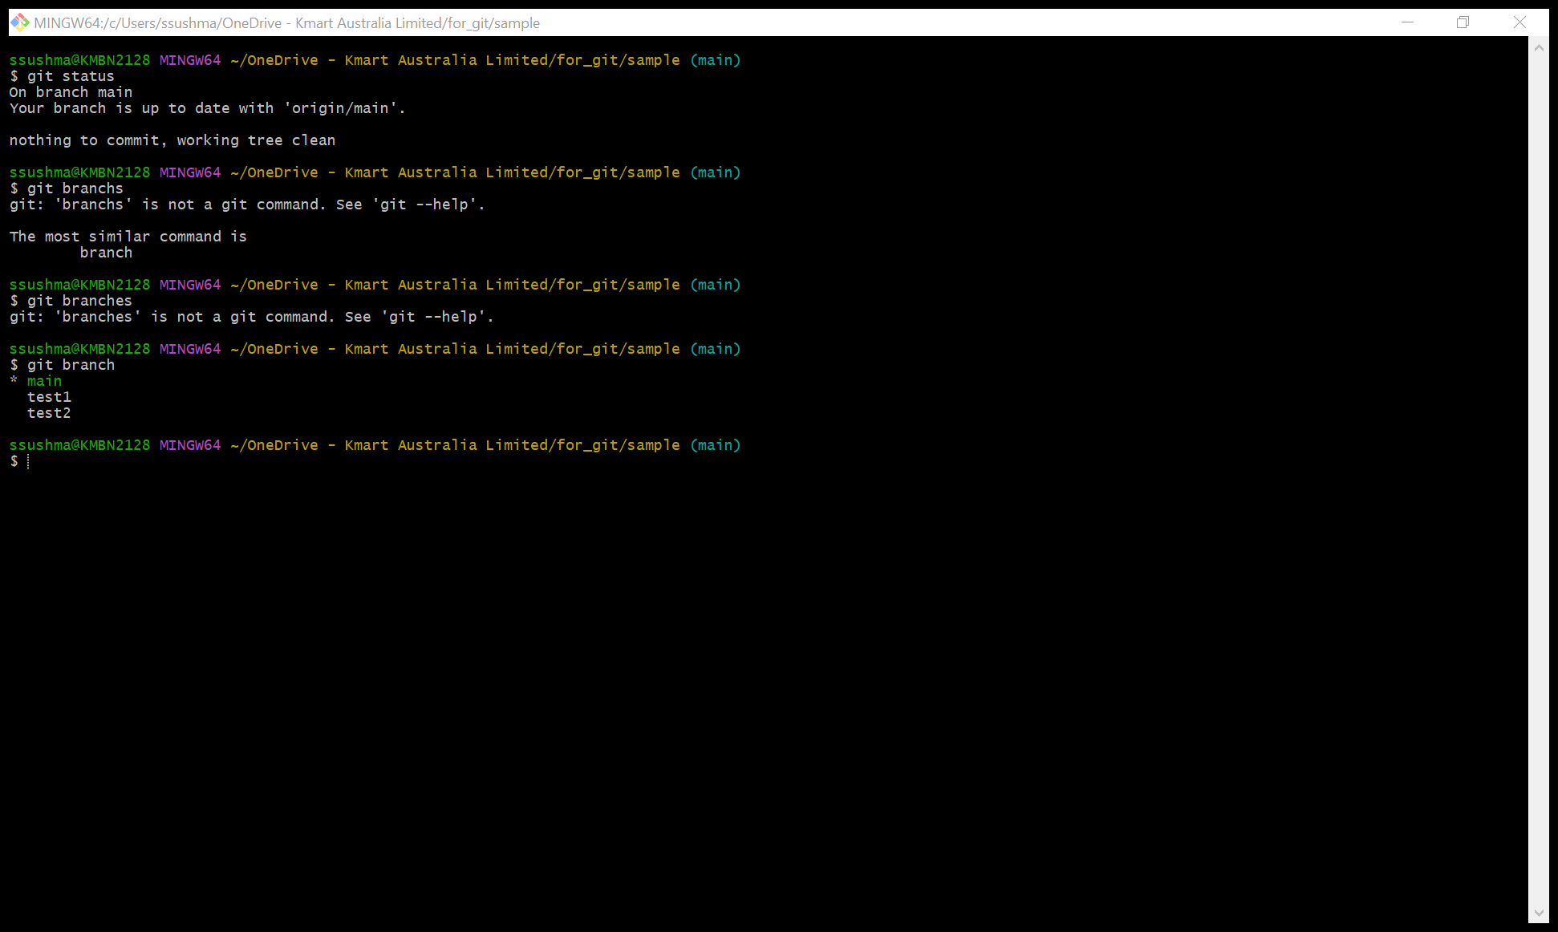
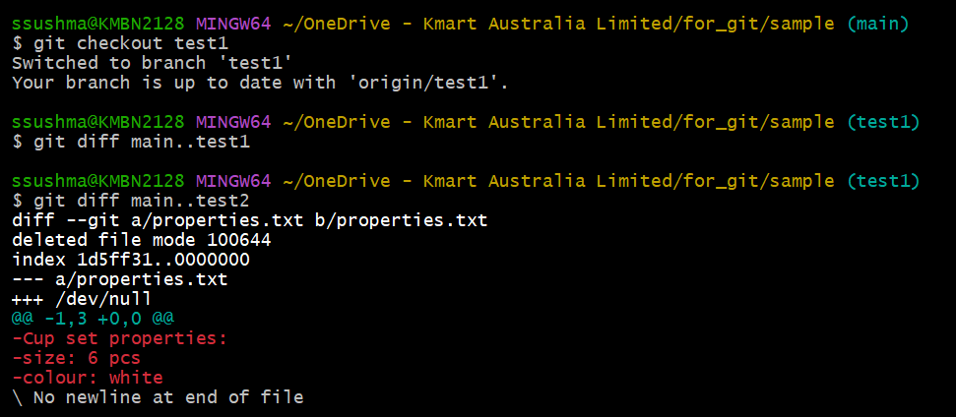
BRANCHING
To create a new branch:
git branch new_branch_name
To switch to new branch:
git checkout new_branch_name
Comparing Branches:
git diff first_branch..second_branch
Description of the properties

Slide 6
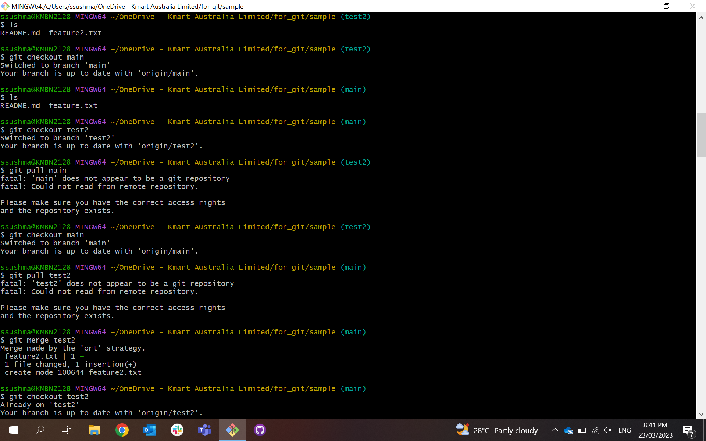
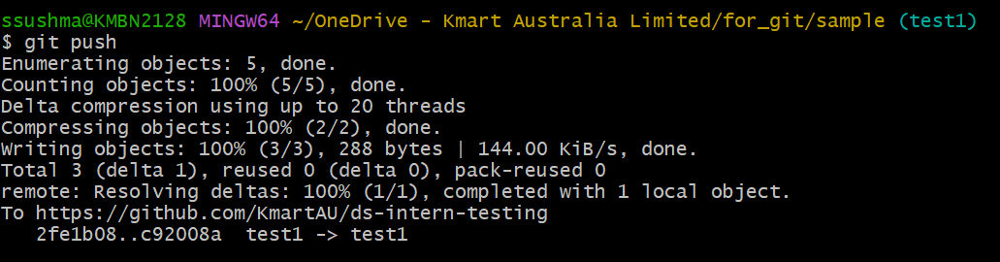
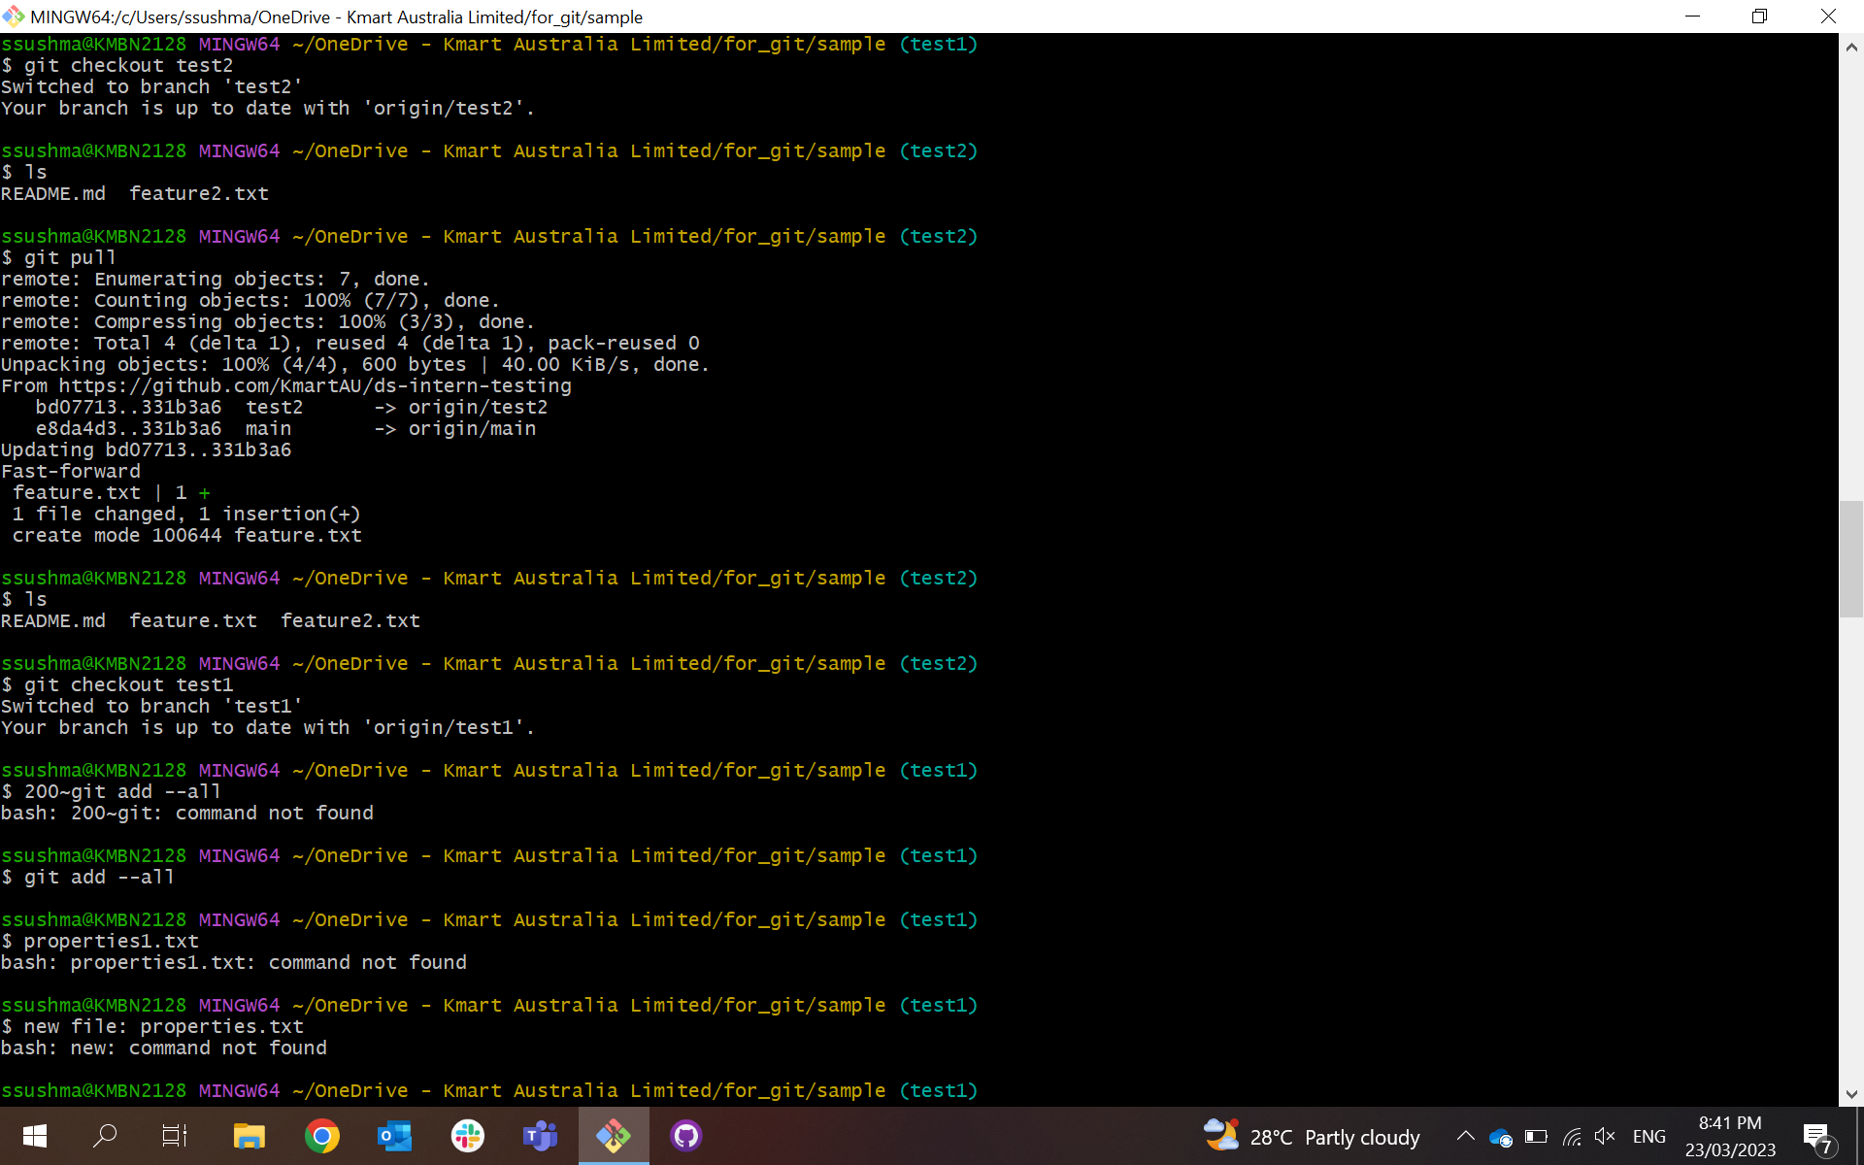
Merging a branch: from the branch into
which we want to merge another branch:
git merge branch_to_merge
To push :
git push
To pull: git pull
Deleting the branch_name:
git branch-d branch_name
Really sure to delete the branch:
git branch-D branch_name

Slide 7
RESOLVING MERGE CONFLICTS
SOLUTIONS:
Abort the merge using git merge –abort
Manually fix the conflict.
Merge commit:
Rebase: Brand new commit
features
features
main
main

Slide 8
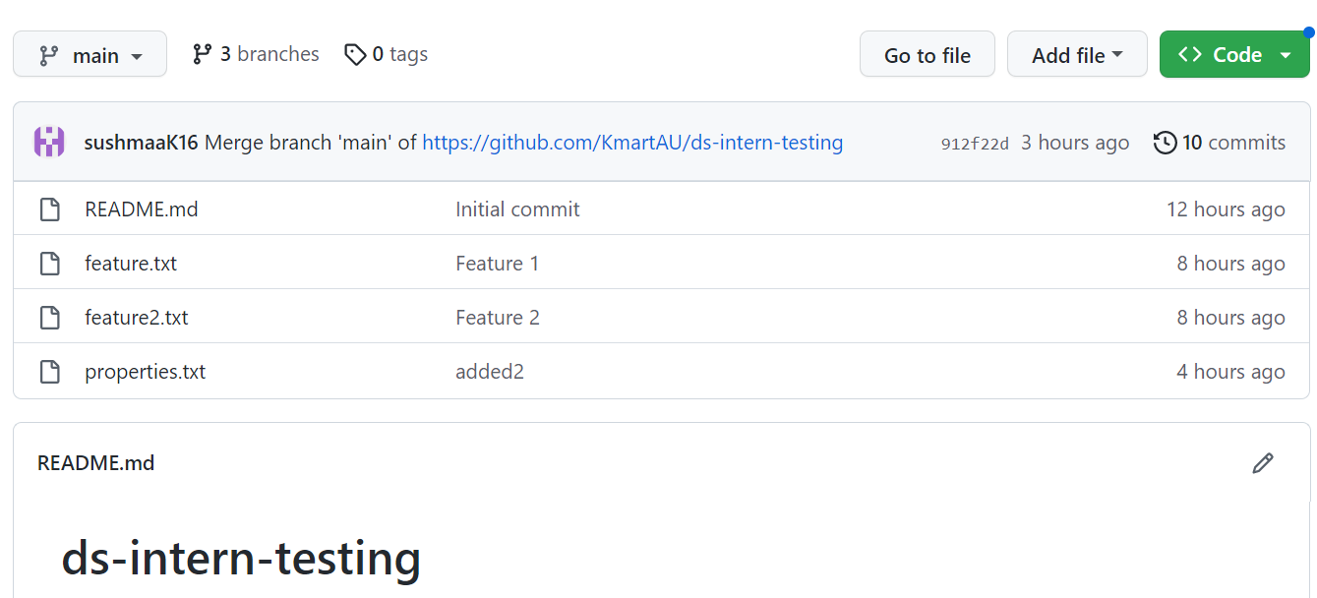
INTRODUCTION OF GitHub
GitHub is a website and cloud-based service that helps developers store and manage their code.
It as well as track and control changes to their code.
GitHub’s interface is user-friendly enough so it makes lot more easier for individuals and teams to use Git for version control and collaborations.

Slide 9
