Slide 1
Project title: Gain, Noise, and Power Study using Cascode Currect Mirrors.
2310040060 – Sowmya
2310040091 – N.Srija
2310040112 – Sushma
2310049143 – B.Srija

Slide 2
Project overview:
This project analyzes the gain, noise, and power consumption of cascode current mirrors.
Low Output Resistance – The output current varies with changes in output voltage, so it is not very stable.
Poor Accuracy – Mismatch and voltage drops cause the mirrored current to be different from the reference current.
Limited Voltage – Needs higher supply voltage to work properly, which is not suitable for modern low-voltage circuits.

Slide 3
A cascode current mirror is an enhanced version of a basic current mirror.
Current mirrors are vital in analog circuits for biasing and signal processing.
Simple current mirrors face issues like low output resistance, poor accuracy, and current mismatch.
Cascode current mirrors improve accuracy, efficiency, and are suitable for modern low-power, high-precision designs.

Slide 4
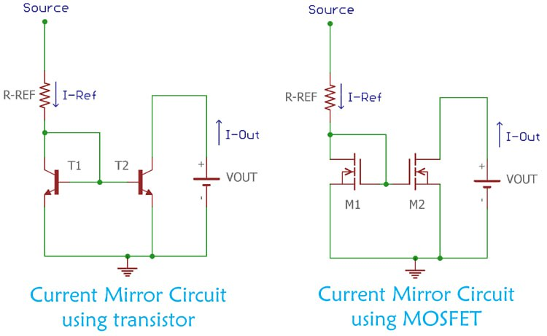
Block diagram:

Slide 5
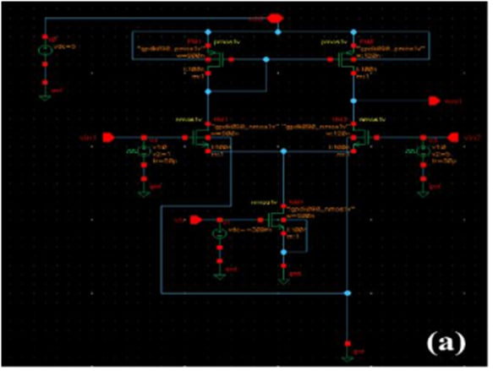
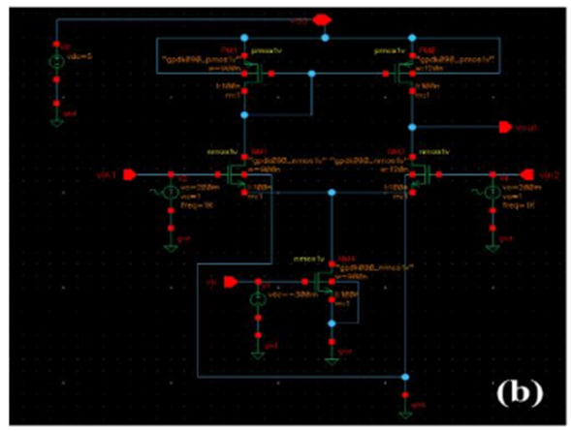
Circuit diagram:

Slide 6
Objectives:
Simple current mirrors have low output resistance and poor accuracy.
Cascode current mirrors improve current matching and minimize channel-length modulation effects.
They provide higher gain and better performance for analog circuits.
Simulation helps in analyzing output resistance, voltage headroom, and power efficiency.
Different cascode configurations can be compared for design trade-offs in practical applications.

Slide 7
Methodology:
Design simple and cascode current mirror configurations.
Set Conditions → VDD = 1.8 V, IREF = 100 µA, CMOS process models
Variation Analysis → Test at different temperatures and process corners.
Compare results of cascode vs. simple mirrors for efficiency improvement.

Slide 8
Thank you

