Slide 1
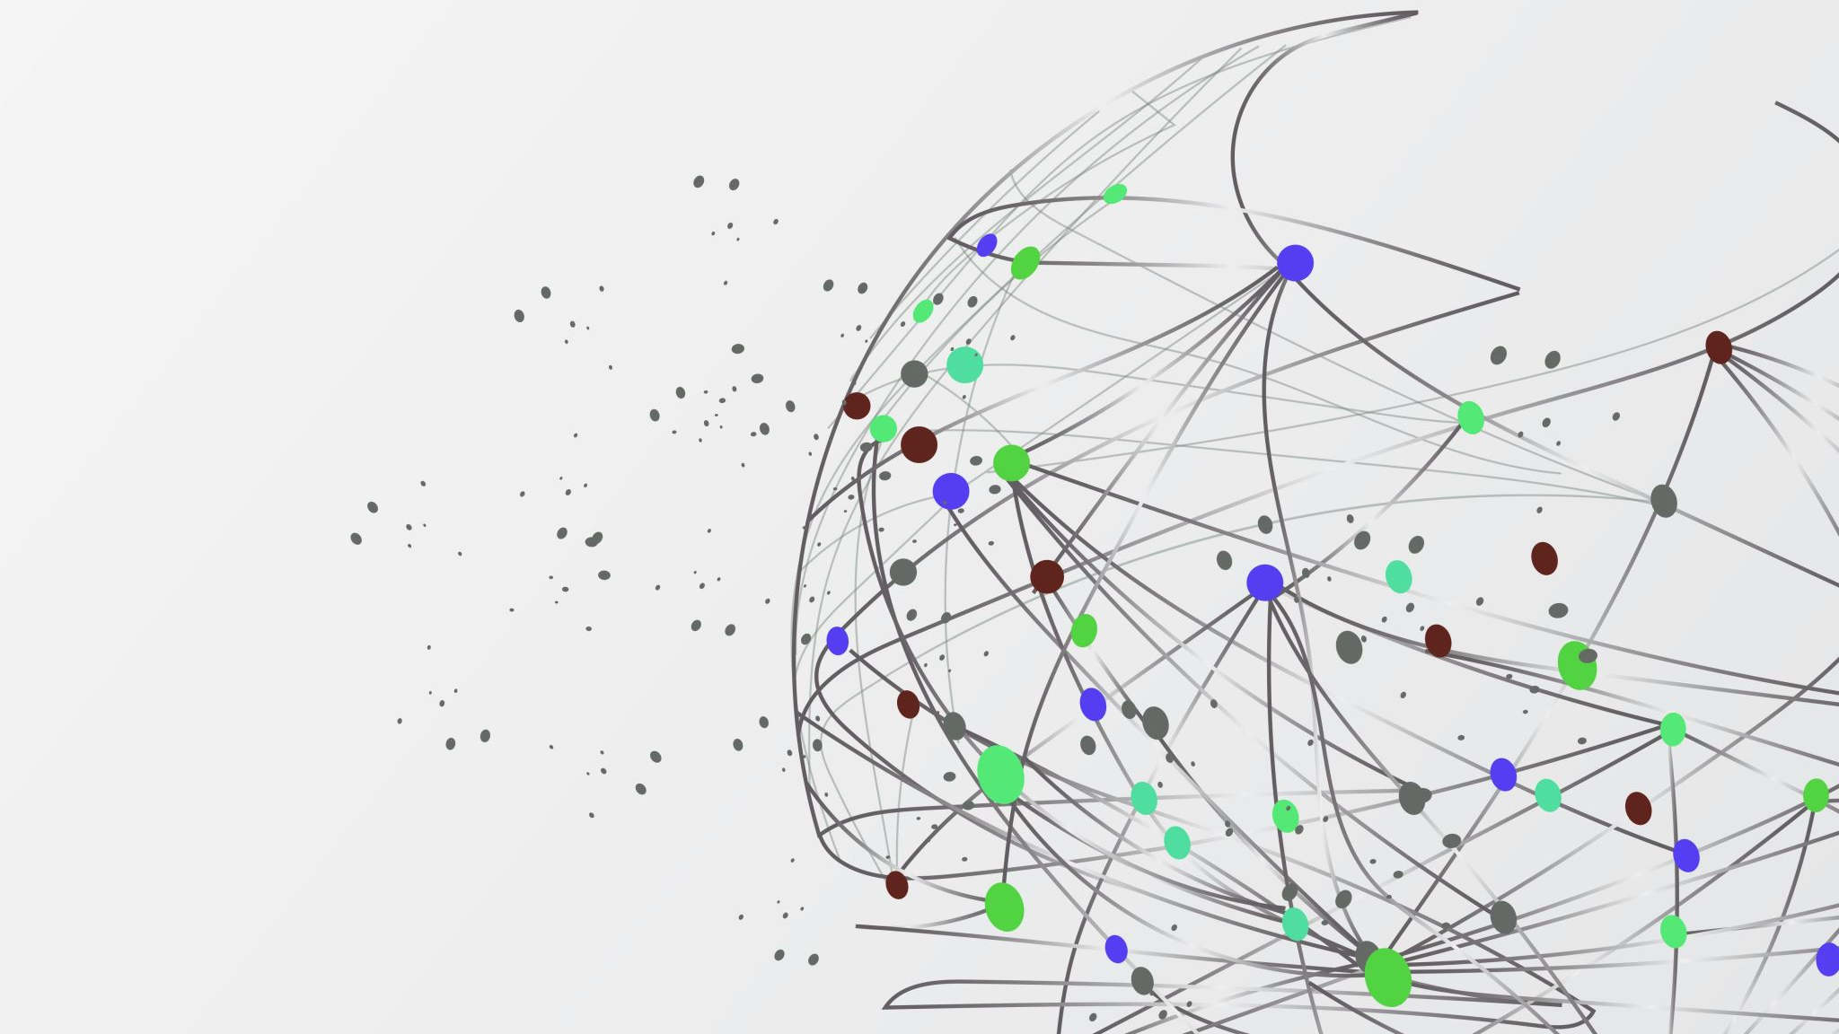
Mathematical Foundation Presentation Principal Component Analysis(PCA)
Team 8
Abhishek Kumar
Alekhya V
Santhosh M M
Sushma D

Slide 2
Introduction
Title of Research Paper:
PRINCIPAL COMPONENT ANALYSIS (PCA) AS AN IDEAL TOOL FOR ANALYSING ON-FARM RESEARCH DATA
What is On Farm Research?
On-farm research is a set of procedures for adaptive research aimed at developing recommendations for representative groups of farmers.
It is a research on a small part of the farm but uses plots large enough to allow for the use of standard field equipment and practical data collection
The objective of On-farm research is to identify existing inputs or practices that might help to solve major problems of many farmers in a defined study area

Slide 3
Why ON-Farm research?
On-farm research gives high quality results regarding the suitability of the investigated technological innovations under small, medium, and large-scale farming conditions.
On-farm research leads to more appropriate site-specific technology and aid faster adoption.
Since farmers are the adopters and often the innovators of new farming techniques, it would therefore be unwise to undertake farm-based research without involving farmers in the research process as much as possible.
Using accepted methods of on-farm testing, farmers can achieve experimental precision comparable to those of intensive university research trials.
On-farm research broadens the range of validity of conclusions beyond the narrow confines of a research institute
Stages of On Farm research:
Diagnosis
Planning
Experimentation
Assessment/Evaluation of results
Recommendation and Diffusion
Different type of field researches:
Small plot research On-station research On-Farm research

Slide 4
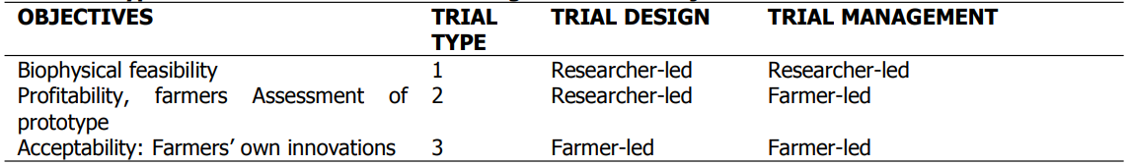
Types of ON Farm Research
On-farm research differs according to the chosen objective, the selected location, the type of design used and the degree of farmer involvement into:
Measurements Of ON-Farm experimental
There are 3 types of ON-Farm experiments:
Measurement of the types that are taken on in-station trails.
Measurement that are taken the Plot level
Measurement of Farmer opinions

Slide 5
Analysis of ON-Farm data
Analysis can be done in 3 ways depending upon the experimental and the survey data:
Analysis of Questionnaire data
Analysis of Plot data
Combination of above 2 analysis data using the results from interviews to understand the variation in yield type data
During the data analysis we should consider the following steps:
Split the data up into subsets
Omit particular plots(Foreign object invasion)
Pay close attention to comments made about individual plots
Use additional information, both at the farmer level and at the plot level
In the absence of within-farm replication, use treatment contrasts at the farm level to investigate the farm by treatment interaction, or investigate the interaction using the additional farmer information
report on, and possibly follow up on particular farmers who show interesting results

Slide 6
Principal Component Analysis(PCA)
Principal Component Analysis, or PCA, is a dimensionality-reduction method that is often used to reduce the dimensionality of large data sets, by transforming a large set of variables into a smaller one that still contains most of the information in the large set.
PCA is a mathematical procedure that uses an orthogonal transformation to convert a set of observations of possibly correlated variables into a set of values of linearly uncorrelated variables components
This transformation is defined in such a way that the first principal component has the largest possible variance (that is, accounts for as much of the variability in the data as possible), and each succeeding component in turn has the highest variance possible under the constraint that it be orthogonal to the preceding components
PCA can be done by eigenvalue decomposition of a data covariance matrix or singular value decomposition of data matrix; usually after mean centering (and normalizing or using Z-score) the data matrix for each attributes

Slide 7
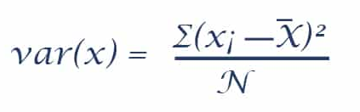
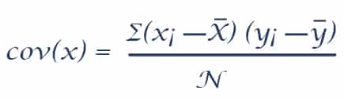
Few basic Terminologies:
Variance: Variance is used to compute the variation of the data points distributed across the dimensionality graph. Mathematically, it is the average squared variation from the mean value.
Covariance: With covariance, we can estimate the degree to which analogous components from a couple of sets of grouped data move in an identical direction. In simple words, it is used to identify the dependencies and relationships between the characteristics of datasets.
(xi and yi are the value of x and y in ith dimension)
Eigen Vectors and Eigen Values: It is used to make alterations in data comprehensible. It can also be understood as expanding/contracting an X-Y graph without altering the directions.
Eigen vectors are those, when a linear transformation is applies on them, then their directions remains unchanged.
An Eigenvalue is a value indicating the variance in a particular direction.
Principal Components: The fresh set of data variables that are collected from the original data set is called Principal Components. The new data variables are extremely meaningful and independent. They possess all the valuable information of the original variables.

Slide 8
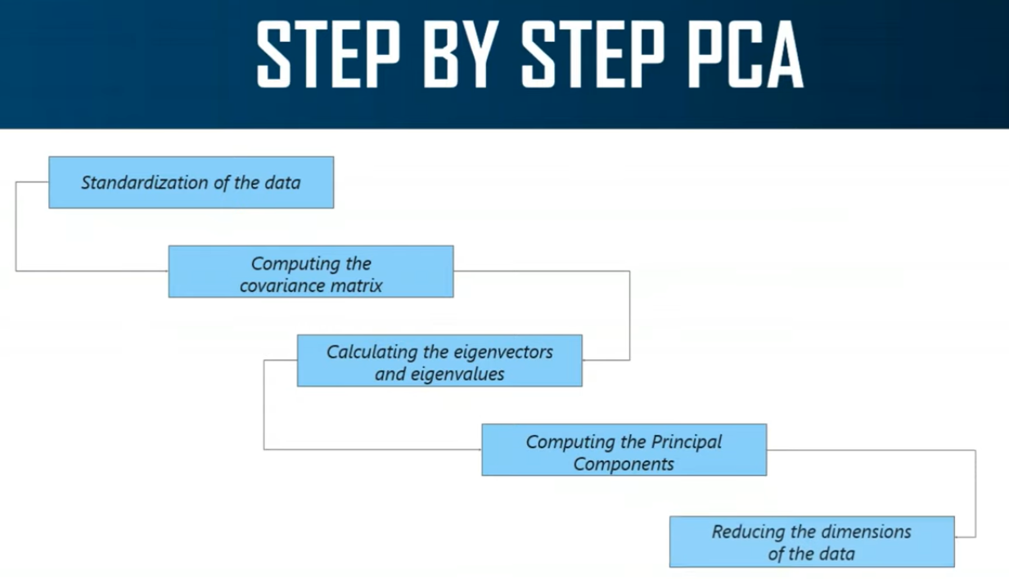

Slide 9
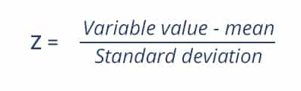
Step 1: Standardize the data
Standardization is the first step in data analysis and processing. It is scaling of data within a specific range so that the output of the corresponding variables is unbiased.
Standardization (Z) is calculated as follows:
Using this formula, all the variables will be scaled over a common scale.

Slide 10
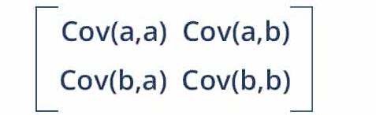
Step 2: Compute the covariance matrix for the data variables.
We calculate the covariance matrix to recognize the interdependencies between the variables and reduce it to improve the performance of the model.
The following is the formula to calculate the covariance of two-dimensional data:
Here, Cov(a, a) and Cov(b,b) is the covariance of a and b with itself.
Cov(a, b) is the covariance of ‘a’ w.r.t ‘b’
Cov(a, b) = Cov(b, a) {By Commutative property}
If Cov(a,b) is -ve, a∝(1/b)
If Cov(a,b) is +ve, a∝b

Slide 11
Step 3: Computing the eigenvectors and eigenvalues
In order to determine the PCA, eigenvectors and eigenvalues must be calculated from the covariance matrix.
For each eigenvector, there is an eigenvalue.
The computation of eigenvectors depends on the dimensions of the data.
If the data is two-dimensional, then we would have to calculate two eigenvectors and their corresponding eigenvalues.
The main objective of eigenvectors is to calculate the Principal Components by finding out the largest variance that exists in the dataset.
The larger the variance, the greater the information content of the data points.
Eigenvalues are just the magnitude of the eigenvectors. Both help to calculate the Principal Components.

Slide 12
Step 4: Calculating the Principal Components
After the calculation of eigenvectors and eigenvalues, we will arrange them in descending order.
Then, the very first Principal Component would be the eigenvector with the largest eigenvalue.
For the purpose of dimensionality reduction, we can eliminate the principal components with minor significances.
We then calculate the feature matrix that holds all the meaningful data that consists of maximal details and figures of the data.
Step 5: Dimensionality reduction of the Data Set
Final step in performing PCA is to re-arrange the original data with the final principal components which represent the maximum and the most significant information of the dataset.

Slide 13
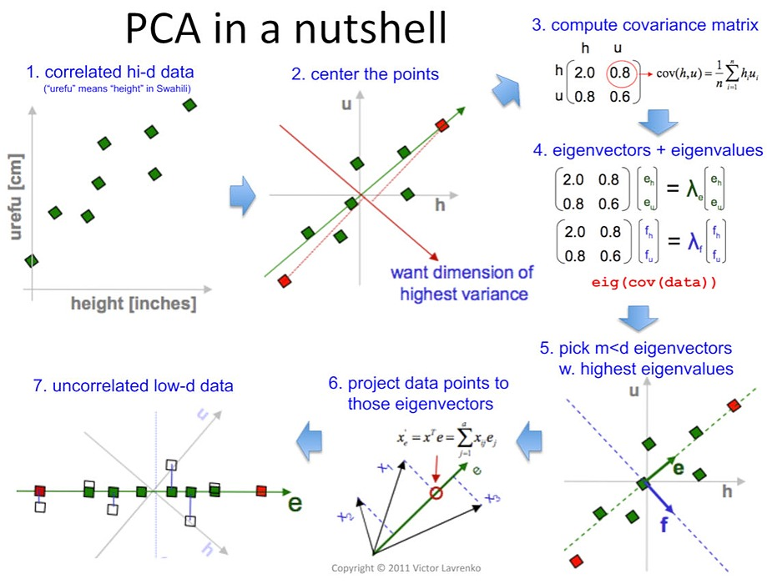

Slide 14
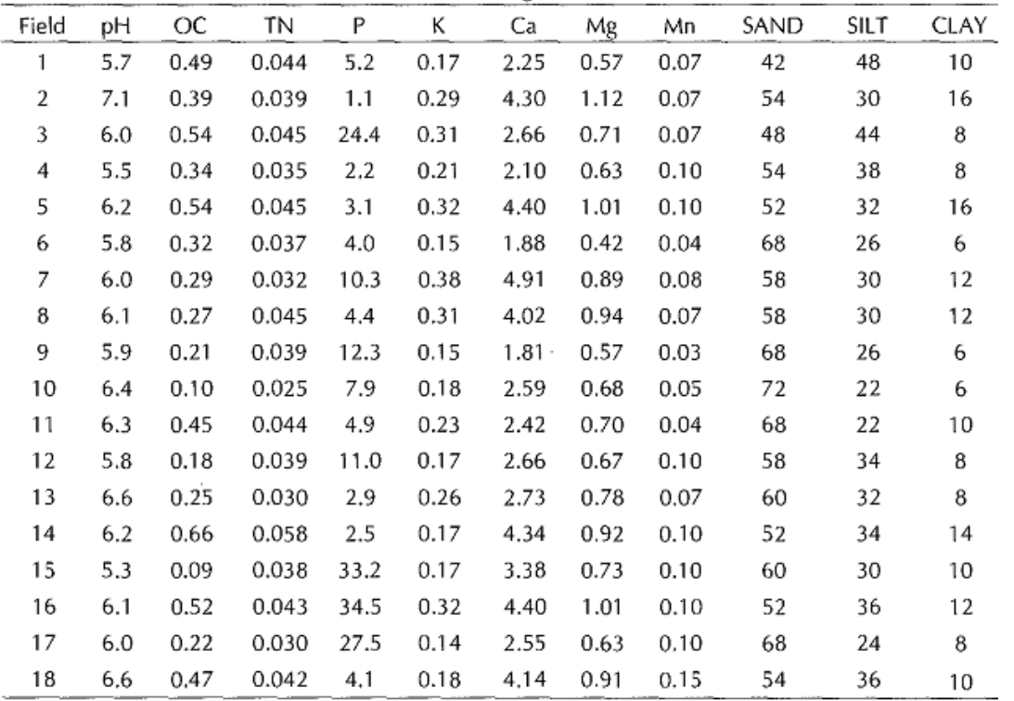
Calculation of PCA IN Paper
Chemical and textural properties were measured on soil from 18 farmers’ fields in Yamrat, Bauchi State, Nigeria
The questions which arise are:
which soil properties are correlated (relationship)
which soil properties contribute most to the overall variance in soil characteristics
How the number of variables can be reduced without losing too much information.

Slide 15
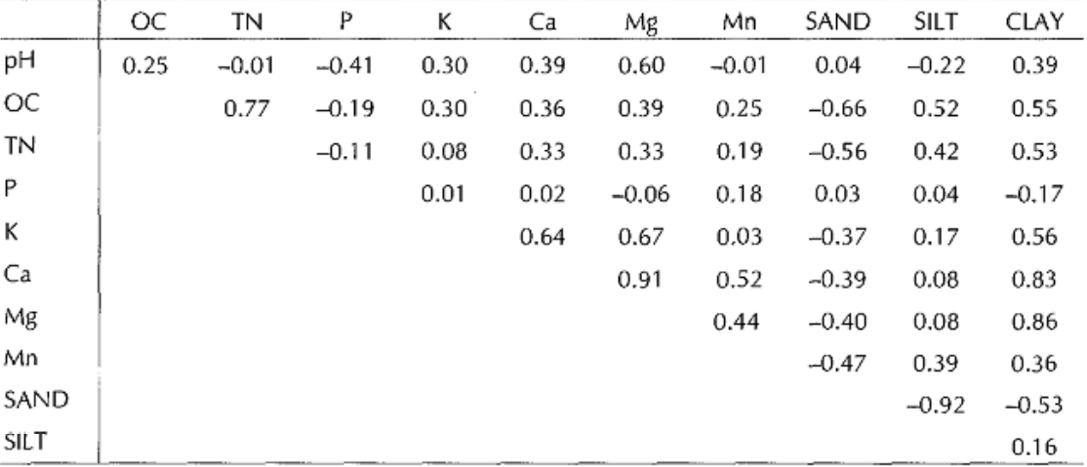
The next step is to compute correlation among the soil characteristics in order to reveal relationships between variables . This provides an insight into the relationship between the variables. In this case, a positive correlation is seen between soil Clay, Ca and Mg contents for the soil in these fields

Slide 16
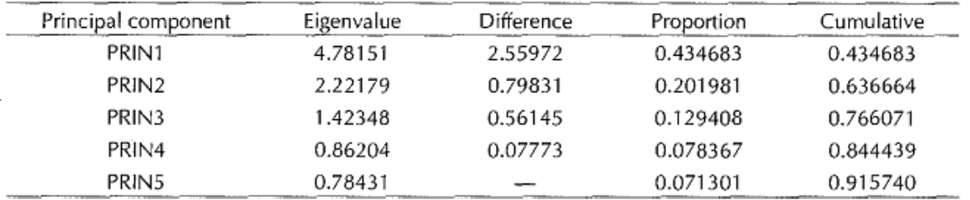
Eigen-values of the Correlation Matrix and the Proportion and Total of Variance Explained by the Five Largest Principal Components
Principal component 1 (PRIN 1) explains 43.4 % of the overall variance
PRIN 2, PRIN 3,PRIN 4, PRIN 5 contribute an additional 20.2 %, 12.9 %, 7.8 % and 7.1 % respectively
All five principal components together in this case explain 91.4 % of the overall variance

Slide 17
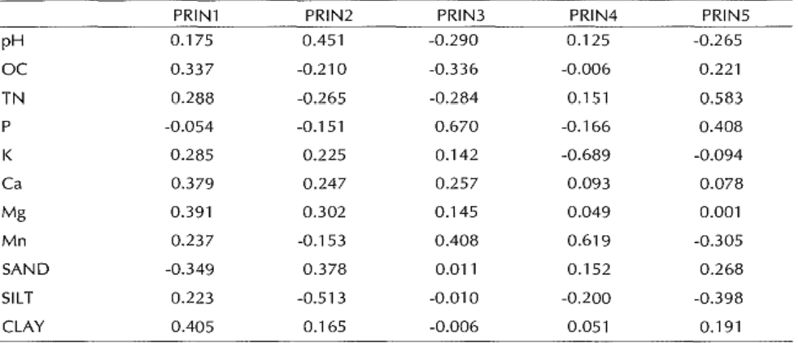
Eigenvectors of principal components representing a linear combination of the original variables
PRIN 1 is most strongly affected by the soil clay content and the Ca and Mg content, which were seen to be correlated earlier on.
PRIN 2 is most strongly associated with soil pH and soil silt content.
PRIN 3 is closely related to soil P.

Slide 18
Showing the PCA scatter diagram (bi-plot) for the variables

Slide 19
Conclusion
On-farm research has shown to be site specific, broader and faster adoption as compared to on-station research.
In on farm research, during data collections, one encounter situations where there are large number of variables. A good statistical analysis would be needed to make valid conclusion about such research.
Principal Component analysis, which is used to reduce the number of observed variables into a smaller number of variables that account for most of the variance in the data set, will find useful application in on-farm experimentation since a lot of variables are encountered.
PCA also reduces the cost of data processing.
PCA allows the use of variables which are not measured in the same units for example elevation, concentration of nutrients, temperature, pH, and so on, thereby making it a good tool for On-Farm research data analysis.

Slide 20
Applications of Principal Component Analysis (PCA)
Spike-triggered covariance analysis in Neuroscience
Quantitative Finance
Image Compression
Facial Recognition
Other applications like Medical Data correlation

Slide 21
Advantages of PCA
Removes Correlated Features
Improves Algorithm Performance
Reduces Overfitting
Improves Visualization

Slide 22
PCA Limitations
Model performance: PCA can lead to a reduction in model performance on datasets with no or low feature correlation or does not meet the assumptions of linearity.
Classification accuracy: Variance based PCA framework does not consider the differentiating characteristics of the classes. Also, the information that distinguishes one class from another might be in the low variance components and may be discarded.
Outliers: PCA is also affected by outliers, and normalization of the data needs to be an essential component of any workflow.
Interpretability: Each principal component is a combination of original features and does not allow for the individual feature importance to be recognized
Information Loss
Data standardization is must before PCA
Independent variables become less interpretable

Slide 23
Thank You!

