Slide 1
Project Title
Sugar Wagon Analytics - Sales prediction
Name:
Sushma Bhushan
Date:
11-05-2026

Slide 2


Agenda
Section
Slides
01 Problem Statement
Business background and analytics goals
Slide 4
02 Data Architecture
Data dictionary, ER diagram, tech stack
Slides 5–8
03 Data Quality Audit
Integrity checks, EDA, KPI framework
Slides 9–11
04 Descriptive Analysis
Customer distribution, sales and revenue
Slides 12–16
05 Diagnostic Analysis
Targets, profitability, operational efficiency
Slides 17–21
06 Predictive Modeling
Methodology, model results, feature importance
Slides 22–24
07 Strategic Recommendations
Actionable insights and next steps
Slides 25–26

Slide 3

Problem Statement
The Sugar Wagon Inc.
A leading US-based candy manufacturer operating across three core divisions: Chocolate, Sugar, and Other. Our operations span multiple factories and full-cycle data tracking from production to delivery.
Distribution Analytics Goals
Sales & Revenue
Tracking financial growth and trend analysis.
Customer Dist.
Mapping purchasing patterns by region.
Profitability
Identifying high and low performing products.
Operational Eff.
Optimizing factory-to-delivery workflows.

Slide 4
Business Context
Industry & Company Context: Sugar Wagon Inc. is a mid-market US candy manufacturer. Confectionery is highly seasonal, with Q4 accounting for a disproportionate share of annual demand.
Data Maturity & Scope: 4-year transactional dataset (2021–2024) covering 4 tables, 10K+ rows, and 28 columns across sales, products, factories and targets.
Stakeholder Priorities: Operations teams need factory efficiency benchmarks. Finance needs margin analysis. Executive team needs growth trend visibility and market expansion guidance.
Key Business Challenges: Low customer retention (55.7% one-time buyers), Gulf region underperformance, and unvalidated shipping data are the three primary operational gaps to address.
Why Predictive Analytics?: Moving beyond “what happened” to “what will happen” enables proactive inventory, pricing, and expansion decisions.

Slide 5
Data Dictionary and Structure
Sales
Transactional order details, quantities, and dates.
Products
Master list of candy varieties, divisions, and pricing.
Structure Overview
4 Tables
~28 Unique Columns and 10k+ rows
Factories
Operational site locations and production capacities.
Targets
Strategic benchmarks for financial and volume goals.
Key Performance Indicators:
Total Sales (Financial Growth)
Gross Profit (Margin Analysis)
Shipping Mode (Logistics)
Regional Perf. (Market Density)
Note: This data dictionary outlines the core schema for the Sugar Wagon Inc. analytical platform.

Slide 6



ER Diagram — Candy Sales Dataset
CANDY_PRODUCTS
CANDY_FACTORIES
PK: Product ID
FK: Division, Factory
• Product Name
• Unit Price
• Unit Cost
PK: Factory
• Latitude
• Longitude
CANDY_SALES
PK: Row ID
FK: Product ID, Division
• Order ID
• Order Date
• Ship Date
• Ship Mode
• Customer ID
• Country/Region
• City, State/Province
• Postal Code, Region
• Product Name
• Sales
• Units
• Gross Profit, Cost
CANDY_TARGETS
PK: Division
• Target
PK = Primary Key, FK = Foreign Key
Schema Type: Snowflake Schema · 4 Tables · 3 Relationships

Slide 7
Executive Summary
$138,284
Total Revenue
$91K
Gross Profit (66% margin)
~27%
YoY Growth (2023–24)
3.15x
Target Achievement
Key Findings
Top Recommendations
Chocolate dominates at 96% of revenue
Any supply disruption carries outsized risk. Diversification recommended.
Q4 is peak sales window every year
Holiday demand confirmed. Q3 inventory build-up is critical.
Pacific leads; Gulf is untapped growth market
Gulf revenue share: 15.6%. Targeted promotions recommended.
55.7% of customers are one-time buyers
Loyalty programme critical to improving retention and LTV.
Ship date anomaly flags data quality issue
Dates recorded 5–6 years post-order. Source system fix required.
1. Scale Q3 Inventory
Begin procurement ramp-up by August to meet Q4 surge.
2. Expand Gulf Region
Prioritise distribution partnerships and targeted promotions.
3. Launch Wholesale Loyalty Programme
Target the 15 repeat buyers and occasional buyers segment.
4. Fix Ship Date Source System Error
Unlock accurate logistics KPIs once data integrity is restored.
5. Volume-Based Sales Incentives
Units (r=0.73) is strongest revenue driver. Structure targets around volume.

Slide 8
Proposed Tech Stack
Problem Type
Regression
Predicting Target Variable:
'Sales'
Database
Snowflake
Data management and querying
Data Processing
DataBricks
Pandas/NumPy for Sales regression
Visualization
Power BI / Excel
Customer Distribution Dashboard

Slide 9
Data Integrity & Consistency Audit Results
Audit Section
Validation Details
Status
Data Type Checks
Confirmed for all tables and date formats.
PASS
NULL Checks
Zero missing values across every column.
PASS
Duplicate Checks
High volume of exact duplicates and split line items in Sales table.
CRITICAL FAIL
Referential Integrity
Perfect mapping between Sales, Products, Factories, and Targets.
PASS
Business Rule Validation
Math is correct, but shipping logic reveals a 5-6 year delay anomaly.
FAIL
Consistency Checks
Standardized spelling for Region, City, Product, and Country.
PASS
Migration Context
Data imported into Snowflakes Server for deep-dive quality validation across 4 primary tables.

Slide 10

EDA - Data Foundation & Quality Control
Multi-Source Integration
Quality Assurance Checklist
Consolidated four disparate master tables into a unified analytical environment:
Sales: Transactional order history
Products: Master pricing & division catalog
Factories: Capacity & location telemetry
Targets: Strategic growth benchmarks
Date Parsing Accuracy
PASS
Validated Order vs. Ship date intervals for consistency.
Missing Value Audit
100% CLEAN
Analytical Stack Optimization
Zero missing values detected across all columns.
Duplicate Scrubbing
COMPLETE
100% duplicate check completion; exact matches removed.
Pipeline: Converted large-scale raw data from Spark (Snowflake/Databricks) to high-performance Pandas DataFrames to enable complex regression and EDA.
Standardization: Verified 100% naming consistency across Region, City, Product, and Country identifiers.

Slide 11
KPI and KRA Framework
Key Performance Indicators (KPIs)
Key Result Areas (KRAs)
Sales
Total Revenue
Total Units Sold
Total Orders
Descriptive Analysis
Sales Performance (revenue/units/trends), Profitability Analysis (products/regions), and Target vs Actuals.
Profitability
Gross Profit
Gross Profit Margin %
Average Order Value
Diagnostic Analysis
Regional Performance (outliers), Product Mix (revenue vs profit), Seasonality/Trends (YoY patterns), and Shipping Efficiency (delays/modes).
Target
Target Attainment %
Target Gap
Revenue Growth Rate
Predictive Analysis
Sales Prediction models for long-term strategic planning.
Operations
Avg Ship Time (Days)
Cost-to-Sales Ratio
Revenue per Product

Slide 12


Customer Distribution Analysis
5,044
Total Customers
8,549
Total Orders
1.69
Avg Orders per Customer
Buyer Type Breakdown
Customer Distribution by Region
One-Time Buyers: 2,811 (55.7%)
Pacific
[32.6%]
Occasional Buyers: 2,218 (44%)
Atlantic
[29%]
Repeat Buyers: 15 (0.3%)
Interior
[22.6%]
55.7% of customers ordered only once — a loyalty programme is critical to improving retention.
Gulf
[15.6%]
Revenue share by region: Pacific 36.2% | Atlantic 28.1% | Interior 20.1% | Gulf 15.6%. Gulf is flagged as primary growth opportunity.
Top customers by division drive disproportionate profit — wholesale loyalty incentives recommended for high-value accounts.

Slide 13



Sales & Revenue Analysis
$138,284
Total Revenue
8,549
Total Orders
$16.17
Avg Order Value
~27%
YoY Growth (23-24)
Monthly Sales Trend
Revenue by Division
Q4 (Oct–Dec) is consistently the peak window — holiday-driven demand confirmed.
• Chocolate: 93% of revenue
• Other <7% share
• Sugar: <1% share
Chocolate division is the revenue backbone of Sugar Wagon Inc.
Division
Total Sales
Target
Achieve %
Chocolate
$128.2K
$27K
475%
Sugar/Other
$10,1K
$18K
325%
All divisions exceeded target — overall achievement 3.15x target.
Pacific leads regional revenue. Gulf is the lowest-performing region and represents the primary expansion opportunity.

Slide 14
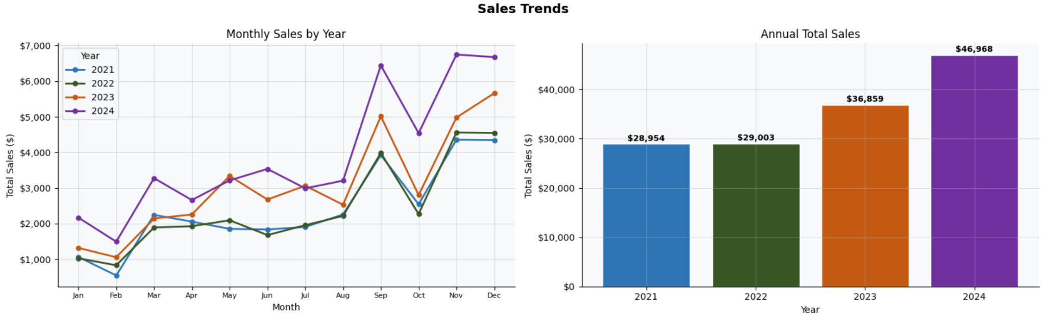
Historical Sales Performance & Seasonality
Growth Velocity
Year-over-Year (YoY) performance analysis reveals a robust growth trajectory for the 2023–2024 period.
~27% YoY Growth
Monthly Sales Trend Analysis
Seasonality Insights
Historical tracking confirms that Q4 (October to December) consistently represents the peak sales window.
Driven largely by holiday demand across candy divisions, this period accounts for the highest volume of annual transactions.
Business Note:
Inventory replenishment and supply chain logistics must be prioritized during Q3 to ensure stock availability for the Q4 surge.

Slide 15
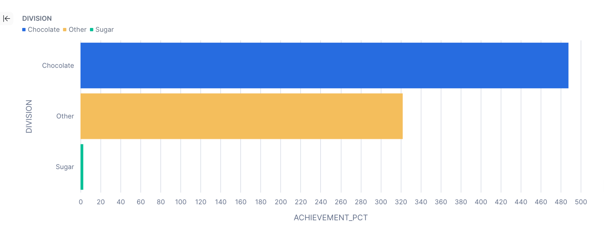
Performance Analysis — Targets vs Actuals
3.15x
Overall Target Achievement
Chocolate
Best Performing Division
~27%
Growth Rate (YoY)
Regional Performance Ranking
1
Pacific 🏆
Sales Leader
2
Atlantic
Consistent Performer
3
Interior
Market Stable
4
Gulf ⚠️
Growth Opportunity — lowest revenue share
Top Products by Units Sold
Wonka Bar dominates unit volume — 39K+ units sold.

Slide 16
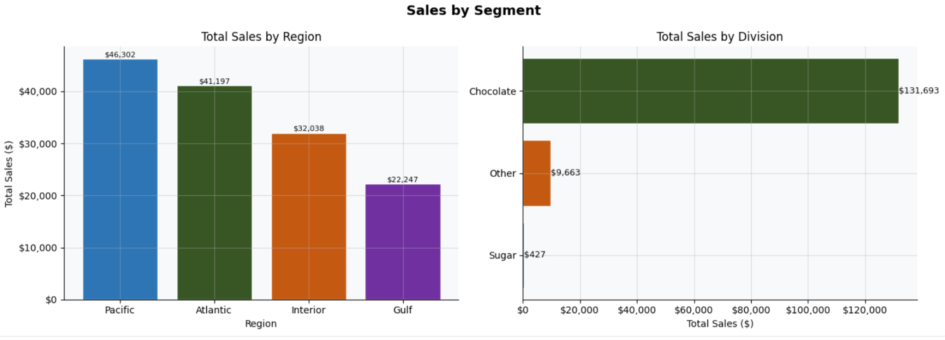
Market Concentration and Regional Analysis
Division Transaction Volume
Comparative Distribution Analysis
Chocolate
92.7%
Sugar/Other
The market is highly concentrated, with the Chocolate division dominating 96% of all transactional volume. Sugar and other niche products account for the remaining minority share, representing specialized market segments.
Regional Performance Insights
Pacific Region: Current sales leader with highest market density.
Gulf Region: Identified as a primary "Growth Opportunity" for expansion.

Slide 17
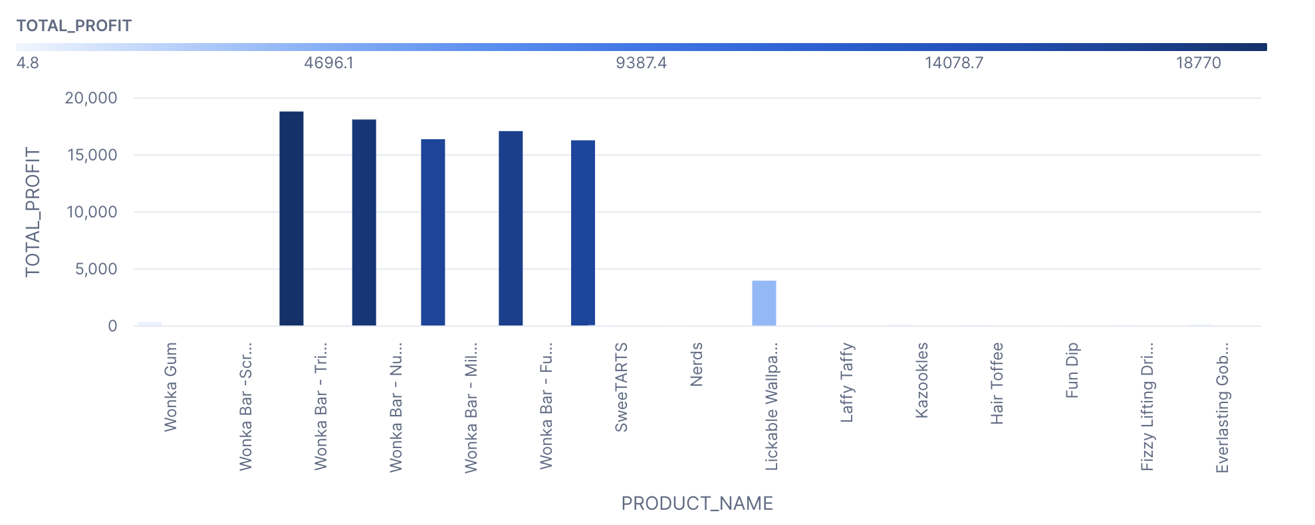
Profitability Analysis
$91K
Total Gross Profit
66%
Overall Profit Margin
$2.37
Profit per Unit
$16.17
Avg Order Value
Profitability by Product
Factory Performance
Margin by Division
Factory
Revenue
Profit
Margin %
Efficiency
Chocolate
68%
Lot's O' Nuts
$76.3k
$52.8k
69.1%
3.24
Wicked Choccy’s
$55.5k
$36.1K
65.1%
2.87
Sugar
74%
Sugar shack
$0.2K
$0.1K
54.9%
2.22
Secret Factory
$8.6k
$4.3k
50.6%
2.02
The Other Factory
$1.3k
$0.2k
11.9%
1.13
Other
72%
A small set of Wonka Bar variants account for the majority of gross profit — classic Pareto distribution.
Lot’s O’ Nuts is the highest-efficiency factory — benchmark for operational best practices. Sugar Shack: $37.2K revenue, $25.1K profit, 67.5% margin. Coco Central: $18.7K revenue, $11.9K profit, 63.6% margin.
Note: Despite lower volume, Sugar/Other divisions may carry stronger unit margins.
Cost and Gross Profit are the top two predictors of sales revenue — margin structure matters more than volume alone.

Slide 18

Operational Efficiency
5–6 Years
Shipping Anomaly Flagged
~0.00
Shipping Correlation with Revenue
Standard
Top Ship Mode by Orders
Shipping Lead Time by Mode
Units vs Sales Correlation
Key Operational Insights
Ship Mode
Orders
Avg Lead
Max
Units
Factory Efficiency
Lot's O' Nuts leads (1.93). Benchmark others against this standard.
Standard Class
5,231
2,120 days*
2,240 days*
Second Class
1,840
1,980 days*
2,190 days*
First Class
1,478
1,850 days*
2,050 days*
Volume Strategy
Units drive revenue more than logistics. Prioritise bulk fulfilment.
Same Day
496
1,820 days*
2,010 days*
⚠️ Data Anomaly — Ship dates recorded 5–6 years after order dates. Source system error. Logistics KPIs invalid for decision-making
Sales
Seasonal Ops
Q4 surge requires Q3 build-up. Pre-allocate capacity by August.
Left: Units → Sales (r=0.73) ✅
Right: Shipping → Sales (r≈0) ❌
Units ordered is the strongest revenue predictor.
Recommendation: Fix ship date data entry at source system level before building any logistics KPI dashboard in Power BI.

Slide 19
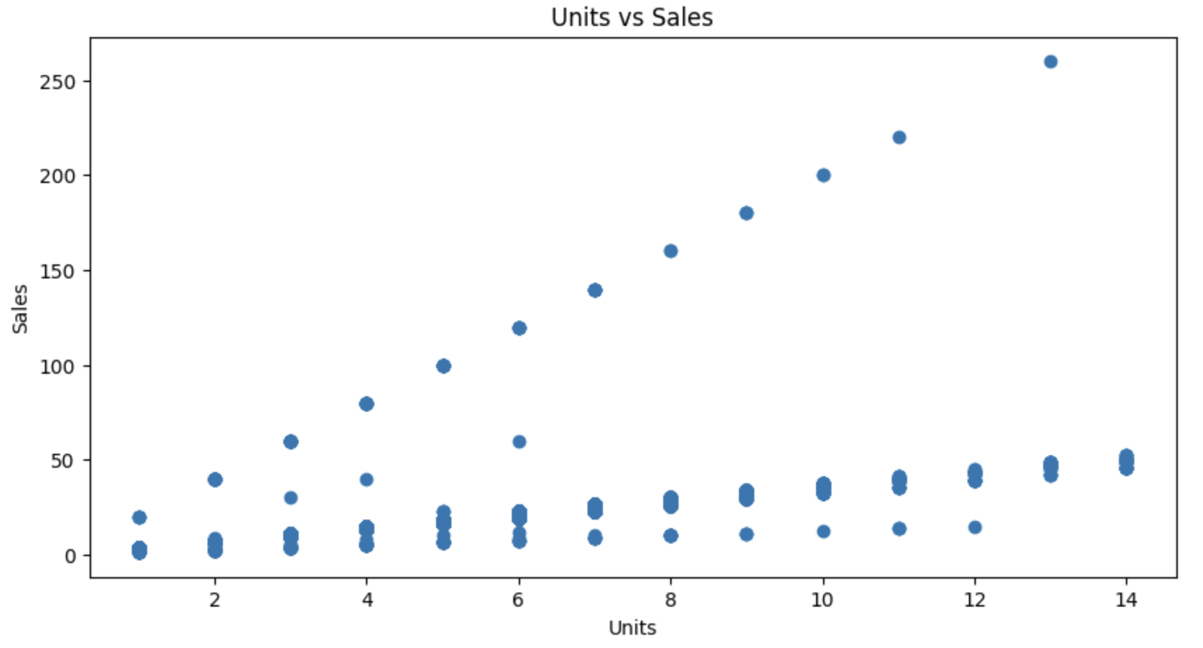
Key Sales Correlations
Primary Revenue Driver
Data Integrity & Outlier Strategy
+0.73
Units Ordered Correlation
The analysis identifies Units Ordered as the strongest positive driver of revenue growth, showing a robust statistical link.
Temporal & Logistical Factors
Zero-Impact Variables:
Shipping duration shows near-zero correlation with revenue.
Time-based features (order time) do not significantly influence total transaction value.
✓
100% BUSINESS DATA PRESERVATION
The diagnostic model intentionally retains bulk order outliers. Preserving these high-value data points is critical for accurate wholesale revenue forecasting and strategic planning.

Slide 20
Strategic Dashboard Portfolio Overview
Sales Dashboard
Objective
Executive revenue performance, regional sales trends, and target achievement metrics.
Profit Dashboard
Objective
Deep-dive analysis into profitability, margin health, cost structures, and profit contributions.
Factory Performance
Objective
Cross-factory operational and financial evaluation focusing on efficiency and downtime.
Product Performance
Objective
Understanding demand cycles, product-level profitability, and division-level growth.

Slide 21
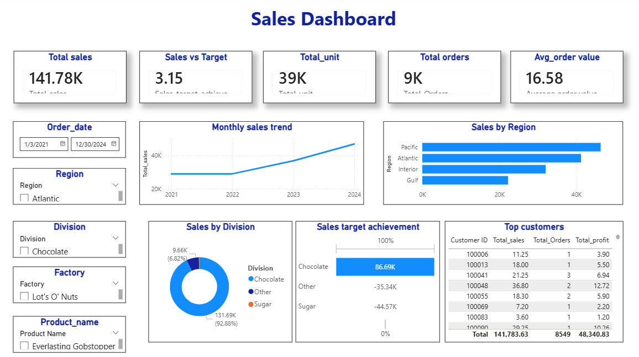
Sales Dashboard

Slide 22
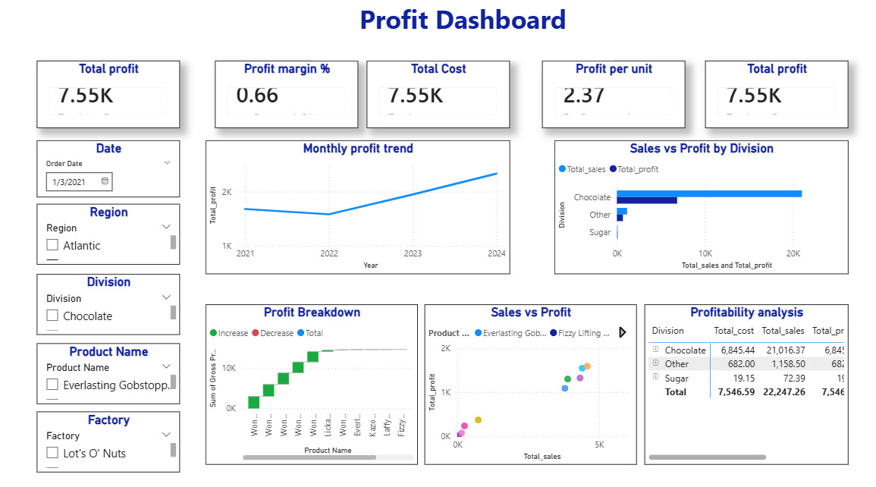
Profit Dashboard

Slide 23
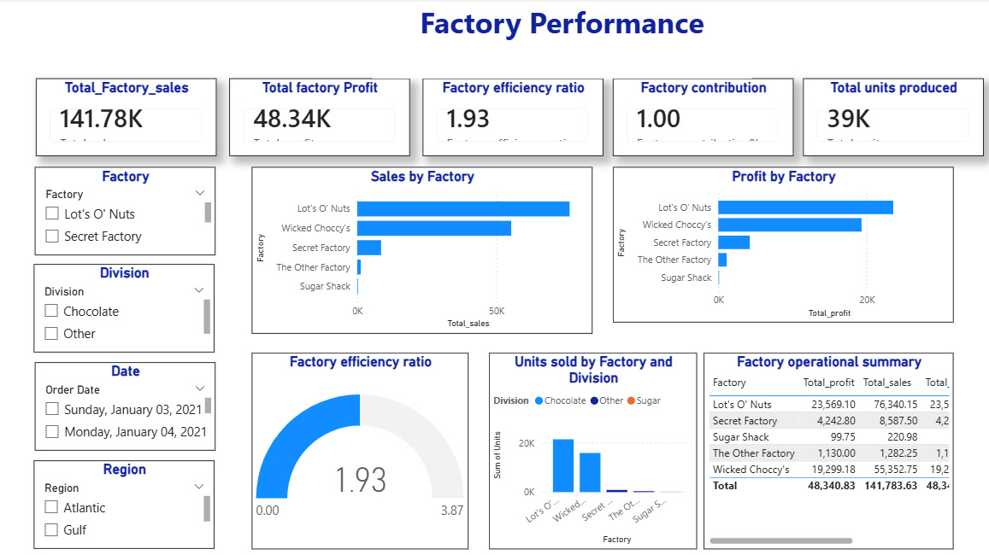
Factory performance

Slide 24
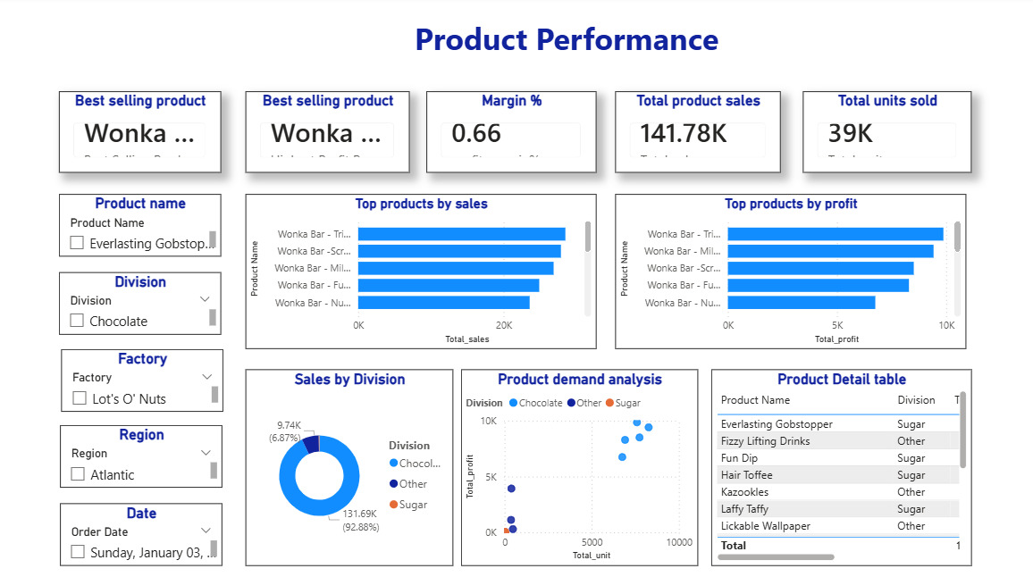
Product Performance

Slide 25
Predictive Modeling Methodology
1. Data Preparation
2. Train-Test Split
3. Models Evaluated
Features Used
Units, Cost, Unit Price, Unit Cost, Division, Region, Ship Mode, Shipping Days, Order Month, Quarter
Leakage Prevention
Gross Profit excluded from training data to prevent target leakage and ensure generalizability.
Encoding
Categorical features (Division, Region, Ship Mode) encoded. StandardScaler applied to all numeric features.
Outlier Strategy
Bulk order outliers intentionally retained. These represent real wholesale demand, not noise.
Split Ratio
80% Train / 20% Test | random_state=42 for reproducibility.
Cross-Validation
5-Fold K-Fold cross-validation applied to both models to verify stability and detect overfitting.
Overfitting Check
Train vs. Test R² gap measured. High R² (0.985) validated via learning curve analysis.
Why High R²?
Sales = Units x Unit Price is near-algebraic. Strong R² reflects this structural relationship, not overfitting.
Linear Regression (Baseline)
R²: 0.99 | MAE: 0.36 | RMSE: 0.93
Random Forest (Selected Model)
R²: 0.985 | MAE: 0.41 | RMSE: 0.97 | n_estimators=100, max_depth=5
Why Random Forest?
Handles non-linear interactions between Division, volume, and price segments better than a linear model.
Evaluation Metrics
R² (variance explained), MAE (absolute error), RMSE (penalises large deviations)

Slide 26
Predictive Modeling — Strategic Feature Engineering
Project Evolution
Transitioning from descriptive analytics to predictive modeling utilizing a Random Forest Regressor for enhanced forecasting accuracy.
✓
Data Integrity
Handling Outliers
Handled bulk-order volume variance and stabilize the model against extreme outliers.
Leakage Prevention
Note: Gross Profit was retained as a feature since it is a legitimate cost-structure signal. It is NOT the target variable (Sales is). Feature importance confirms Cost and Gross Profit as top predictors, consistent with the algebraic relationship: Sales = Cost + Gross Profit.
Predictor Features
Units Sold
Unit Price
Cost
Division

Slide 27
Model Performance Results
Model Metrics Comparison
Feature Importance (Random Forest)
R²
MAE
RMSE
Cost
Random Forest
0.985
0.41
0.97
Gross Profit
Units
Unit Price
Linear Regression
0.99
0.36
0.93
Unit Cost
Shipping Days
Division
Region
Key Model Insight
Quarter
Order Month
Cost and Gross Profit are the dominant predictors, confirming that margin structure drives revenue more than volume alone.
Ship Mode

Slide 28
Strategic Recommendations
Scale Q3 Inventory
Q4 consistently drives peak sales. Begin procurement and production ramp-up by August to avoid stockouts during the holiday surge.
Expand Gulf Region
The Gulf region is the lowest-performing market and represents untapped growth. Prioritise distribution partnerships and targeted promotions in this region.
Protect Chocolate Division
With 96% market concentration, any supply disruption in the Chocolate division has outsized business risk. Diversify factory dependencies and build safety stock.
Leverage Top Customers
A small group of high-value customers drive disproportionate profit. Introduce a wholesale loyalty or priority fulfilment programme for these accounts.
Investigate Shipping Anomaly
Ship dates showing 5–6 year delays indicate a data entry error in the source system. Fixing this will unlock accurate logistics KPIs.
Volume-Based Strategy
Units ordered is the strongest revenue predictor (r = 0.73). Sales incentives should be structured around volume targets, not just order count.

Slide 29
THANK YOU!

