Slide 2
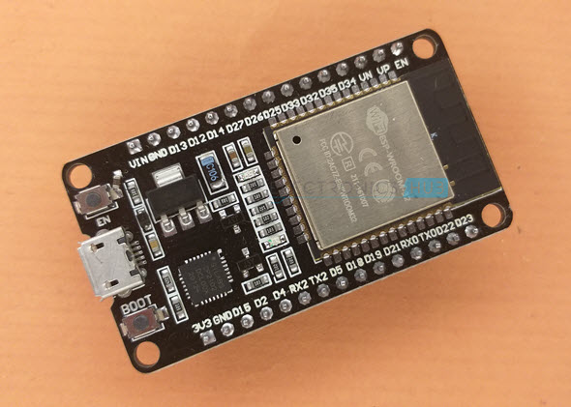
ESP32
ESP32 is a low-cost System on Chip (SoC) Microcontroller from Espressif Systems, the developers of the famous ESP8266 SoC. It is a successor to ESP8266 SoC and comes in both single-core and dual-core variations of the Tensilica’s 32-bit Xtensa LX6 Microprocessor with integrated Wi-Fi and Bluetooth.
The good thing about ESP32, like ESP8266 is its integrated RF components like Power Amplifier, Low-Noise Receive Amplifier, Antenna Switch, Filters and RF Balun. This makes designing hardware around ESP32 very easy as you require very few external components.

Slide 3
Specifications of ESP32
ESP32 has a lot more features than ESP8266 and it is difficult to include all the specifications in this Getting Started with ESP32 guide. So, I made a list of some of the important specifications of ESP32 here. But for complete set of specifications, I strongly suggest you to refer to the Datasheet.
Single or Dual-Core 32-bit LX6 Microprocessor with clock frequency up to 240 MHz.
520 KB of SRAM, 448 KB of ROM and 16 KB of RTC SRAM.
Supports 802.11 b/g/n Wi-Fi connectivity with speeds up to 150 Mbps.
Support for both Classic Bluetooth v4.2 and BLE specifications.
34 Programmable GPIOs.
Up to 18 channels of 12-bit SAR ADC and 2 channels of 8-bit DAC
Serial Connectivity include 4 x SPI, 2 x I²C, 2 x I²S, 3 x UART.
Ethernet MAC for physical LAN Communication (requires external PHY).
1 Host controller for SD/SDIO/MMC and 1 Slave controller for SDIO/SPI.
Motor PWM and up to 16-channels of LED PWM.
Secure Boot and Flash Encryption.
Cryptographic Hardware Acceleration for AES, Hash (SHA-2), RSA, ECC and RNG.

Slide 4
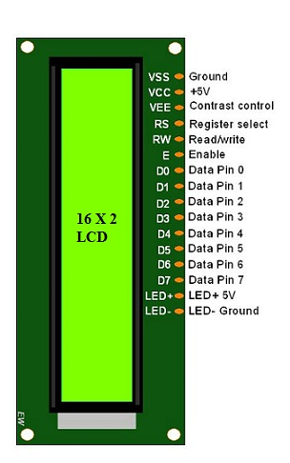
Lcd display
The term LCD stands for liquid crystal display. It is one kind of electronic display module used in an extensive range of applications like various circuits & devices like mobile phones, calculators, computers, TV sets, etc. These displays are mainly preferred for multi-segment light-emitting diodes and seven segments. The main benefits of using this module are inexpensive; simply programmable, animations, and there are no limitations for displaying custom characters, special and even animations, etc.

Slide 5
PIN DESCRIPTION:
Pin1 (Ground/Source Pin): This is a GND pin of display, used to connect the GND terminal of the microcontroller unit or power source.
Pin2 (VCC/Source Pin): This is the voltage supply pin of the display, used to connect the supply pin of the power source.
Pin3 (V0/VEE/Control Pin): This pin regulates the difference of the display, used to connect a changeable POT that can supply 0 to 5V.
Pin4 (Register Select/Control Pin): This pin toggles among command or data register, used to connect a microcontroller unit pin and obtains either 0 or 1(0 = data mode, and 1 = command mode).
Pin5 (Read/Write/Control Pin): This pin toggles the display among the read or writes operation, and it is connected to a microcontroller unit pin to get either 0 or 1 (0 = Write Operation, and 1 = Read Operation).
Pin 6 (Enable/Control Pin): This pin should be held high to execute Read/Write process, and it is connected to the microcontroller unit & constantly held high.
Pins 7-14 (Data Pins): These pins are used to send data to the display. These pins are connected in two-wire modes like 4-wire mode and 8-wire mode. In 4-wire mode, only four pins are connected to the microcontroller unit like 0 to 3, whereas in 8-wire mode, 8-pins are connected to microcontroller unit like 0 to 7.
Pin15 (+ve pin of the LED): This pin is connected to +5V
Pin 16 (-ve pin of the LED): This pin is connected to GND.

Slide 6
HUMIDITY AND TEMPERATURE SENSOR:
DHT11 is a low-cost digital sensor for sensing temperature and humidity. This sensor can be easily interfaced with any micro-controller such as Arduino, Raspberry Pi etc… to measure humidity and temperature instantaneously.
DHT11 sensor consists of a capacitive humidity sensing element and a thermistor for sensing temperature. The humidity sensing capacitor has two electrodes with a moisture holding substrate as a dielectric between them. Change in the capacitance value occurs with the change in humidity levels. The IC measure, process this changed resistance values and change them into digital form.
For measuring temperature this sensor uses a Negative Temperature coefficient thermistor, which causes a decrease in its resistance value with increase in temperature. To get larger resistance value even for the smallest change in temperature, this sensor is usually made up of semiconductor ceramics or polymers.
The temperature range of DHT11 is from 0 to 50 degree Celsius with a 2-degree accuracy. Humidity range of this sensor is from 20 to 80% with 5% accuracy. The sampling rate of this sensor is 1Hz .i.e. it gives one reading for every second. DHT11 is small in size with operating voltage from 3 to 5 volts. The maximum current used while measuring is 2.5mA.

Slide 7
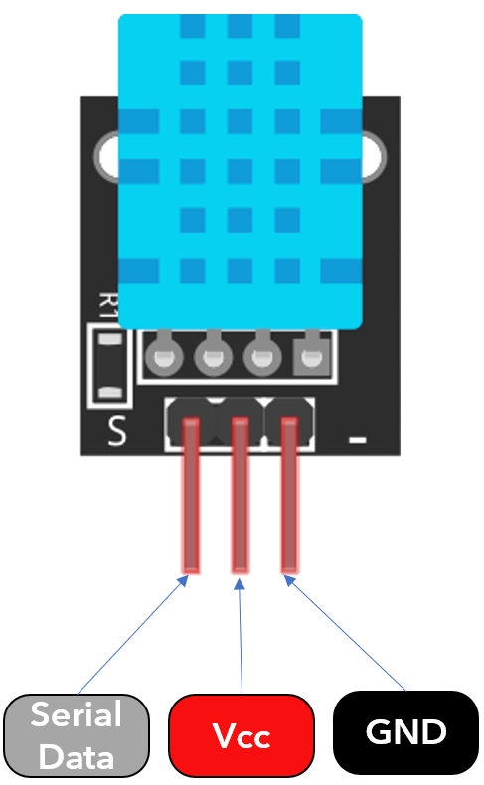
SPECIFICATIONS:
3 to 5V power and I/O
2.5mA max current use during conversion (while requesting data)
Good for 20-80% humidity readings with 5% accuracy
Good for 0-50 °C temperature readings +-2 °C accuracy
No more than 1 Hz sampling rate (once every second)
Body size 15.5mm x 12mm x 5.5mm
4 pins with 0.1" spacing

Slide 8
WET SENSOR:
The moisture of the soil plays an essential role in the irrigation field as well as in gardens for plants. As nutrients in the soil provide the food to the plants for their growth. Supplying water to the plants is also essential to change the temperature of the plants. The temperature of the plant can be changed with water using the method like transpiration. And plant root systems are also developed better when rising within moist soil.
The soil moisture sensor is one kind of sensor used to gauge the volumetric content of water within the soil. As the straight gravimetric dimension of soil moisture needs eliminating, drying, as well as sample weighting. These sensors measure the volumetric water content not directly with the help of some other rules of soil like dielectric constant, electrical resistance, otherwise interaction with neutrons, and replacement of the moisture content.

Slide 9
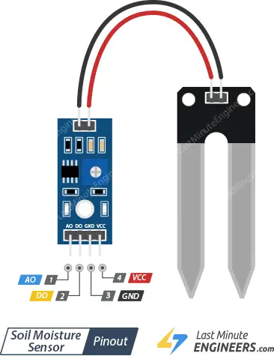
PIN DETAILS:
VCC pin is used for power
A0 pin is an analog output
D0 pin is a digital output
GND pin is a Ground
SPECIFICATION:
The required voltage for working is 5V
The required current for working is <20mA
Type of interface is analog
The required working temperature of this sensor is 10°C~30°C

