Slide 1
Autism Prediction Using Supervised Learning
Final Project – Supervised Learning
By Sushma Suresh
MS-AI Program

Slide 2
What Problem Do We Solve?
• Autism Spectrum Disorder (ASD) diagnosis is time-consuming and subjective.
• Goal: Build a machine learning model to predict ASD likelihood.
• Objective: Classify participants as ASD or non-ASD based on screening data.

Slide 3
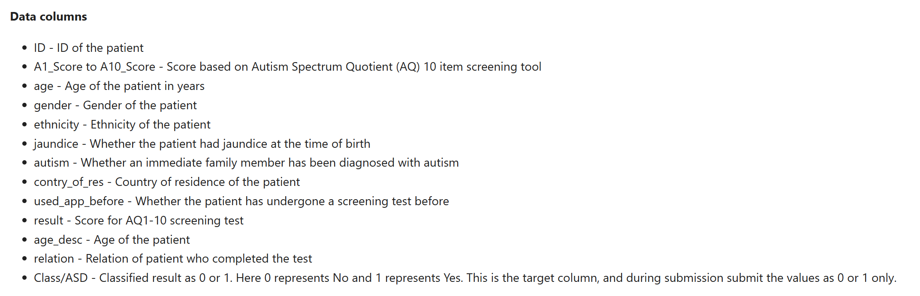
Dataset Overview
• Source: Kaggle Autism Prediction Challenge
• Records: 800 participants
•Target variable: Class/ASD (1 = ASD, 0 = Non-ASD)

Slide 4
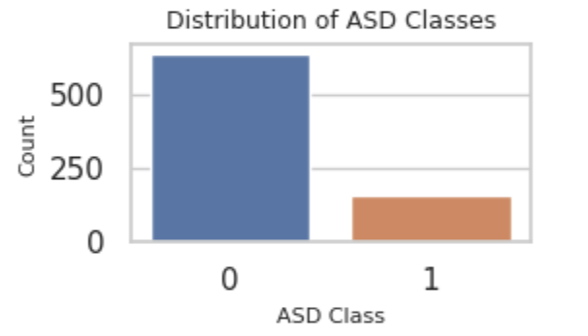
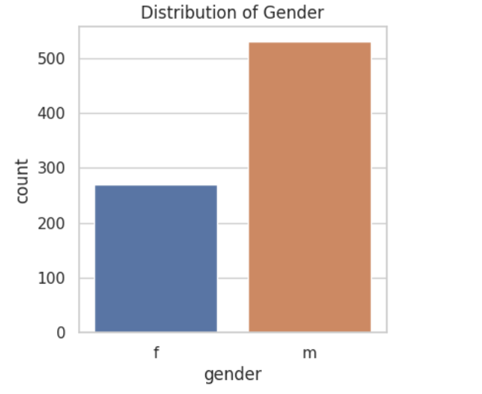
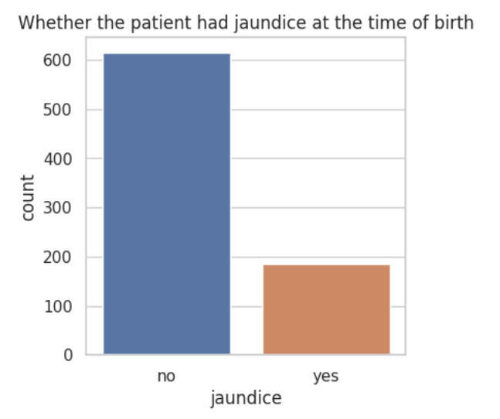
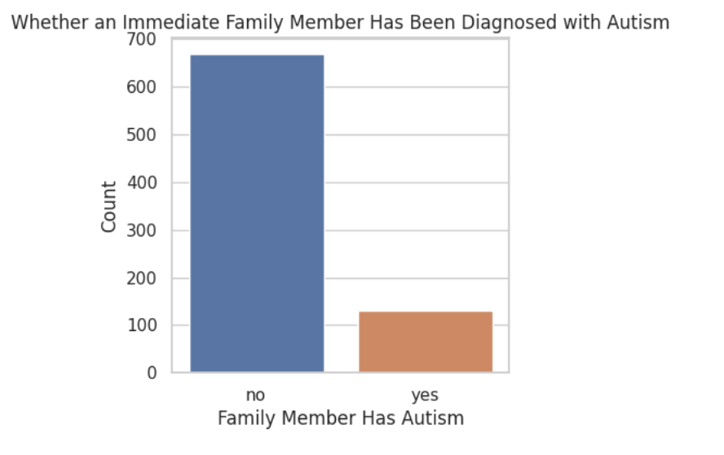
Exploratory Data Analysis (EDA)

Slide 5
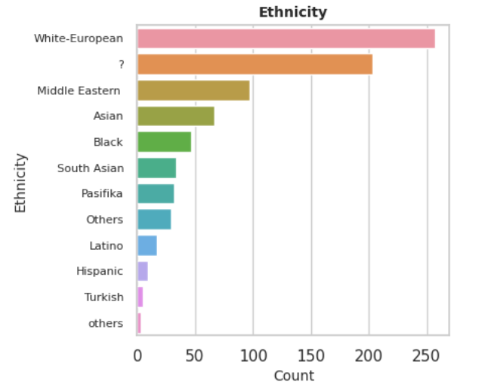
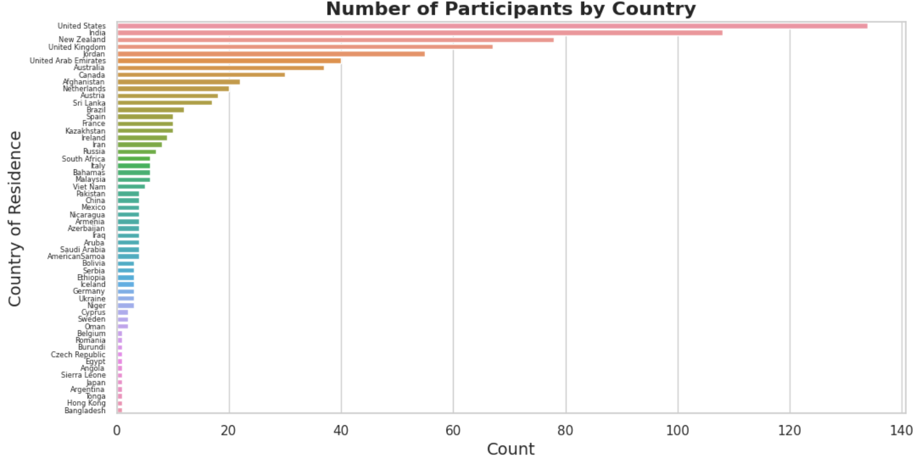

Slide 6
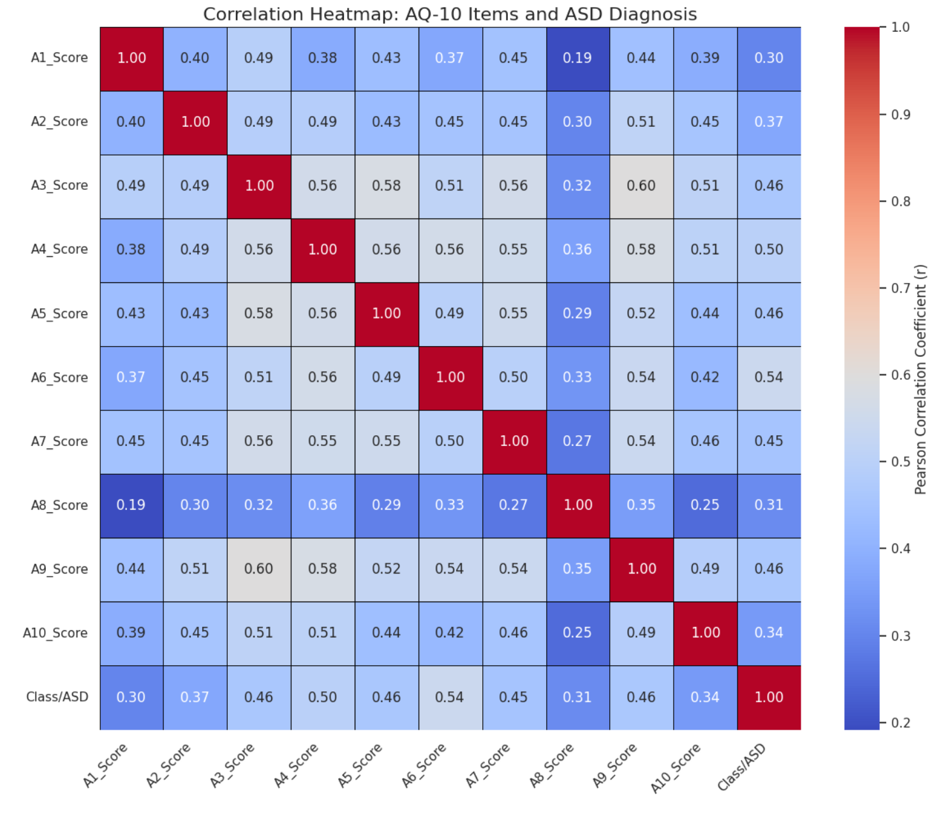

Slide 7
Data Cleaning and Preprocessing
• No missing data found
• Encoded categorical variables (Label & One-Hot Encoding)
• Scaled numerical features (StandardScaler)
• Split: 80% training, 20% testing

Slide 8
Machine Learning Approach
Models used:
• Logistic Regression
• Random Forest
• SVM
• XGBoost
• K-Nearest Neighbors
Metrics:
• Accuracy
• F1-Score
• ROC AUC

Slide 9
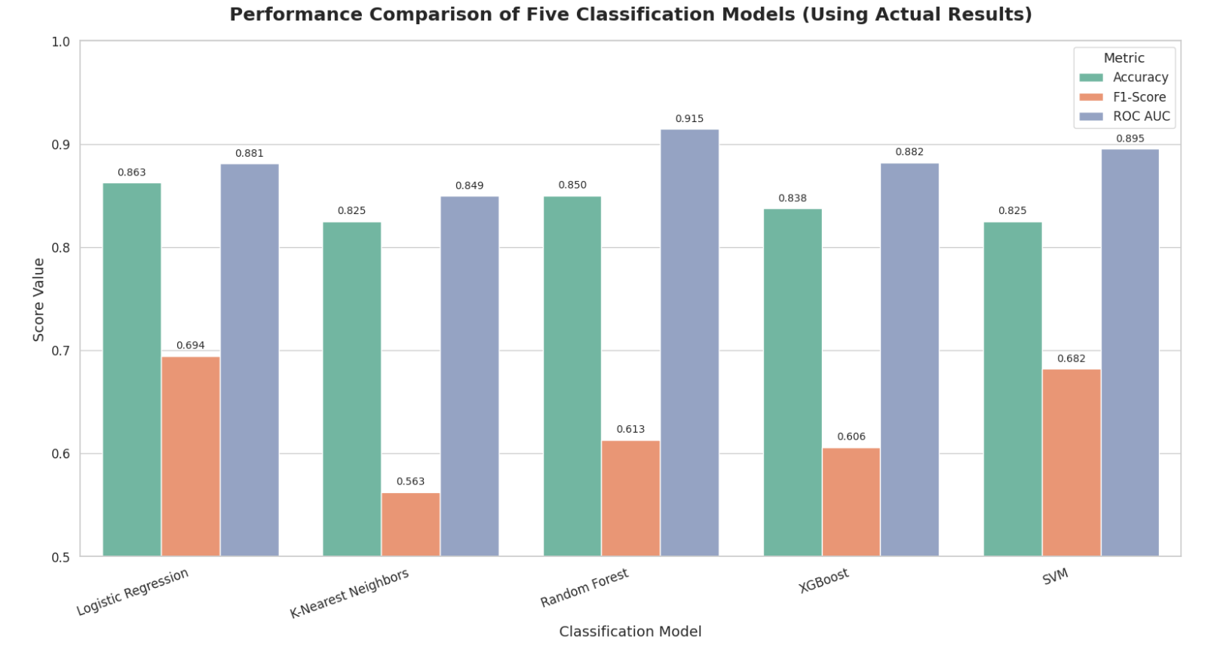
Model Comparison Results

Slide 10
Key Takeaways
• Machine learning effectively predicts ASD likelihood.
• Random Forest achieved best ROC AUC (0.91).
• Insights can help with early ASD screening.

Slide 11
Demo

