Slide 1
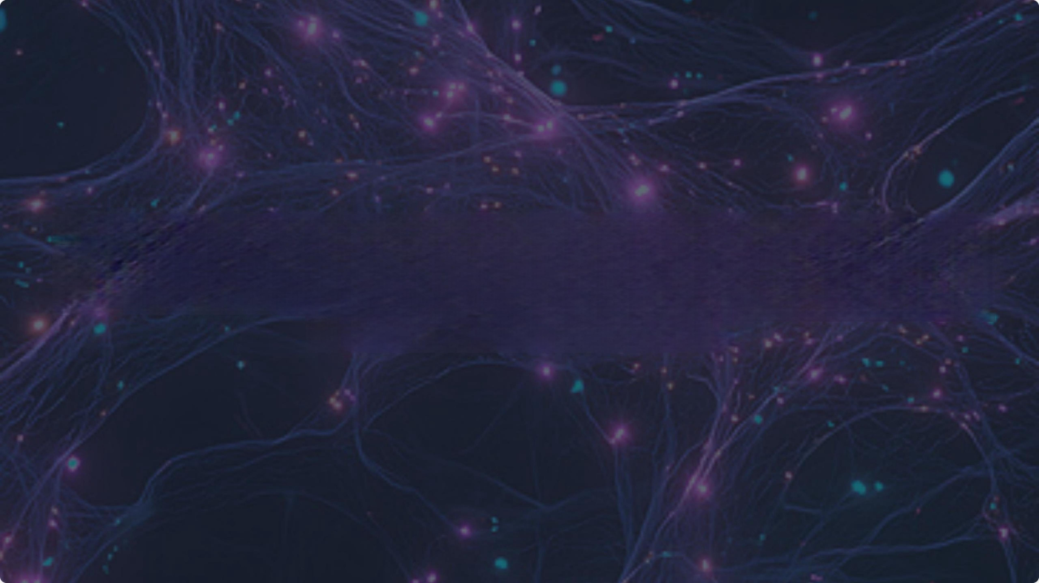
Bridging Communication Gaps
Sign Language Interpretation with Deep Learning

Slide 2
Project Overview
The Objective
Build a Convolutional Neural Network(CNN) model to
classifying the hand signs of the American Sign Language (ASL)alphabet.
The Goal
Use the trained model to accurately predict a complete line of text from ashort,synthesized video input,bridging from
staticimages to sequential decoding.

Slide 3



The ASL Alphabet Dataset
29 Classes
The dataset includes all 26 letters(A- Z)plus three crucial classes for real- world use:'del,nothing,and'space!.
Data Split
The data was split into 69,600 files for
training(80%)and 17,400 files for
validation(20%)to test
generalization.
Perfectly
Balanced
Features 3,000 images for *every"
class,totaling 87,000 training images.
This balance is key to the model's
stable convergence.

Slide 4
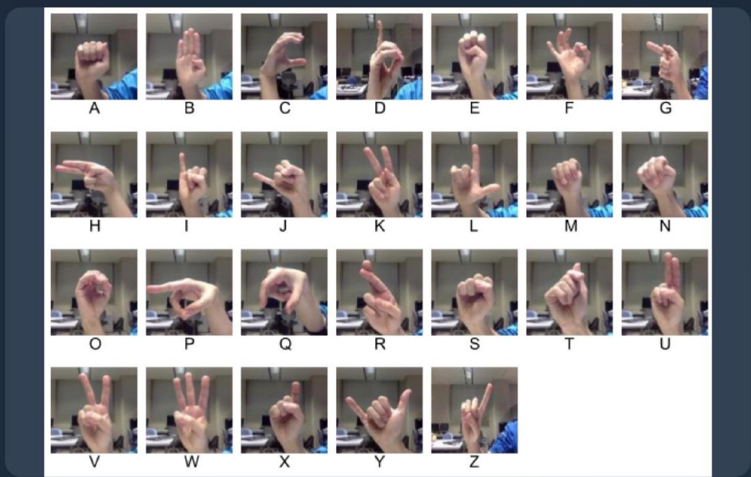
Exploratory Data Analysis
Visual Inspection
EDA confirmed the dataset’s high quality and perfect class balance.This balance is a keyfactor in the model's rapid and stable convergence.
·All 29 classes have exactly 3,000images.
·lmages areclear,centered,and high-quality.
·The clean data allows the model to focus on learning features
without noise.

Slide 5


Model :Hyperparameter Tuning
Finding the Optimal Model
Weused the Keras Tuner library with the Hyperband algorithm to automatically test thousands of combinations and find the best hyperparameters.
Architecture: Tuned the number of Convolutional blocks (from 1 to 3).
Layers:Tuned flter counts,kernel sizes (3x3 or 5x5),and the number of dense units.
Learning Rate:Searched from 1e-4to 1e-2 to find the most efficient training rate.
Objective:The tuner was optimized to find the model with the maximum validation accuracy.

Slide 6

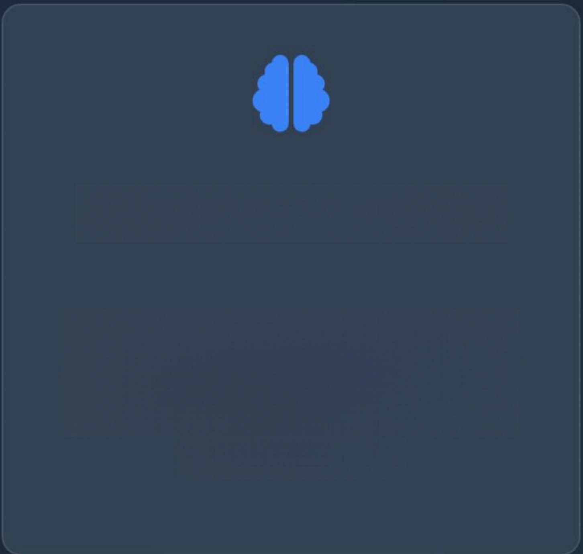

Final Model:Tuner's Optimal Architecture
3 Conv Blocks
The tuner selected a deeper 3-block
architecture with hlter sizes of 32,32
and 64,using larger 5x5 kernels for the
first two.
256 Dense Units
Alarger dense layer with 256 units
was chosen by the tuner for the final
classification head,providing more
learning capacity.
0.0048 LR
Aprecise and relatively high learning
rateof~0.0048 combined witha0.3
dropout rate was found to be the
optimal setting.

Slide 7
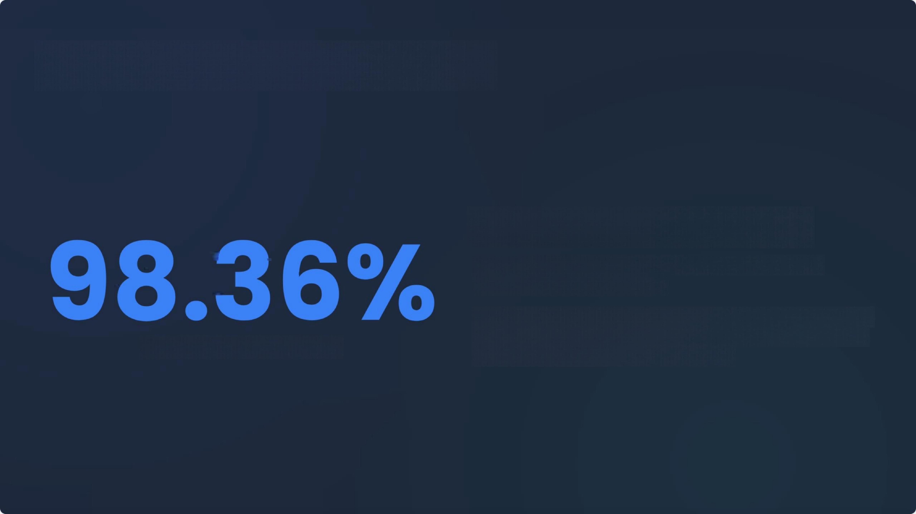


Final Model:Training &Results
Training with Early stopping
The final model was trained for 50 epochs using Early Stopping
(patience=4)to monitor valloss'.
This technique automatically stopped training at epoch 12 and restored the best weights from Epoch 8,preventing overfitting and ensuring the best possible generalization for the video task.
Final Validation Accuracy

Slide 8

From Frames to Words:The Decoding Pipeline
The Smart Decoding Logic
To predict a full sentence,the model doesn't just guess one frame.It uses arobust pipeline to ensure accuracy.
Predict:The stable CNN model classifhes every single frame of the video.
Majority Vote:Frames are grouped by sign (1 sign per second).The most common prediction in that group becomes the chosen letter.
Space Logic:Ablackframe is*forced*to be a'space!.Any nothing or del'prediction is also converted to a 'space.
二 Assemble:Repetitiveletters(eg,,"S-S-S-H-H")arecollapsed into one ("S H")to form thefinal,clean text.

Slide 9

Final Demonstration:Success!
Target Message:
"HI I AM SUSHMA I AM STUDYING IN UNIVERSITY OF COLORADO"
Decoded Message:
"HI I AM SUSHMA I AM STUDYING IN UNIVERSITY OF COLORADO"

