Slide 1

DRIP ‘M’
Problem Statement: Intravenous Infusion is one of the common methods to supply the medication to a patient. Monitoring the infusion is tedious task for nurses as they monitor many patients simultaneously. Due to lack of staffing/timely monitoring there is a possibility of reverse blood flow into IV when its complete which is very dangerous
Objective: Create an mechanism that
Timely alerts to prevent reverse blood flow into IV
Automatic IV cut-off in worst-case
Remote monitoring across beds within hospital
Doctors has capabilities to view the blood flow remotely based on their recommended prescription (Future)
Benefit(s) :
Timely Alerts, IV cut-off
Remote monitoring
Portability
Cost Effective
User friendly
Resources:
Hardware:
ESP32, IR sensor, OLED, LDR, Lasor sensor, servo motor
Software:
Flutter(Mobile app), Firebase (NoSQL)
Comrades
Nitish
Rajesh
Sushma

Slide 2
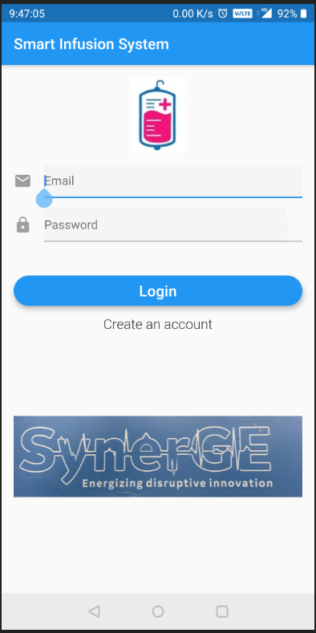
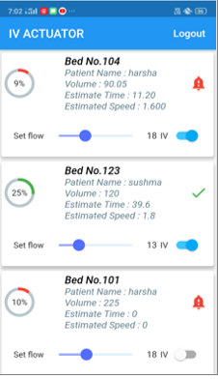

Flow Diagram
ESP 32
Micro controller
Laser
LDR
Buzzer
IR sensor
Cut-off
Network call
Firebase

Slide 3
Appendix

Slide 4

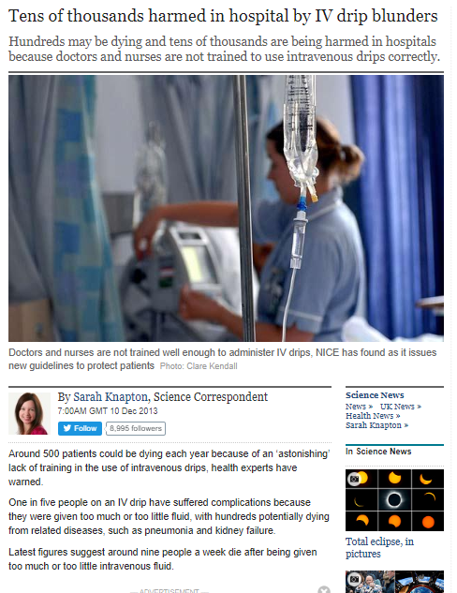

Slide 5
FIVE RIGHTS
Right Patient
Right Drug
Right Dose
Right Route
Right Time

Slide 6
Key Takeaways
Cost Effective
Learning new technologies
Real time business case
Networking
Team experience and exposure diversity

