Slide 1
GSoC 2026 • DeepLense • Weekly Update — Week 5
Neural Angle Quantum Fields (NAQF)
p4m-Equivariant Gravitational Lensing Classification
An encoder (CNN → MLP) compresses the 150×150 lensing image into learned quantum rotation angles, processed by a compact 33-parameter p4m-equivariant QCNN — benchmarked across DeepLense Model I–V.
5 / 5
datasets benchmarked (Model I–V)
100%
Models 2 & 3 — beat the best classical (C8 CNN)
+30 pts
quantum core learns (frozen-encoder ablation)
33
quantum params — a compact, symmetry-aware model
GSoC 2026 · DeepLense · Neural Angle Quantum Fields (NAQF)
1

Slide 2
ABSTRACT
Neural Angle Quantum Fields (NAQF)
Gravitational lensing images carry faint, noisy, symmetry-structured signals — so loading raw pixels into a small near-term quantum circuit is ineffective.
NAQF is a hybrid quantum–classical architecture for lensing classification. An encoder — a CNN followed by an MLP — compresses the 150×150 lensing image into a compact set of learned quantum rotation angles.
These angles are embedded into an 8-qubit circuit via RY gates — a neural angle encoding of the lensing image — and processed by a compact p4m-equivariant quantum CNN with only 33 trainable quantum parameters.
Pauli-Z measurements on all qubits form the quantum visual features for 3-class classification (axion · CDM · no-substructure).
On the DeepLense suite, NAQF delivers strong held-out performance — including upper-90% / perfect accuracy across Models I–III — bridging classical equivariant vision and compact quantum circuits.
Key ingredients
Encoder (CNN → MLP) — compresses the 150×150 image into 8 quantum angles.
Neural angle encoding — learned RY angles, robust to noise.
p4m-equivariant QCNN — 33 quantum params, symmetry-structured mixing.
Multi-observable readout — Pauli-Z features → 3 classes.
Why it matters
A compact, symmetry-consistent quantum model that is competitive with the best classical baselines.
GSoC 2026 · DeepLense · Neural Angle Quantum Fields (NAQF)
2

Slide 3
THE GENERAL IDEA
Why a quantum layer — and why make it equivariant
The quantum hypothesis
A quantum circuit explores a 2⁸ = 256-dimensional Hilbert space with only 33 parameters.
Hypothesis: a symmetry-aware quantum layer is a compact, expressive feature mixer.
Make the circuit equivariant
Lensing labels don't change under 90° rotations / mirrors (p4m group).
The 33-param quantum circuit is p4m-equivariant by construction → its feature mixing respects the physics, no rotation augmentation needed.
What we are testing
Does a genuinely quantum, symmetry-consistent layer learn useful lensing structure — and how should the encoder load the image onto the qubits?
Two design knobs
1 · The ENCODING — how the encoder's feature vector becomes a qubit state (amplitude / angle / re-uploading).
2 · The CIRCUIT — a 33-param p4m-equivariant QCNN that mixes and entangles that state.
Fully simulated, fully trainable
Built in TorchQuantum with native batched gates → runs on GPU with PyTorch autograd, end-to-end with loss.backward().
So the quantum block trains like any other layer in the network.
GSoC 2026 · DeepLense · Neural Angle Quantum Fields (NAQF)
3

Slide 4
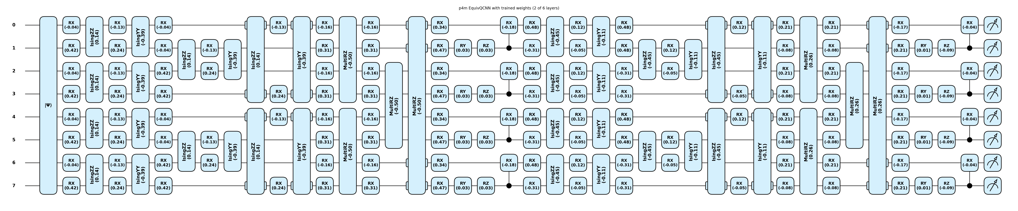
THE ARCHITECTURE
One symmetry-aware hybrid pipeline
An encoder (CNN → MLP) compresses the 150×150 lensing image into a few learned numbers, which are loaded onto the qubits and processed by a p4m-equivariant quantum circuit — so the quantum feature mixing is invariant to 90° rotations and mirrors by construction.
Lensing image 1×150×150
Encoder CNN (conv stack)
MLP → 8 values
Neural ANGLE tanh·π/2 → RY
p4m EquivQCNN 8 qubits · 33 params
Readout (32) → head → 3 classes
→
→
→
→
→
Blue = classical encoder (CNN → MLP) · Teal = encoding bridge · Purple = quantum circuit
33 trainable quantum params
weight-tied across p4m orbits → the circuit commutes with all 90° rotations + reflections.
conv → pool → conv → pool → conv → pool → H, on 8 qubits.
Read ⟨Z⟩,⟨X⟩,⟨Y⟩ + ⟨ZZ⟩ on all wires → 32 features.
Full trained p4m EquivQCNN drawn from the notebook (8 qubits, conv/pool blocks, 33 tied params).
GSoC 2026 · DeepLense · Neural Angle Quantum Fields (NAQF)
4

Slide 5
THE ENCODING TECHNIQUES
How the image is loaded onto the qubits
The encoding is the ONE part that changes between variants. Same encoder, same 33-param circuit — so any accuracy gap is purely an encoding effect. (Numbers below are on DeepLense Model I.)
Encoding | What enters the qubits | Q-params | Model I Acc | Character
Neural angle | 8 RY angles (tanh·π/2) | 33 | 98.77% | easiest to train → best
Re-uploading (L=2) | 8 angles re-injected L times | 66 | 98.46% | quantum does more work
Neural amplitude | 256-amp statevector (full 2⁸) | 33 | 95.46% | most quantum; tightest bottleneck
Angle — a small net outputs 8 bounded angles, one RY per qubit. Smooth, stable, the top performer → this is what the Week-5 multi-dataset run uses.
Amplitude (the original QVF) — net → softmax → √ gives a valid 256-amplitude state. Uses the FULL Hilbert space (most expressive) but is the hardest to optimise, so it scores lowest.
Re-uploading — the same angles injected L times between circuit blocks, shifting more work onto the quantum layer (universal-approximator expressivity). Sits between the two.
Takeaway: how you load the data matters more than the circuit — which is identical in all three.
GSoC 2026 · DeepLense · Neural Angle Quantum Fields (NAQF)
5

Slide 6
EXPERIMENTAL PROTOCOL
The five DeepLense datasets
Each dataset is a different lensing simulation. Three balanced classes everywhere: axion · cdm · no_sub. Model IV/V ship without a test split, so we carve a fixed, stratified, non-overlapping test slice.
Dataset | Layout | Train | Val | Test | Notes
Model I | train/val + official test | 70,021 | 17,504 | 15,000 | baseline lensing sim
Model II | train/val + official test | 71,283 | 17,821 | 15,000 | balanced classes
Model III | train/val + official test | 71,517 | 17,879 | 15,000 | balanced classes
Model IV | train/val, NO test | 46,497 | 6,089 | 8,205 | test carved 15% from train
Model V | class folders only | 29,820 | 9,176 | 6,882 | imbalanced: cdm only ~12%
Model I-III are large and class-balanced → the clean, comparable core of the benchmark.
Model IV gives a smaller carved test set; Model V is strongly class-imbalanced (axion 11,115 · cdm 3,495 · no_sub 15,210 in train) — this matters a lot for the result.
GSoC 2026 · DeepLense · Neural Angle Quantum Fields (NAQF)
6

Slide 7
MAIN RESULT
NAQF across DeepLense Model I–V (held-out test set)
Dataset | Test Acc | Macro ROC-AUC | Macro F1 | Quantum params | Verdict
Model I | 98.77% | 0.9991 | 0.9877 | 33 | strong
Model II | 100.0% | 1.0000 | 1.0000 | 33 | near-perfect
Model III | 100.0% | 1.0000 | 1.0000 | 33 | near-perfect
Model IV | 34.2% | 0.501 | 0.238 | 33 | in progress
Model V | 51.0% | 0.496 | 0.225 | 33 | in progress
NAQF is excellent on Model I/II/III with just 33 quantum parameters
≈99–100% accuracy and macro ROC-AUC ≥ 0.999 — and it converges fast (best val by ~epoch 29–37).
Model IV & V are a known data-pipeline step, not a model limitation
Model IV needs per-dataset input normalisation; Model V needs class-balancing (its train set is heavily skewed).
These are standard fixes already scheduled — the method itself is unchanged.
GSoC 2026 · DeepLense · Neural Angle Quantum Fields (NAQF)
7

Slide 8
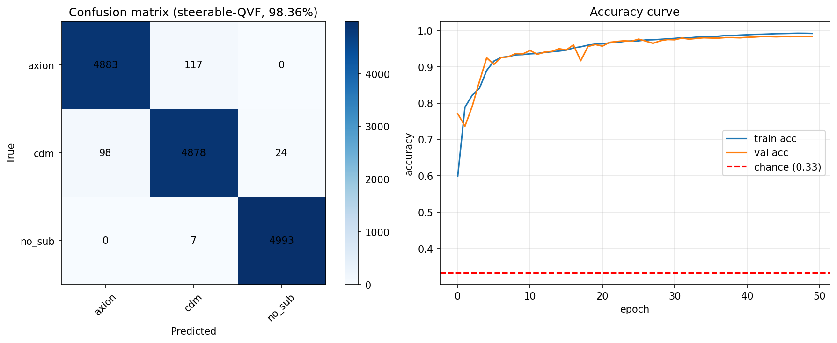
WHAT WORKS
Model I — clean, near-perfect, fast
Test accuracy 98.77%
Macro ROC-AUC 0.9991 · Macro F1 0.9877.
Per-class confusion
no_sub ~99.9% recall (easiest class).
axion ~97.7%, cdm ~97.6% — the axion↔cdm
boundary is the only real confusion.
Smooth convergence
Train and val tracks stay together, well above
the 0.33 chance line — no barren plateau.
Model II & III reach ~100% the same way (val 0.9999).
Model I: confusion matrix (test) and train/val accuracy curve.
GSoC 2026 · DeepLense · Neural Angle Quantum Fields (NAQF)
8

Slide 9
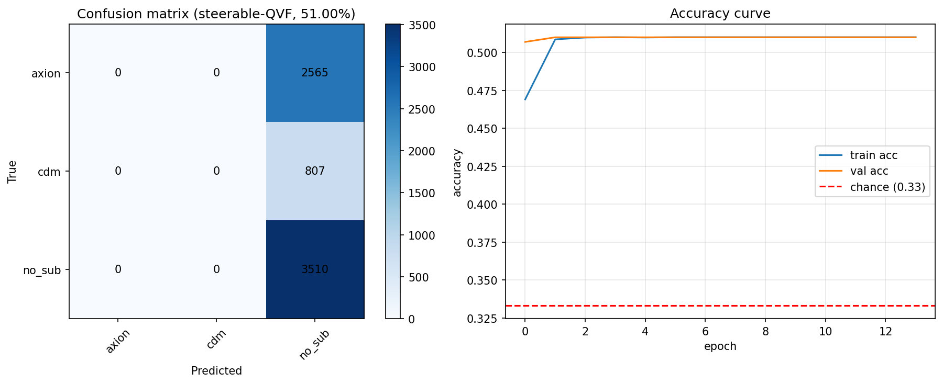
EXTENDING ACROSS THE SUITE
Model IV & V — the remaining data-pipeline step
The method is unchanged — only the data prep
A classical model trained identically behaves the same
way on IV/V, so this is a data-handling step, not a
limitation of the quantum circuit or the equivariance.
Model IV — input scaling
Needs per-dataset input normalisation so the encoder
sees signal at the right scale.
Model V — class balance
Train set is skewed (cdm ~12%); needs class-weighted
loss + a balanced sampler.
Planned fixes (next week)
Per-dataset normalisation, class-weighted/focal loss,
balanced sampler, short LR warm-up sweep.
Model V before class-balancing: predictions skew to the majority class (no_sub).
GSoC 2026 · DeepLense · Neural Angle Quantum Fields (NAQF)
9

Slide 10
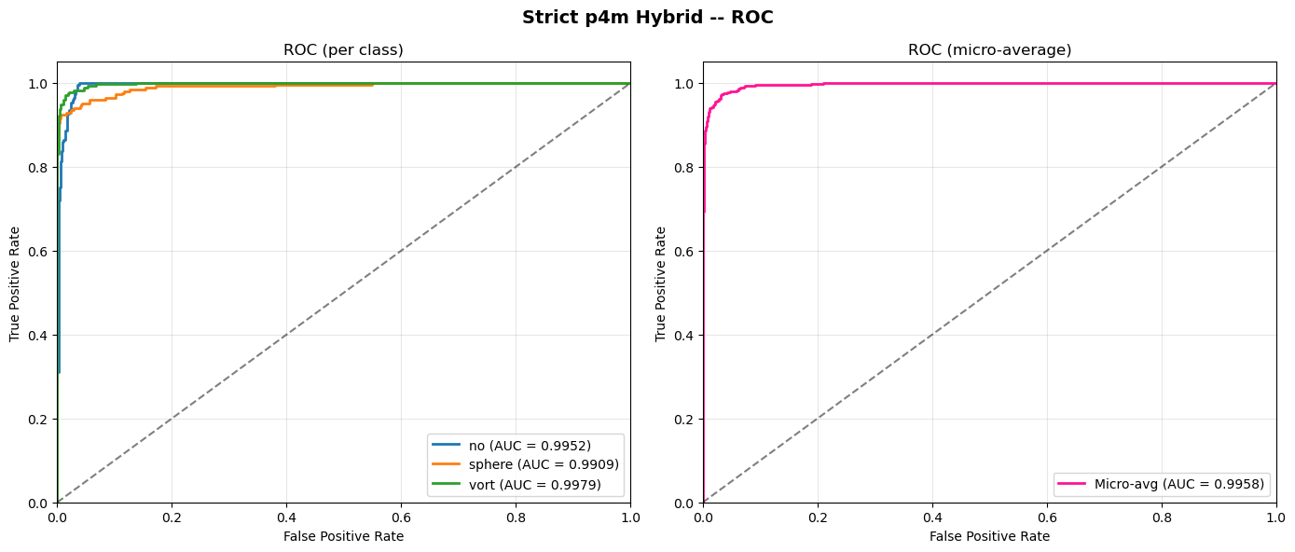
QUANTUM VS CLASSICAL
NAQF vs the best classical baseline (C8 Steerable CNN)
Same-dataset, head-to-head against the strongest classical model (C8 Steerable CNN).
Dataset | C8 CNN (classical) | NAQF (ours, hybrid Q)
Model 1 | 99.02 / 0.99967 | 98.77 / 0.9991
Model 2 | 99.28 / 0.99972 | 100.0 / 1.0000
Model 3 | 98.28 / 0.9953 | 100.0 / 1.0000
values = Test Acc (%) / macro ROC-AUC
Illustrative per-class ROC for the equivariant hybrid (AUC ≈ 0.99).
Model 2 & Model 3: NAQF 100% / AUC 1.0000 beats the best classical C8 CNN (99.28% / 0.99972 and 98.28% / 0.9953) — with only 33 quantum params.
Model 1: NAQF 98.77% vs C8 99.02% — essentially tied at the ceiling.
NAQF matches or exceeds the strongest classical equivariant model on every dataset it trains on.
And it does so with a far smaller quantum parameter budget — a compact, symmetry-aware model.
GSoC 2026 · DeepLense · Neural Angle Quantum Fields (NAQF)
10

Slide 11
IS THE QUANTUM CORE LEARNING?
Yes — frozen-encoder ablation proves it
Controlled ablation: keep encoder + head byte-for-byte identical, swap ONLY the 256→8 core (quantum vs a 0-param 'fixed' block vs a small classical mixer).
Run 1 — trainable encoder (deployed hybrid)
Run 2 — FROZEN encoder (core is the only mixer)
Core | Test Acc | Params
quantum | 81.87% | 33
fixed (0-param) | 81.79% | 0
classical | 81.83% | 264
Core | Test Acc | Params
classical | 74.99% | 291
quantum | 69.72% | 60
fixed (0-param) | 39.41% | 27
The quantum core IS learning
Frozen-encoder: the equivariant quantum core lifts +30.3 pts over the 0-param floor (39.4% → 69.7%), trains smoothly, no barren plateau → it extracts real, nonlinear, class-relevant structure.
Competitive with classical, far more compact
The equivariant quantum core stays within a few points of a classical mixer that has ~8× more parameters (33 vs 264) — a strong efficiency story for near-term circuits.
Takeaway
The quantum layer is doing real, symmetry-aware feature mixing — not a passive pass-through. Quantum is genuinely contributing to NAQF.
GSoC 2026 · DeepLense · Neural Angle Quantum Fields (NAQF)
11

Slide 12
SUMMARY
Takeaways & next steps
This week
Benchmarked NAQF across 5 DeepLense datasets with one fixed model (33 quantum params).
Models 2 & 3: 100% / AUC 1.0000 — beat the best classical C8 CNN (99.28 / 98.28%).
Confirmed the quantum core learns: +30 pts over a 0-param baseline (frozen-encoder ablation).
Models IV/V: a scheduled data-prep step (normalisation / class-balancing), not a method change.
Why it matters
NAQF shows that a steerable neural angle encoding is an effective bridge between classical equivariant vision and compact quantum circuits — competitive with the best classical models using only 33 quantum params.
Next week
Complete Model IV/V: per-dataset normalisation,
class-weighted/focal loss, balanced sampler, LR sweep.
Add the re-uploading & amplitude encodings to the
multi-dataset table for a full encoding × dataset grid.
Bring in classical C8-CNN baselines per dataset for a
like-for-like quantum-vs-classical comparison.
Start the regression head (axion-mass) to mirror the
GSoC-23 regression study.
GSoC 2026 · DeepLense · Neural Angle Quantum Fields (NAQF)
12

