Slide 1
Event Management Application
Coding Platform : Visual Studio
Technologies used : React.js, Express.js and node.js
Database : SQL server
By,
NKP Range Creation Team
am

Slide 2
TASK ASSIGNED
SUSHMA-SPOC | Home page flow Registration Page Add Event
AMBA | Account Creation
USHA MURALI | Login and Authentication
TEAM-1
DEEPJYOTI-SPOC | List of Events to Edit and Delete
SONIKA REEMA | Notification and Triggering
ALEKHYA | Database Management
TEAM-2

Slide 3
TIMELINE
1ST WEEK | Prototype Design Done
2ND WEEK | Main Functionality Home Page Flow Event Registration Add Event Account Creation

Slide 4

Home
Add Event
Upcoming Events
Create Account
Login
Login
User
Admin
Manager

Slide 5
Account Registration
User Name
Email ID
Gender Male Female
Password
Confirm Password
Mobile Number
Sign Up

Slide 6
User Login
Username:
Password:
Login

Slide 7
Admin Login
Username:
Password:
Login

Slide 8
Manager Login
Username:
Password:
Login

Slide 9
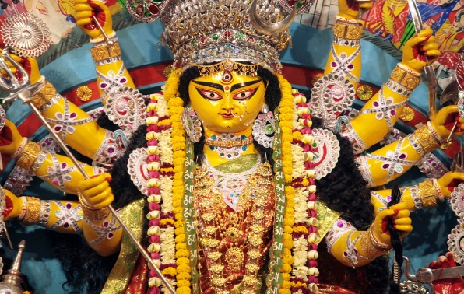
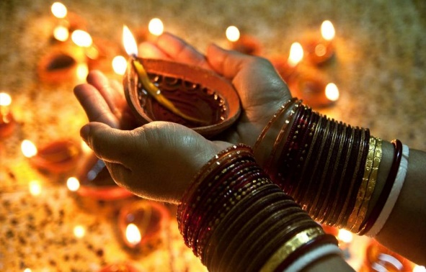
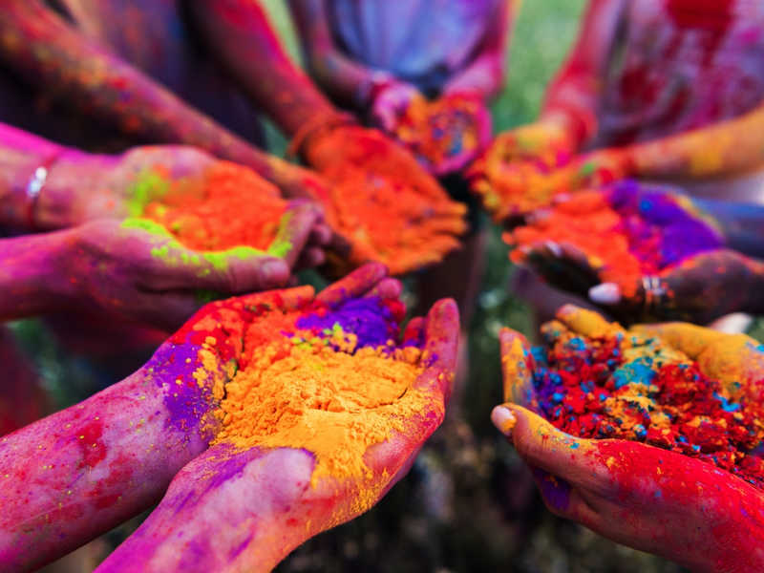
Home Screen
Durga Puja
Date/Time
Diwali Fest
Date/Time
Holi Fest
Date/Time
Show More Details
Show More Details
Show More Details

Slide 10
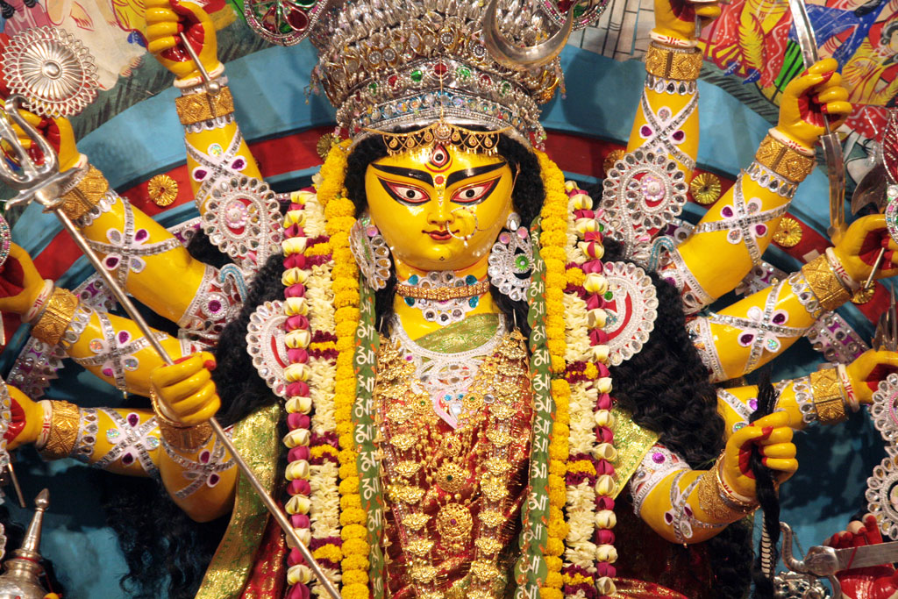
Event Details
Event Name:
Date/Time:
Location:
Price:
Food Details:
Description:
Register

Slide 11
Event Registration
Full Name
Email ID
Mobile Number
Headcount Adult(15-80yrs)
Headcount Child
Event Type
Food Option Veg Non-Veg Not Applicable
Drinks Applicable Not Applicable
I agree to terms and conditions
▼
0-6yrs ▼
6-15yrs ▼
√
Submit

Slide 12
Upcoming Events
Index | Name | Start Date/Time | End Date/Time | Location | Food | Price | Description
1 | Durga Puja | 07/10/2019 | 16/10/2019 | Sweden | Veg | 4000rs/day | Dandya Nights
2 | Holi Fest | 20/03/2020 | 21/03/2019 | Sweden | Veg & Non-Veg+Drinks | 6000rs/day | Organic colors holi powder

Slide 13
Admin Perspective
Home
Add Event
List of Events
Login

Slide 14
Add Event
Event Name
Start Date/Time End Date/Time
Location
Food Option Veg Non-Veg Not Applicable
Drinks Applicable Not Applicable
Adult Price Child Price
Description
Add

Slide 15
List Of Events
Index | Name | Start Date/Time | End Date/Time | Location | Food | Price | Description
1 | Durga Puja | 07/10/2019 | 16/10/2019 | Sweden | Veg | 4000rs/day | Dandya Nights
2 | Holi Fest | 20/03/2020 | 21/03/2019 | Sweden | Veg & Non-Veg+Drinks | 6000rs/day | Organic colors holi powder
Delete
Edit
Delete
Edit

Slide 16
Thank you!

