Slide 1
BANKING APPLICATION – CYBER SECURITY
Sushma Suttakote Parameshappa

Slide 2
Description About Banking Application
A Bank helps customers to bank smarter with Online Banking, Bill Pay, Checking Accounts, Savings Accounts and Loans.
A Bank will have several branches. Each branch has a specific set of employees and customers. There will be 3 departments in each branch: Customer Service , Loan, and Security.
A customer can physically go to any branch to open an account and do transactions like credit/debit, applying for loan and other transactions. An employee of corresponding department will help customers in their banking activities. A customer can do online transactions like make bill payments and amount transfer.

Slide 3
Agenda
Architecture
Actors
Functionality(Objectives)

Slide 4
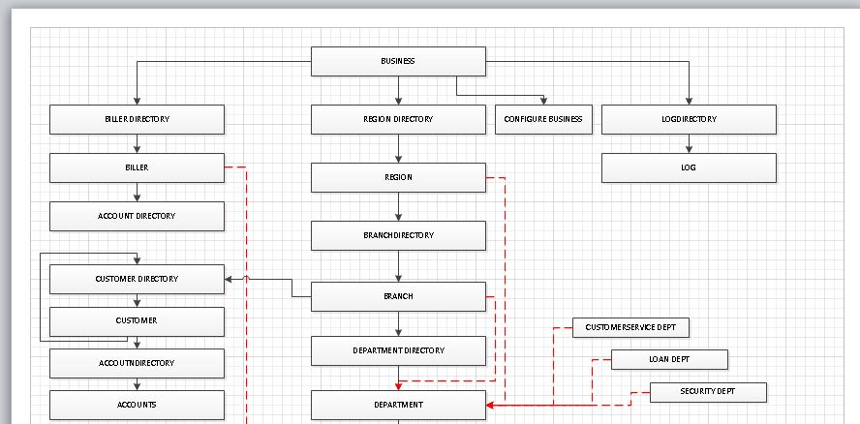
Architecture

Slide 5
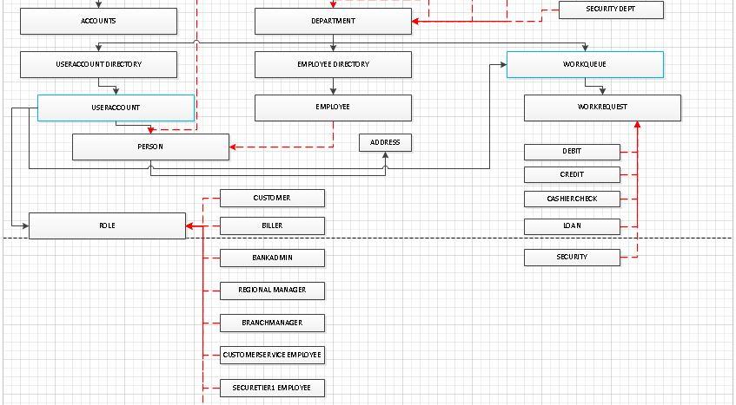

Slide 6
Actors
Bank Manager
Regional Manager
Branch Manager
Customer Service Employee
Loan Department Employee
Security Department Tier1 Employee
Security Department Tier2 Employee
Customer

Slide 7
Functionality
Bank Admin:
Login.
Can create regions.
Can manage regions.
Can manage a set of billers.
Can do analytics like region specific customer count, branch specific credit/debit details.
Regional Manager:
Login.
Can create branches.
Can manage branches.
Can do analytics like branch specific customer count, branch specific credit/debit details.
Branch Manager:
Login.
Manage departments - employees.
Approve loan requests.
Consider the security requests.

Slide 8
Functionality
Customer Services Employee:
Login.
Open an account for customer.
Issue Cashier’s Check.
Do credit/debit for customer.
Loan Department Employee:
Login.
Do the background check of customer for issuing loan and send the request to Branch Manager for approval.

Slide 9
Functionality
Security Department Employee:
Tier 1 Security Employee :
Keeps track of work log of customers and employees of that branch.
If an abnormal activity is identified, the problem will be escalated to Tier 2 Security Employee for further investigation.
Tier 2 Security Employee:
Assign himself the open work requests from Tier 1 Security Employee.
Investigate the reported issue to identify whether it is a valid threat incident or not.
If threat incident has been evidenced, will report the incident to related authority and provide all possible solutions to avoid such incidents in future.

Slide 10
Customer:
Online:
Login.
Add payees to his Payee list.
Make a bill payment.
Transfer the money to his own different type of account (Checking Account to Savings Account or vice-versa)
Transfer the money to any payee in his payee list.
Cyber Security:
Initial Implementation in the application:
Implementing strong password policy.
Enforcing role specific access to employees.
Masking the sensitive information like Social Security Number hiding from all levels of management authority.

Slide 11
Cyber Security
Possible Threat Use Cases:
Employee:
Trying to login from out of network i.e. from his home computer etc.
Trying to login at unusual time other than working hours (eg : 2 am).
Security approaches:
Identify the issue and investigate whether it is a security incident.
If it is a security incident, report it to the higher authority and possibly warn/block/terminate the employee and allow the access to the employee from set of IP addresses (assigned computer systems) between specified time intervals.

Slide 12
Cyber Security
Customer:
Multiple failed login attempts from the same IP address.
Logins with multiple usernames from the same IP address.
Logins for a single account coming from many different IP addresses.
Security approaches:
Lock the user account.
If the user account has been locked, notify the user to reset the password cross checking against SSN .

Slide 13
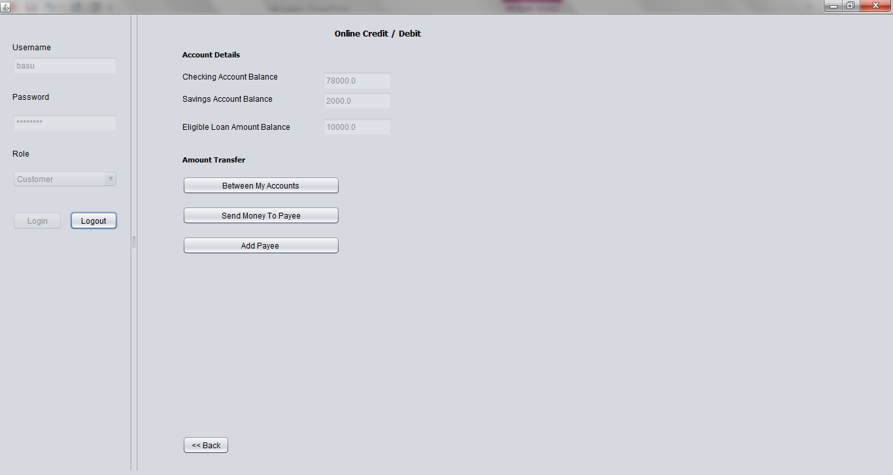
Screenshots
Customer

Slide 14
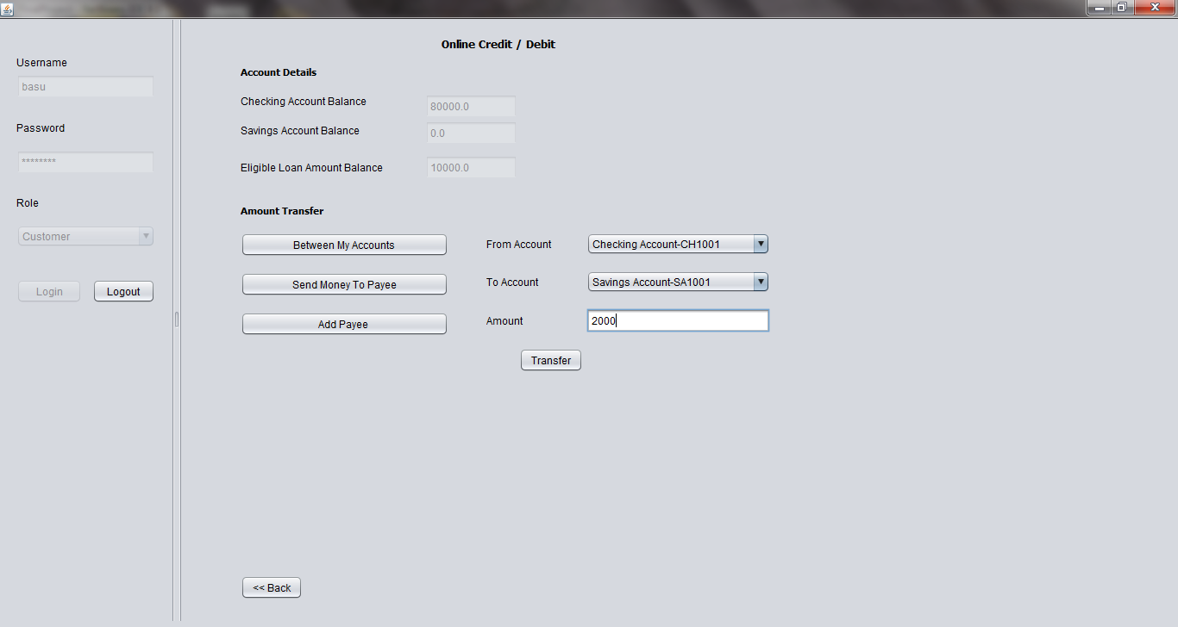
Screenshots
Customer

Slide 15
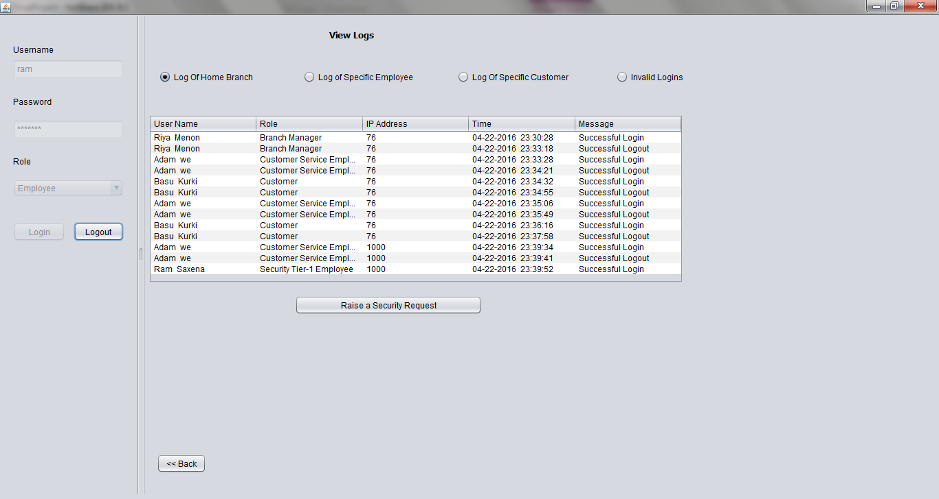
Screenshots
Security Tier – 1 Employee

Slide 16
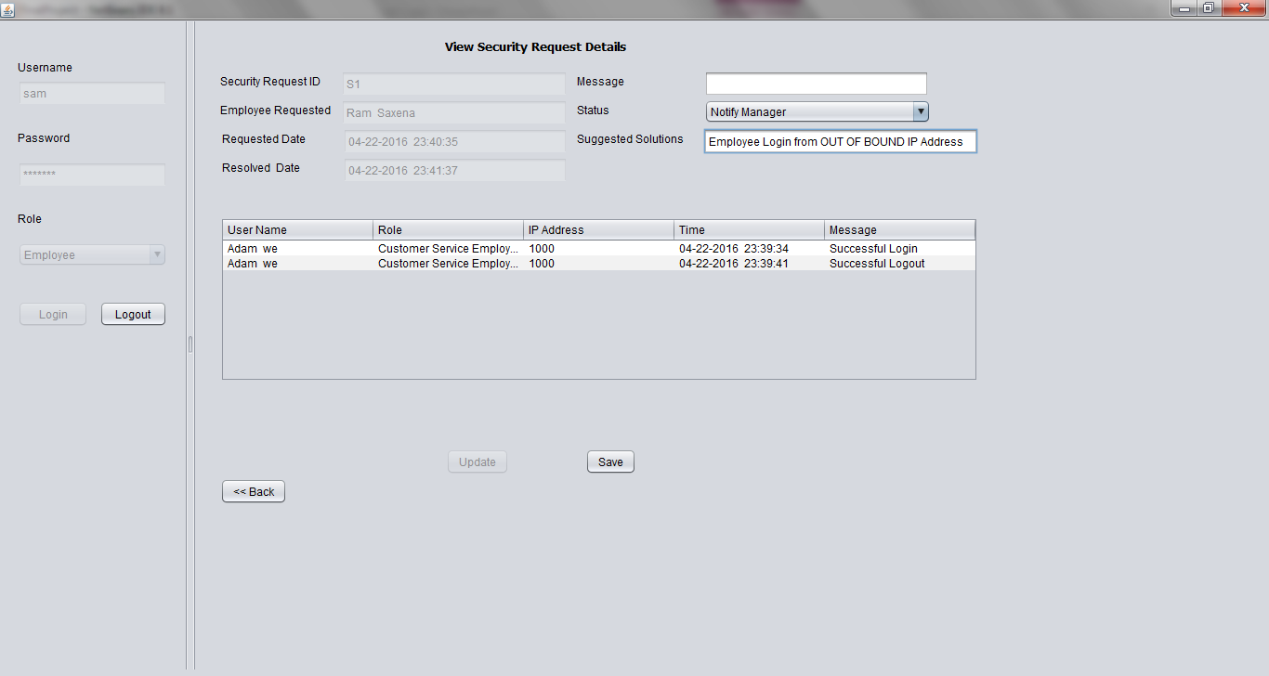
Screenshots
Security Tier – 2 Employee

Slide 17
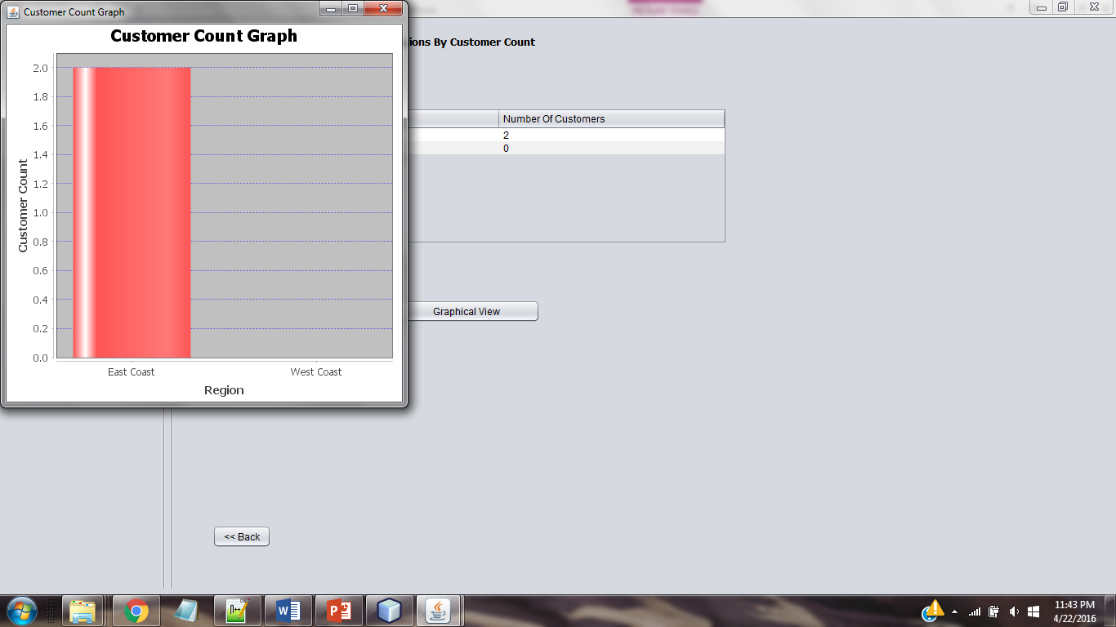
Screenshots
Bank Admin - Analytics

Slide 18
Thank You ☺

