Slide 1
ANALYSIS OF CRIME IN CHICAGO
Sushma Suttakote parameshappa

Slide 2
Introduction
Chicago’s Crime Dataset
This dataset reflects reported incidents of crime that occurred in the City of Chicago from 2001-2016. Data is extracted from the Chicago Police Department's CLEAR (Citizen Law Enforcement Analysis and Reporting) system.
The reason for considering Chicago Crime is the high man slaughter rate which is 15.2 per 100,000 residents in Chicago while it is 4.0 for New York and 6.5 for Los Angeles according to the FBI crime statistics
Our goals to improve policing related to crime in Chicago through Big Data Analytics using Data Analysis and machine learning

Slide 3
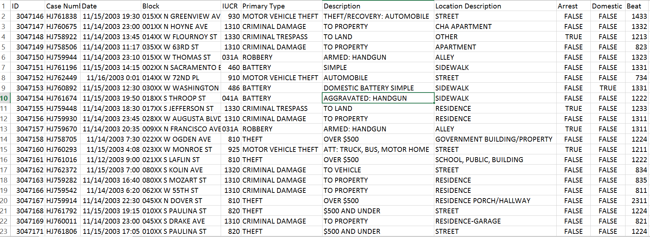
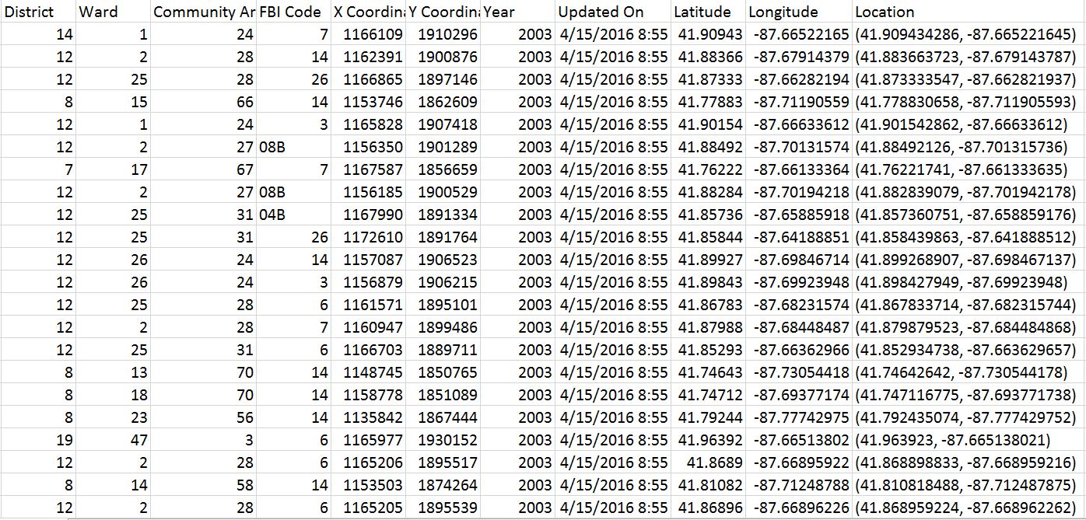
Snippet of our Dataset Size-1.4GB Number of Features-22 Number of records~6400000

Slide 4
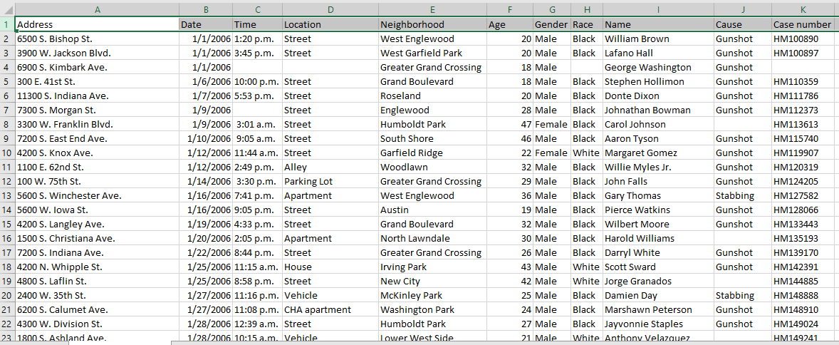
Additional Dataset Used
Chicago Homicide Dataset

Slide 5
Techniques used for Big-data analysis
Machine Learning - 3
Hadoop MapReduce - 7
Hive - 8
R - 2
Tableau - Visualisation

Slide 6
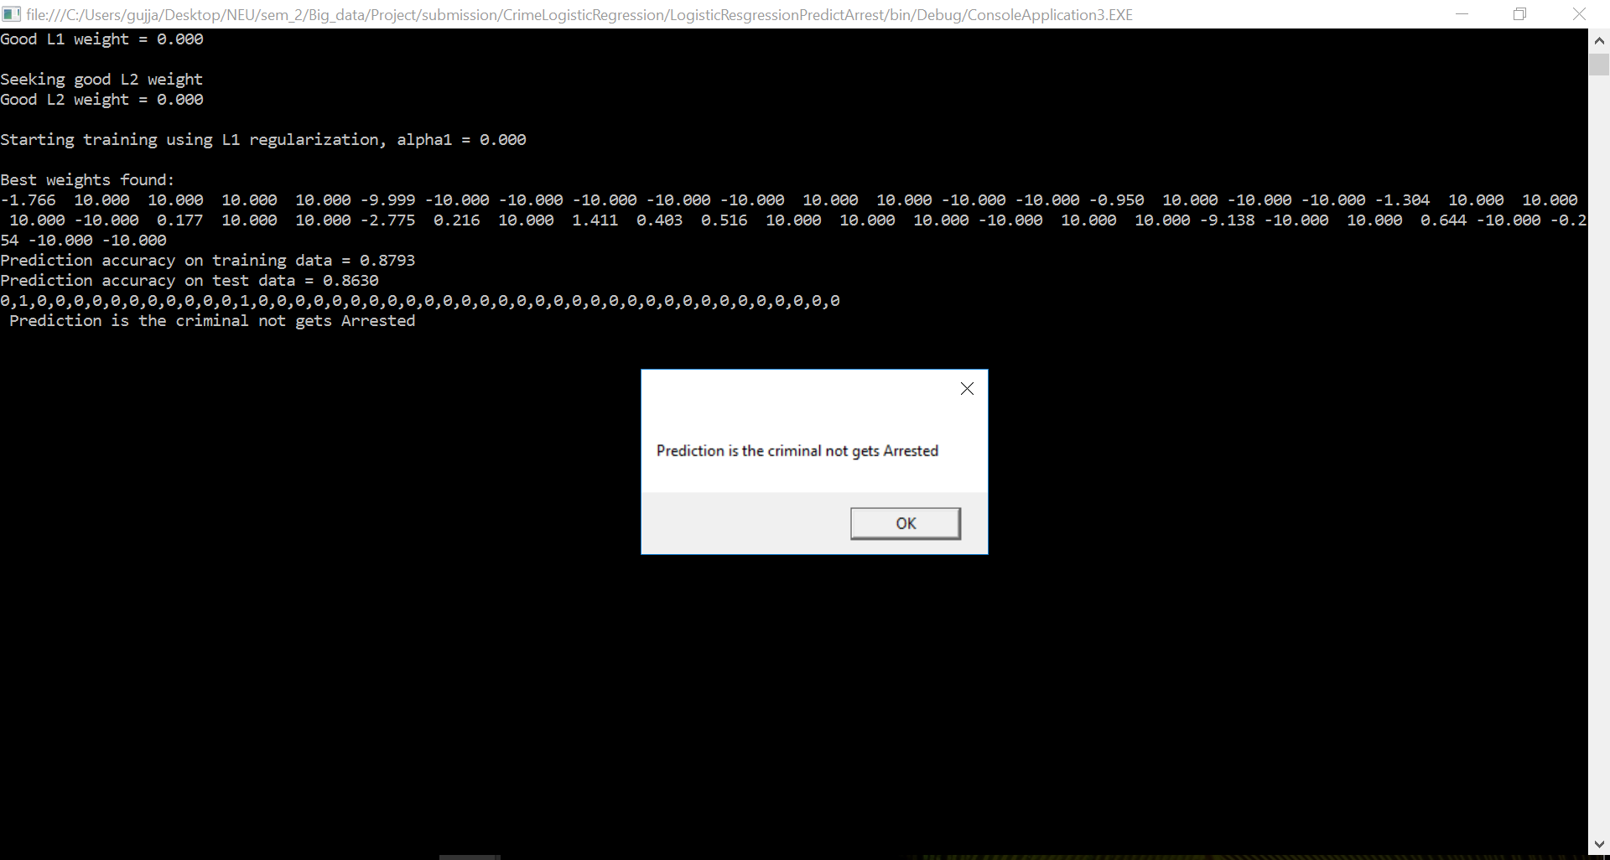
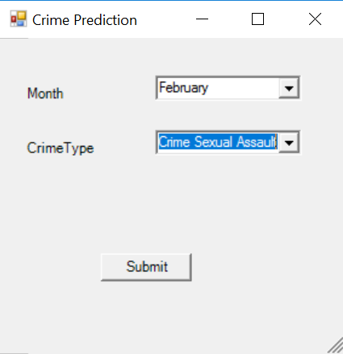
Analysis using Machine Learning
Predicting whether an arrest will be made for a committed crime based on month and crime type as predators using Logistic regularization
We chose logistic regression as it will work better for a single decision boundary
If arrest probability > 0.5 ==== > Arrested
If arrest probability < 0.5 ==== > Not Arrested

Slide 7
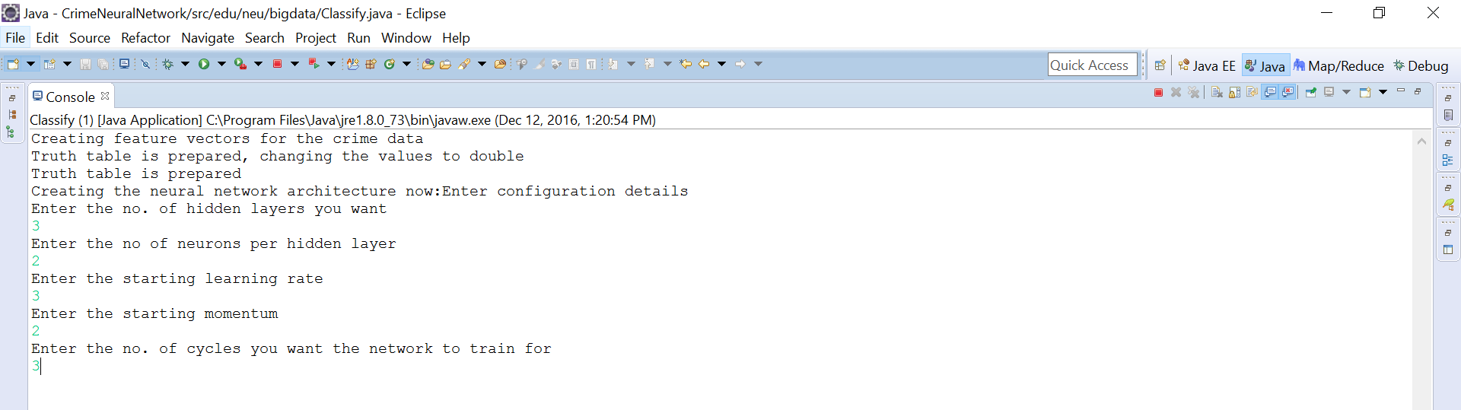
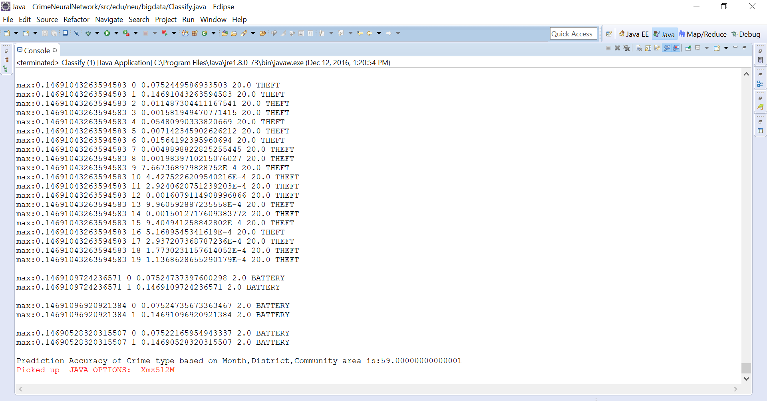
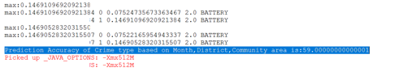
Analysis using Machine Learning
Prediction of crime type which may happen in near based on month, district and community area using BackPropagation algorithm
Better performance

Slide 8
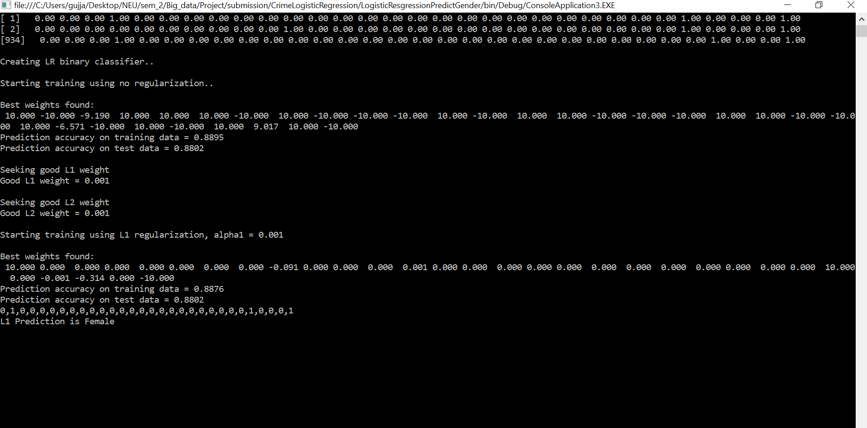
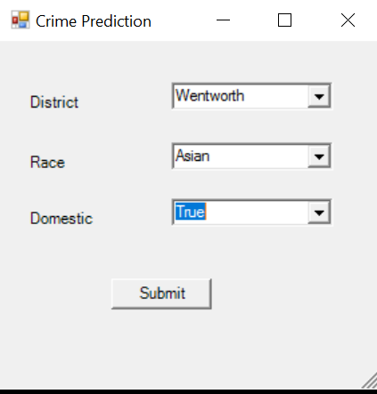
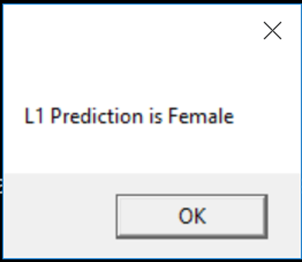
Analysis using Machine Learning
Prediction of gender based on month, district and community area using Logistic regression
Our analysis indicated that the positive and negative correlations in the trends in our features would have greater accuracy with logistic regression

Slide 9
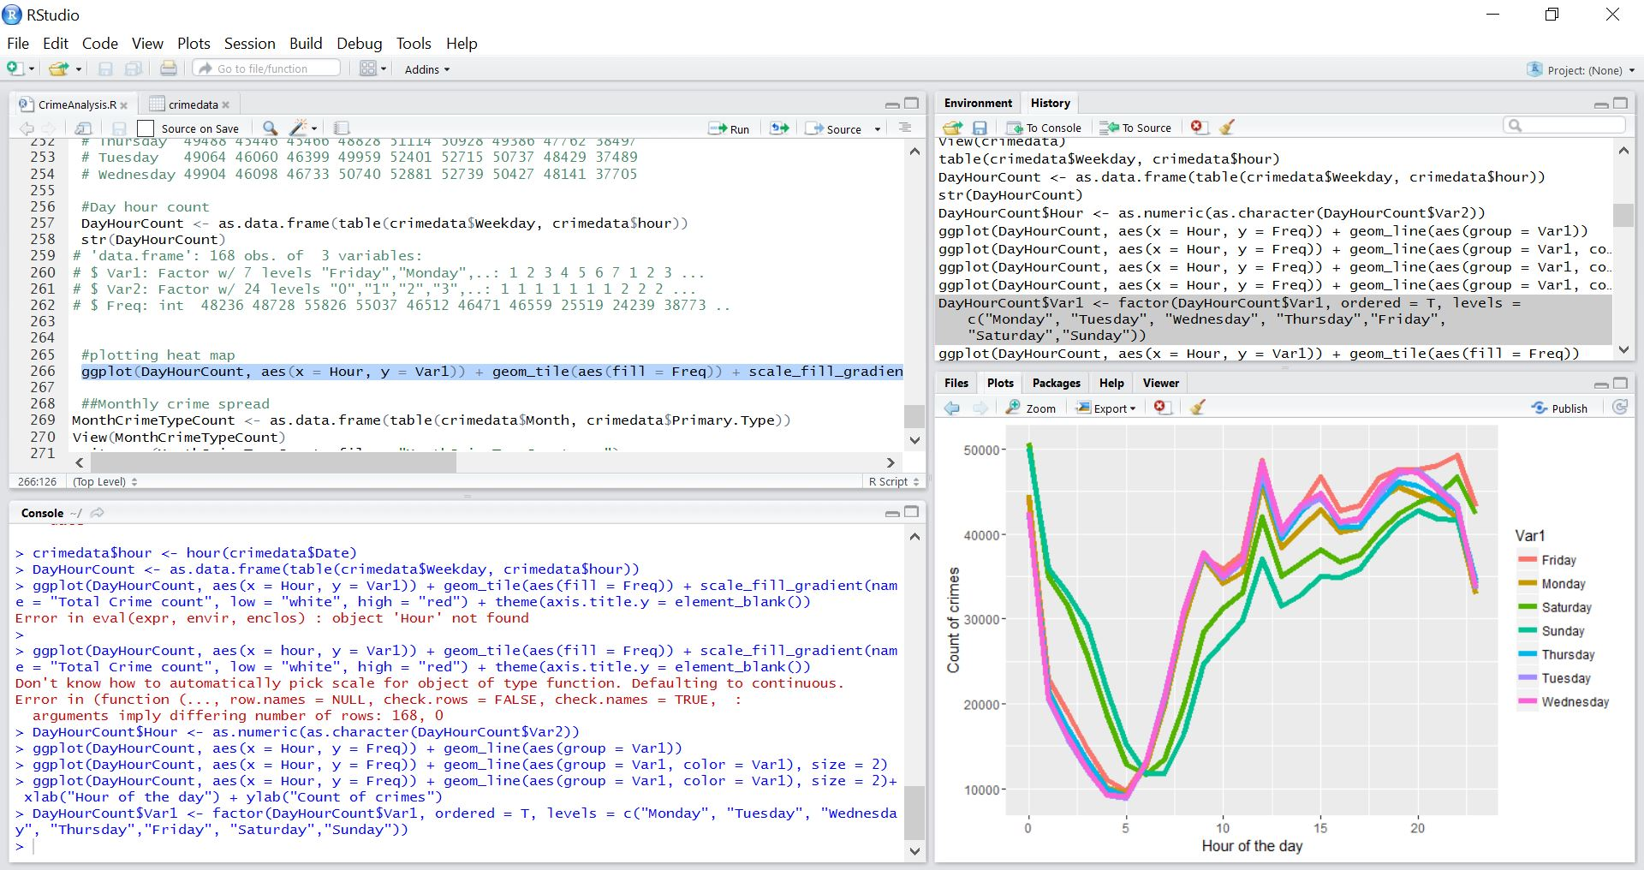
Analysis of Crime count during weekdays for every hour using R

Slide 10
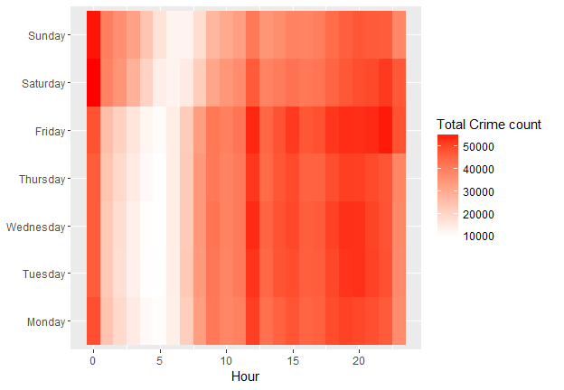
HeatMap for weekday per hour crime count

Slide 11
TABLEAU Presentation

Slide 12
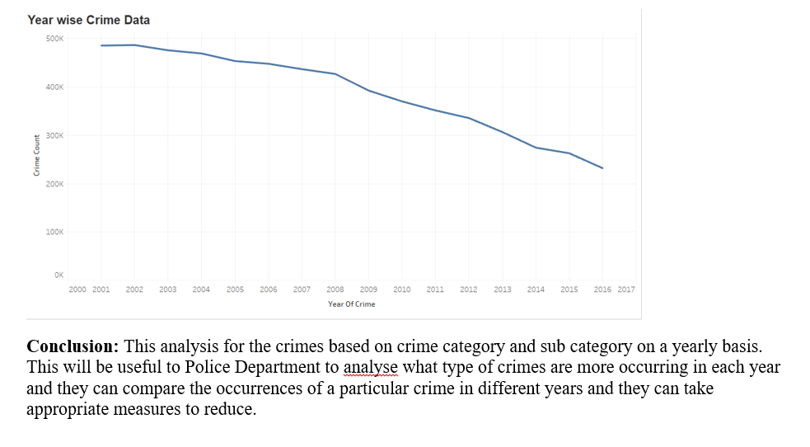
RESULTS

Slide 13
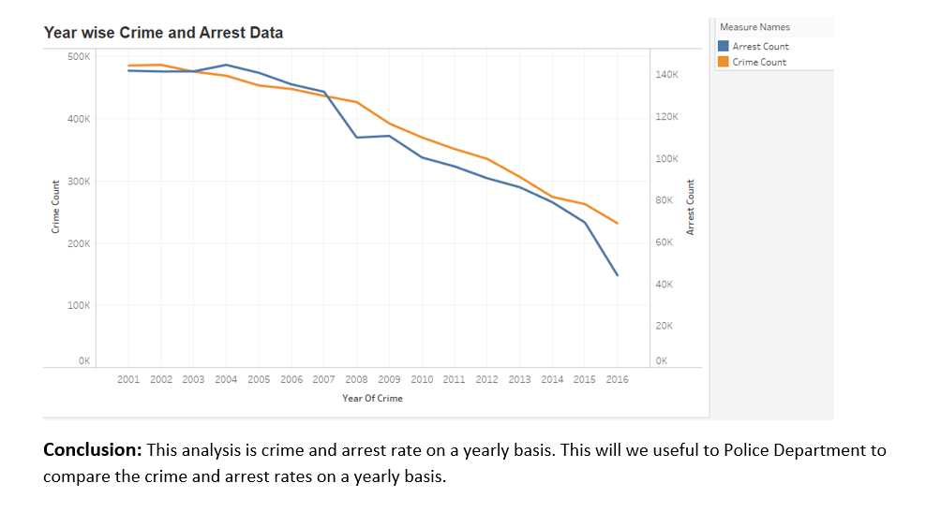
Analysis

Slide 14
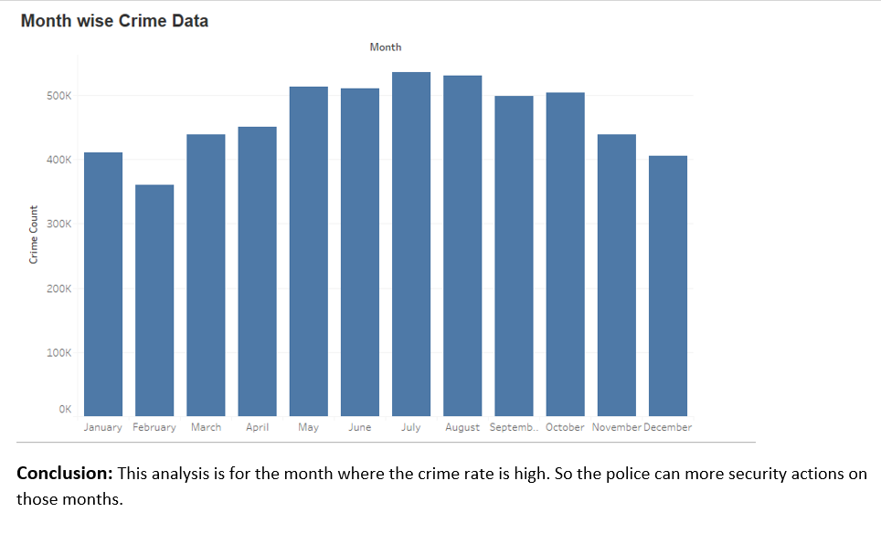
Analysis

Slide 15
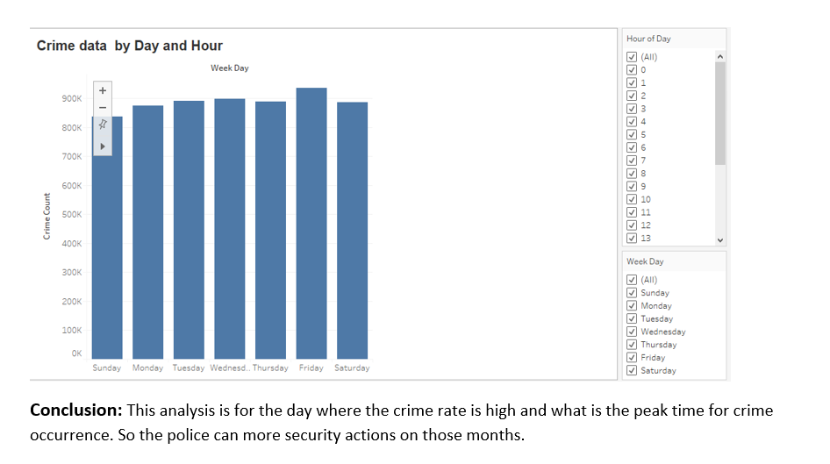
Analysis

Slide 16
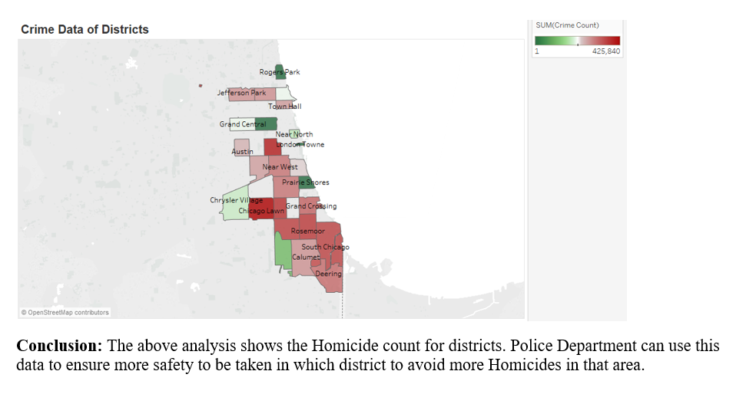
Analysis

Slide 17
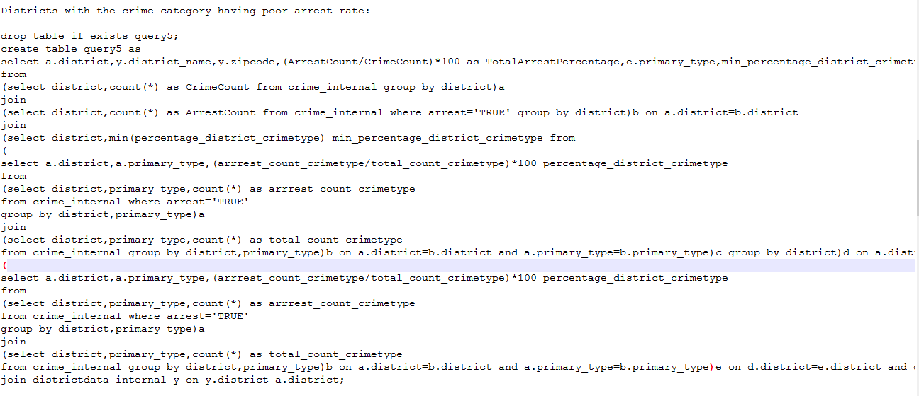
Analysis using Hive

Slide 18
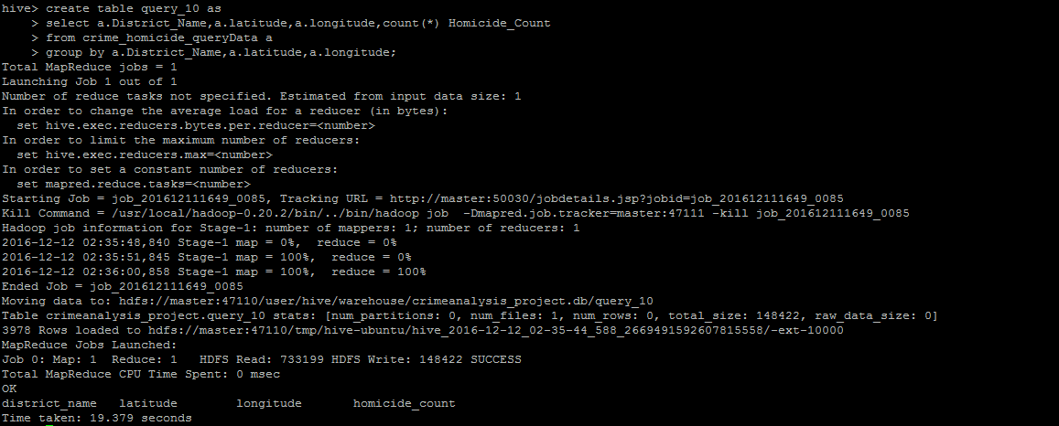
Analysis using Hive

Slide 19
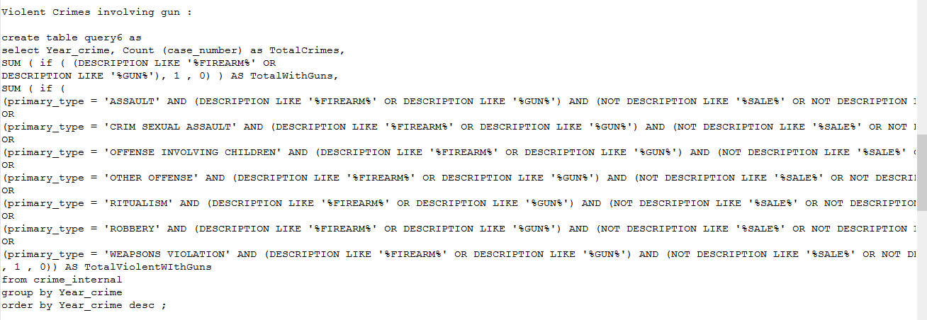
Analysis using Hive

Slide 20
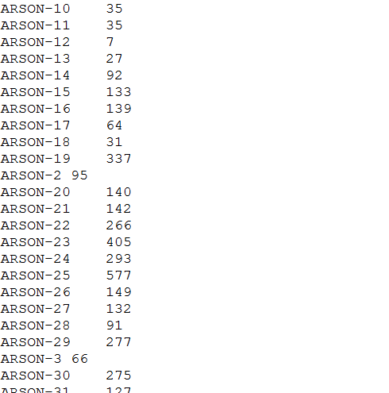
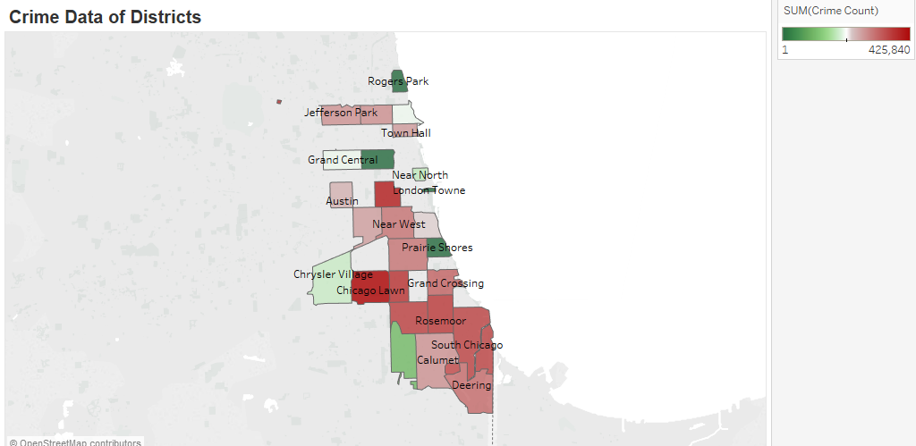
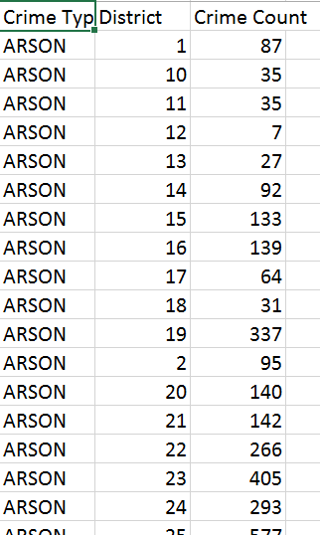
Analysis Using Hadoop Example: District wise crime count
Conclusions from output:
The District with maximum count of crime for a crime type. This data can be used for concentrating more to fight against a particular crime type in a district.

Slide 21
INFERENCE
Both arrest and crime rate have decreased from 2001 till now. But the crime rate as compared to the arrest rate in latest years is more. So, a measure needs to be taken to fill this gap in order to take actions on crime happening.
Most of the crime occurs during the month of July is more and most occurring crime type for this is theft.
Most of the crime occurs over the weekends from 7 pm to 6am
The most unsafe area is Chicago Lawn with highest crime count
Albany Park has least arrest percentage in Chicago which shows that the police in that particular area needs to be more efficient
In most districts in Chicago, the peak crime time is early morning
Theft is the most occurring crime
Crimes involving gun are increasing
Males and Females with Ethnicity - 'Black' are victims of Homicides but, the arrest rate for Asians is more.
Gunshot is major cause for Homicide
Adult males are more murdered
Harrison is a district with more number of murders

Slide 22
Future Scope
Looking at incorporating Tweets into a model and use for sentimental analysis
Begin exploring and understanding Gaussian processes for predicting time series data
We want to use geospatial crime incident data to predict future hot spots for crime
Using Spatial clustering algorithms

Slide 23


