Slide 1

ENERGY CONSUMPTION
Dt: 10/10/2023

Slide 2

Problem Statement
Need for a comprehensive understanding and prediction of Romania’s weekly electricity consumption patterns over a span of 4.5 years to guide efficient resource allocation, policy-making, and sustainable energy practices.
1

Slide 3
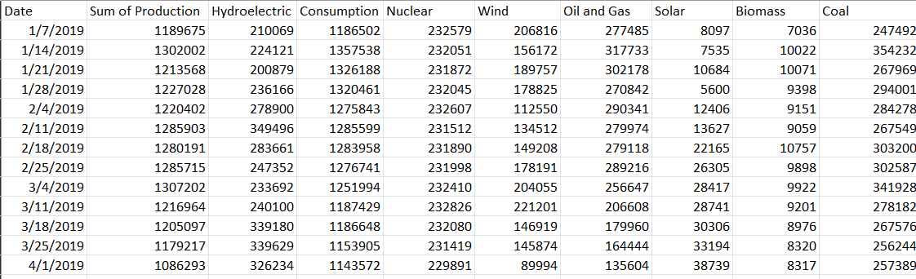
Data Description:
Source of Data: Kaggle.
Time Span: Weekly intervals from 2019 to 2023.
Data Focus: Electricity Consumption.
Measurement Unit: Kilowatts (kW).
2

Slide 4
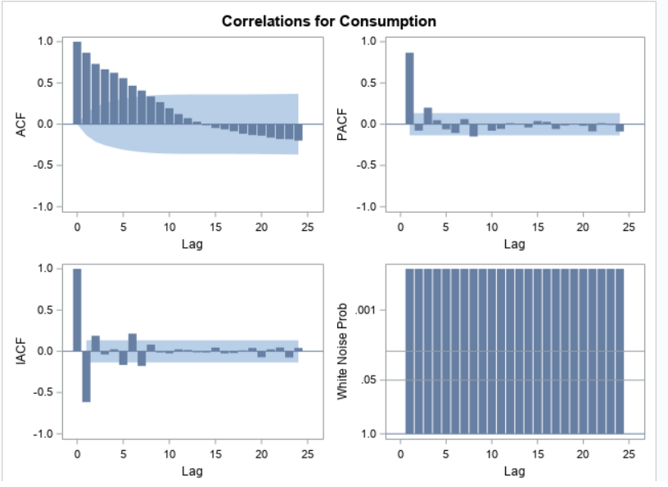
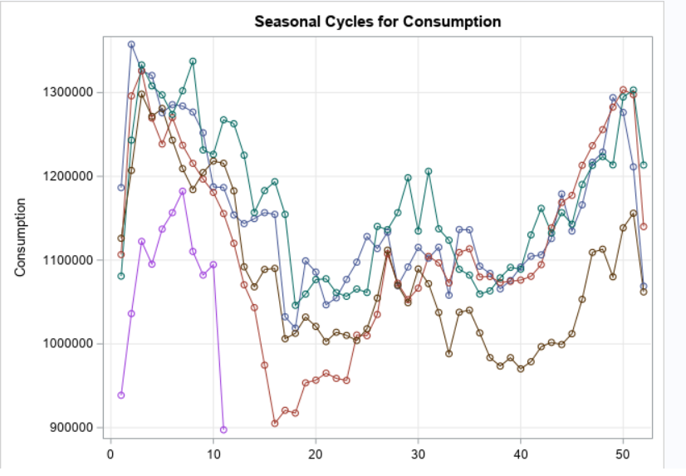
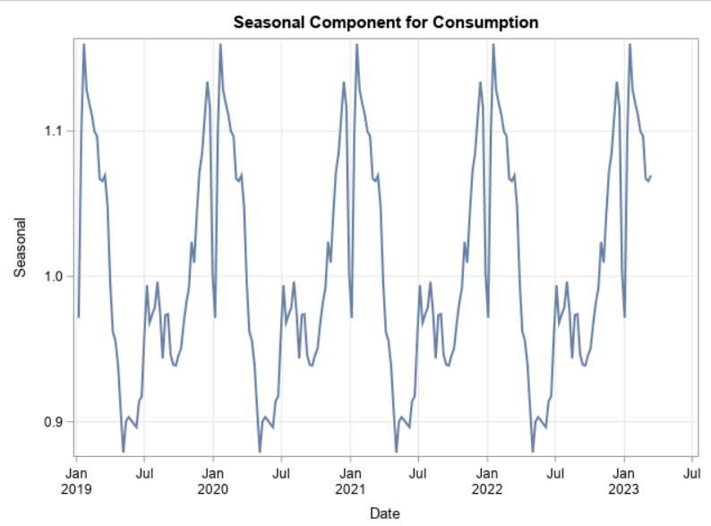
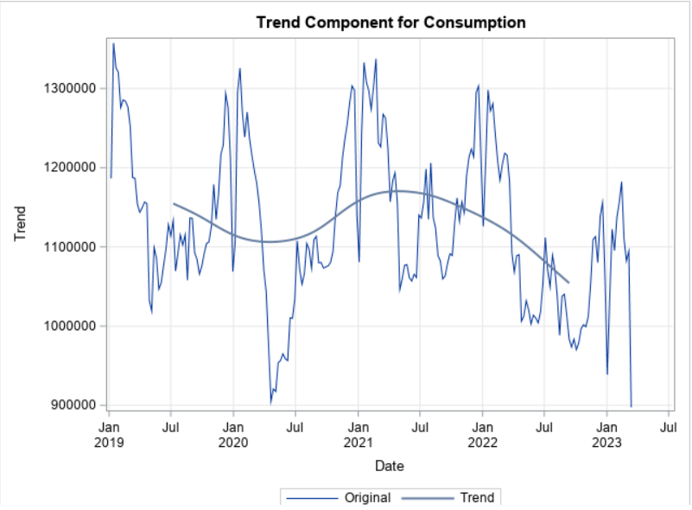
Time Series Exploration
3

Slide 5
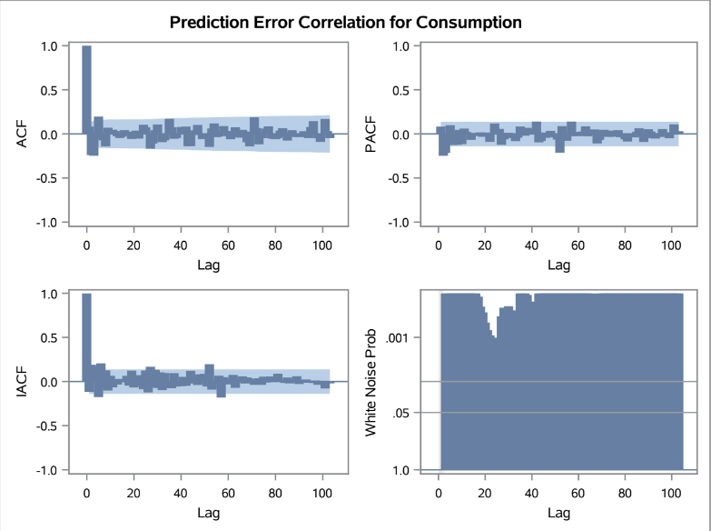
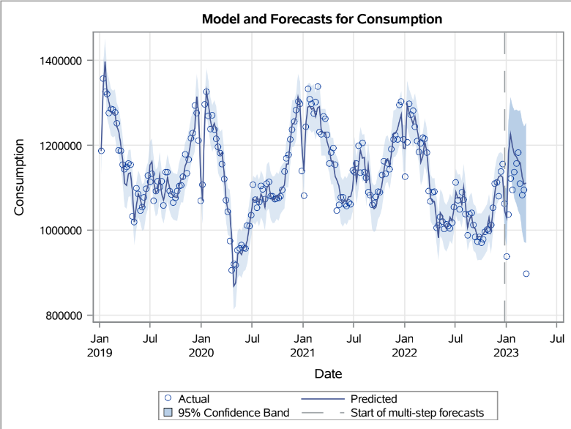
Additive Seasonal Exponential Smoothing Model
 | MAPE | AIC | SBC
Actual | 1.9738 | 4377.03 | 4383.76
Forecasted | 5.0467 | 135.35 | 135.35
4

Slide 6
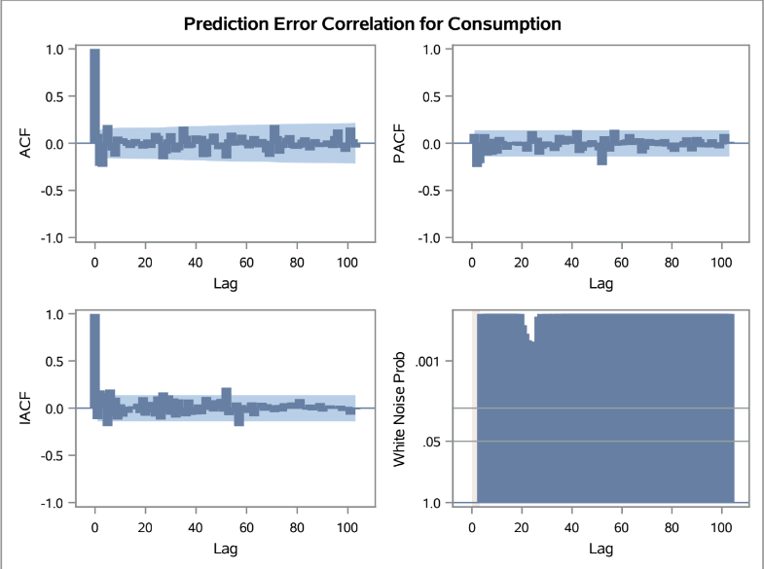
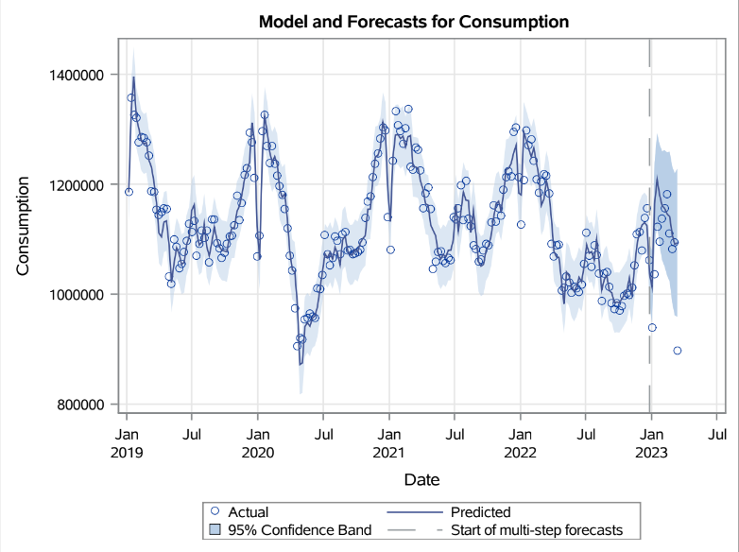
Winters Additive Exponential Smoothing Model
 | MAPE | AIC | SBC
Actual | 2.194 | 4371.99 | 4382.00
Forecasted | 67.47 | 301.81 | 301.81
5

Slide 7
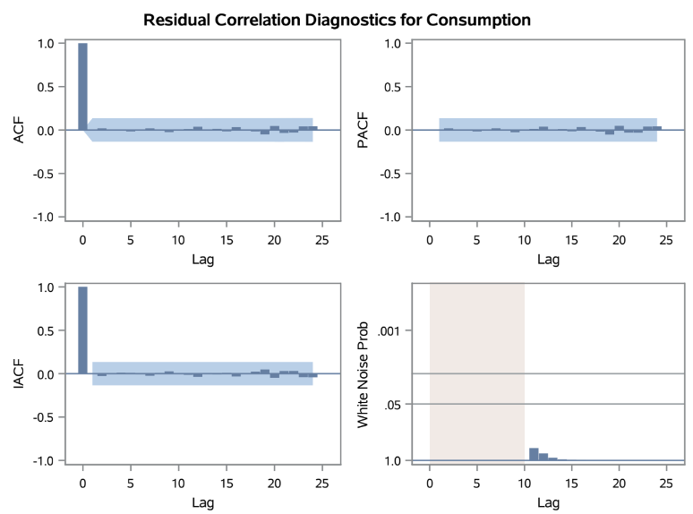
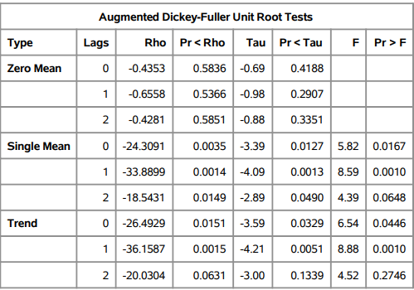
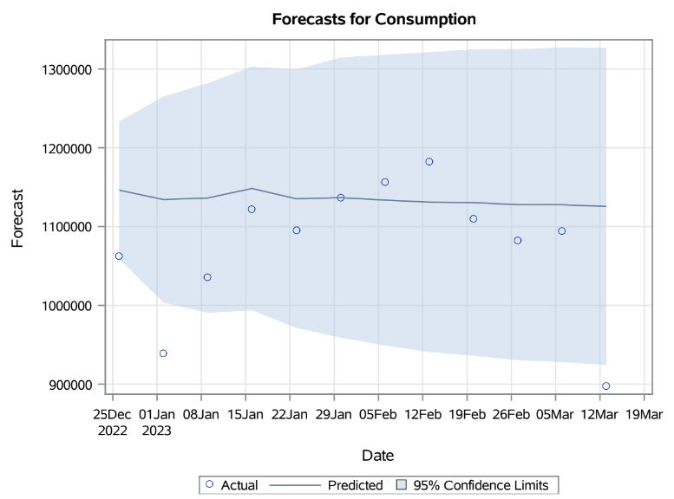
ARIMA(3,7)
AIC | SBC | MAPE | RMSE | MAE
5305.363 | 5318.901 | 2.95 | 46929.90 | 33058.33
8

Slide 8
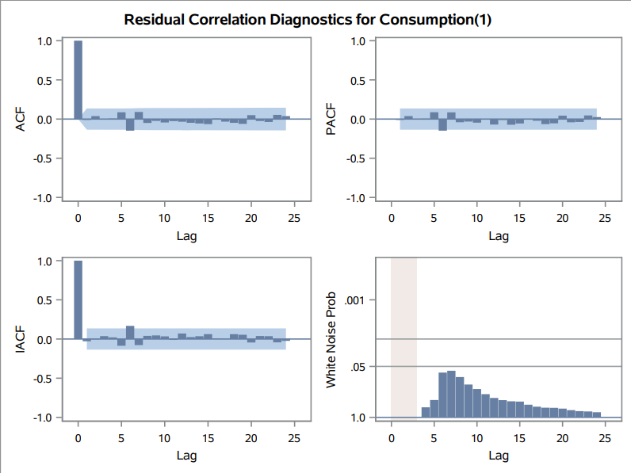
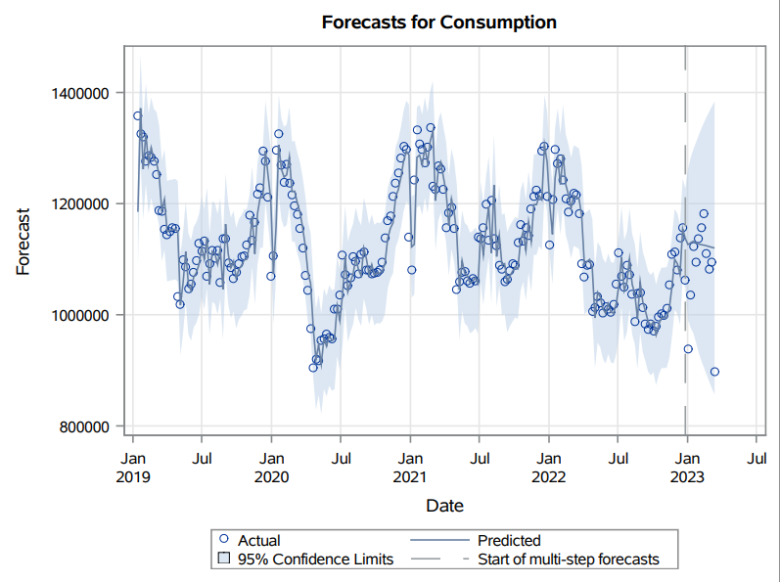
ARIMA(2,1,1)
AIC | SBC | MAPE | RMSE | MAE
5305.3637 | 5318.9017 | 2.92 | 47180.68 | 32733.35
7

Slide 9
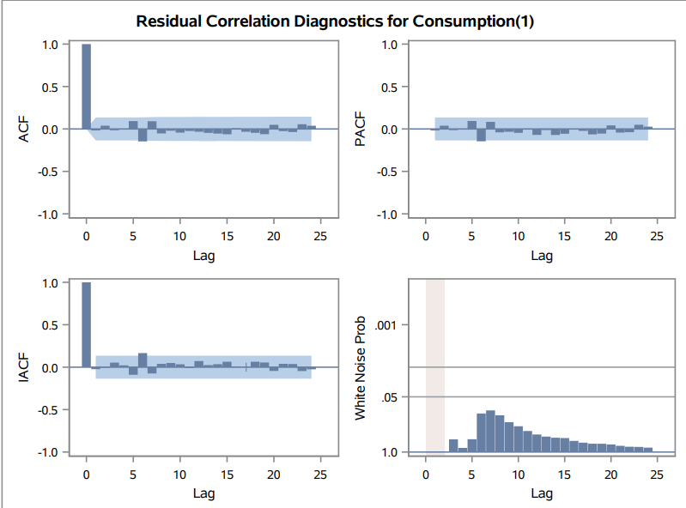

ARIMA(2,1,0)
AIC | SBC | MAPE | RMSE | MAE
5303.4586 | 5313.6121 | 2.92 | 47193.76 | 32709.99
6

Slide 10
Business Insights
ARIMA(2,1,0) is our Best Model which is used to forecast Energy Consumption trends for Romania
Policy Recommendations
Price Prediction and Hedging Strategies
Better Decision Making
Handling Energy Demands
9

Slide 11
THANK YOU
10

