Slide 1
Presenting slide of my project “jahan’s mobiles & accessories”
SUBMITTED TO :
MD. MOSIDUL
IDB CONSULTANT
JAVA & WPH
SUBMITTED BY :
ISRAT JAHAN
ID-1244155
ROUND-37
JAVA

Slide 2
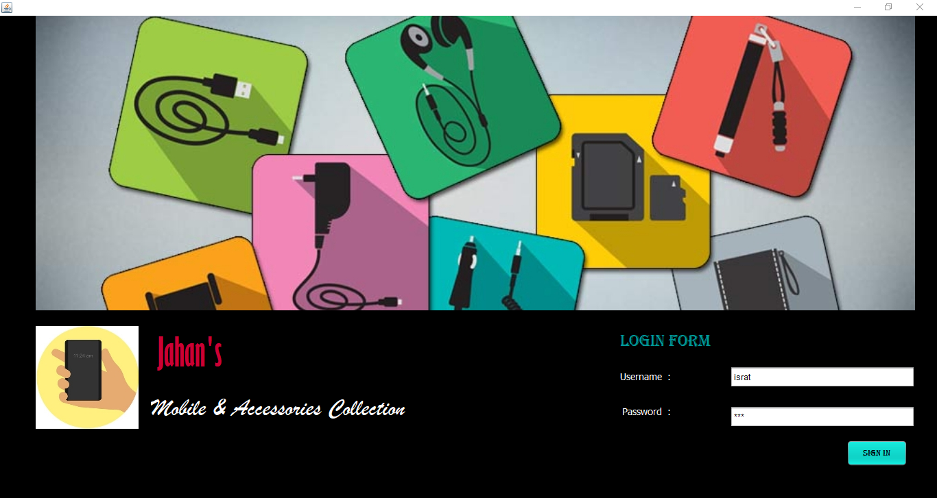
Login Page

Slide 3
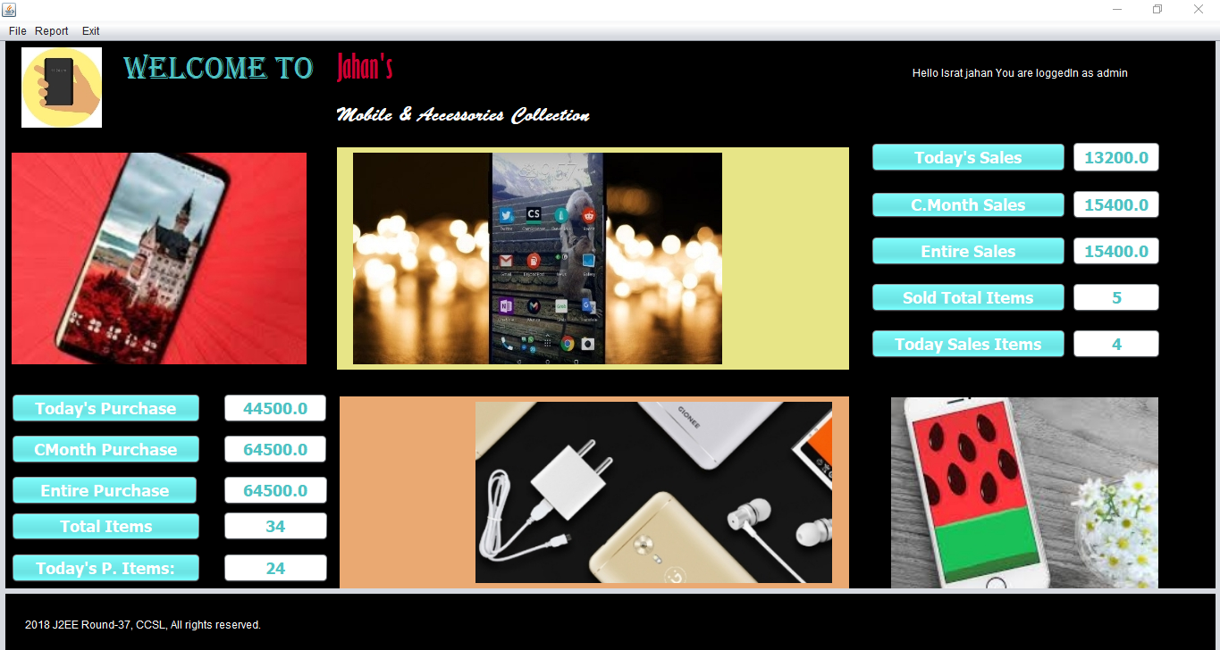
Dashbord

Slide 4
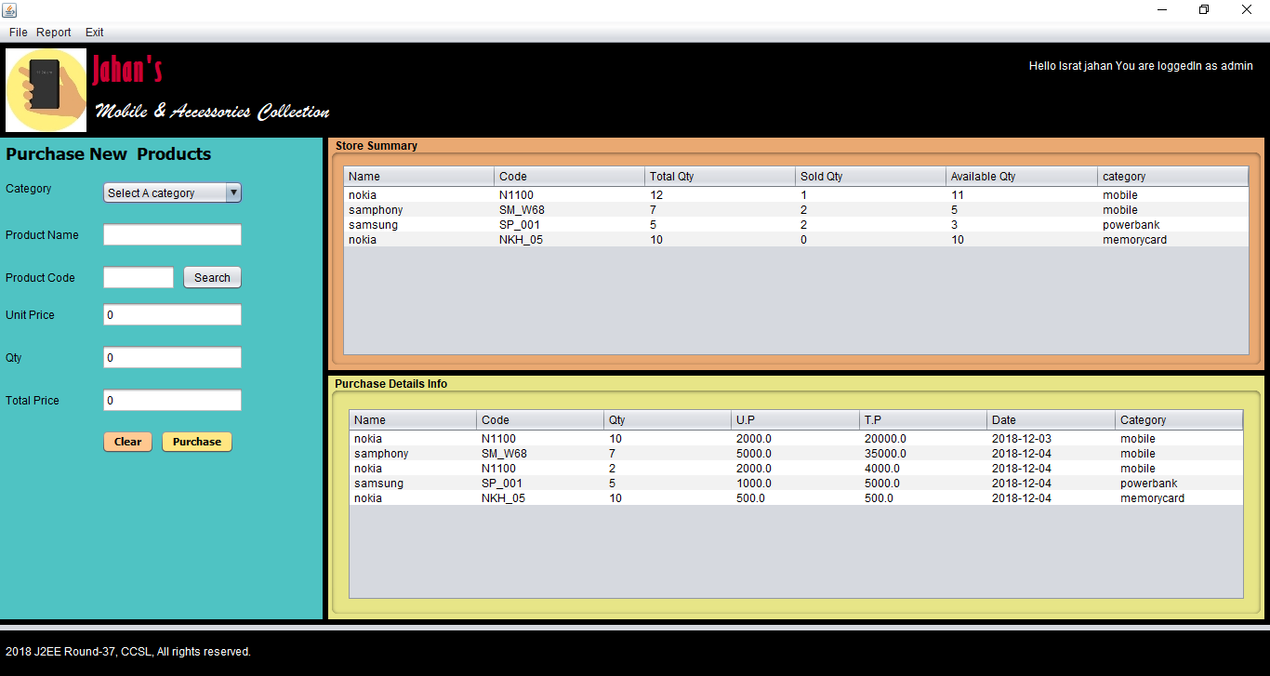
purchase page

Slide 5
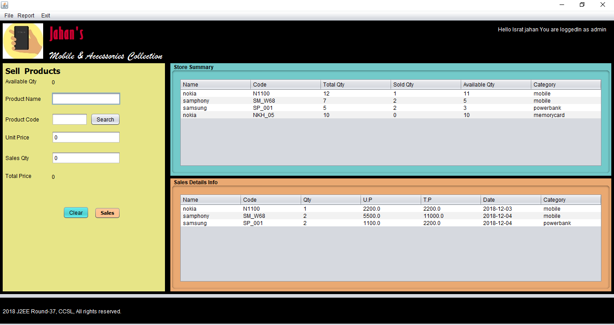
Sales page

Slide 6
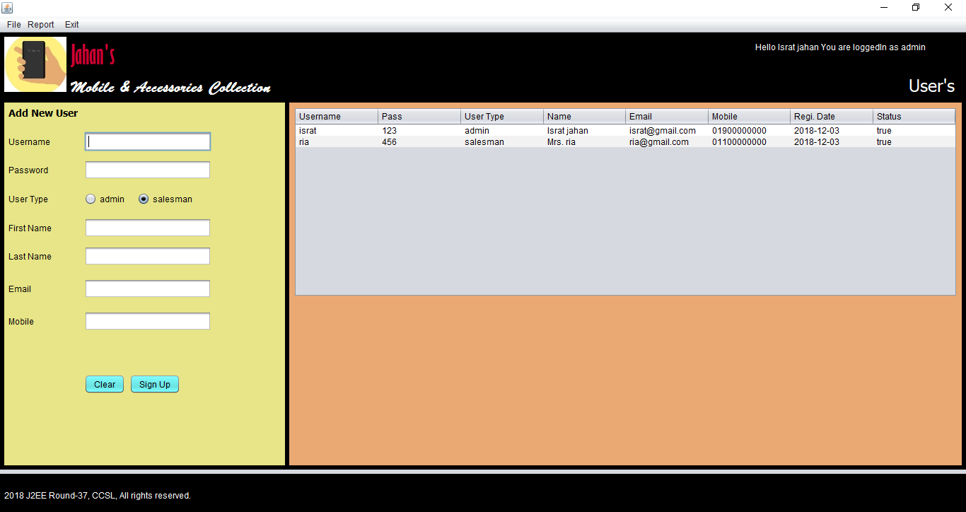
Signup page

Slide 7
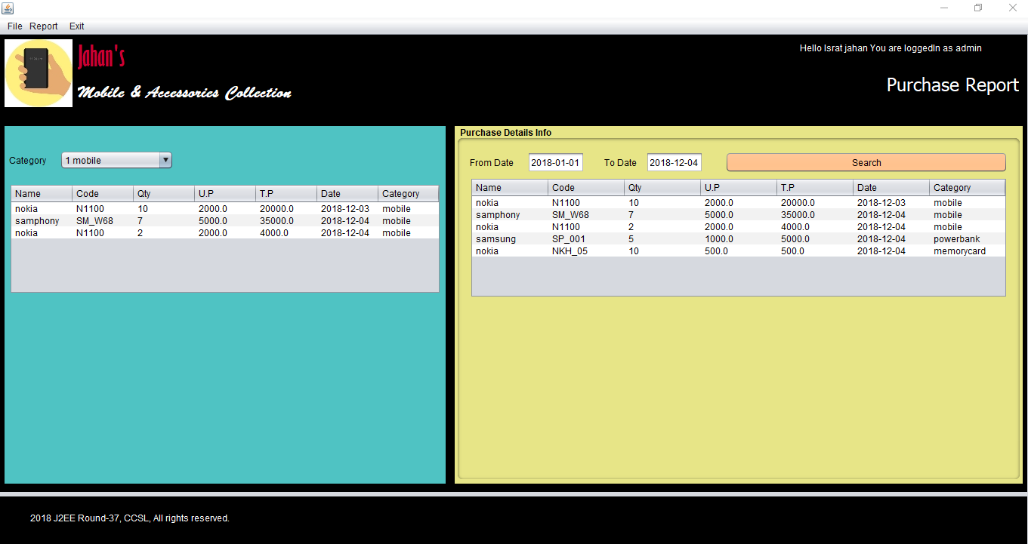
Purchase report

Slide 8
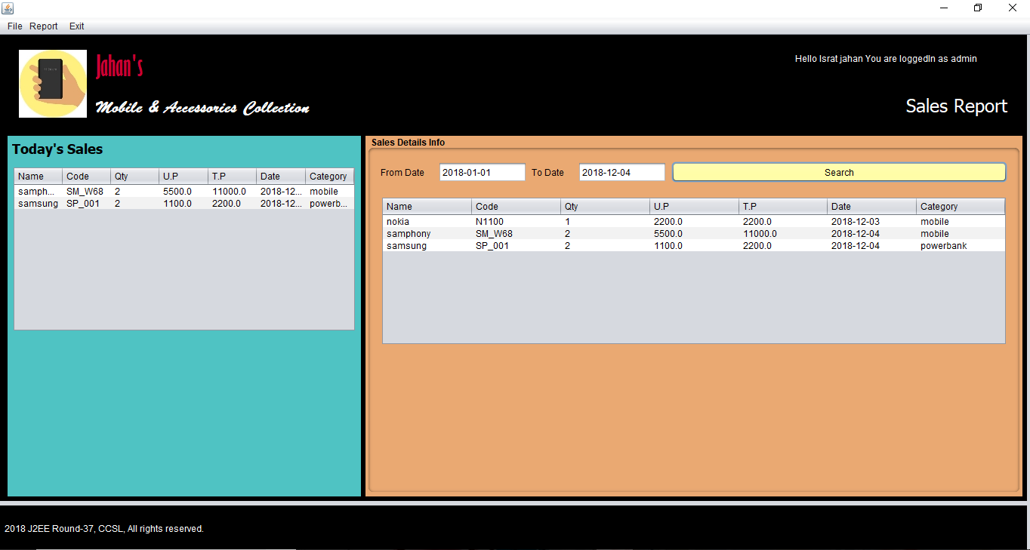
Sales report

Slide 9
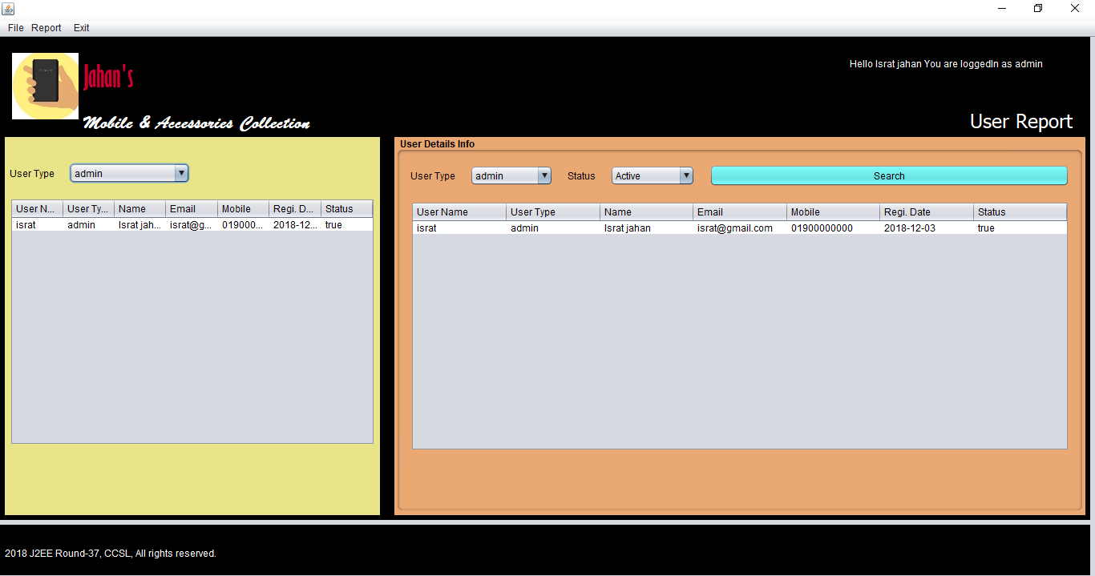
User report

Slide 10
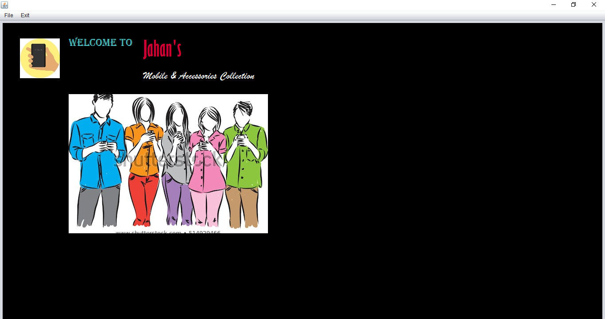
User dashbord

